Slide 1
PrognosAI: AI-Driven Predictive Maintenance System Using Time-Series Sensor Data

Slide 2
Introduction
PrognosAI is an AI-based predictive maintenance system designed to estimate the Remaining Useful Life (RUL) of industrial machinery using multivariate time-series sensor data. It leverages deep learning models such as LSTM to predict potential failures before they occur, ensuring timely maintenance and reduced downtime.

Slide 3
Motivation
Unplanned machinery failures in industries lead to high repair costs, production loss, and safety hazards. Predictive maintenance using AI allows early fault detection, enabling proactive maintenance scheduling. This enhances reliability, minimizes costs, and improves operational efficiency.

Slide 4
Objectives
- Design and develop a predictive maintenance system using AI and time-series data.
- Estimate Remaining Useful Life (RUL) of machinery using deep learning.
- Implement LSTM-based sequential pattern recognition for failure prediction.
- Reduce unplanned downtime and optimize asset utilization.
- Ensure model generalization for turbines, pumps, and motors.

Slide 5
Project Workflow :
Data Ingestion: Load and preprocess CMAPSS dataset.
Feature Engineering: Create rolling window sequences and compute RUL targets.
Model Training: Train LSTM/GRU models for RUL prediction.
Model Evaluation: Evaluate using RMSE and compare predicted vs actual RUL.
Risk Thresholding: Define alert thresholds for maintenance.
Visualization & Output: Display RUL trends and alert zones via dashboards.

Slide 6
Tech Stack :
- Python – Core programming language
- Pandas, NumPy – Data processing
- Matplotlib, Seaborn – Visualization
- TensorFlow / Keras – LSTM model training
- Scikit-learn – Metrics & preprocessing
- Streamlit / Flask – Dashboard or API interface
- Docker – Optional deployment
- NASA CMAPSS Dataset – Source data

Slide 7
Model Training and Evaluation:
A LSTM deep learning model was developed to predict the Remaining Useful Life (RUL) of engines.
The model was trained using the CMAPSS sensor dataset containing multiple engine cycles.
Rolling window sequences were created to capture time-based patterns in sensor readings
The model’s predictions were evaluated using RMSE and visual comparison with actual RUL values.
Achieved an Root Mean Squared Error (RMSE): 3.0430 showing that the model can accurately estimate machine health.

Slide 8
Rolling Window Sequence:
• Rolling window sequences split time-series sensor data into overlapping parts to capture short-term trends.
• Each window (around 30 cycles) helps the LSTM model learn machine behavior over time for RUL prediction.
• Approximate Data Size:
- Before preprocessing: ~50,000 rows (raw sensor data)
- After cleaning and windowing: ~45,000 training sequences
• This improves model accuracy by preserving temporal relationships and reducing data noise.

Slide 9
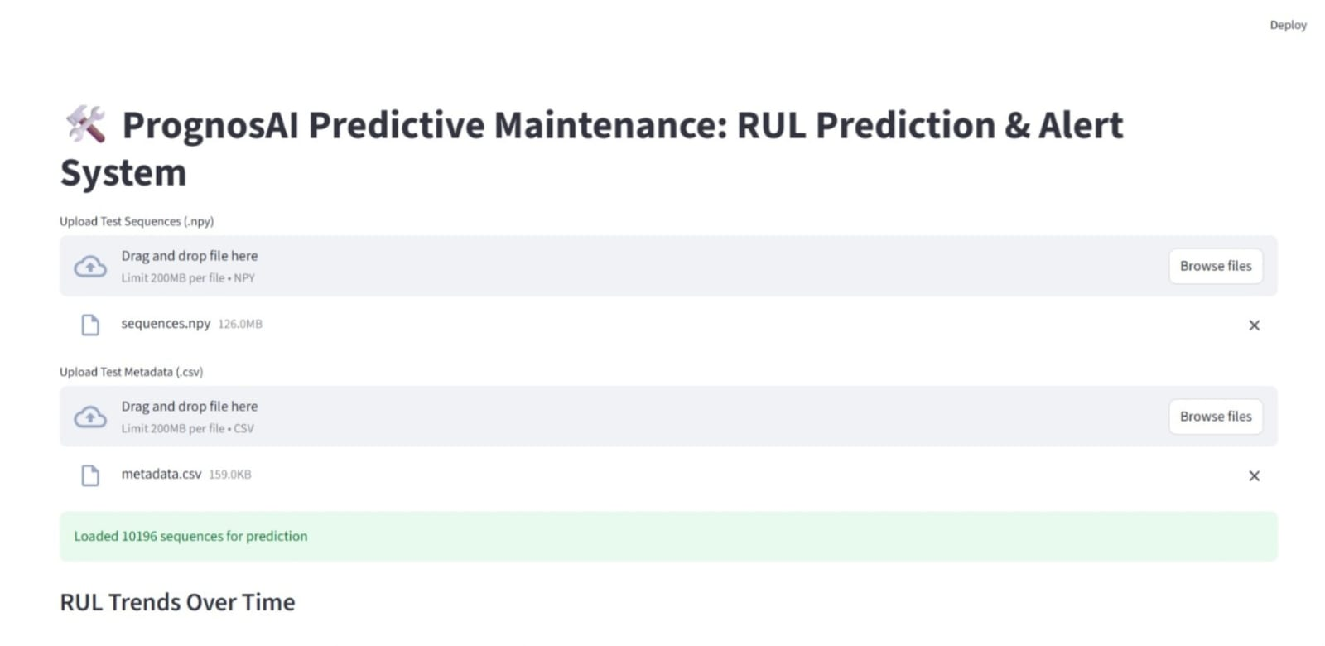
User Interface :
Built a Streamlit-based dashboard allowing users to upload sensor data and visualize predicted RUL.
UI features:
Data upload form
Real-time RUL prediction output
Graphs comparing actual vs predicted RUL

Slide 10
Output Summary:
• The CMAPSS dataset was used, containing data from 100 engines across multiple operational cycles.
• The LSTM model effectively predicted the Remaining Useful Life (RUL) for each engine based on sensor readings.
• Evaluation metrics:
- Root Mean Squared Error (RMSE): 3.0430(indicating strong predictive performance).
.Model shows strong correlation between predicted and actual RUL.
• Visualization dashboard displays real-time RUL predictions and engine performance trends.
• Output examples include:
- Predicted RUL curve vs. actual RUL.
- Maintenance alert zones for early fault detection.
• The model supports scalability for turbines, pumps, and motors.

Slide 11
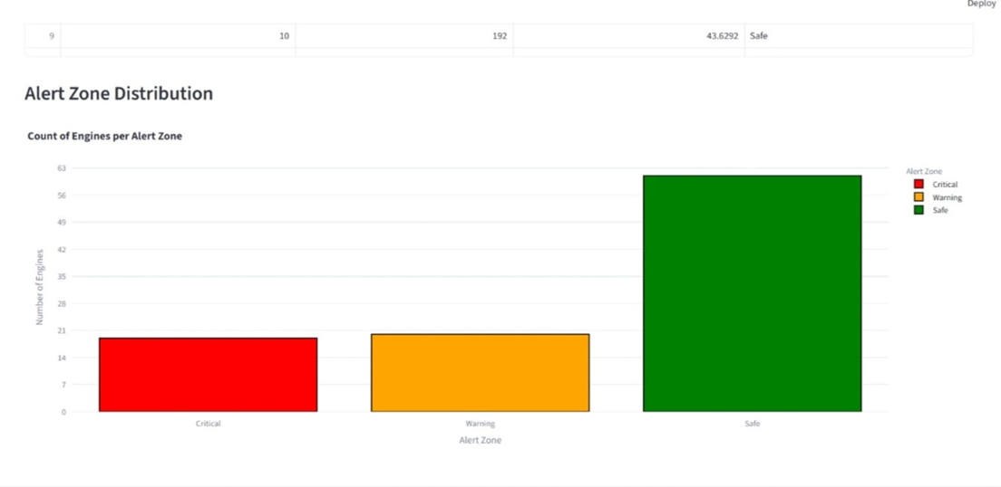
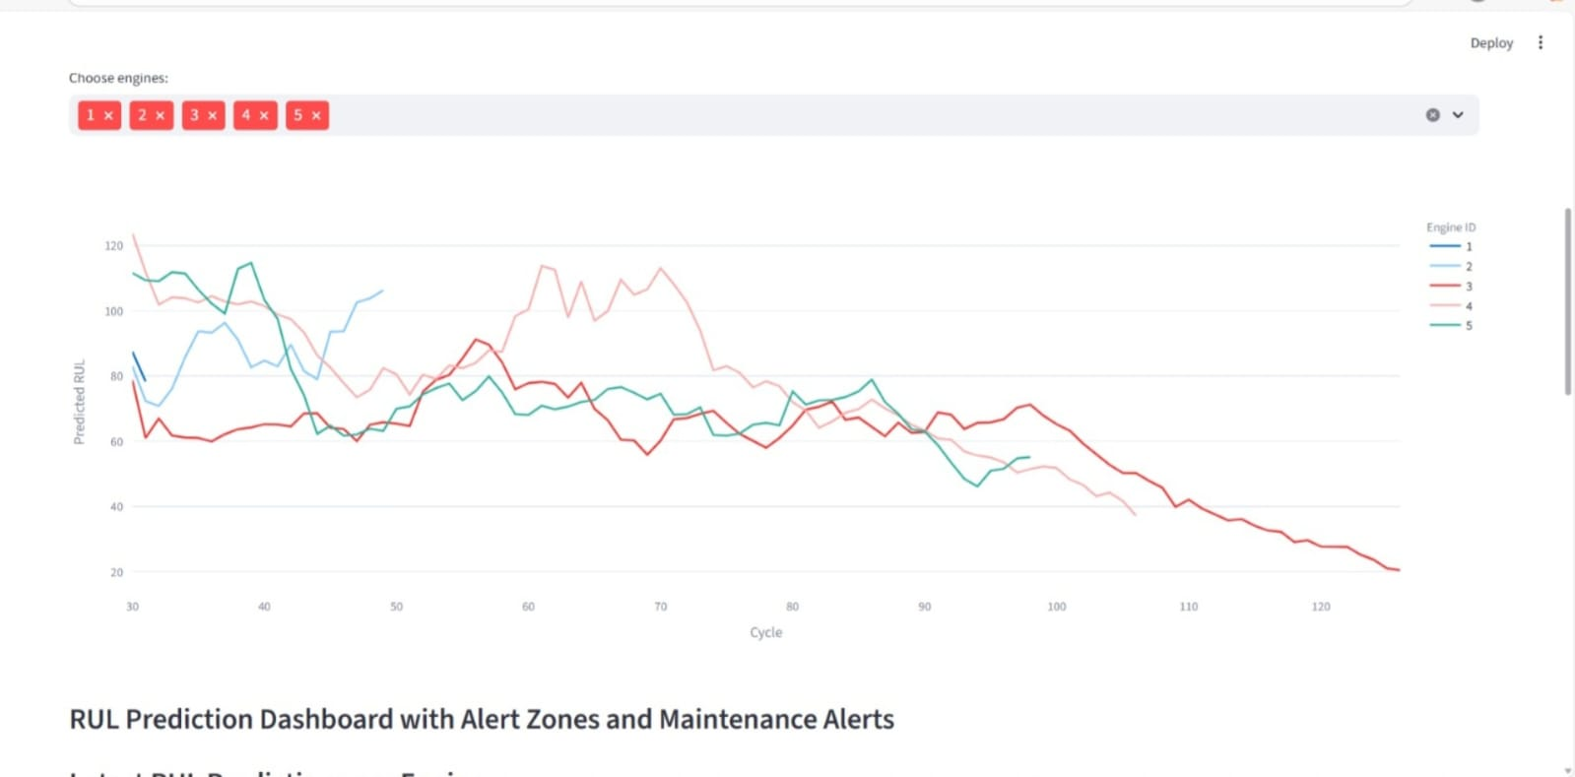
Output :

Slide 12
Future Work :
Expected outcomes include accurate RUL predictions and visual dashboards for maintenance alerts. Future work involves integrating real-time IOT sensor data, enhancing model interpretability, and deploying the system in industrial environments.

Slide 13
Conclusion
PrognosAI demonstrates how AI and deep learning can revolutionize industrial maintenance. By predicting equipment failures ahead of time, it reduces downtime, improves safety, and increases productivity. The project lays the foundation for smart, data-driven asset management.

Slide 14
THANK YOU

