Slide 1

IILM UNIVERSITY, GREATER NOIDA
School of Computer Science and Engineering
Internship Presentation
Data Analytics with Python & Power BI
STUDENT NAME
ORGANIZATION
Kunal Agratam
EduSkills Academy
ENROLLMENT / ROLL NUMBER
DURATION
2410030691
8 Weeks
PROGRAM & BATCH
CERTIFICATE ID
B.Tech CSE | Batch 2024–28
2026-9ACA033384

Slide 2
ABOUT THE ORGANIZATION
EduSkills Academy
A skilling and industry-academia collaboration initiative preparing a digitally skilled, Industry 4.0-ready workforce among Indian students.
ES
Partners with academic institutions to deliver structured, certification-based internship programs.
Industry–Academia
Collaboration
Covers emerging technology domains including data analytics, cloud computing, artificial intelligence, and cybersecurity.
Aims to bridge the gap between classroom learning and real industry requirements.
Kunal Agratam | Data Analytics with Python & Power BI
2

Slide 3
CHAPTER 4.1 – 4.3
Introduction & Problem Statement
INTRODUCTION
PROBLEM STATEMENT
An 8-week internship in Data Analytics with Python & Power BI, conducted by EduSkills Academy — covering the complete analytics workflow from data collection and cleaning, through exploratory analysis in Python, to interactive dashboarding and reporting in Microsoft Power BI.
Organizations generate large volumes of transactional and behavioural data but often lack the in-house capability to clean, analyze, and visualize it for timely decisions. Raw data across spreadsheets, databases, and applications stays underutilized without systematic processing.
The internship addressed this by training interns to build an end-to-end analytics pipeline — Python for preparation, SQL for extraction, Power BI dashboards for decision-making.
Certificate ID: 2026-9ACA033384 | Issued 28 Jul 2026
Kunal Agratam | Data Analytics with Python & Power BI
3

Slide 4
CHAPTER 4.4
Project Objectives
Set up and use a Python-based environment for data analysis, including core programming concepts
Clean, preprocess, and structure raw datasets using the Pandas library
1
2
Learn and apply SQL for data extraction, querying, and integration with Python
Design interactive dashboards and reports in Power BI, including data modeling and DAX
3
4
Integrate Python and Power BI for advanced visualization and automated reporting
Apply these skills on real-world style projects, culminating in a capstone dashboard
5
6
Kunal Agratam | Data Analytics with Python & Power BI
4

Slide 5
CHAPTER 4.5 – 4.6
Scope & Technologies Used
SCOPE OF THE PROJECT
TECHNOLOGIES & TOOLS
Covered the complete lifecycle of a data analytics project — environment setup, data cleaning, SQL querying, exploratory & visual analysis in Python, and BI dashboarding in Power BI. Concluded with two real-world style projects and a capstone E-commerce Sales & Customer Insights Dashboard.
Python
Programming language, incl. the Pandas library for data manipulation
SQL
Fundamentals to advanced techniques and data extraction
Power BI
Data modeling, DAX, visualizations, and Power BI Service
Integration
Python–SQL and Python–Power BI integration for automated workflows
Kunal Agratam | Data Analytics with Python & Power BI
5

Slide 6
CHAPTER 4.7
System Architecture
1
2
3
4
Data Layer
Processing Layer
Modeling Layer
Presentation Layer
➜
➜
➜
Raw data sourced and queried using SQL
Python & Pandas used to clean, transform, and structure data
Data imported into Power BI; relationships and DAX measures created
Interactive dashboards published via Power BI Service for collaboration
A layered flow from raw data to business-ready insight, mirroring the internship's Python → SQL → Power BI pipeline.
Kunal Agratam | Data Analytics with Python & Power BI
6

Slide 7
CHAPTER 4.8
Methodology — Week-wise Curriculum
W1
W2
W3
W4
Environment Setup & Core Python
Data Cleaning (Pandas) & SQL Fundamentals
Advanced SQL & Power BI Basics
Python–SQL Integration & DAX Basics
W5
W6
W7
W8
Advanced Power BI & Python Visualization
Python–Power BI Integration & Power BI Service
Real-World Projects: Sales & Customer Behaviour
Capstone: E-commerce Sales & Insights Dashboard
Kunal Agratam | Data Analytics with Python & Power BI
7

Slide 8
APPLIED PROJECTS
Real-World & Capstone Projects
1
2
3
Sales Performance Analysis
Customer Behaviour Analysis
Capstone: E-commerce Sales & Customer Insights Dashboard
Real-world style project analyzing sales trends and performance metrics using Python and Power BI.
Explored customer behaviour patterns to support data-driven business decisions.
End-to-end dashboard consolidating all eight weeks of skills — from raw data to interactive Power BI insights.
Kunal Agratam | Data Analytics with Python & Power BI
8

Slide 9
CHAPTER 4.9
Expected Outcomes
✓
Ability to independently clean, preprocess, and analyze raw datasets using Python and Pandas
✓
Proficiency in writing SQL queries for data extraction and integration with analytical tools
✓
Capability to build data models and interactive dashboards using Power BI and DAX
✓
Practical experience analyzing sales performance and customer behaviour data
✓
A completed capstone project demonstrating end-to-end analytics competency
Kunal Agratam | Data Analytics with Python & Power BI
9

Slide 10
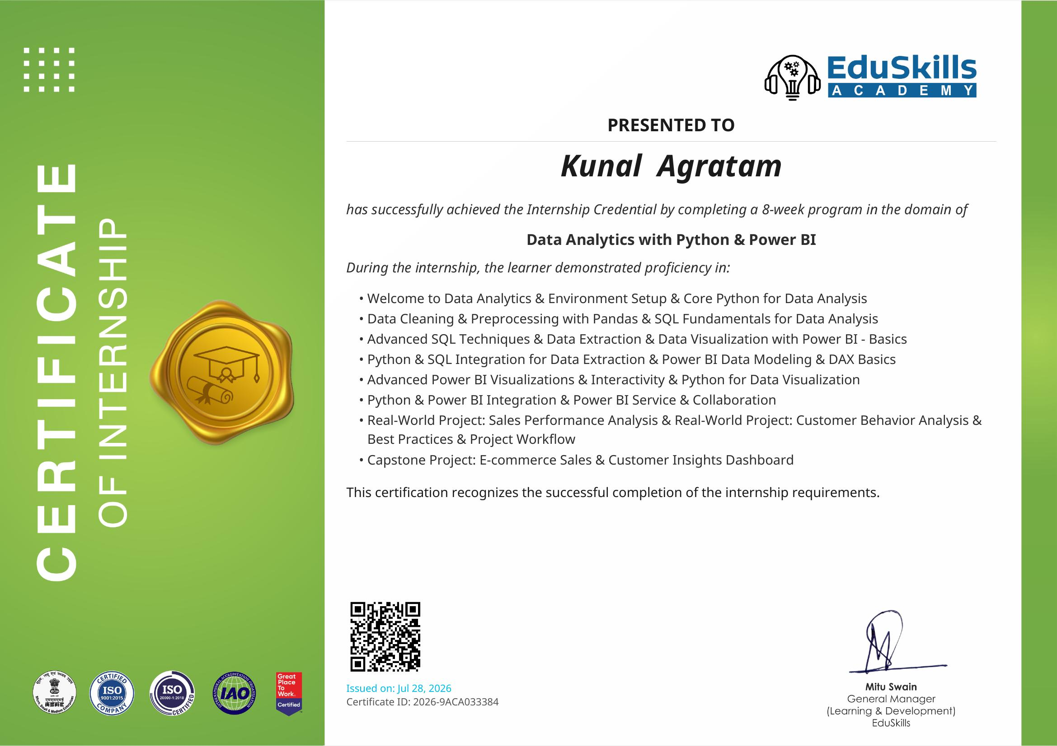
PROOF OF COMPLETION
Internship Completion Certificate
Certificate ID: 2026-9ACA033384 | Issued on 28 July 2026 | Signed by Mitu Swain, General Manager – Learning & Development, EduSkills
Kunal Agratam | Data Analytics with Python & Power BI
10

