Slide 1
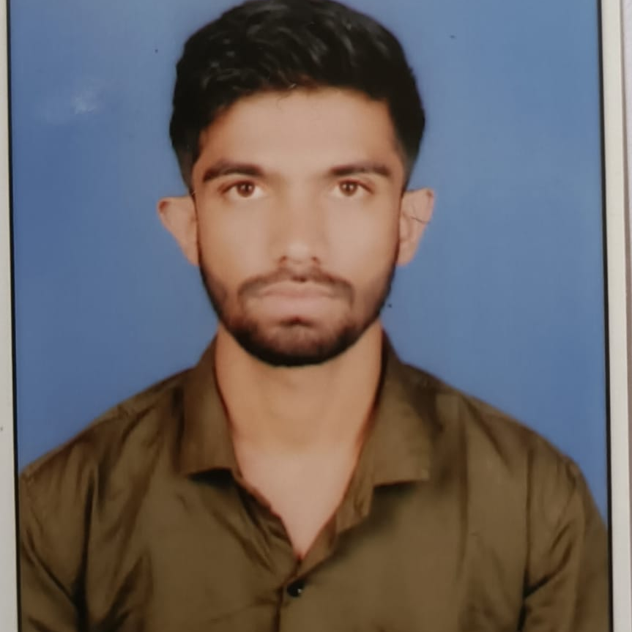
Kunal S Belkhede
Software Engineer
2017-2021: Bachelor of Technology
CGPA: 7.51
AZ 900: Azure Fundamentals
AZ 104:Azure Administrator Associate
Career
03-2022 – Present – Capgemini
Skills
Languages: Java
DevOps Tools: Azure DevOps
Cloud & Containers: Azure Fundamentals
Additional Skills: Java, Spring Boot
DevOps: Git, Azure DevOps (ADO), YAML-based multistage pipelines, Work-item management Azure: ARM/Bicep/Terraform templates for resource provisioning, Azure AD automation
Scripting: PowerShell
Grade:
Senior Analyst (A4)
City:
Mumbai
I am a motivated and detail-oriented Software Engineer with foundational skills in automation, cloud computing, and software development. My background includes experience with JAVA, DevOps tools, PowerShell, Azure cloud platform, and infrastructure as code (IaC) technologies- (ARM, Bicep, Terraform).
With a solid understanding of development and operations, I am eager to contribute to creating efficient, scalable, and secure environments. I am committed to learning and growing in the field of DevOps, continually seeking opportunities to expand my knowledge and skills.
12/2023 – Present / Software Engineer
Worked on DevOps tool.
- Worked and contributed on self service provisioning engine which is currently being used in one of public sector account
- Created YAML based multistage pipelines for Infrastructure provisioning and code deployment.
- Manage Azure Repos including security like setup branch policy, permissions, granting permission to team etc.
- Worked on PowerShell
- Developed ARM/Bicep/Terraform templates and provisioned resources to Azure cloud.
- Using templates, provisioned azure services like Web-App, App-insights etc.

