Slide 1
LMS Pro Suite
From learning operations to interview-ready skill prioritization
Problem: random candidate interviews cause poor project-fit outcomes.
Solution: rank employees using completed-course evidence and organizational scope.
Tech: ASP.NET Core modular API + SQL Server + React with mock or real API modes.
Complex Problem -> Built System -> Explainable Decisions

Slide 2
1) Problem Framing
Why this is hard and why a full system is needed
One dataset must serve leaders, team managers, and individual learners differently.
Mandatory compliance, deadlines, and provider progress sync must remain consistent.
Staffing must become evidence-based, not manager memory or random selection.
This requires policy modeling, scoped analytics, and integration-safe workflows.

Slide 3
2) System Design
Modular monolith architecture with future microservice path
Composition root configures SQL Server, CORS, integration clients, and endpoint modules.
Feature modules: departments, teams, learners, courses, assignments, dashboard, reports, integrations.
Code-first EF constraints enforce data integrity (unique employee code/email, provider course identity).
Frontend API adapter allows one-click switch between in-memory mock and real backend endpoints.
Data flow: React UI -> API adapter -> (Mock engine OR Backend API) -> SQL + Provider integrations

Slide 4
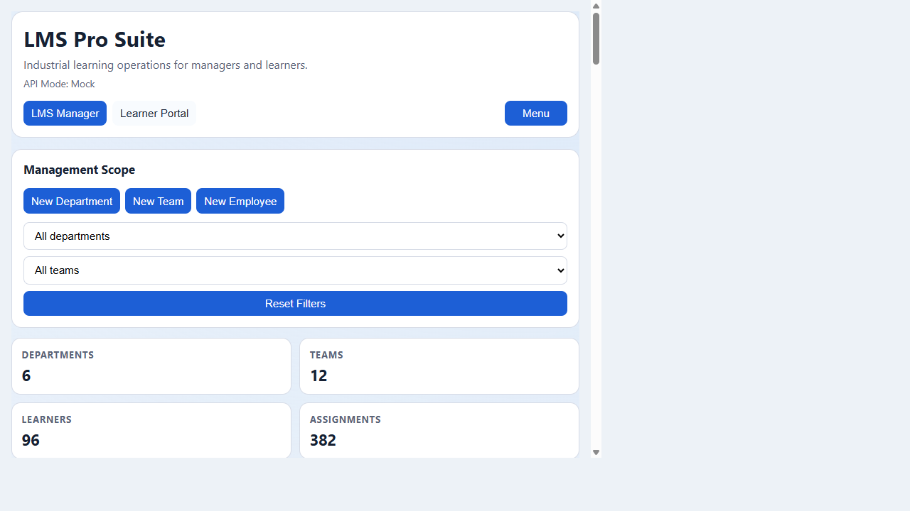
Manager Command Center
Scope filters, KPIs, assignment operations, progress and compliance

Slide 5
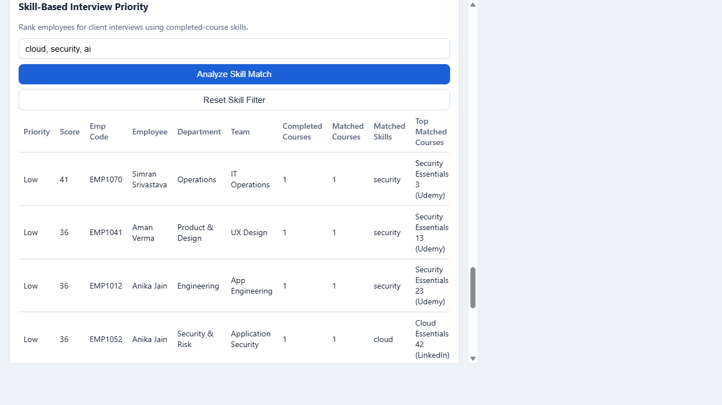
Skill-Based Interview Priority
Turn project skill keywords into ranked candidate shortlists

Slide 6
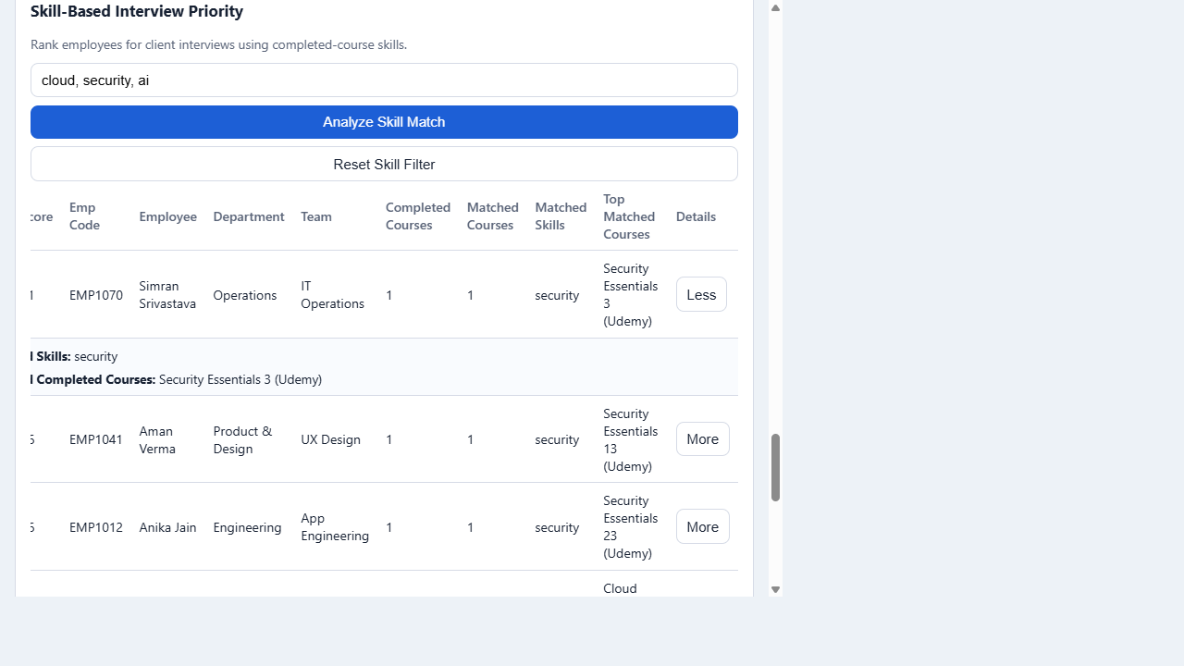
Explainability: Expanded Candidate Details
Per employee, show complete matched skills and matched completed courses

Slide 7
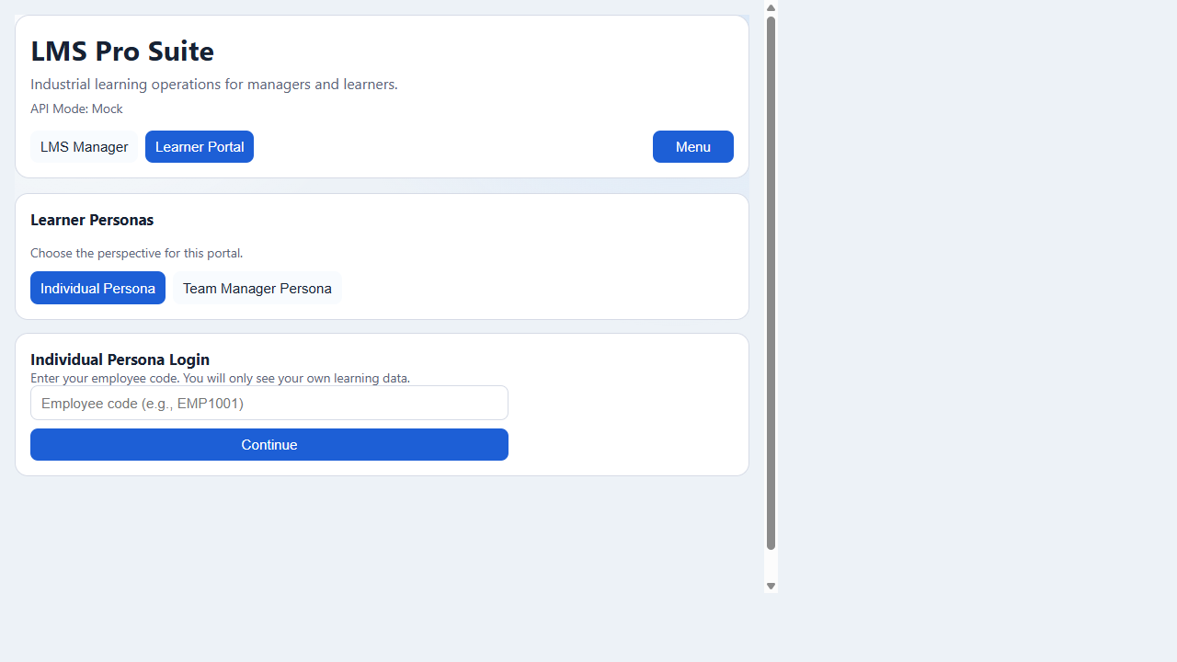
Learner Portal Personas
Individual privacy scope and team-manager monitoring scope

Slide 8
3) Tradeoffs and Decisions
What was chosen, alternatives, and what would change
Modular monolith now, extraction to microservices later for speed and maintainability.
Keyword scoring chosen for explainability and fast delivery; semantic matching is next iteration.
On-demand sync endpoints simplify MVP; production should move to background workers and retries.
Mock mode ensures demo continuity; contract tests are needed to prevent drift over time.

Slide 9
4) Failure Modes and Behavior
How the system degrades and recovers
Provider sync unavailable: core LMS still operates with existing assignments and local/mock data.
Invalid operations blocked by validation and DB constraints (duplicate identities, bad targets).
No exact skill keyword match: shortlist still returns ranked employees (lower priority tiers).
Backend downtime: frontend can run in mock mode for uninterrupted demo and validation.

Slide 10
Roadmap and Production Readiness
Next steps beyond MVP
Add authentication/authorization and audit trails for assignment and scoring actions.
Introduce skill taxonomy + embeddings for semantic role-to-skill mapping.
Add background sync scheduler, queue-based retries, and observability dashboards.
Publish weighted scoring controls for hiring leads and project managers.

