Slide 1
Full Stack Engineering
File Sharing System
Lakshay Garg, 2310990640
Kunal Bhatia, 2310990638
Priyanshu Srivastava, 2310991183
Mudit Kalra, 2310990660
Class Group: 8
Project Guide Name :
Md Nurul Islam
FSE Trainer

Slide 2
Introduction
PROJECT GOALS:
  Develop a secure and scalable file sharing platform where users can upload, store, and share files easily.
  Replace traditional file sharing methods (like USB, email attachments) with a centralized digital solution
  Ensure fast access, reliability, and smooth user experience across devices.
B) OBJECTIVES:
  Technical Objective:
  Build a strong full-stack system using Node.js, Express, MySQL, and React, ensuring proper authentication, validation, and efficient file handling.
  User Objective:
  Provide a simple and intuitive interface where users can upload files, create folders, and share content without confusion.
  Security Objective:
  Implement JWT authentication, password hashing, and access control to keep user data safe.

Slide 3
Introduction
C) VISUAL IDEA:
Folder-based layout similar to Google Drive for better organization.
A clean dashboard UI where users can easily see their files and folders.
Clear buttons like Upload, Create Folder, Share for easy navigation.
Responsive design so it works smoothly on mobile, tablet, and desktop.

Slide 4
Problem Statement
Traditional file sharing methods like USB drives, email attachments, or messaging apps are inefficient and unorganized. Files often get lost, duplicated, or difficult to manage.
There is no proper centralized system where users can store, organize, and access their files anytime from anywhere. This creates dependency on physical storage or scattered platforms.
Security is a major concern in existing methods, as files can be accessed by unauthorized users, and there is no proper authentication or permission control.
Lack of structured file management (folders, categorization, search) makes it difficult for users to handle large amounts of data efficiently.
These challenges highlight the need for a secure, organized, and user-friendly file sharing platform that ensures easy access, proper management, and controlled sharing of files.

Slide 5
System Overview
The File Sharing Platform is a full-stack web application that allows users to upload, store, manage, and share files in a centralized system. It eliminates the need for scattered storage methods.
Users can create folders to organize files, making it easier to manage large amounts of data in a structured and efficient way, similar to modern cloud storage systems.
The system provides multiple sharing options, including sharing files with specific users or generating public links for easy access.
It includes a secure authentication system, ensuring that only authorized users can access or modify files based on their permissions.
The platform is designed to be scalable, user-friendly, and responsive, providing smooth performance across different devices and handling increasing data efficiently.

Slide 6
Tech Stack
Frontend:
  Built using React 19 for creating a dynamic and component-based user interface.
  Styled with Tailwind CSS for fast and responsive design.
  Vite is used as a build tool for faster development and performance.
  React Router DOM handles navigation between different pages.
  Axios is used for making API requests to the backend.
Backend:
  Node.js is used as the runtime environment for server-side logic.
  Express.js is used to build RESTful APIs and handle requests efficiently.
  Sequelize ORM simplifies database operations and model management.
  JWT (JSON Web Tokens) is used for secure authentication.
  Multer handles file uploads on the server.
  ZOD is used for input validation.
  bcryptjs is used for secure password hashing.
Database:
  MySQL is used as a relational database to store user data, file details, and folder structure.

Slide 7
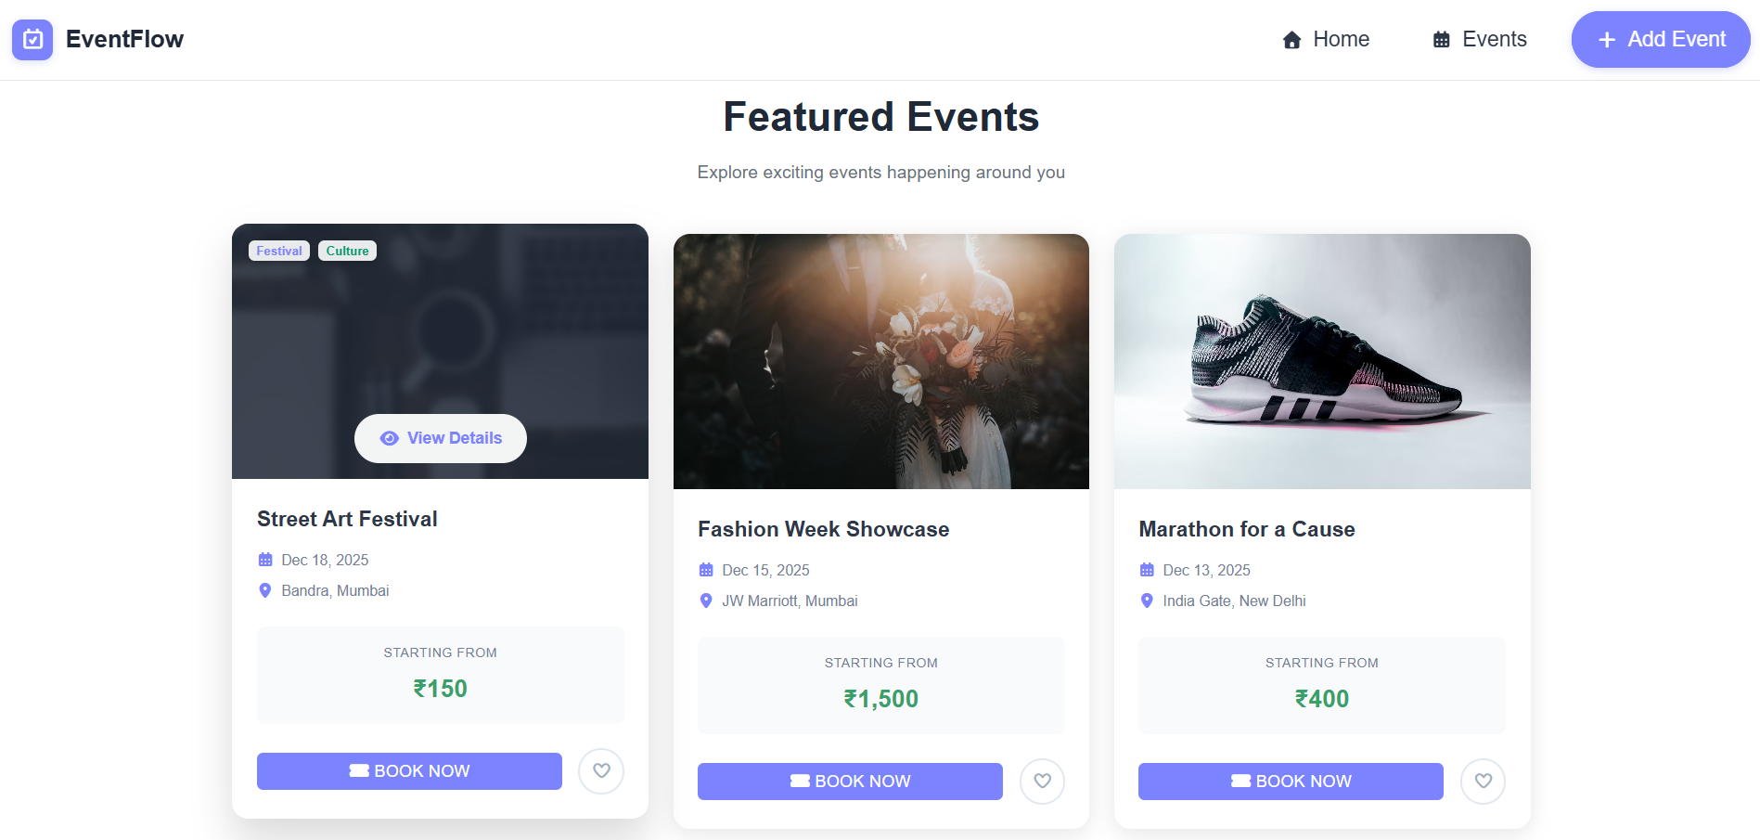
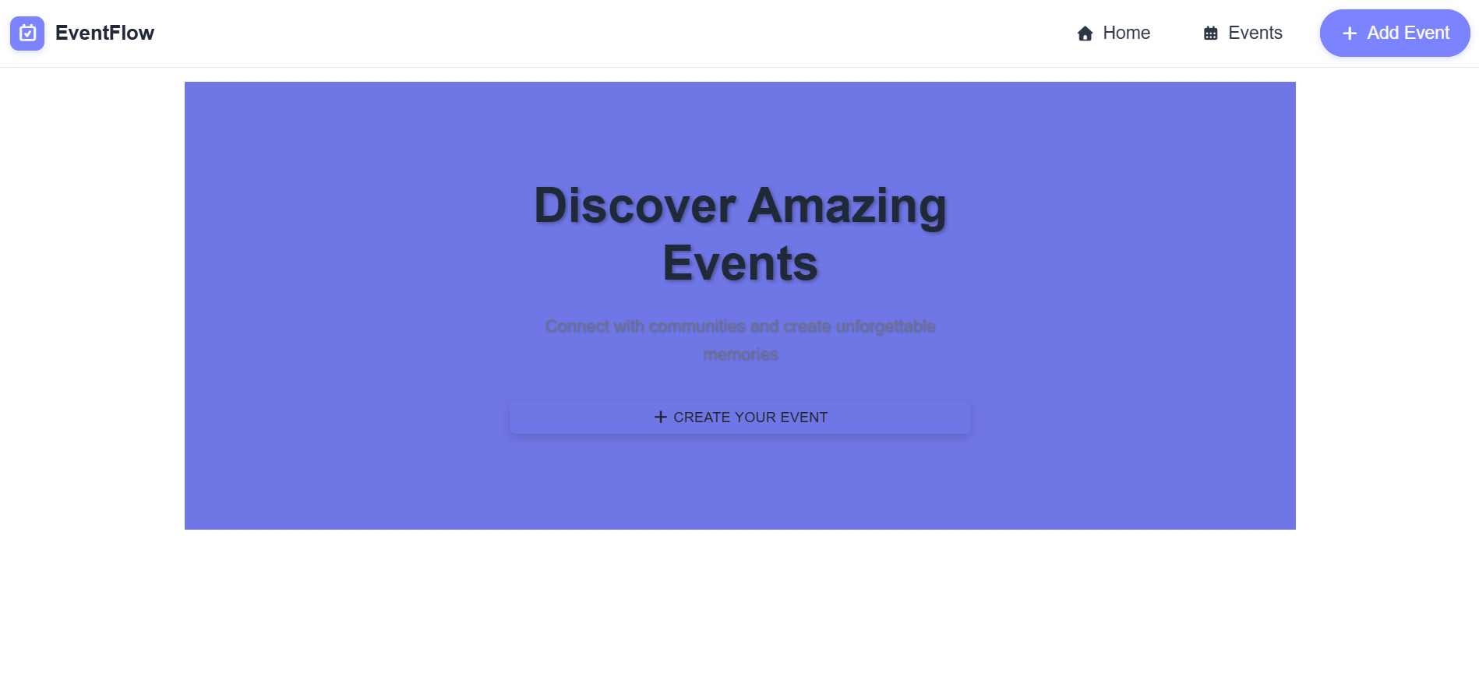
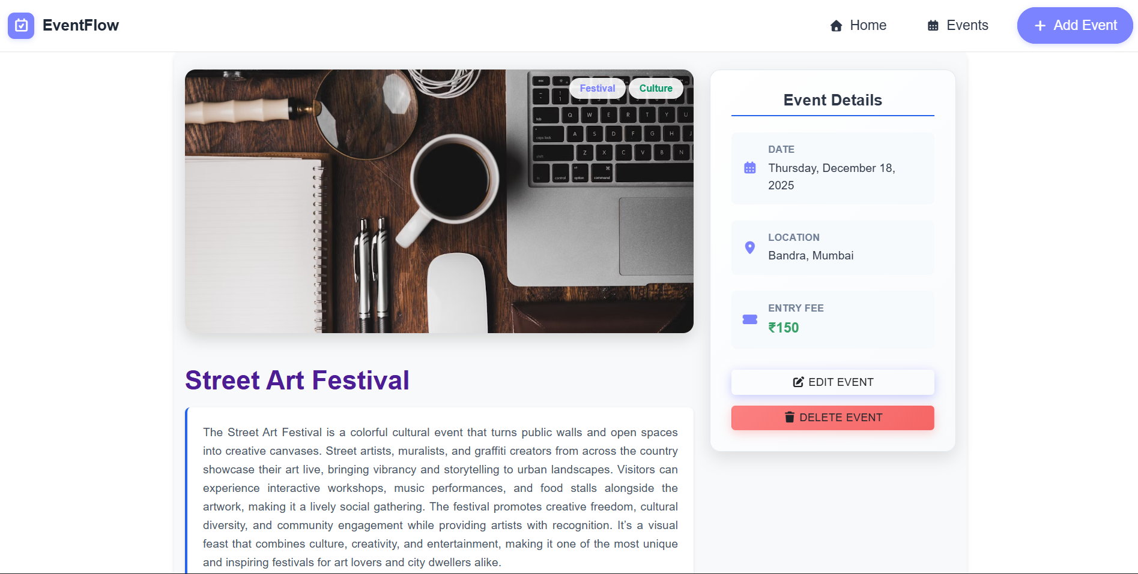
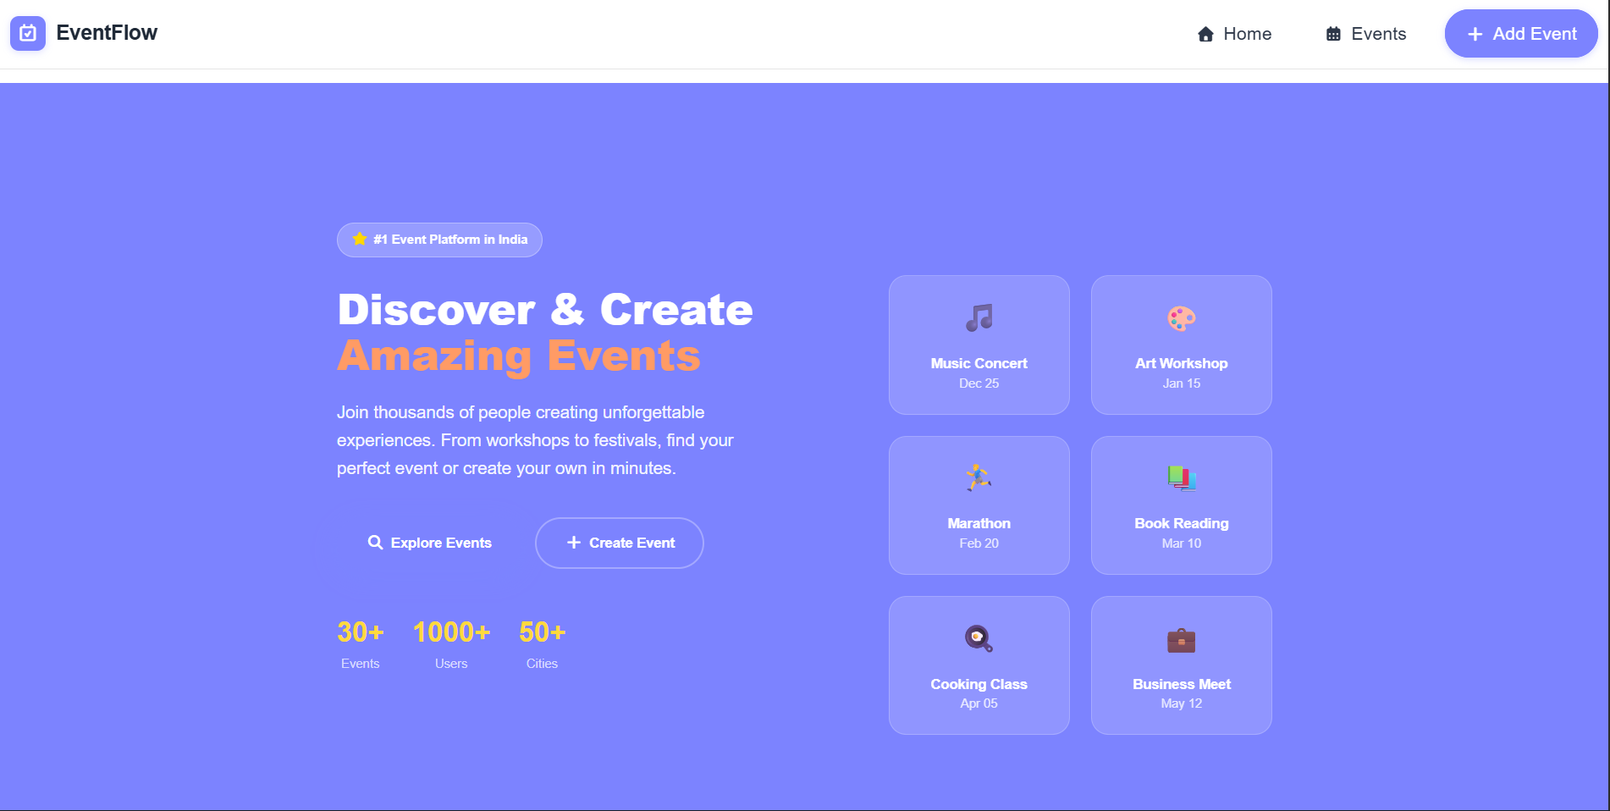
PROJECT OVERVIEW

Slide 8
Key Features
File Upload & Management: Users can easily upload, view, download, and delete files. The system supports multiple file types and ensures smooth handling of file operations.
Folder Organization: Users can create folders to organize their files in a structured way, making it easier to manage and locate data efficiently.
Secure File Sharing: Files can be shared with specific users or via public links, with proper access control to ensure data privacy and security.
Authentication & Authorization: The platform uses JWT-based authentication to verify users and restrict access based on permissions, ensuring secure usage.
Responsive & User-Friendly Interface: Designed with a clean and intuitive UI, the platform works smoothly across desktop, tablet, and mobile devices.

Slide 9
Conclusion
The File Sharing Platform provides a complete solution for secure, organized, and efficient file management, replacing traditional and unstructured methods.
With features like file upload, folder organization, and controlled sharing, it improves productivity and makes file handling simple for users.
The use of modern technologies like React, Node.js, and MySQL ensures that the system is scalable, fast, and reliable.
Strong security measures such as JWT authentication and password hashing protect user data and ensure safe access.
In the future, the platform can be enhanced with features like cloud storage integration, file preview, and real-time collaboration.

Slide 10
Thank you

