Slide 1
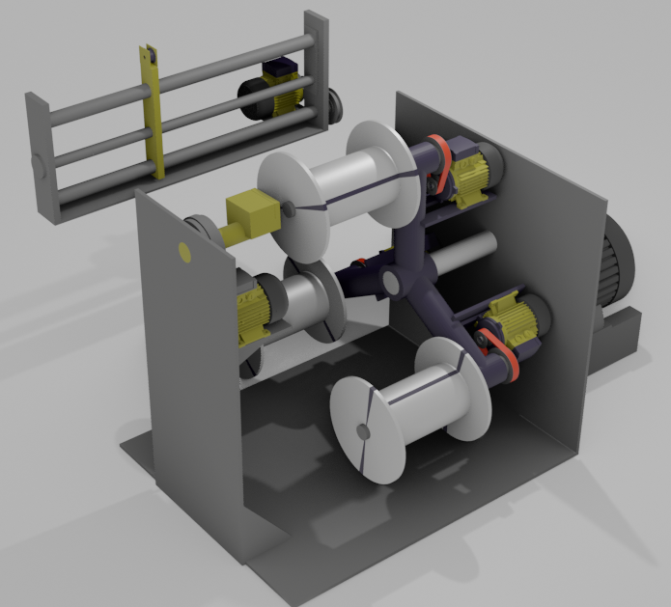
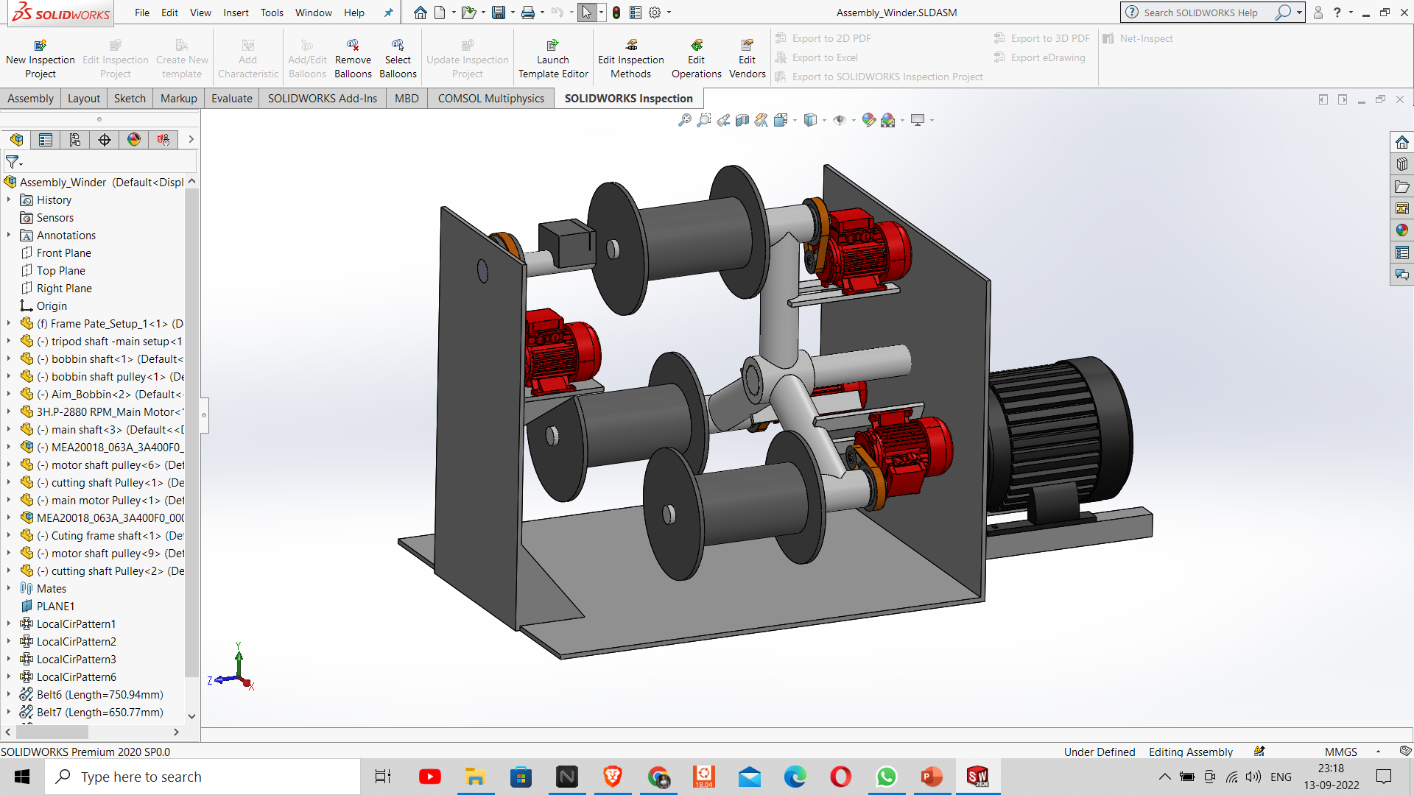
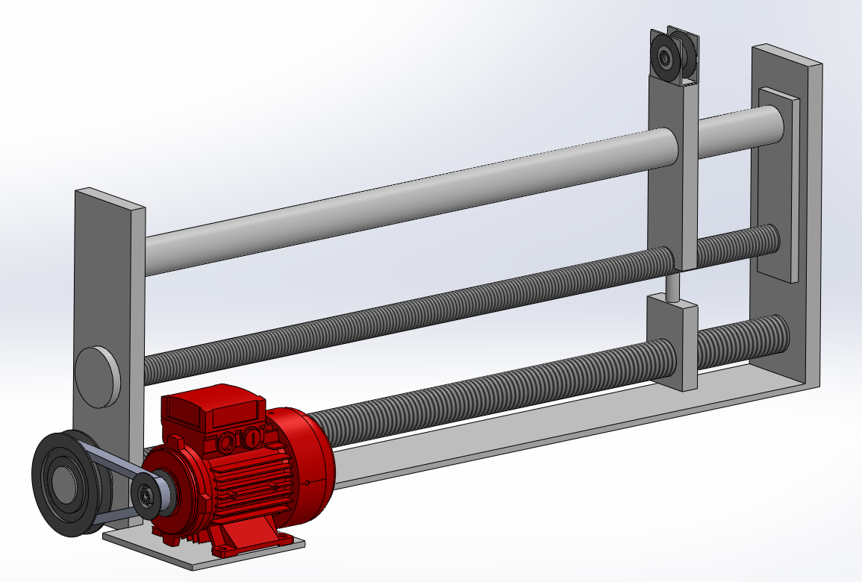
Design and Analysis of Automatic Multi Bobbin Wire Winder
Introduction :-
Automatic Tripod style Horizontal Multi bobbin wire Winder that could be used in wire drawing production line is designed. It is capable of supplanting, entanglement and clamping of wire automatically on newly supplanted bobbin and wound wire evenly on bobbin using Traveller. It has 3 bobbins which could be replaced once filled and supplanted with new bobbin automatically. It is operated using Electric Panel unit which has motor regulators and PLC unit to actuate the machine.
Traveller
Winder
Winder Assembly
Advantages :-
Automatic supplanting, entanglement, clamping and winding of wire on bobbin.
Saves time required for bobbin supplanting and replacement.
Improved Production rate and cost-benefit ratio by saving 3-4 minutes per bobbin replacement.
Cost effective.
Specifications :-
Bobbin Capacity- 3 bobbins
Bobbin motor- 1 HP Induction motor
Tripod Frame- 3 Hp Induction motor
Traveller- 1 HP Synchronous motor
Clamping Mechanism- 1/2 HP motor
Variable Speed Control unit.
Wires Preferred - All Metals with maximum diameter 2 mm.
Conclusion :-
We have successfully Designed Automatic Multi bobbin wire winder capable of supplanting, clamping, entanglement and winding of wire on Bobbin. This machine is compact and cost effective as compared to other available solutions.

