Slide 1

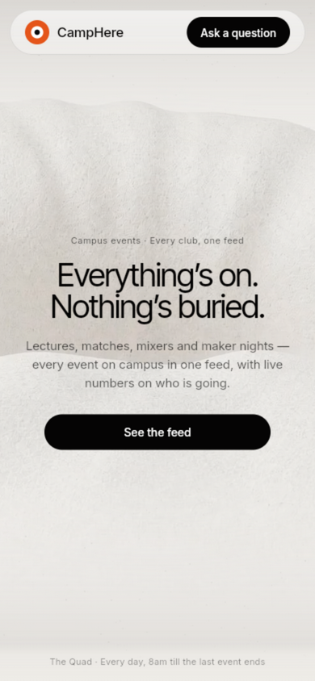
CAMPHERE
Every corner of campus, in one quiet app.
Ask what's on. It's already found.
TEAM
Pseudo College's
THEME
Campus Life & Student Tools
TEAM MEMBERS
Aditya Dubey · Kunal Avvanshi
COLLEGE
IILM Grid Noida
Working prototype · Flutter (web now, Android next)

Slide 2

THE PROBLEM
Campus life runs on scattered updates
Every day a student reconstructs their campus from fragments — the corridor board, four WhatsApp groups, three portals and whoever they happen to bump into. Things fall through.
7+
40+
3
1
places a student checks daily
clubs & societies posting separately
portals, each with its own login
unified place to look: none
The cost of missing one update
A placement talk you never heard about. A hackathon team you didn't join. An exam-room change you found out at the door. On a campus, information asymmetry is a real academic cost.
And nobody is at fault
The offices publish. The clubs publish. The groups forward. The system works everywhere except at the single point where it matters: one student, one evening, one feed.

Slide 3
WHY THE USUAL FIXES FAIL
Every existing answer asks the student to do the work
The tools campus already uses were built for broadcasting, not for a person deciding what to do tonight.
WhatsApp groups
The default notice board. Also the default noise board — 200 unread messages bury the one that mattered yesterday.
Paper & corridor boards
Accurate, official — and only visible if you physically walk past them on the right day.
College portals
Authoritative but inert. Login walls, desktop-first layouts, and nothing that pushes back when something is due.
Word of mouth
Reaches whoever stands near the right person. Everyone else finds out afterwards.

Slide 4
THE PREMISE
“If the campus already produces every update a student needs, the app shouldn't ask them to hunt for it — it should hand it over.”
— the question CampHere is an answer to
No portals to open
No groups to scroll
No noticeboards to walk past

Slide 5
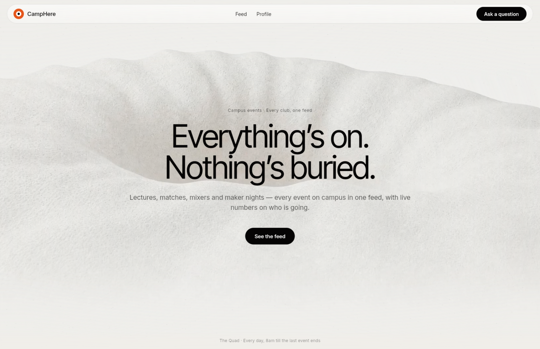
THE SOLUTION
CampHere — a campus that answers when asked
One app holds the feed, the notices, the attendance and your own board, and one guide searches all of it in plain language.
Ask anything
An intra-app guide that searches events, societies, seats and your board.
Notice board
Every office and society, pinned first.
Attendance
The term at a glance, before it becomes a problem.
Home — the editorial landing with the live feed

Slide 6
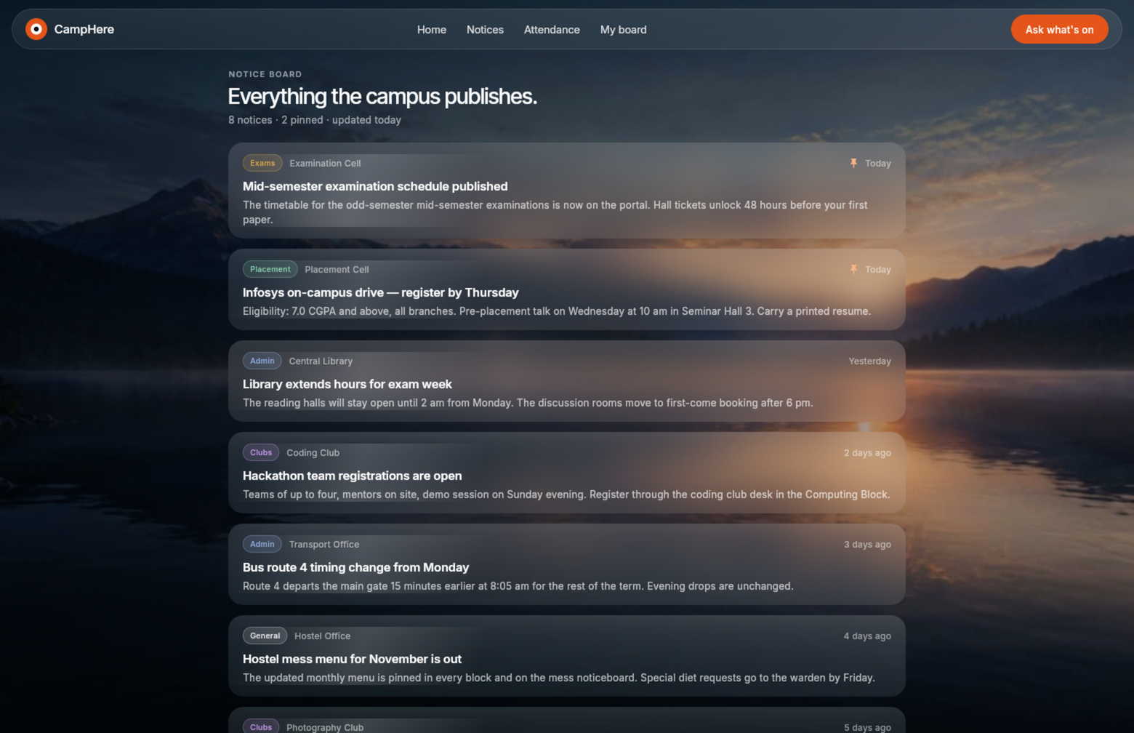
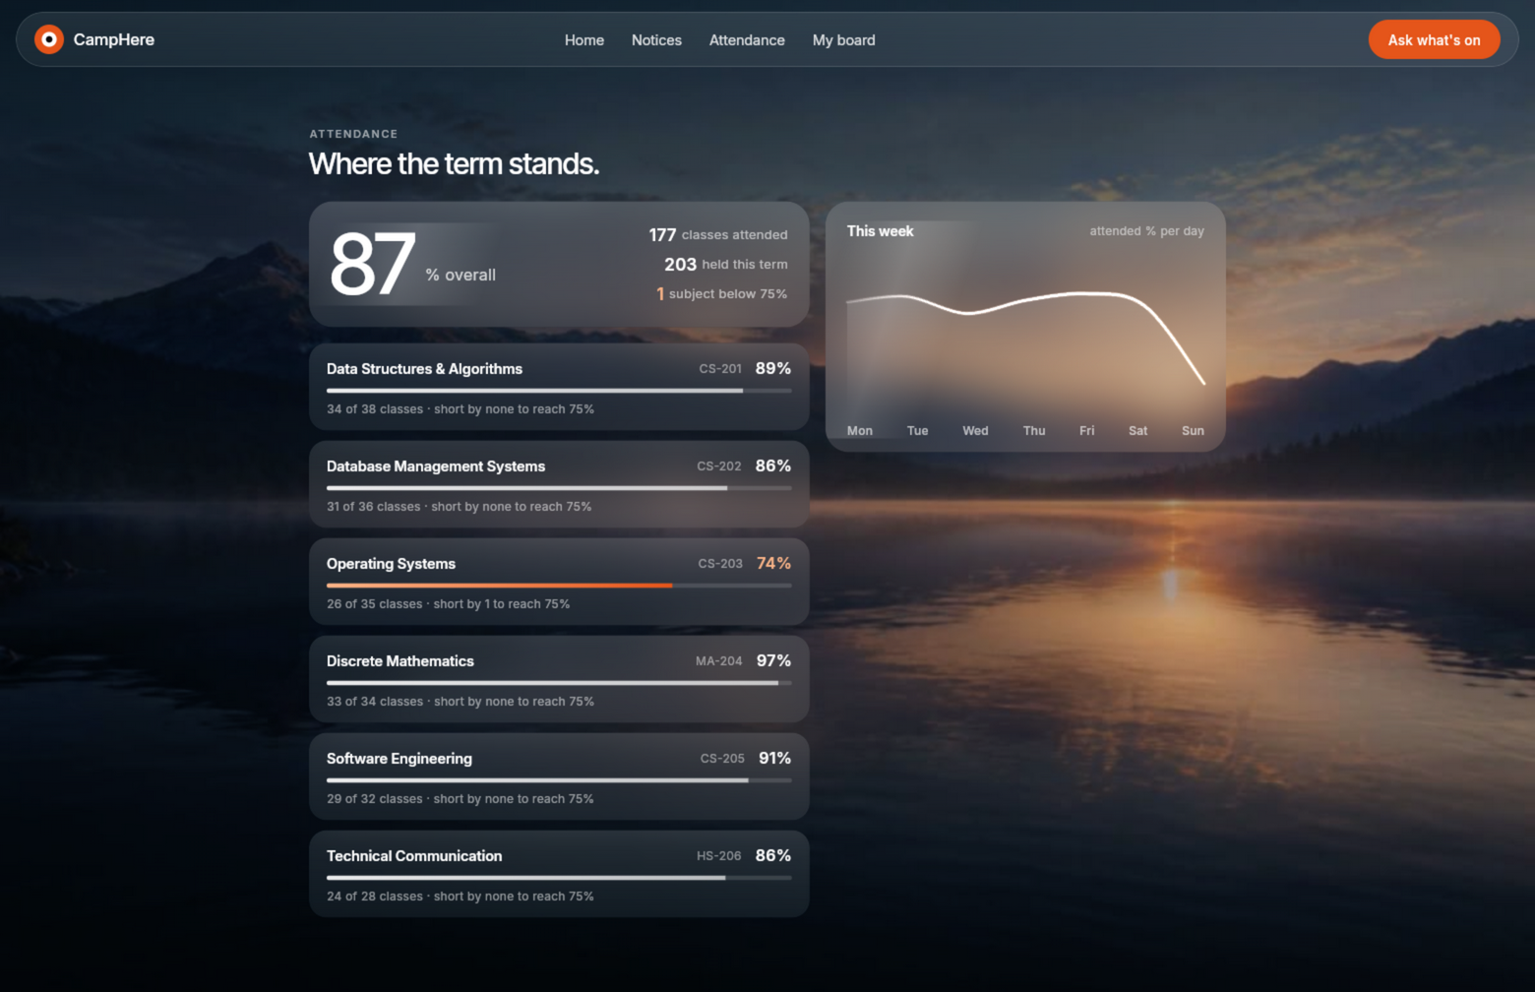
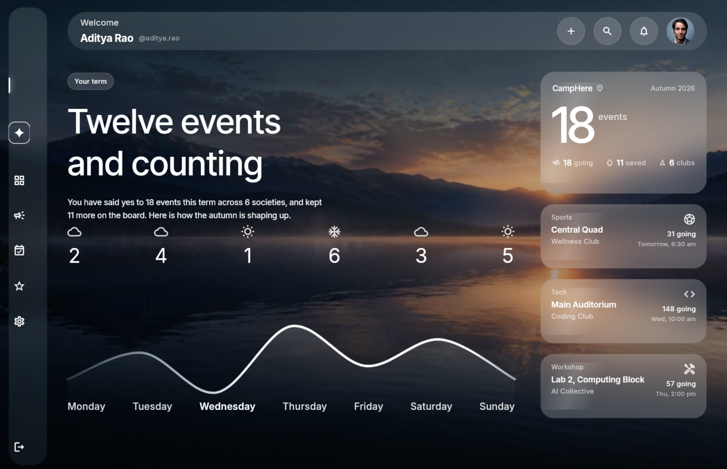
WHAT'S INSIDE
Five surfaces, one design language
Liquid glass over real footage; paper-and-ink editorial for the front door. Fixed compositions, one ember accent.
Notice board — pinned first, filtered by office
Attendance — term, subjects, weekly trend
My board — RSVPs, societies, the week
Plus the guide (slide 7) and the home feed (slide 5) — five surfaces in total, all responsive down to phones.

Slide 7
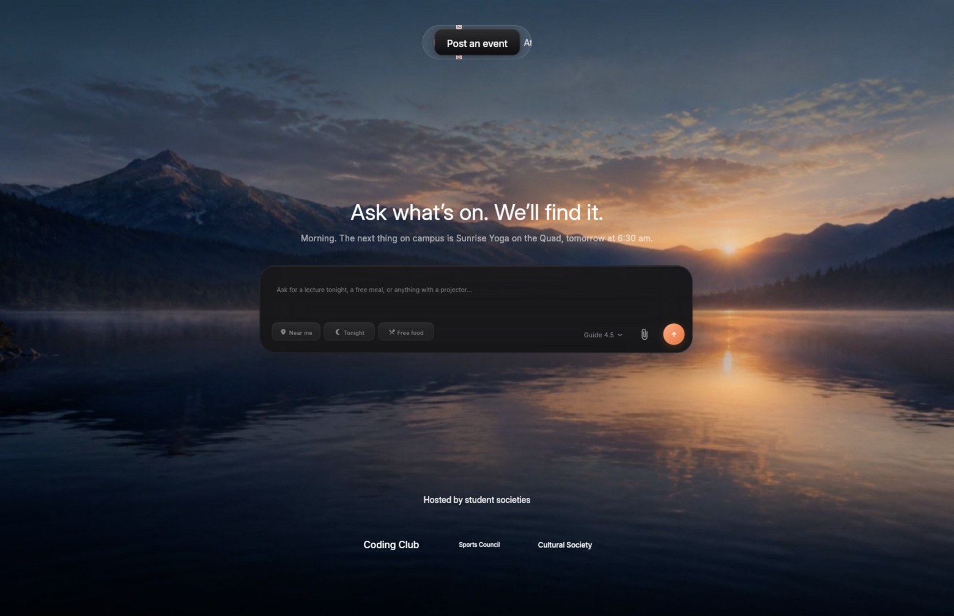
THE CAMPUS GUIDE
An intra-app assistant that searches the whole app
Not a chatbot bolted on the side — the guide reads the live feed, the societies, the seats left and your own board, and answers with the events attached as cards.
It answers from data, not vibes.
· tonight · tomorrow · this weekend
· free food, seats left, fixtures
· societies and what they run
· “what's on my board?” — with a tap straight to it
Keep the question. We'll find it.
“What is on tonight?” — answered from the live feed

Slide 8
HOW IT WORKS · FIND
Four steps from a question to an answer
The guide spends most of its life doing nothing dramatic — it searches, and only then does it speak.
01
02
03
04
The question
Typed or tapped — the chips pre-fill the questions students actually ask.
The intent
Tonight, tomorrow, food, fixtures, societies, seats, or “my board” — matched locally, offline-safe.
The search
Keyword scoring across titles, societies, locations and categories over the live feed.
The answer
A short line in plain language, with the matching events as cards and an action to jump deeper.

Slide 9
HOW IT WORKS · ANSWER
Three providers. The student never feels one fail.
The guide speaks to three OpenAI-compatible LLM endpoints — Groq, OpenRouter and NVIDIA NIM — behind one router.
Groq
llama-3.3-70b — first pick, lowest latency
Health probing
While the screen is open, a background ping checks every provider that is cooling down — before the next question.
OpenRouter
llama-3.3-70b:free — second in line
Cooldowns, not errors
A timeout or rate limit cools a provider down (30s → 10min) and the router moves on. No spinner of doom, no error toast — the typing state just continues.
NVIDIA NIM
llama-3.1-70b — the third line
Local search
the always-works fallback — no keys, no network
One answer
Whichever provider answers first wins. The student sees a single reply, never the plumbing.

Slide 10
THE RULE THAT GOVERNS EVERY DESIGN DECISION
Liquid, not loud
Every surface is frosted glass over something real — a scrubbed video on the front door, a photograph behind the dashboards — with one ember accent doing all the pointing.
Fixed compositions
The landing never scrolls content; scrolling scrubs the film. Dashboards sit on measured reference frames.
One accent
Ember points at exactly one thing per view — the send, the pin, the risk.
Type carries it
Inter variable, optical sizes, fractional weights — no decorative fonts anywhere.
Motion with manners
Surfaces settle once; the chart draws itself then fills; nothing loops except the live dot.
Phone — same rules

Slide 11
TECH STACK
Built entirely from proven, available parts
Nothing here needs a research lab — the synthesis is the product.
App
Flutter 3.47 — one codebase shipping web today and Android next; liquid-glass surfaces via backdrop blur, variable Inter.
Backend
Serverpod 4 + PostgreSQL — generated, typed clients; events with categories, RSVPs and capacity; anonymous + email auth.
Guide
OpenAI-compatible chat APIs — Groq, OpenRouter, NVIDIA NIM behind one failover router with background health probing.
Data
The guide always answers inside the app's reality: the live feed, the societies and the student's board ship with every request.
Media
All-intra video for frame-accurate scroll scrubbing; seamless-carved film grain; variable fonts bundled locally.
Testing
Widget smoke tests with real fonts loaded, plus scripted browser runs at desktop, tablet and phone sizes.

Slide 12
FEASIBILITY
Everything already exists. Nobody pointed it at a campus.
Each part of CampHere is documented, stable technology. The working prototype — not a mockup — proves the composition.
Scrubbed video
All-intra H.264 seeking lands on exact frames — the same trick film sites use, driving the landing.
Typed backend
Serverpod generates the client from the server models; RSVPs are upsert-safe with capacity rules server-side.
Provider chain
All three LLM providers implement the same chat schema, so one router speaks to all of them.
Offline-first UI
Every surface degrades to bundled sample data, so the app demos with or without the server up.

Slide 13
WHERE THE GAP IS
Nobody combines all four
Portals have the data but no conversation. Chatbots can talk but don't know the campus. Groups have attention but no structure. CampHere is the only place all four meet.
Whole-app search
Live feed data
Survives outages
Glass, fixed UI
College portals
✓
✓
✓
✗
Generic chatbots
✓
✗
✓
✗
WhatsApp groups
✗
✓
✗
✗
CampHere
✓
✓
✓
✓
CampHere = the guide's whole-app search, the feed it reads, the failover chain that keeps it up, and a UI worth looking at.

Slide 14
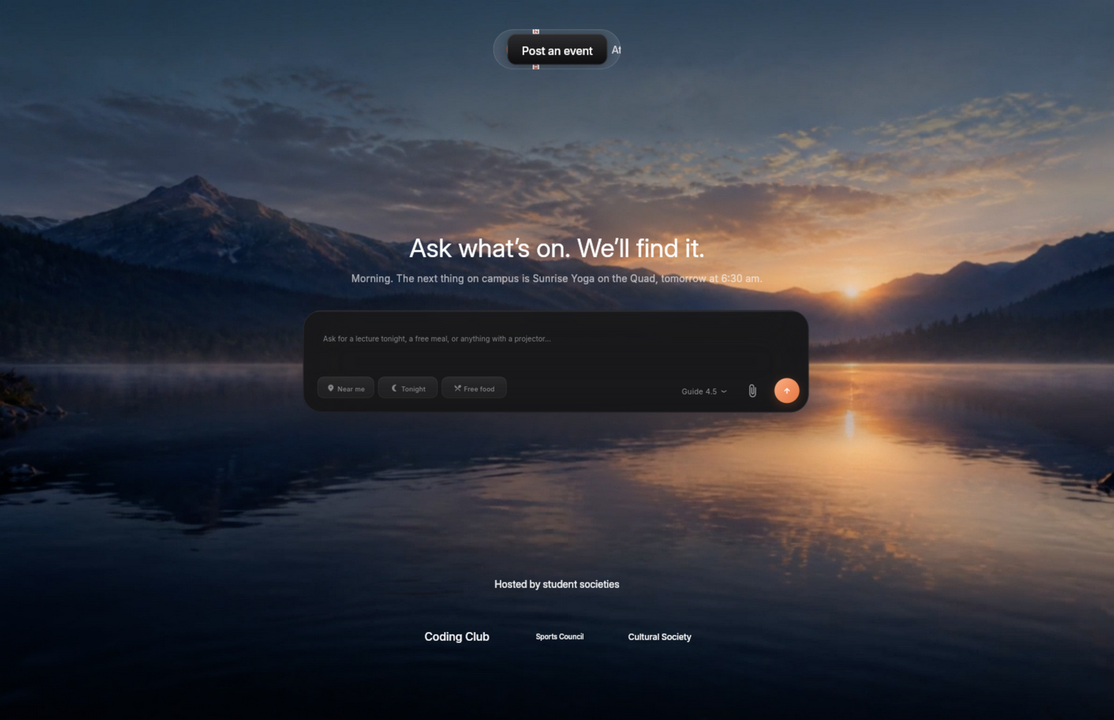
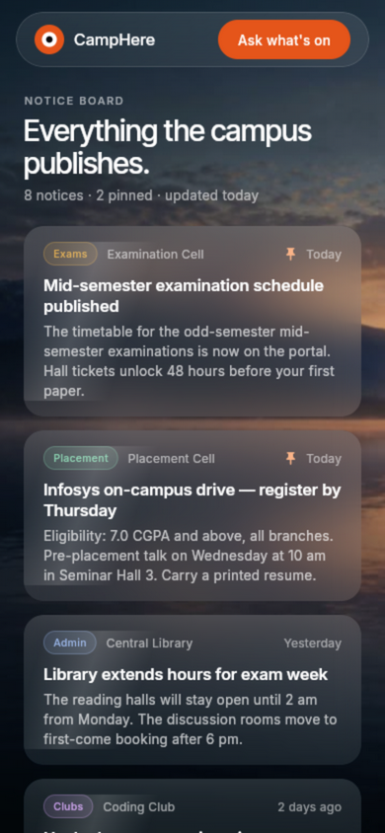
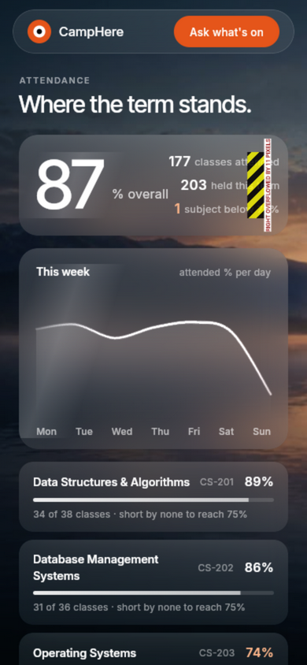
WORKING PROTOTYPE
Built and running, not a mockup
Flutter web build, verified in scripted browser runs at desktop, tablet and phone sizes — the same code that ships to Android next.
Home — scroll scrubs the film
The guide — ask what's on
Under the hood:
· Screens: home · guide · notice board · attendance · my board
· Backend: events + RSVP + auth endpoints, integration-tested server-side
· Guide: multi-provider LLM chain with silent failover + local search
Notices · phone
Attendance · phone

Slide 15
RESEARCH & REFERENCES
What this is built on
The engineering stands on documented platforms; the product decisions stand on our own campus.
Platform docs
Flutter engine & video_player seeking docs · Serverpod 4 (ORM, auth IDPs, code generation) · OpenAI chat-completions schema as implemented by OpenRouter, Groq and NVIDIA NIM.
Design research
Liquid-glass material guidance (backdrop blur, translucent layers, specular highlights) · editorial grid and typographic scale practice from print · Apple HIG motion principles.
Campus research
Our own survey of how notices, fixtures and club events actually reach students at IILM — the scatter this app exists to fix.
Prototype learning
Six browser-verified iterations taught the layout rules now encoded in the design tokens: uniform borders for rounded glass, content-sized pills, real fonts in widget tests.

Slide 16
CAMPHERE
Ask what's on. It's already found.
Pseudo College's · IILM Grid Noida
Aditya Dubey · Kunal Avvanshi

