Slide 1

HOUSING: PRICE PREDICTION
Using Machine Learning Algorithms
Created by-
Kunal Chand
Internship 19

Slide 2
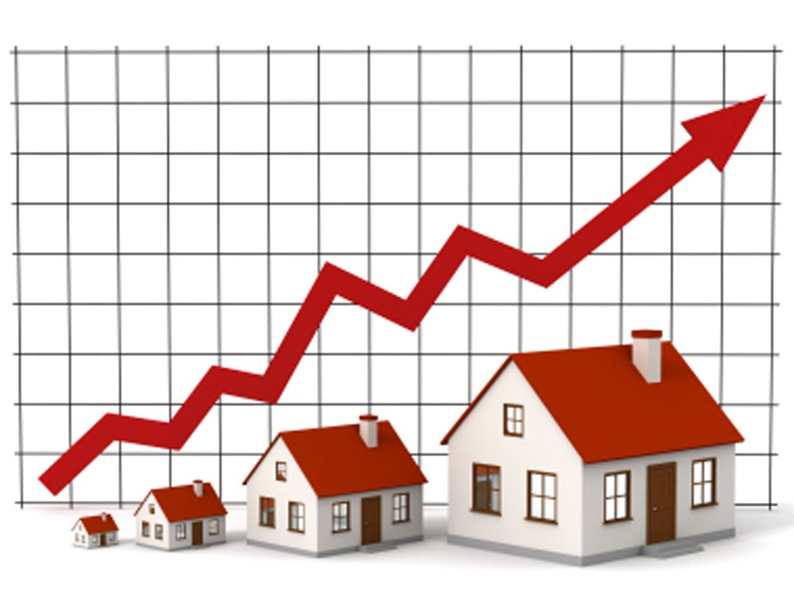
INTRODUCTION
The company is looking at prospective properties to buy houses to enter the market. Using Machine Learning to predict the actual value of the prospective properties and decide whether to invest in them or not.
And, with the help of M.L we make it possible.

Slide 3
The 7 Key Steps To Build Your Machine Learning Model
Step 1: Collect Data.
Step 2: Prepare the data.
Step 3: Choose the model.
Step 4 Train your machine model.
Step 5: Evaluation.
Step 6: Parameter Tuning.
Step 7: Prediction or Inference.

Slide 4
Data Exploration
Data exploration is the first step in data analysis and typically involves summarizing the main characteristics of a data set, including its size, accuracy, initial patterns in the data, and other attributes
It is commonly conducted by data analysts using visual analytics tools, but it can also be done in more advanced statistical software, Python.
An initial exploration of the data set can help answer these questions by familiarizing analysts with the data with which they are working.

Slide 5
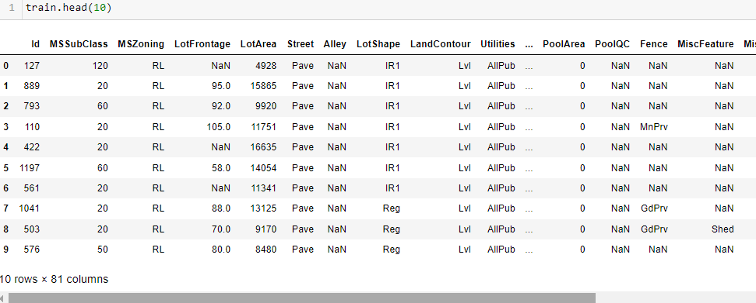
Data Sources and their formats
Most of the time data is in CSV file.
Then we load it in the system using python notebook and frame the data in data frame using pandas.
Dataset looks as follows-

Slide 6
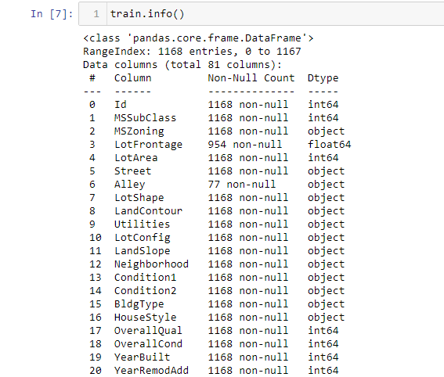
Dataset Information looks as follows-

Slide 7
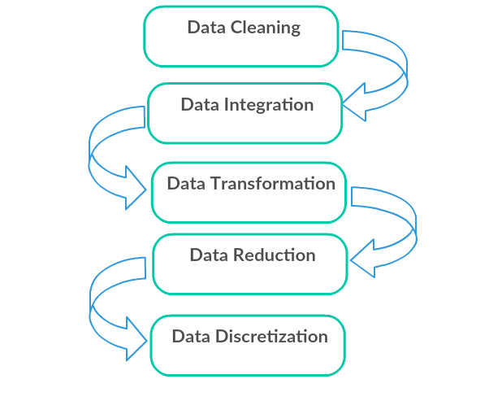
Data Pre-processing Done
Data pre-processing can refer to the manipulation or dropping of data before it is used to ensure or enhance performance, and is an important step in the data mining process.

Slide 8
Data Cleaning: First we clean the data which have no use in prediction like the ID column, then we drop the data which has a high no of missing percentages.
Data Integration: then we do some EDA process for finding out the meaning full insights of the data.
Data transformation is the process of changing the format, structure, or values of data; we use a labelled encoder for coding the object data into integer data.
Data Reduction: it is the process of finding the most correlated columns, and combining them because the machine does not understand which feature columns impact the most on accuracy.
Data discretization converts a large number of data values into smaller once, so that data evaluation and data management becomes very easy, using box plots is makes a clear understanding of the data.

Slide 9
EDA Concluding Remark.
As for any basic model building, we have to understand the type of target variable; the data of the target variable is continued or classified.
Data Analysis is always the difficult part, for better understanding different kinds of bar plots, distribution plots are created with the target Column for finding the insights of the dataset we have.
Analytical Modeling always starts with the target variable we have, and in that case, our target variable is Sales Price, for that, we create some box plots with the target variable to understand which feature columns help to learn the model best and which feature columns reduce the accuracy of the model.
And after finding the relation and correlation with the target variable we choose either Regression Model or Classification Model. Here in this problem, our target feature column continues so we build our Machine Learning model on Regression.

Slide 10
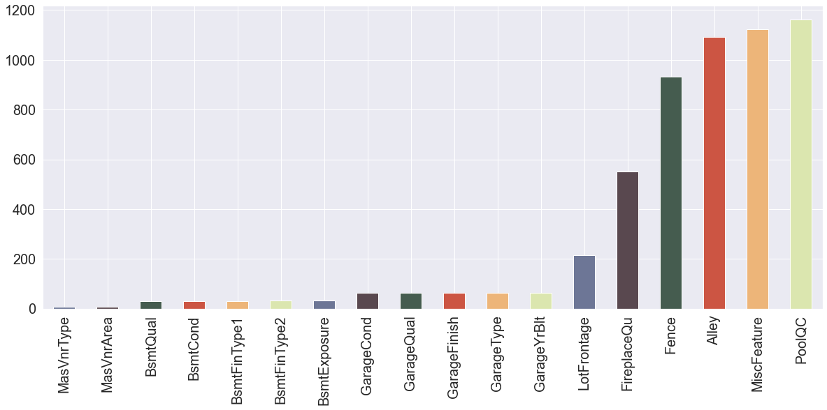
Data Cleaning
Missing values:
Observations:Poolqc, Miscfeatures, alley, fence having most missing values. So, we drop these feature columns.

Slide 11
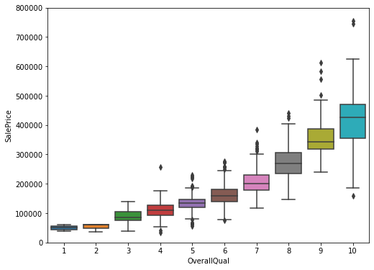
Visualization.
Visualization of the Sales Price with Overall Quality.

Slide 12
Observation:
As from the above observations, Overall quality increases the Sale price of the House.
Overall quality will depend on other features as well.
As the Score increases Sales price also increases.

Slide 13
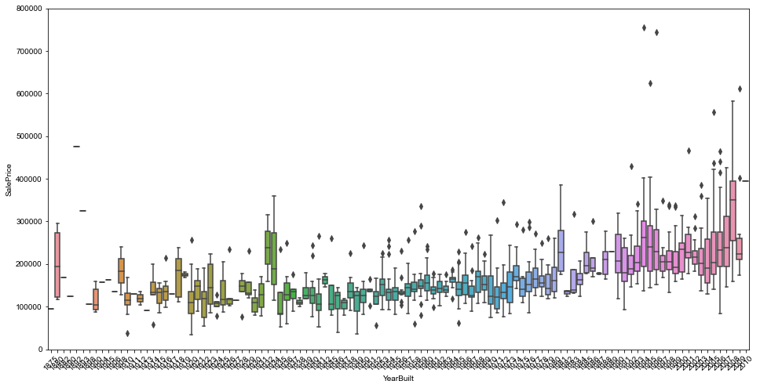
Visualization:
Visualization of the Sales Price with Year Build.

Slide 14
Observations:
1. As from the above observations, Overall quality increases the Sale price of the House.
2. Overall quality will depend on other features as well.
3. As the Score increases Sales price also increases.

Slide 15
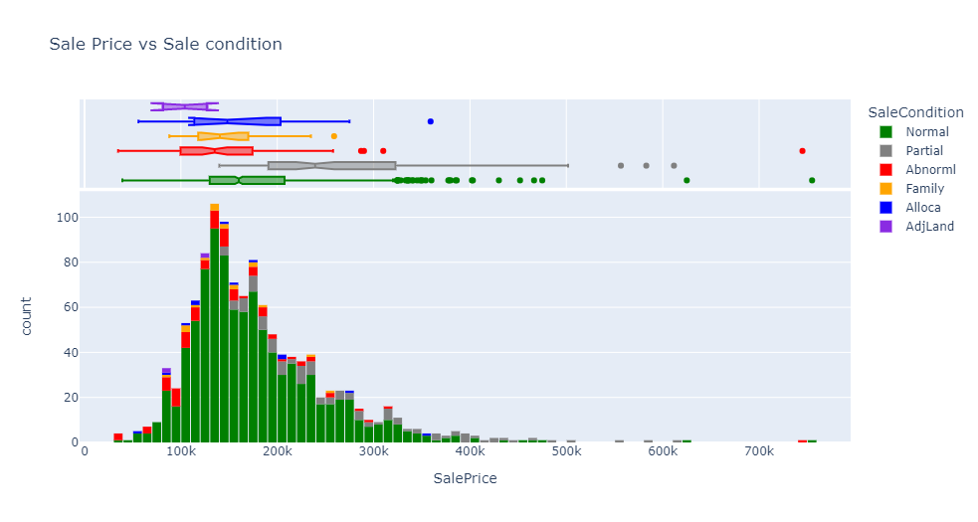
Visualization
Visualization of the Sales Price with Sales Condition.

Slide 16
Observations:
As from above observations and plotting we can easily see the Sales Conditions increases the Sales Pricing.
Abnormal condition increases the sales Prices as expected.

Slide 17
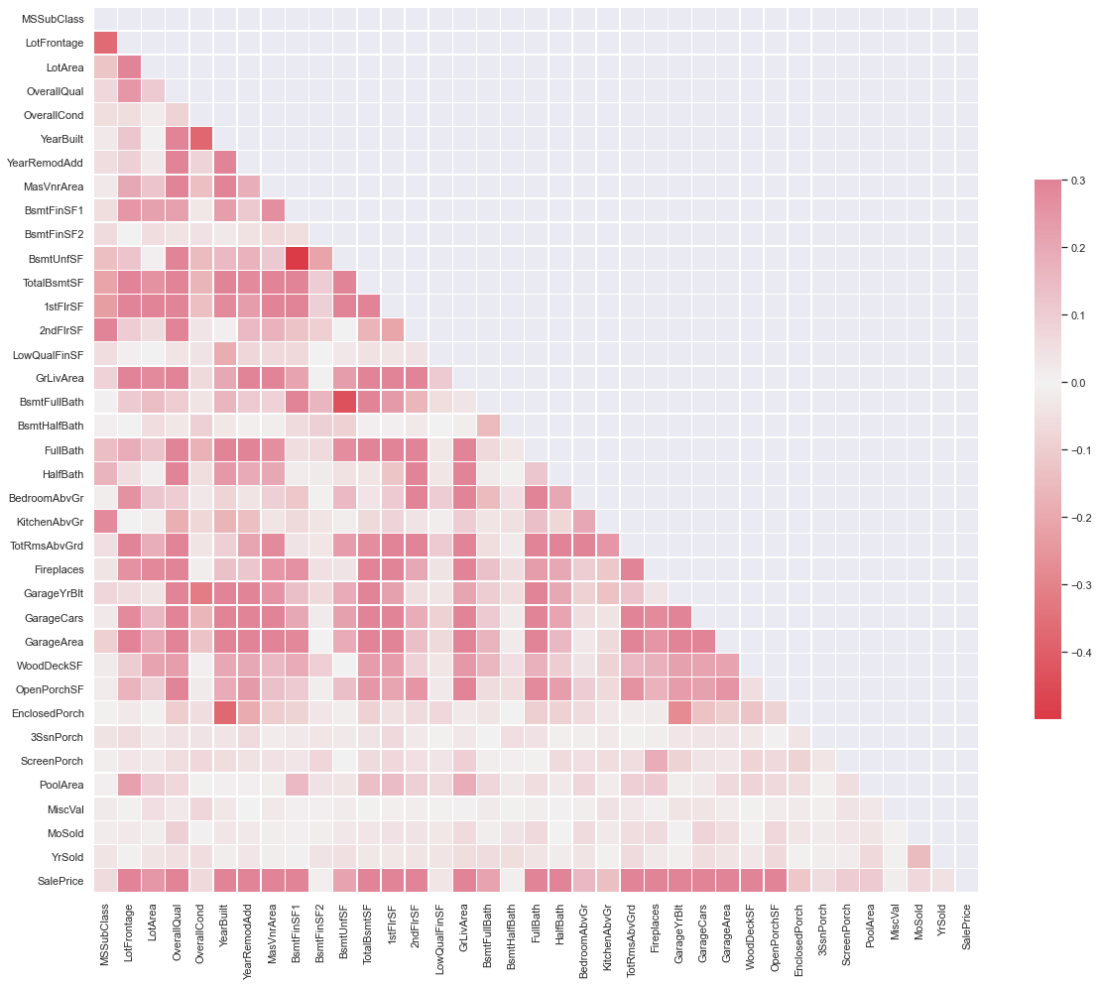
CORRELATION BETWEEN THE COLUMNS

Slide 18
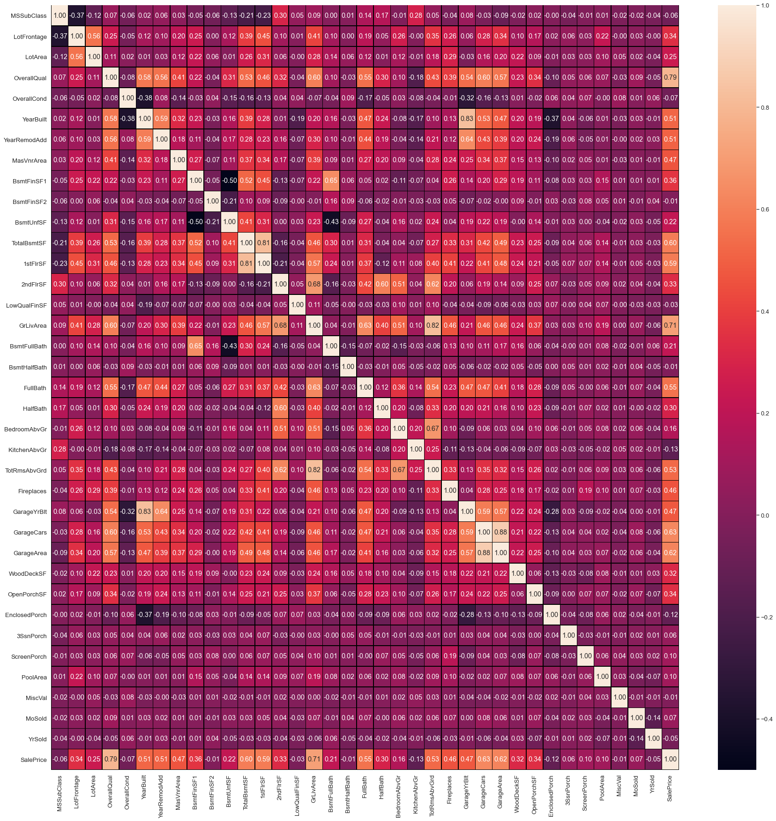
Heat Maps Plotting

Slide 19
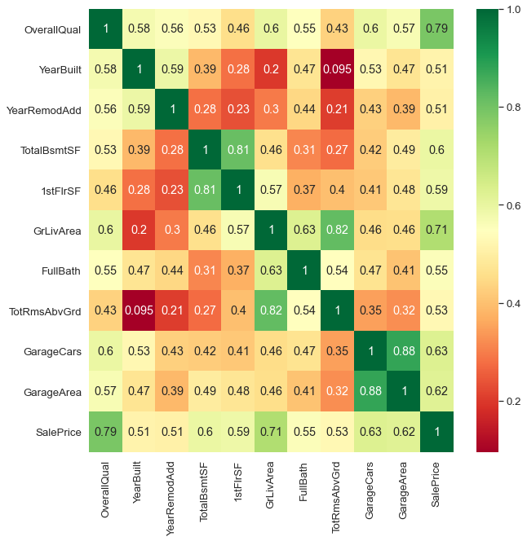
Top Correlated feature columns

Slide 20
Observations:
Most of the features are correlated with each other like Garage Cars and Garage Areas.
OverallQual is highly correlated with target feature Sale Price 0.79 can you see. we'll see how it affected the sale price in the below graph.

Slide 21
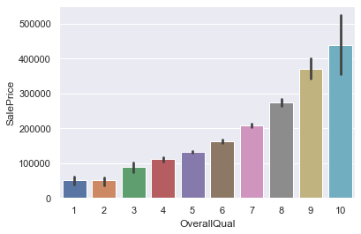
Visualization:
Visualization of the Sales Price with Overall Quality.
Observations:Overall quality increases the sales prices of the house.

Slide 22
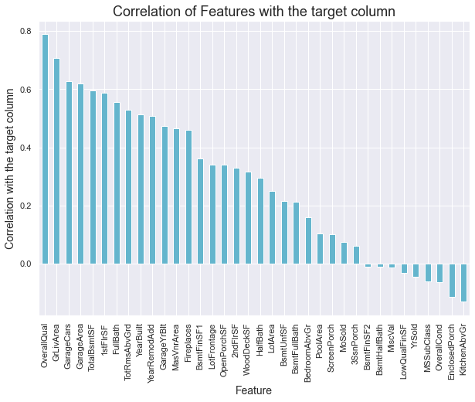
Correlation of features columns with target columns.

Slide 23
Observations:
Overall quality, Ground live area, garage cars are highly correlated with target variables and impact more on predicting Sales price.
Kitchen above ground and enclosed porch are
negatively impacting on prediction of Sales prices.

Slide 24
Building Machine Learning Models
After analyzing the dataset, I observe that many of the feature columns are object type so first, we have to convert them in integer or float type so that machine interpret the data and or that we do label encode all the feature column.
After label encoding, we find that many feature columns have Nan values so we use mean and median for filling that missing data,
Then find the correlation between the columns with target columns and delete the non-related feature columns.
We observe that the target column is skewed so we remove the skewness of the target column because normal data gives better results when we make the M.L model.
The target column is continuous type so we start work on Regression models building.

Slide 25
Testing of Identified Approaches (Algorithms)
Linear Regression
Regurgitation:
Lasso & Ridge Regression
Ensemble techniques
Decision Tree Regression
Random forest Regression
Gradient Boosting Regression
Support vector machine
K-nearest Neighbour Regression

Slide 26
Linear Regression Model
Linear Regression is a machine learning algorithm based on supervised learning.
It performs a regression task. Regression models a target prediction value based on independent variables.
It is mostly used for finding out the relationship between variables and forecasting.

Slide 27
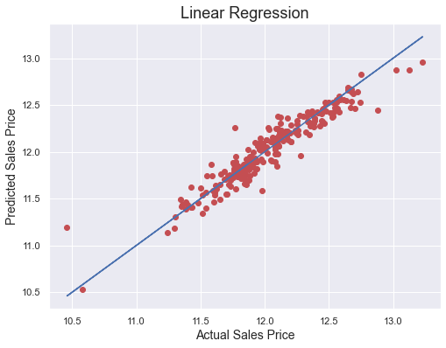
Observations:
This Linear Regression Performs with 90% accuracy for predicting house prices.
We use the best-fit line and we can easily see that most of the price points are fall on the line.

Slide 28
Decision Tree Regression
A decision tree builds regression or classification models in the form of a tree structure. It breaks down a dataset into smaller and smaller subsets while at the same time an associated decision tree is incrementally developed.
The final result is a tree with decision nodes and leaf nodes. A decision node (e.g., Outlook) has two or more branches (e.g Normal, Abnormal, and Family), each representing values for the attribute tested. Leaf node (e.g., present or not-present) represents a decision on the numerical target. The topmost decision node in a tree that corresponds to the best predictor is called the root node. Decision trees can handle both categorical and numerical data.

Slide 29
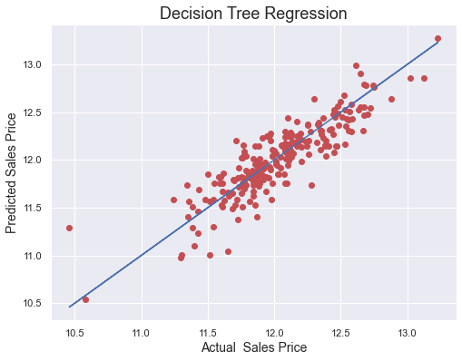
Observations:
This Decision Tree Regression Performs with 76% accuracy for predicting house prices.
After predicting and plotting the predicted data on the best fit line we observe that DTR is not so accurate.

Slide 30
Random Forest Regression Model
A Random Forest is an ensemble technique capable of performing both regression and classification tasks with the use of multiple decision trees and a technique called Bootstrap Aggregation, commonly known as bagging.
Bagging, in the Random Forest method, involves training each decision tree on a different data sample where sampling is done with replacement.
The basic idea behind this is to combine multiple decision trees in determining the final output rather than relying on individual decision trees.

Slide 31
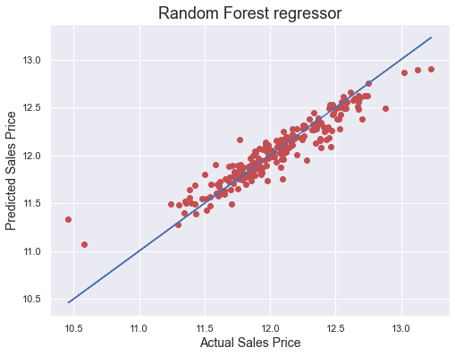
Observations:
1. RFR performs well but not that well.
2. CV at 6 is giving good results.
3. After predicting and plotting the predicted data on the best fit line we observe that RFR is not so accurate.

Slide 32
Gradient Boosting Regression
Gradient boosting is a machine learning technique for regression, classification, and other tasks, which produces a prediction model in the form of an ensemble of weak prediction models, typically decision trees.
When a decision tree is a weak learner, the resulting algorithm is called gradient boosted trees, which usually outperforms random forest.
It builds the model in a stage-wise fashion as other boosting methods do, and it generalizes them by allowing optimization of an arbitrary differentiable loss function.

Slide 33

Observations:
GBR performs better and gives optimum results.
After predicting and plotting the predicted data on the best fit line we observe that GBR is accurate.

Slide 34
Support Vector Regression
SVMs or Support Vector Machines are one of the most popular and widely used algorithms for dealing with classification problems in machine learning. However, the use of SVMs in regression is not very well documented.
This algorithm acknowledges the presence of non-linearity in the data and provides a proficient prediction model.

Slide 35
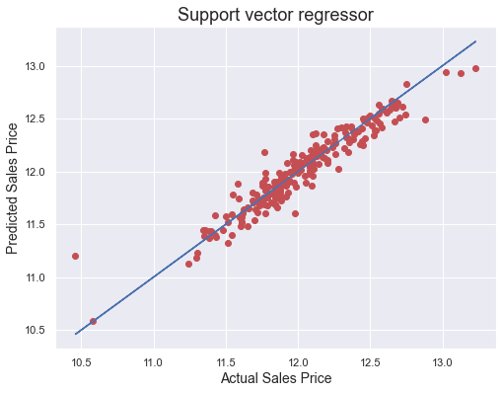
Observations:
SVR performs better and gives optimum results.
After predicting and plotting the predicted data on the best fit line we observe that SVR is accurate.
But when we observe that cv is not better than GBR.

Slide 36
K-nearest Neighbors Regression
KNN regression is a non-parametric method that, intuitively, approximates the association between independent variables and the continuous outcome by averaging the observations in the same neighborhood.
The size of the neighborhood needs to be set by the analyst or can be chosen using cross-validation (we will see this later) to select the size that minimizes the mean-squared error.
While the method is quite appealing, it quickly becomes impractical when the dimension increases, i.e., when there are many independent variables.

Slide 37
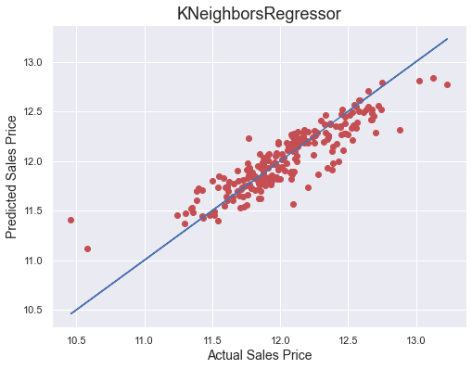
Observations:
1. KNN performs not well and gives no proper results.
2. After predicting and plotting the predicted data on the best fit line we observe that KNN is far behind from remaining algorithms.

Slide 38
Concluding Remarks.
So, our Aim is achieved as we have successfully ticked all our parameters as mentioned in our Aim Column. It is seen over time as the most effective attribute in predicting the Attrition and that the Gradient Boosting Regression is the most effective model for our Dataset with an R2 score is 0.9055.
The best model is Gradient Boosting Regression. Since the difference between the percentages score of cross-validation and R2_score is optimum.

Slide 39
At CV: - 9
R2 Score: 90.55288176914567
Cross Val Score: 88.64708889146074
That's it! We reached the end of our presentation.
Throughout this kernel, we put in practice many of the strategies for predicting the prices of the house. We philosophized about the variables, we analyzed 'Sale Price' alone and with the most correlated variables, we dealt with missing data and outliers, we tested some of the fundamental statistical assumptions and we even transformed categorical variables into dummy variables. That's a lot of work that Python helped us make easier.

Slide 40
Thank you

