Slide 1
Intelligent content based Logo Retrieval System for Industrial Application
Kunal Dilip Chandiramani, Rishabh Verma
School of Computer Science Engineering
Vellore Institute of Technology,
Chennai, India

Slide 2
INTRODUCTION
In industries categorization of invoices in a major problem which happens manually and consumes a lot of time.
This problem can be eradicated by automating the process by categorizing these invoices using content based image retrieval techniques. In this paper our main objective is to develop an efficient system to extract the logo out of the invoices and identify the organization it belongs to.
To develop this system, we will use OpenCV library in python.
This system will not only significantly reduce the time to categorize invoices manually but also will help reduce the human errors.

Slide 3
LITERATURE SURVEY
Extracting images from PDF documents has been a topic of research interest. Images that include complex vector graphic elements, text, and other pictorial graphic elements are particularly challenging.
Xu[1] proposed a method to segment graphics embedded in a PDF document using a layer based document analysis method.
Shao[2] proposed a method to recognize and classify diagrams in vector-based PDF documents.
Lin[3] proposed a method to identify mathematical formulas using rule-based and learning-based methods.
Doermann et al. [4] use a combination of text, shape, and global and local affine invariants for logo recognition.

Slide 4
METHODS AND MATERAILS
Dataset: The dataset FlickrLogos-32 contains photos showing brand logos and is meant for the evaluation of logo retrieval and multi-class logo detection/recognition systems on real-world images. The dataset consists of total 1060 images and there are 32 different logo brands by downloading them from Flickr.
we have used pointers in python to extract the logo from the invoice and used a content based image retrieval system to recognize the logo. Next, We have developed two methods for image matching:
HSV Based Feature Extraction
HOG based Feature Extraction

Slide 5
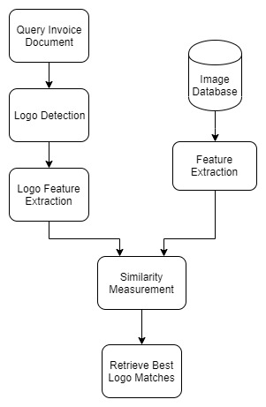
FLOWCHART OF WORKING

Slide 6
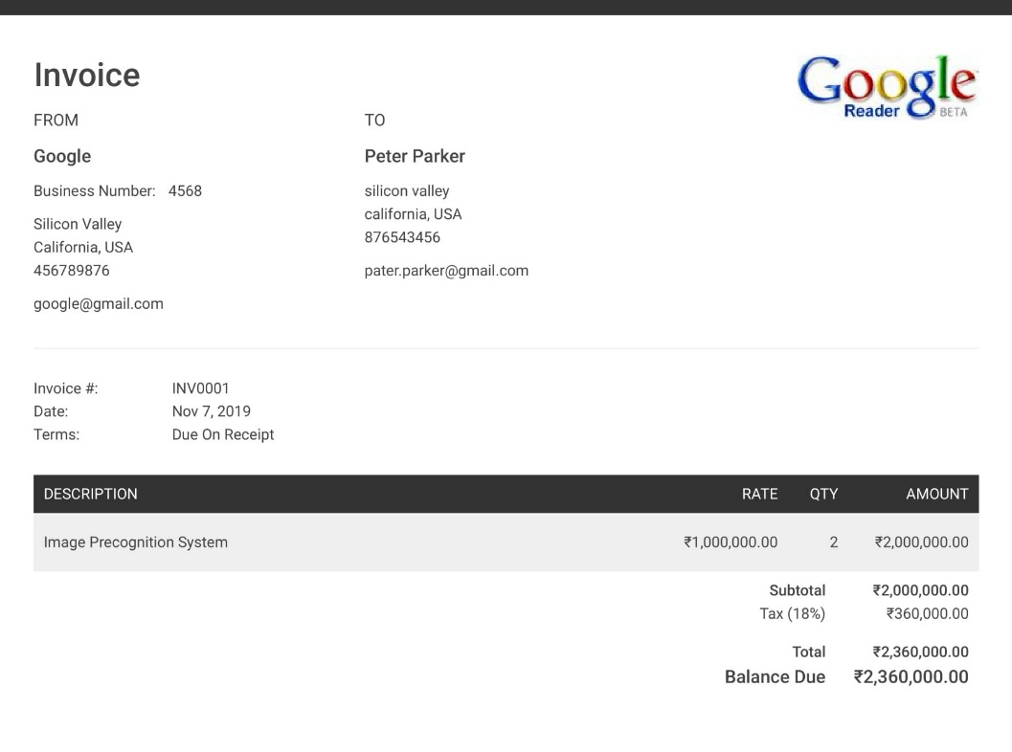

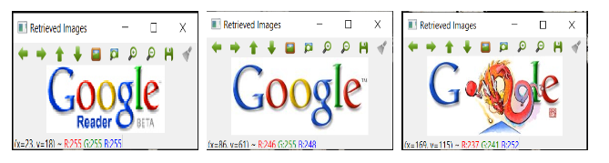
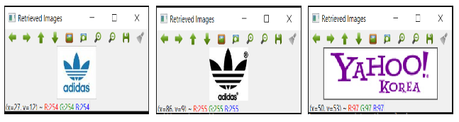
RESULTS
METHOD 01: HSV Based Model
METHOD 02: HOG Based Model
Query Invoice
Query Invoice
Retrieved Images
Retrieved Images

Slide 7
CONCLUSION
In this paper we have proposed an efficient invoice categorization system by extracting logo from these invoices and using content based image retrieval system to recognize it.
Although both the method performed well for the system but using HOG based features for logo detection has a problem, Histogram of gradient based method is not scale invariant.
In histogram of gradients based method the system calculates the features based on the size of the image i.e if the size of an image is big the length of the feature vector is large while if the size of the same logo image is small the length of the feature vector is small.
Because of this issue in HOG based method for logo detection, Hue saturation value based method performs better for intelligent logo retrieval system since it is scale invariant.

Slide 8
REFRENCES
1] Xu, C., Tang, Z., Tao, X., Shi, C., ”Graphic composite segmentation for PDF documents with complex layouts,” Document Recognition and Retrieval XX, Proceedings of SPIE 8658, 86580E1-86580E10 (2013)
[2] Shao, M., Futrelle, R., P., ”Recognition and classification of figures in PDF documents,” in Graphics Recognition. Ten Years Review and Future Perspectives. LNCS, 239-251 (2006).
[3] Lin, X., Gao, L., Tang, Z., Lin, X., Hu, X., ”Mathematical formula identification in PDF documents,” 2011 International Conference on Document Analysis and Recognition, 1419-1423 (2011)
[4] D. Doermann, E. Rivlin I. Weiss. Logo Recognition Using Geometric Invariants. International Conference on Document Analysis and Recognition (ICDAR), pp. 894-897, 1993.
[5] G. Zhu and D. Doerman. Automatic Document Logo Detection. IC-DAR, pp. 864–868, 2007.

Slide 9
THANKYOU

