Slide 1
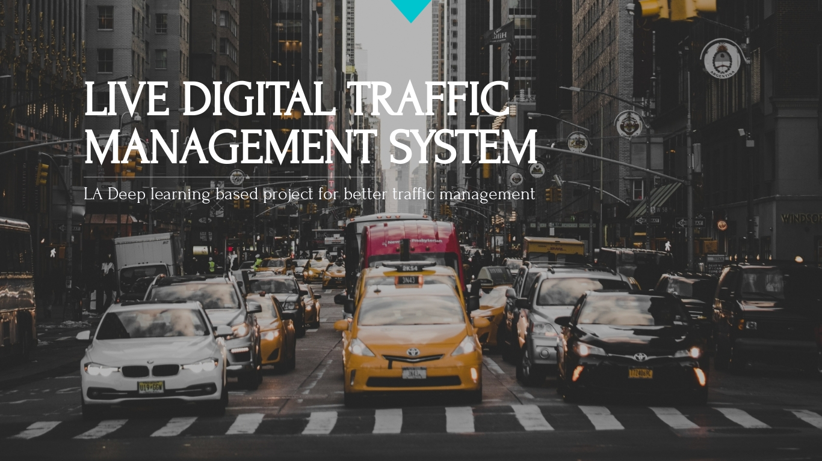

Slide 2
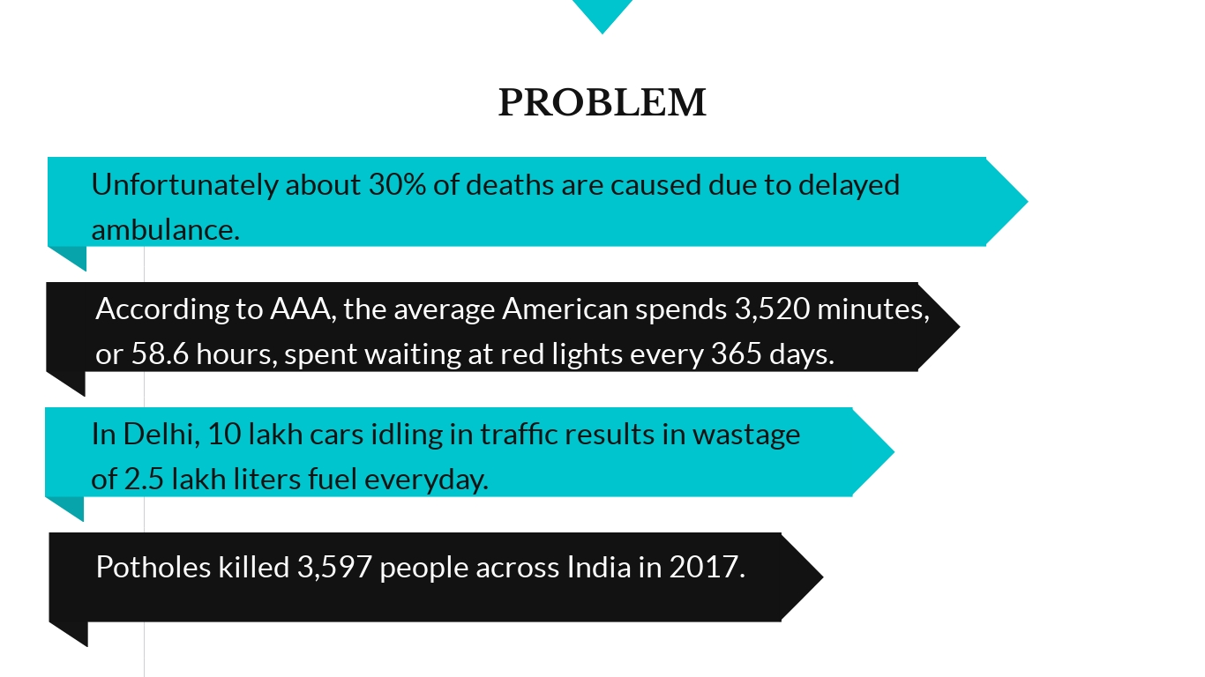

Slide 3
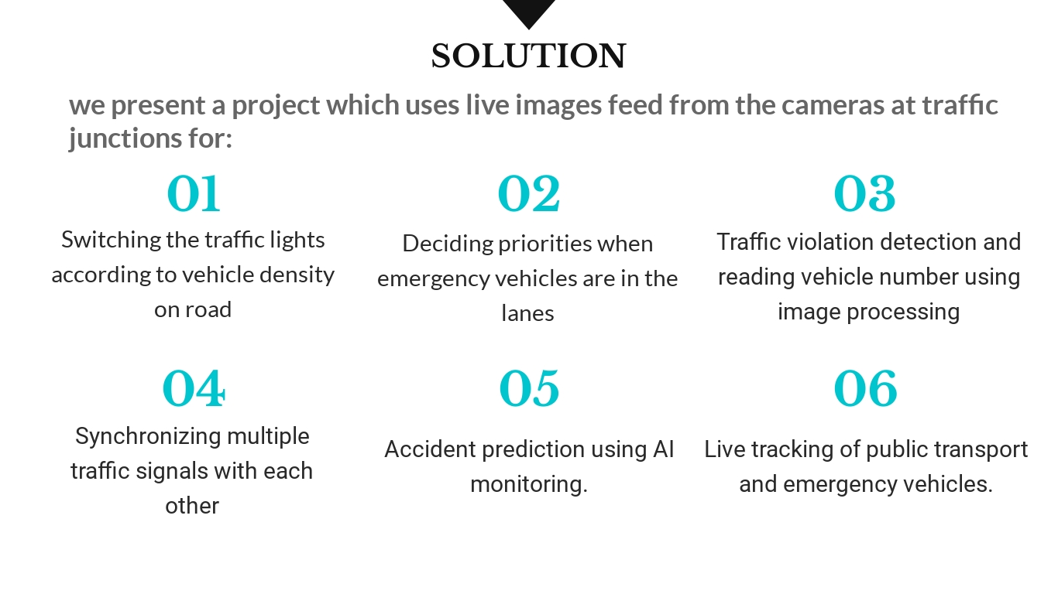

Slide 4
CURRENT STATE
These technologically advanced system methods to solve traffic congestion are not used widely in real world specially in countries like India where timers at traffic signals are static or hardcoded irrespective on traffic density n roads.
However, there are serval proposed methodologies for traffic management based on detecting traffic densities using infrared sensors but not much work is done on traffic management using image processing.

Slide 5


