Slide 1

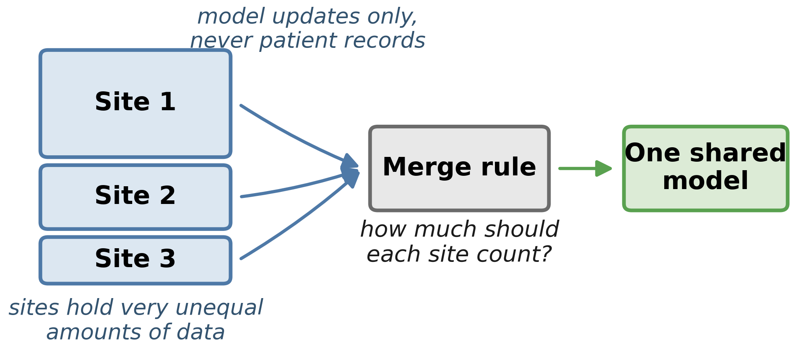
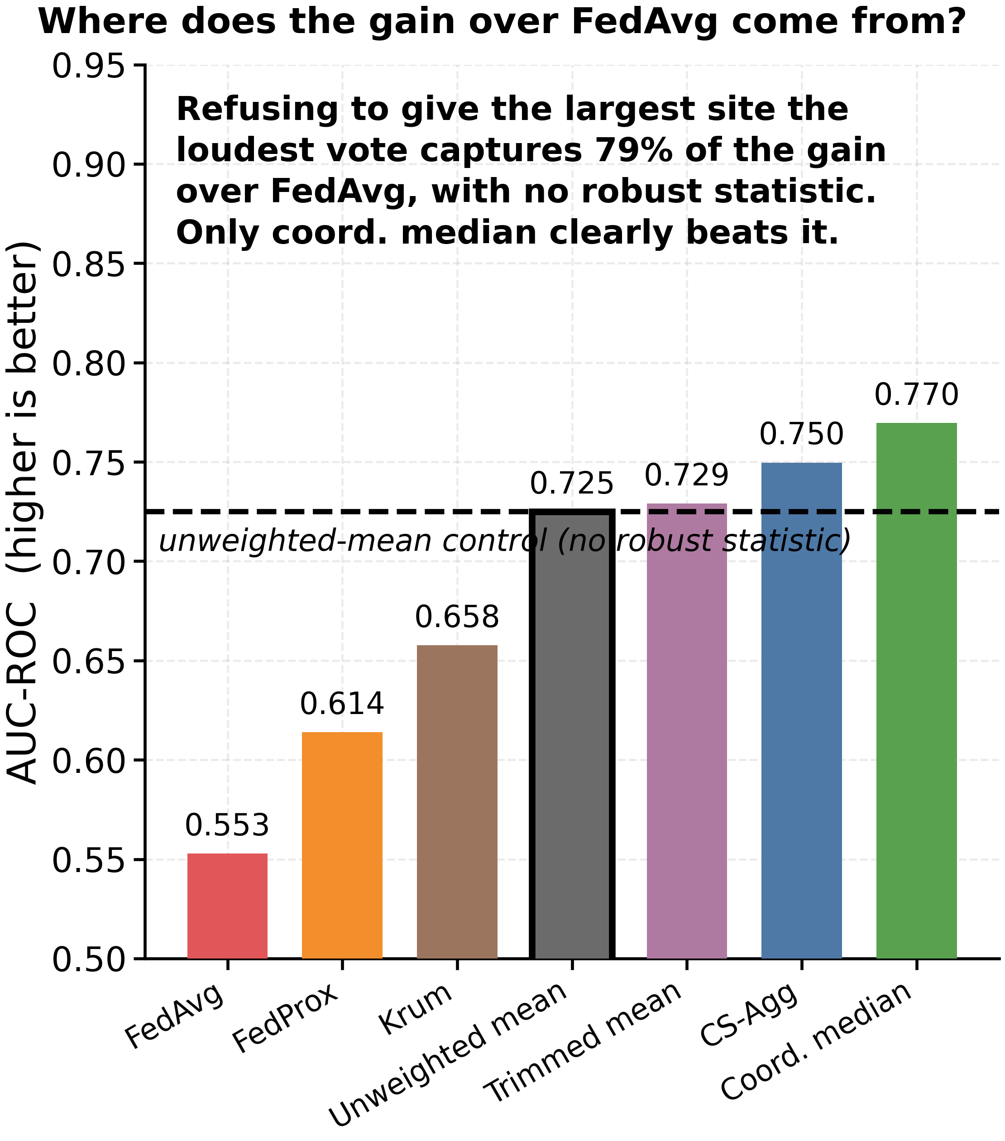
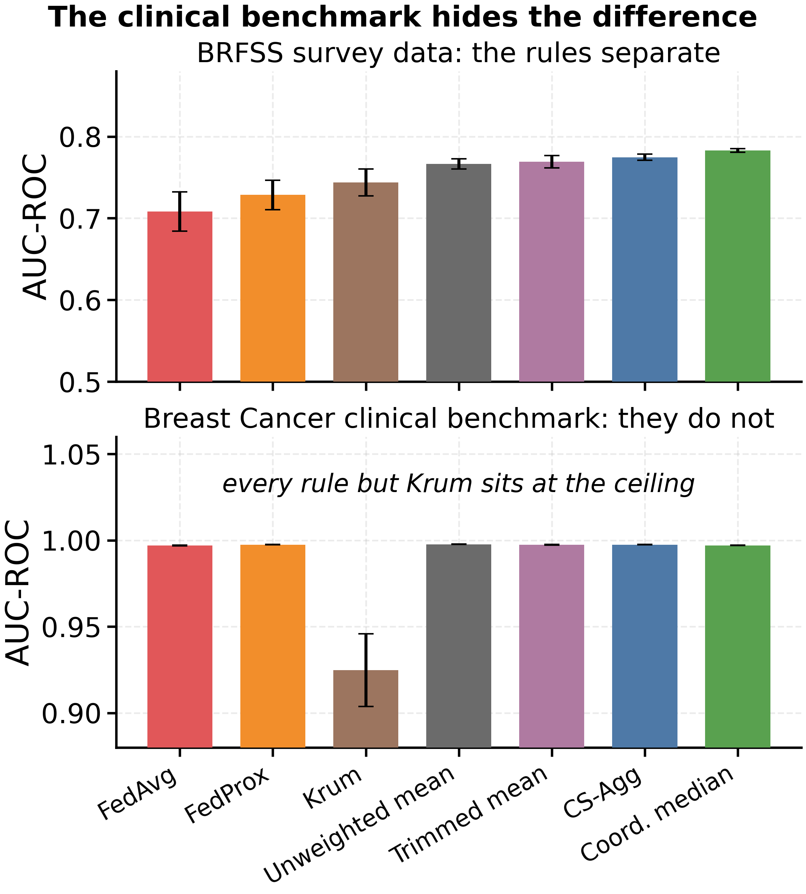
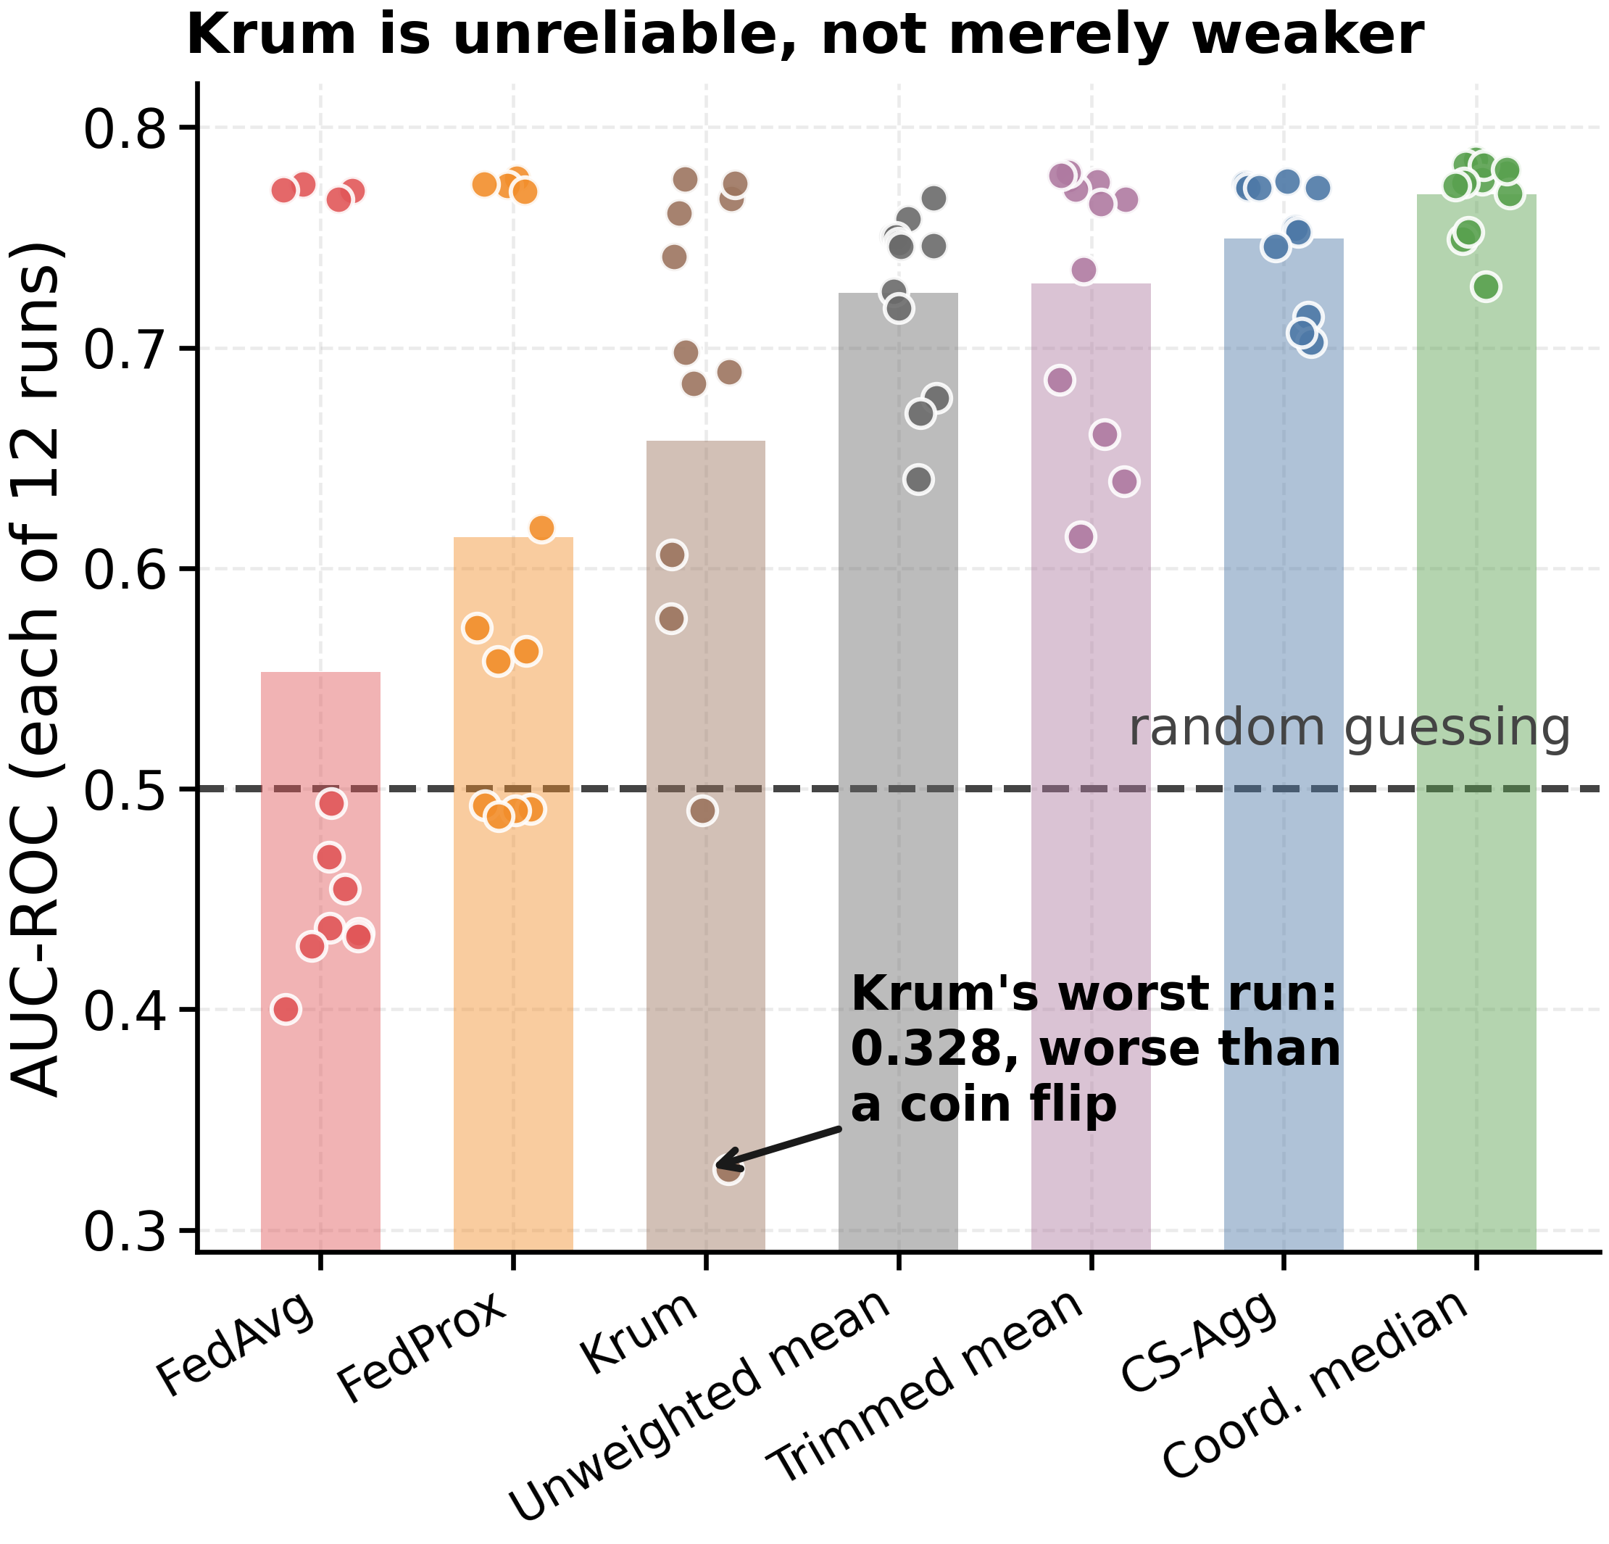

Robustness or Weighting? Re-Evaluating Federated Aggregation on Heterogeneous Health Data
Kunal Chevuri and Dr. Mohammed Aledhari
University of North Texas
Hospitals cannot share patient data. Federated learning gets around that. We found the field is crediting the wrong thing.
INTRODUCTION
Hospitals, clinics and health agencies each hold records that could sharpen how we predict disease. Privacy law keeps them from pooling those records in one place.
Federated learning is the workaround, sketched below. The merge step is the real design decision, because real sites are lopsided and self-reported health data arrives with errors.
RESULTS
Every rule below is scored against the unweighted-mean control, not against FedAvg alone. Figures show BRFSS at the harshest split (alpha = 0.1) unless the panel says otherwise.
Reading the charts. AUC-ROC measures how well the model tells apart people who have depression from people who do not. 0.5 is a coin flip, 1.0 is perfect.
KEY FINDINGS
1. Most of the benefit is bookkeeping, not robustness. Simply declining to over-weight the biggest site recovers 79 to 98 percent of everything the three strongest robust rules gain over FedAvg.
2. Only one rule earns its keep. Coordinate-wise median clears the control by +0.0163 AUC (p < 0.0001). Trimmed mean's +0.0026 is real but too small to matter, and CS-Agg cannot be told apart from the control at all (p = 0.22).
3. A popular rule does worse than doing nothing. Krum lands below the control, and on one run collapses to 0.328 AUC, worse than a coin flip, from a rule chosen for its robustness.
4. Lopsided data hurts far more than broken labels. About a hundred times more. That gap narrows when each site tracks more health variables, but it never closes.
5. A clean benchmark would have hidden all of this. On Breast Cancer every rule but Krum reaches 0.997 AUC or better, where no difference is visible. Messy self-reported population health data is where these rules actually separate.
PURPOSE
Robust merge rules are always scored against FedAvg, which weights each site by how many records it holds. In effect the biggest site gets the loudest vote. Robust rules drop that weighting entirely, so two things change at once.
The question. When a robust rule wins, is it the robust statistic winning, or just the end of the loudest vote?
METHODS
Seven merge rules, head to head. FedAvg, FedProx, CS-Agg, Krum, trimmed mean, coordinate-wise median, and an unweighted mean we added ourselves as a control.
The control is the experiment. It uses no robust statistic at all, and differs from FedAvg in one respect: it ignores how much data each site holds. Anything it gains is weighting.
The data. CDC's 2023 BRFSS survey, 382,709 U.S. adults, predicting self-reported depression, with Breast Cancer Wisconsin alongside as a clean clinical benchmark. The shared model is a small neural network.
Splitting it up. Each dataset is dealt out to 20 simulated sites, deliberately unevenly. The dial, alpha, sets how lopsided: at alpha = 0.1 one site holds over a third of the data and others hold none.
Breaking the labels. We flip labels at 20 percent of sites, across 0 to 30 percent of their records, only the way real people get it wrong: reporting no depression when they have it.
The scale of it. 624 conditions covering every rule, dataset, split, noise level and seed. 50 rounds each, scored on a clean held-out test set. Holm-corrected Wilcoxon tests throughout.
CONCLUSION
Across the datasets and partitioning studied here, most of the advantage robust aggregators hold over FedAvg comes from how they weight sites, not from the robust statistic they are named for.
What to do about it. Any robustness evaluation run on size-skewed data should include an unweighted-mean control. It is one line of code, and without it a reported gain cannot be credited to robustness.
Why it matters in the field. A rule's reputation is not evidence. Krum is widely cited and failed badly here. Coordinate-wise median is about as simple as merge rules get, and it held.
REFERENCES
[1] McMahan et al. Communication-efficient learning of deep networks from decentralized data. AISTATS, 2017.
[2] Blanchard et al. Machine learning with adversaries: Byzantine tolerant gradient descent. NIPS, 2017.
[3] Yin et al. Byzantine-robust distributed learning: towards optimal statistical rates. ICML, 2018.
[4] Karimireddy et al. Byzantine-robust learning on heterogeneous datasets via bucketing. ICLR, 2022.
[5] Hsu et al. Measuring the effects of non-identical data distribution for federated visual classification. arXiv:1909.06335, 2019.
[6] Centers for Disease Control and Prevention. BRFSS 2023 survey data and documentation.
CODE & DATA
Code, data and the full experimental harness are open, with a script that re-checks every number on this poster.
osf.io/d5u2q

