Slide 1
SUMMER INTERNSHIP PROJECT
AT SAMSUNG R&D ,NOIDA
Kunal Dagar

Slide 2
Content:
Objective
Learnings
Uses
Implementation Assignment
Burster Game
Conclusion

Slide 3

OBJECTIVE:
To develop a Shape Bursting game using frontend , for Samsung products .

Slide 4
Learnings:
Learned the basics of HTML , CSS , Javascript .
Created a webpage using HTML and using the attributes only to design the web page and for the interaction.
Did an assignment to gain confidence in what i was learning and learned more about CSS and Javascript to create different files for each of them and use them accordingly to perform different changes on the web page .
Learned React js as it makes easier to design a web .

Slide 5
Uses:
Css - Used to randomise balloon positions and their animations
HTML - Used this to divide the window into different containers and then use them to add features to the game
Javascript - To make the game window interactive and to add the features of bursting, sounds , timer , score, etc.
React - To break down an interface into reusable components that allow you to build dynamic user interfaces, to make

Slide 6
Implementation Assignment
The objective behind this assignment was to learn how to use html , css and javascript together.
HTML :- Divided the page in two containers i.e. left and right , Left contains the list of title of the images and right shows the image you choose .
CSS :- I used CSS to assign the box dimensions, margin , relative positions ,etc.

Slide 7
Implementation Assignment
Javascript :-
Added event listener to each and every title to which shows the Image corresponding title in the right container .
Used Innertext and textinput to change the title of the image , One can edit the text just the changing the caption of the image .
Added event listener with keydown event so that one can navigate through the images not only by clicking the titles but by pressing the keydown button on the keyboard
Using the hovering attribute , it highlights the title corresponding to the image shown in the right container.

Slide 8
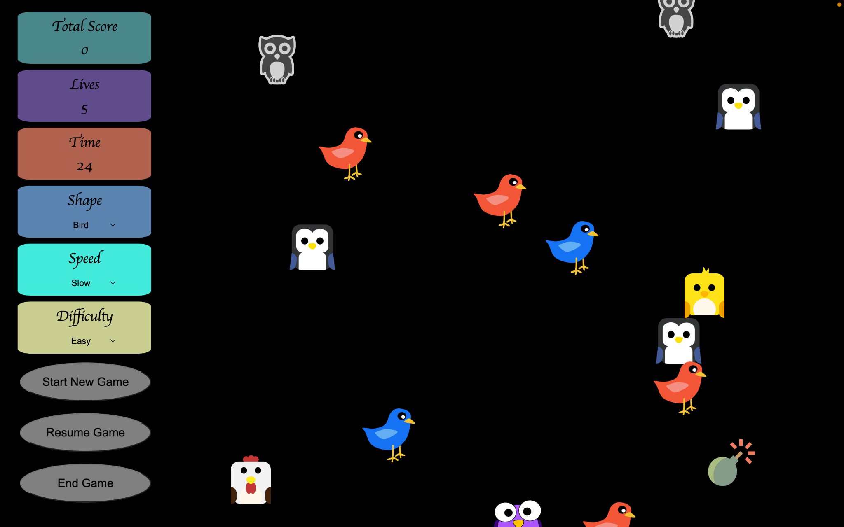
Burster Game
Goal of this game is to pop as many objects as possible
You can select the settings to play the game from the left shown features .
Click Start New Game to play the game , Pause game to pause the game and the same button changes to resume button after pausing the game and press end game to end the game.

Slide 9
Burster Game
Divided the window into 2 containers , i.e. Game info (which contains the divs to take input for playing the game) and Game Window (in this containers the objects are there which floats from bottom to top).
Game window :- In this I created a time loop and after a particular interval divs of different categories are added to the ballon window using append() function .
Game info :- This contains Different divs which has choices for the different features of the game to make it interesting

Slide 10
Objects
The shape of the objects is the input from the shape div in the game info and based on that i used backgroundImage and random to assigns the svgs to the div based on the input.
I used a select tag to get the shape input , there are three choices and based for every shape there are no. of images from which random function chooses to assign to a particular div .
There are bomb and bonus objects as well .
The objects get removed by clicking , i used .parentNode().removechild() function to remove the div clicked from the game window.

Slide 11
Bursting
I used event listener to add the feature which removes the object from the window by using the removechild() function and increases the score by 1 and used audio.play() to play the sound whenever the object is bursted.
If we click on the bomb then the lives decreases by 1 and when we click on the bonus the timer increases by 5 seconds , score increases by 1 and different sounds are played for different objects . I Did this using event Listener
I created addrandom() function to create surprise elements , used hovering attribute and random function to change the object shape to bomb or bonus based on the output from random function.And then it shows the properties of the that shape.

Slide 12
Floating
I created a pushbottom() function which pushes the bottom of every object from bottom to top.
Every object in game window is stored in a array , so i run a loop Over all the objects and push the bottom up , so it seems to flow.
I used this.balloons[i].style.bottom = (parseInt(this.balloons[i].style.bottom, 10)+4)+'px'; to make the balloon flow .

Slide 13
Game Info:-
Shape , Difficulty and Speed:-
I used a select tag to create a drop down list to choose the feature you want .
Added event listener to it which helps in taking the input and provides it to make changes in game window
In Speed i used different no. based on which the time interval for changing the bottom of objects changes and appears as speed has changes
In difficulty i used different no. based on which the time interval for adding the object to the gamewindow and the density of the objects changes , making it look as if the difficulty has changed

Slide 14
Game Info:-
Timer , Lives:-
I used a input tag with type attribute set to number to take the input for these .
In timer i added a setInterval() method with a interval of 1000ms and in it i added an eventlistener to the div of timer which updates the time every second .
I also added a timer alert sound for the last 5 seconds , for this in the same event listener i added an if statement for timer less than 5 and used audio.play() to play the sound , and the timer gets updated for every bonus object bursted.
For lives as well i added an event listener which changes (decreases ) the no. of lives whenever you click on the bomb.

Slide 15
Game Info:-
Start , Pause and End Buttons:-
Whenever we click on start button, a function is called , which gets input every setting of the game , calls the setintervals for adding objects, bomb,surpriselements ,bonus objects and also calls the setinterval for the time to begin.
For the Pause button, whenever we click on it , all the setIntervals are cleared using clearInterval() and the text on the button changes to Resume Game and the event listeners are disabaled so that one can’t increase the score and timer also stops.
When we click on the Resume button Everything we disabled using pause button is enabled again.
For the end button ,by clicking it calls a function end() which clears all the Intervals, removes all the objects from balloon window ,sets the settings to as it were before starting .

Slide 16
Game END
Game ends when either the lives becomes 0 or the timer .
When the game ends then there are 3 alert messages which are :
Game Over
Your Score is ____
Before starting new game please enter the details and switch to full screen

Slide 17
CONCLUSION:
I was able to create the whole game using just the HTML , CSS and JavaScript .
I made it interactive and removed each and every bug i found .
Worked fine when tested on different devices with different resolutions and screen sizes.
Added various modes to add variety to it and make it interesting and at the same time competitive as well.

