Slide 1
ETL Jobs using AWS Glue
Understandings

Slide 2
EMR
Amazon EMR is the industry-leading cloud big data platform for processing vast amounts of data using open source tools such as Apache Spark, Apache Hive, Apache HBase, Apache Flink, Apache Hudi, and Presto.
Amazon EMR makes it easy to set up, operate, and scale your big data environments by automating time-consuming tasks like provisioning capacity and tuning clusters.

Slide 3
EMR Advantages
Easy to use
Low cost
Elastic
Reliable
Secure
Flexible

Slide 4
EMR Usage
Machine learning
Extract, transform, load (ETL)
Clickstream analysis
Real-time streaming
Interactive analytics
Genomics

Slide 5
Data Lake
A data lake is a centralized, curated and secured repository of all raw and processed data for analysis.
A data lake enables us to break down data silos and combine different types of analytics to gain insights and guide better business decisions.

Slide 6
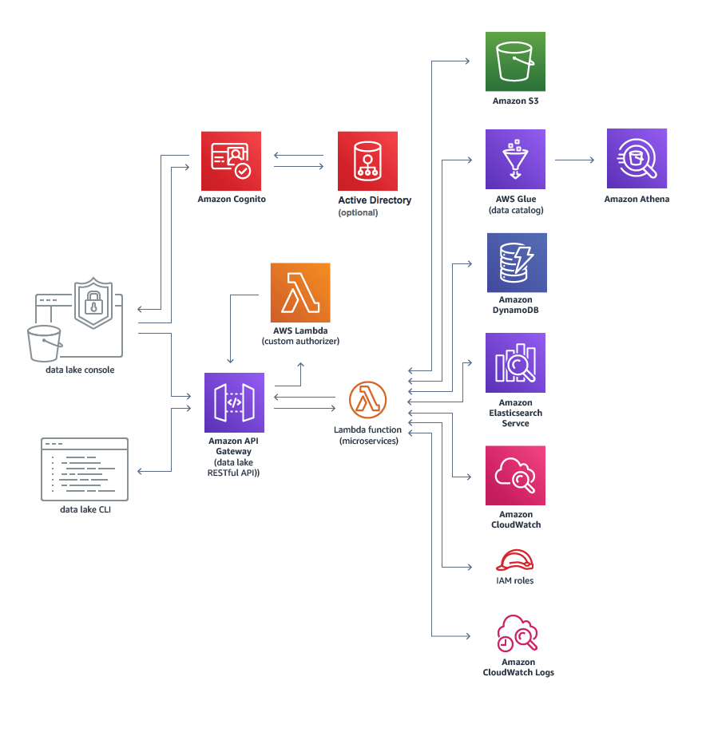
Data Lake Template

Slide 7
Process of Building Data Lake
Select data source – HDFS
Select services to process and query data
Use AWS higher-level services to subsequently further process and transform the data.

Slide 8
Key Data Lake Services
Athena – Serverless SQL on parquet data
Glue – Serverless ETL to run Apache Spark job on scale
Data lake – CFT/CDK templates to build the lake
Lake Formation – Superset of Glue and Security patterns

Slide 9
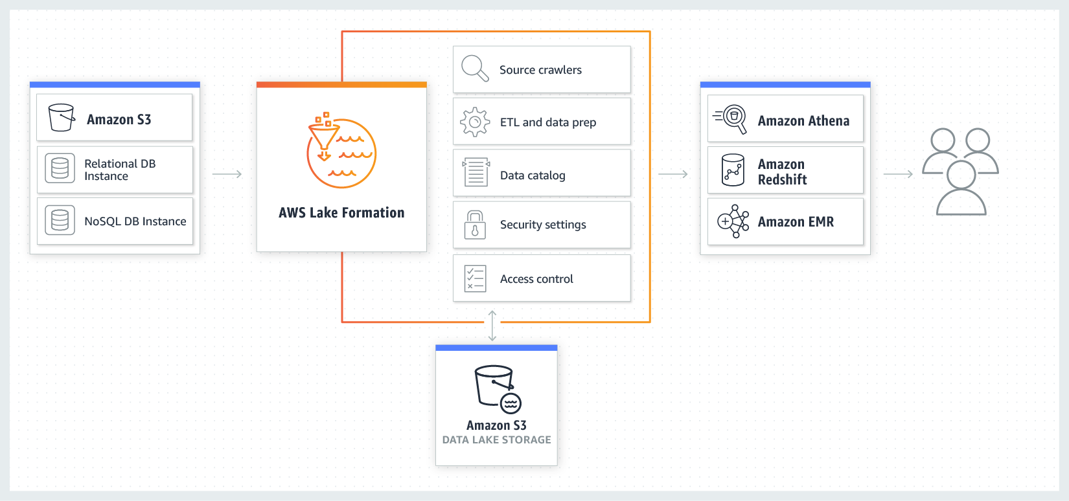
AWS Lake Formation

Slide 10
AWS Athena
Athena is an interactive query service that allows us to query data from S3 without the need for clusters or data warehouses.

Slide 11
Data Formats in Athena
Apache Web Logs
CSV
TSV
Text file with custom delimiters
JSON
Parquet
ORC

Slide 12
Glue Connections
AWS Glue Connection is used to connect to different data sources

Slide 13
Glue Connections Types
JDBC
Amazon RDS
Amazon Redshift

Slide 14
Glue Crawlers
AWS Glue Crawler is used to put a structure on top of the connection retrieved information.

Slide 15
Glue Classifiers
A classifier determines the schema of crawler retrieved data.

Slide 16
Glue Classifiers Types
Grok
XML
JSON
CSV

Slide 17
Glue ETL Workflow
Glue ETL workflow is used to orchestrate ETL jobs, triggers and crawlers.

Slide 18
Glue ETL Workflow Legends
Start
Trigger
Job
Crawler

Slide 19
Glue Jobs
Jobs are scalable serverless Spark jobs.

Slide 20
Glue Jobs Types
Spark
Spark Streaming
Python Shell
Notes:
Spark is extremely fast distributed data processing that runs in the memory of the worker nodes

