Slide 1

ETL Jobs using AWS Glue
Understandings

Slide 2
EMR
Amazon EMR is the industry-leading cloud big data platform for processing vast amounts of data using open source tools such as Apache Spark, Apache Hive, Apache HBase, Apache Flink, Apache Hudi, and Presto.
Amazon EMR makes it easy to set up, operate, and scale your big data environments by automating time-consuming tasks like provisioning capacity and tuning clusters.

Slide 3
EMR Advantages
Easy to use
Low cost
Elastic
Reliable
Secure
Flexible

Slide 4
EMR Usage
Machine learning
Extract, transform, load (ETL)
Clickstream analysis
Real-time streaming
Interactive analytics
Genomics

Slide 5
EMR Cluster used
Core Hadoop: Hadoop with Ganglia + Hive + Hue + Mahout + Pig + Tez
HBase: HBase with Ganglia + Hadoop + Hive + Hue + Phoenix + ZooKeeper
Presto: Presto with Hadoop + HDFS + Hive + Metastore
Spark: Spark on Hadoop + YARN with Ganglia + Zeppelin

Slide 6
Data Lake
A data lake is a centralized, curated and secured repository of all raw and processed data for analysis.
A data lake enables us to break down data silos and combine different types of analytics to gain insights and guide better business decisions.

Slide 7
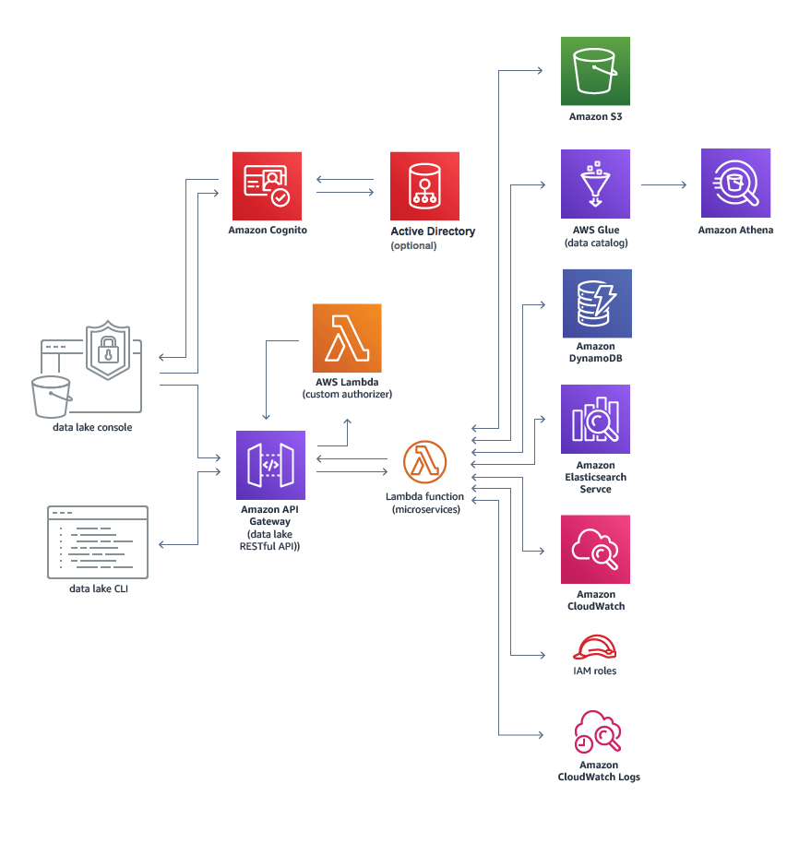
Data Lake Template

Slide 8
Process of Building Data Lake
Select
Select data source – HDFS
Select
Select services to process and query data
Use
Use AWS higher-level services to subsequently further process and transform the data.

Slide 9
Key Data Lake Services
Athena – Serverless SQL on parquet data
Glue – Serverless ETL to run Apache Spark job on scale
Data lake – CFT/CDK templates to build the lake
Lake Formation – Superset of Glue and Security patterns

Slide 10
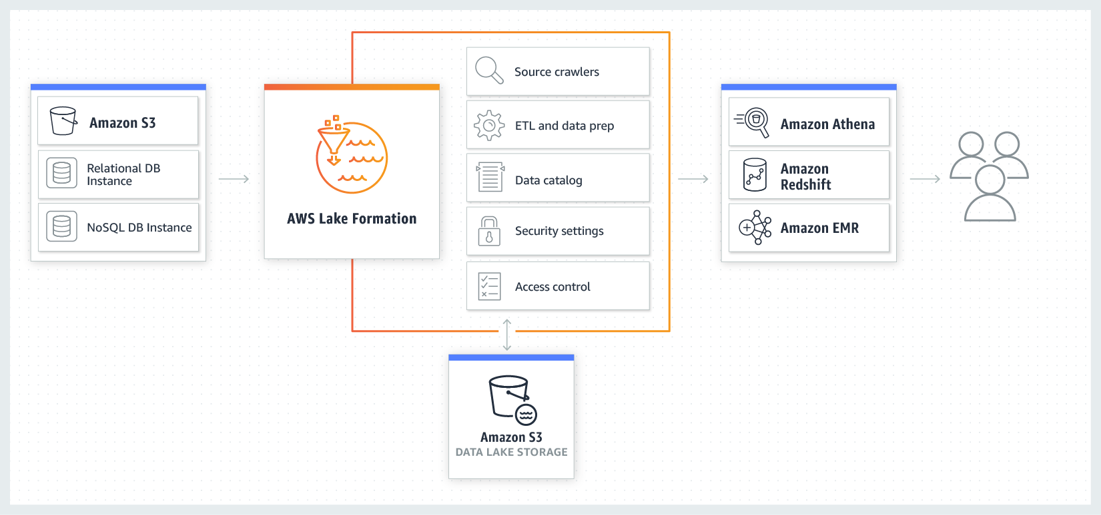
AWS Lake Formation

Slide 11
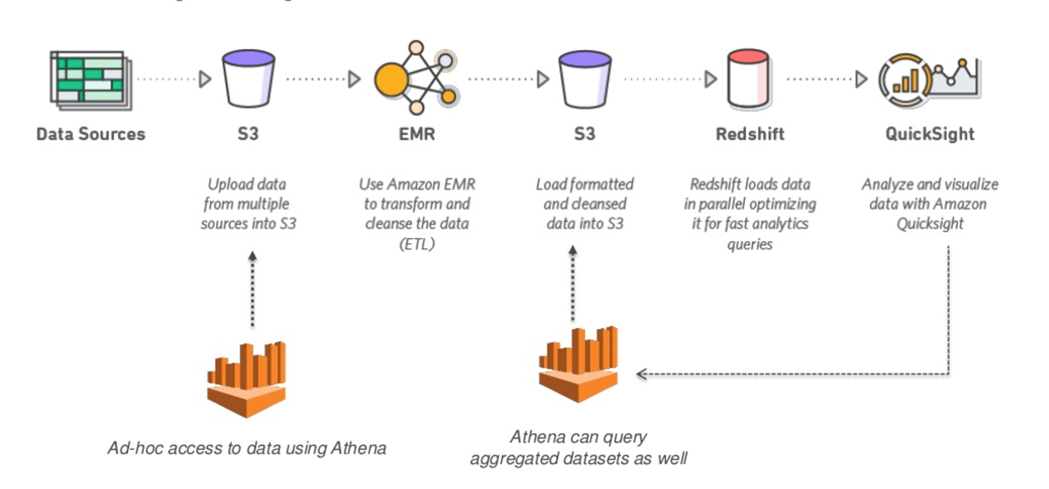
AWS Athena
Athena is an interactive query service that allows us to query data from S3 without the need for clusters or data warehouses.

Slide 12
Data Formats in Athena
Apache Web Logs
CSV
TSV
Text file with custom delimiters
JSON
Parquet
ORC

Slide 13
AWS Glue
AWS Glue is a serverless data integration service that makes it easy to discover, prepare, and combine data for analytics, machine learning, and application development.

Slide 14
Glue Components
Data catalog
Databases
Tables
Connections
Crawlers
Classifiers
Schema Registries
Schemas
ETL
AWS Glue Studio
Blueprints
Workflows
Jobs
ML transforms
Triggers
Dev endpoints
Notebooks

Slide 15
Glue Connections
AWS Glue Connection is used to connect to different data sources

Slide 16
Glue Connections Types
JDBC
Amazon RDS
Amazon Redshift
Amazon DocumentDB
Kafka
MongoDB
Network

Slide 17
Glue Crawlers
AWS Glue Crawler is used to put a structure on top of the connection retrieved information.

Slide 18
Crawler source types
S3
JDBC
DynamoDB
Amazon DocumentDB
MongoDB

Slide 19
Glue Classifiers
A classifier determines the schema of crawler retrieved data.

Slide 20
Glue Classifiers Types
Grok
XML
JSON
CSV

Slide 21
Schema Registries
A registry is a logical container of schemas. Registries allow you to organize your schemas, as well as manage access control for your applications.
A registry has an Amazon Resource Name (ARN) to allow you to organize and set different access permissions to schema operations within the registry.

Slide 22
Schemas
A schema defines the structure and format of a data record. A schema is a versioned specification for reliable data publication, consumption, or storage.

Slide 23
Glue ETL Blueprints
A blueprint is used to generate AWS Glue workflows for common ETL use case

Slide 24
Glue ETL Workflow
Glue ETL workflow is used to orchestrate ETL jobs, triggers and crawlers.

Slide 25
Glue ETL Workflow Legends
Start
Trigger
Job
Crawler

Slide 26
Glue Jobs
Jobs are scalable serverless Spark jobs.

Slide 27
Glue Jobs Types
Spark
Spark Streaming
Python Shell
Notes:
Spark is extremely fast distributed data processing that runs in the memory of the worker nodes

Slide 28
ETL Job
ETL is a three-fold process including extract, transform and load.
It is used to transform raw data so it can be used to gain actionable insights.

Slide 29
Extract
Extraction means consolidation of data in required sources like cloud environments, CRM, or external systems.

Slide 30
Transform
After data is collected from its sources, it's in a raw state. It needs to transform to be compatible with the defined standards.
General transformation methods include:
Cleansing
Standardization
Deduplication
Verification
Sorting

Slide 31

Types of Transforms offered out-of-the-box
ApplyMapping
DropFields
DropNullFields
Filter
FindMatches
Join
Map
MapToCollection
Relationalize
RenameField
ResolveChoice
SelectFields
SelectFromCollection
SplitFields
SplitRows
Unbox

Slide 32
Load
In this fold transformed data is saved in a data sink.

Slide 33
ML Transforms
We can use this to fuzzy match records and perform transformation using pre-built ml transform models.

Slide 34
Triggers
A trigger starts a job when it fires.

Slide 35
Trigger Types
Schedule
Job events
On-demand
EventBridge event

Slide 36
Dev Endpoints
A development endpoint is an environment used to develop and test your AWS Glue scripts.
Billing for a development endpoint is based on the Data Processing Unit (DPU) hours used during the entire time it remains in the READY state.

Slide 37
Notebooks
A notebook enables interactive development and testing of your ETL scripts on a development endpoint.

Slide 38
Notebook Types
SageMaker Notebooks
Zappelin Notenook Servers

Slide 39
Demo1

Slide 40
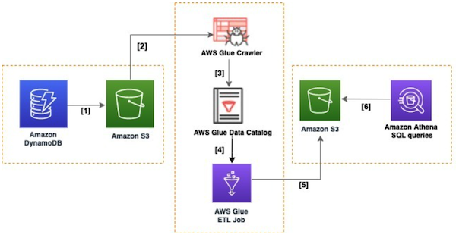
Analysis of a DynamoDB Table
Enable point-in-time recovery (PITR) on DynamoDB table
Initiate a data export in Amazon S3
Transform the exported data into Apache Parquet by using AWS Glue
Execute SQL queries with Athena

Slide 41
Demo2

Slide 42
Perform ETL Job
Resources Deployed using Serverless, CDK/CFT
Create a DynamoDB table
Create a Lamda Function to populate the database
Create a S3 Bucket to export the database
Create a Glue Database for crawler
Create a Glue target Table
Add a crawler to create a data catalog
Add a job to perform ETL
Analyze results from Athena

Slide 43
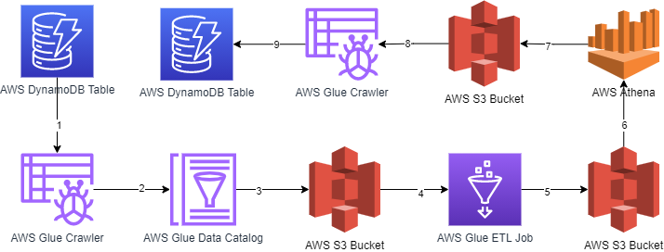
Architecture of Demo2

