Slide 1
Econometric Model for Time Series Analysis

Slide 2
Auto-Regressive Moving Average(ARMA)
Auto-regression (AR) –
Captures the impact of lagged values in the time series i.e. regression between - Y_{T}, Y_{T-t}
Moving Average (MA) -
Market shocks are measured by moving average of the model.

Slide 3
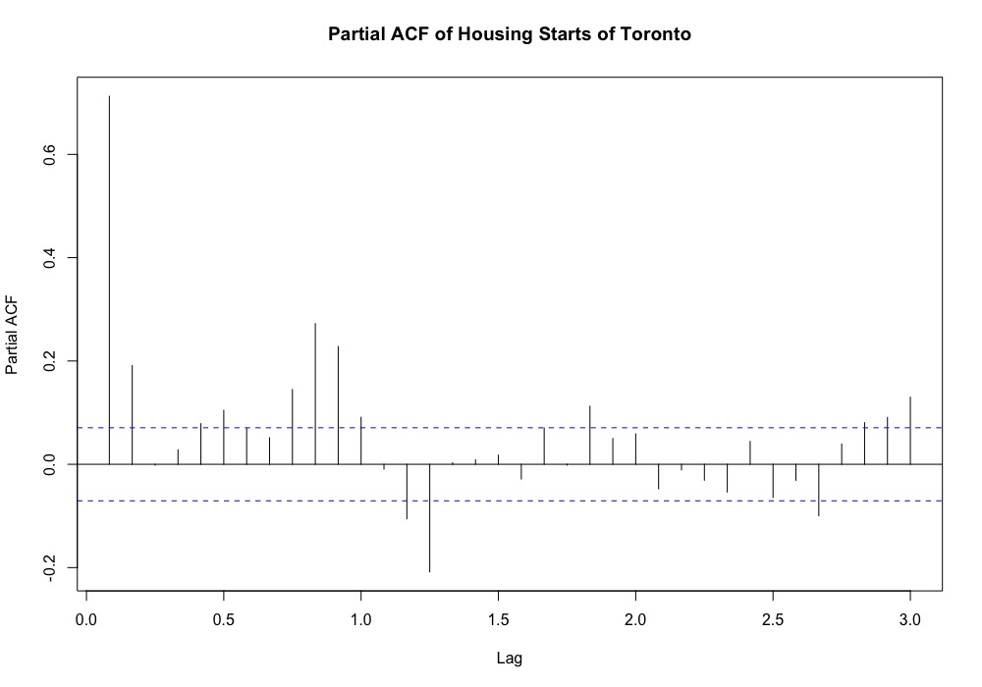
Seasonality Test

Slide 4
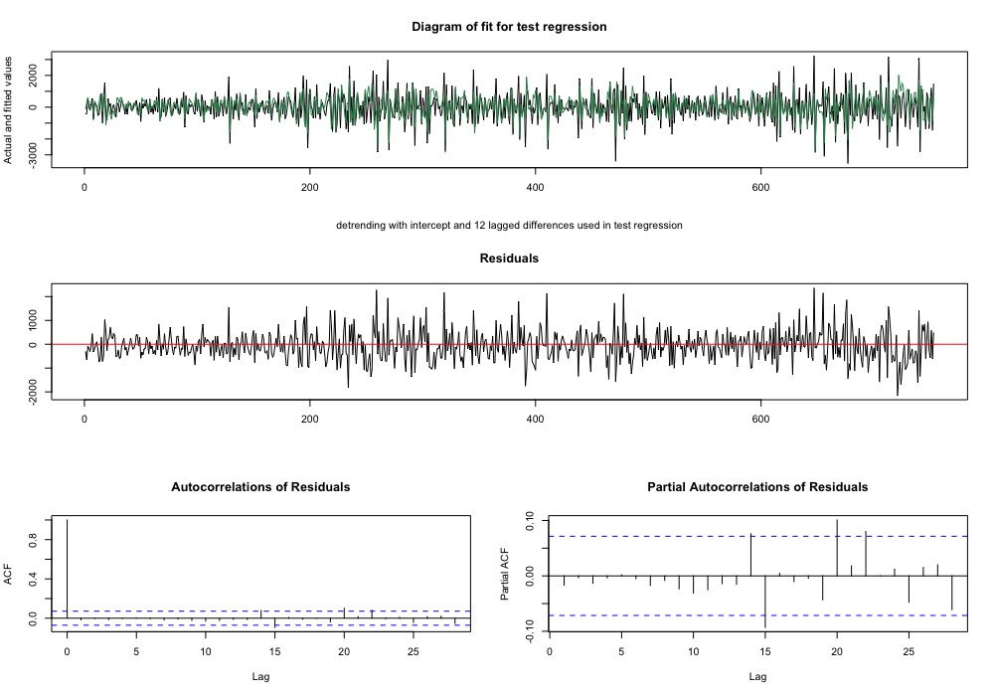
Test for Suitability of the Data for ARMA analysis

Slide 5
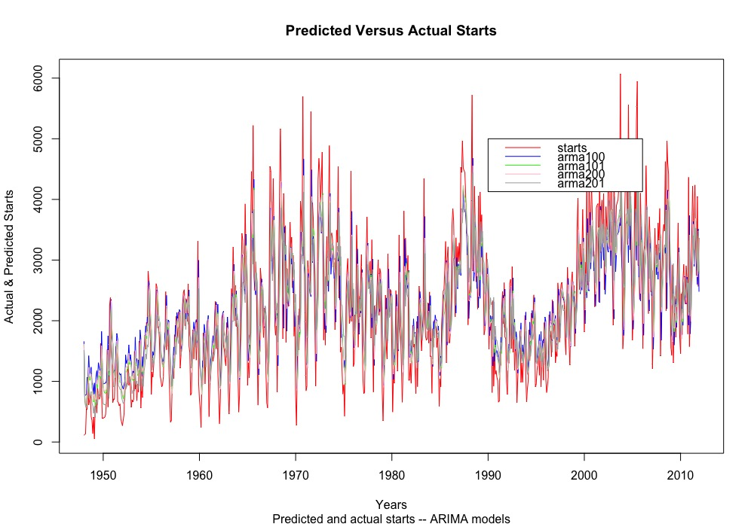
Training Data
ARMA models in different lag and moving average values successfully captures the nonlinear nature of the housing market.

Slide 6
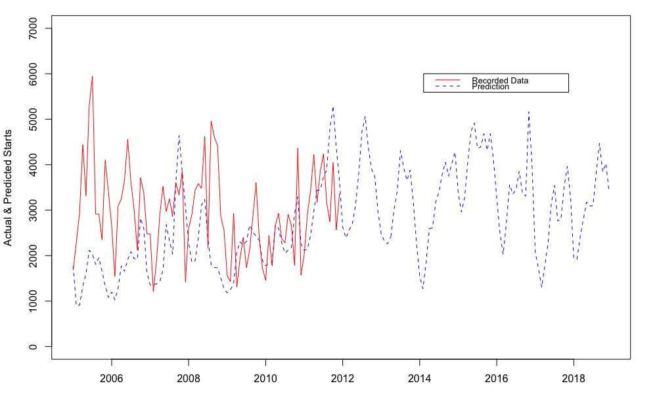
Testing Model on Test Data Set (Jan 2004-Dec 2011)

Slide 7
