Slide 1

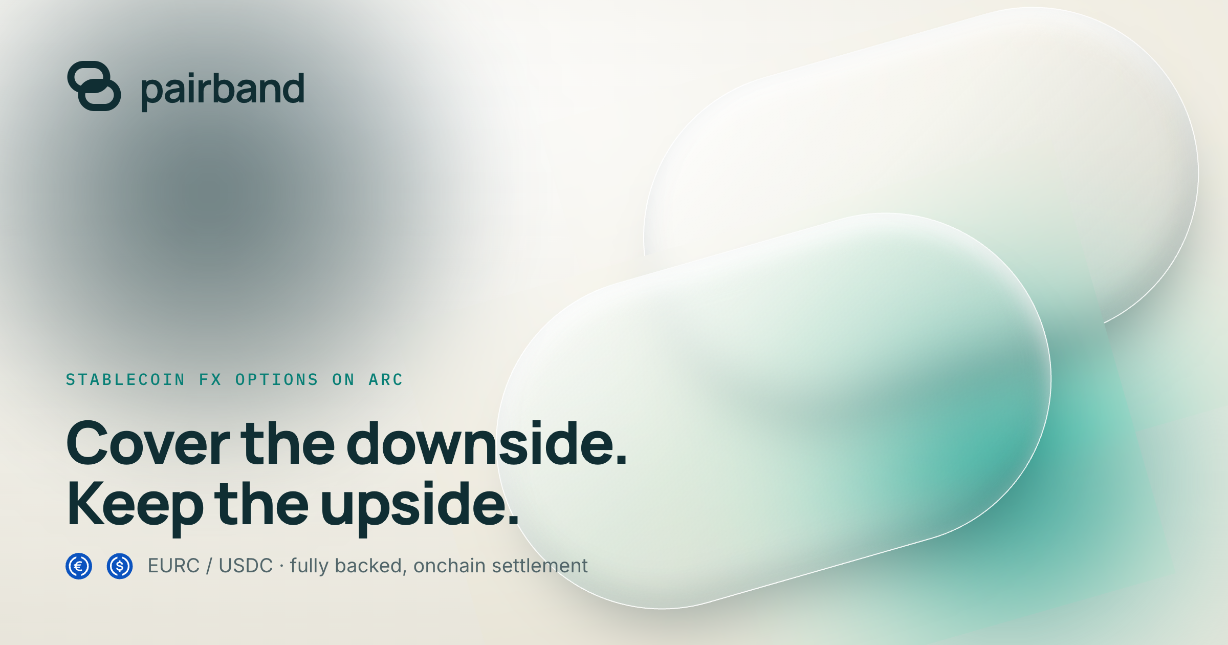
PAIRBAND
Launch in USDC.
Graduate to a book.
The Arc-native launchpad: bonding curve → locked Uniswap LP → on-chain order book. Quoted and gas-paid in USDC.
Live on testnet
pairband.com · docs.pairband.com
Connect a wallet on Arc · create, buy, sell on-chain
Pitch deck · Arc testnet live
Mainnet target · 26 September 2026

Slide 2
01 · PROBLEM
Token launches force a bad tradeoff.
Most launchpads quote in volatile gas tokens, trap liquidity, or dump creators into thin AMM books with no real price discovery.
01
02
Volatile quote asset
Liquidity that vanishes
ETH/SOL launches price risk into every buy. Creators and traders manage gas volatility on top of token risk.
Soft locks and unlock cliffs let early LP exit. Graduates land on empty pools with no depth.
03
04
No post-curve market structure
Chain fragmentation
After the curve, price discovery is a thin AMM or a centralized book. No continuous on-chain CLOB on the same ticket.
USDC lives everywhere via CCTP, but launches still demand a single native gas token and a single home chain UX.
pairband.com
2 / 11

Slide 3
02 · SOLUTION
Pairband: USDC-native launch → locked LP → on-chain book.
One ticket. One quote asset. Settlement on Arc — where USDC is gas.
01
02
03
04
USDC in, USDC out
Honest graduation
Book on the same market
CCTP-ready settler
Create, buy, sell, and pay gas in USDC on Arc. No wrapping theater.
At $80 raised, remaining inventory + USDC mint a Uniswap-style pair. LP burns to dead. No unlock cliff.
An on-chain order book opens on graduation. Markets walk price-time; residual hits the pair.
Cross-domain USDC ingest path so buyers can pay from CCTP chains and settle on Arc.
pairband.com
3 / 11

Slide 4
03 · HOW IT WORKS
Three steps. One continuous market.
Create on Arc
01
Name, ticker, optional first buy. 1B supply. $1 USDC launch fee. Quote asset is native Arc USDC — the same token that pays gas.
Fill the USDC curve
02
Constant-product bonding curve. 1.0% protocol + 0.5% creator, taken in USDC. Exit anytime on the curve before it fills.
Book, then Uniswap
03
At $80 the inventory + USDC mint a locked pair. On-chain book opens. Markets walk the book; leftover hits the pair at 0.30%. LP → 0xdead.
pairband.com
4 / 11

Slide 5
04 · WHY PAIRBAND
Not another meme factory. Market structure as product.
Dimension
Typical launchpad
Pairband
Quote asset
Volatile gas token
USDC (gas + quote)
Graduation
Optional / soft lock
Hard threshold · LP burned
Post-curve venue
Thin AMM only
On-chain book + AMM residual
Fees
Opaque token cuts
Transparent USDC fees on curve
Settlement
Single L1/L2 silo
Arc home · CCTP ingest path
UX
Casino chrome
Paper / desk — Pairband brand
pairband.com
5 / 11

Slide 6
05 · TECHNOLOGY
Contracts on Arc. App that speaks them.
On-chain
Application
Stack principles
▸ PairbandLaunchpad — create / buy / sell / graduate
▸ Bonding curve math (constant product, USDC 6-dec)
▸ AmmFactory + pair — LP burned on graduate
▸ On-chain order book (price-time)
▸ Settler — CCTP ingest / settle path
▸ Arc testnet 5042002 · mainnet 5042 ready
▸ TanStack Start + React 19
▸ wagmi / viem wallet path
▸ Discover syncs live launchCount + getLaunch
▸ Create / trade default to Arc txs
▸ Local preview engine mirrors curve math
▸ Docs at docs.pairband.com
▸ No proxies · no delegatecall on launchpad
▸ CEI + reentrancy lock
▸ Fees capped in code
▸ USDC as gas and quote
▸ Same bytecode testnet → mainnet
▸ Ops keys never in the browser
pairband.com
6 / 11

Slide 7
06 · BUSINESS MODEL
Aligned fees in the asset everyone already holds.
$1
1.0%
0.5%
0.30%
Launch fee
Protocol fee
Creator fee
Post-grad AMM
Paid in USDC on create
On curve volume (USDC)
On curve volume (USDC)
Uniswap-style residual
Unit economics that scale with usage
▸ Protocol earns on every curve trade — not on inflationary token emissions.
▸ Creators earn 0.5% of their own volume — incentive to ship real markets, not rug chrome.
▸ Graduation burns LP: Pairband does not extract unlock value from trapped liquidity.
pairband.com
7 / 11

Slide 8
07 · GO-TO-MARKET
Ship where USDC already settles.
Beachhead
Arc builders & USDC-native traders
Live testnet at pairband.com. Docs, smoke markets, wallet-connected create/trade.
Creator wedge
Teams who want locked LP + a real book
Pitch: graduate without unlock politics; keep a CLOB on the same ticker.
Distribution
Arc / Circle / CCTP ecosystem
Co-market with Arc testnet campaigns; CCTP “pay from anywhere, settle on Arc” story.
Content loop
Tape + demos + open contracts
Public DEMO hashes, narrated product video, open ABIs — trust through verify.
pairband.com
8 / 11

Slide 9
08 · LIVE NOW
Check it out on Arc testnet.
CHAIN
pairband.com
Arc Testnet
Connect a wallet on Arc testnet. Create a token. Buy and sell on the live launchpad. Discover syncs on-chain markets.
GRADUATE AT
$80 USDC
✓ Launchpad, AMM factory, settler deployed & verified
✓ Create / buy / sell broadcast on-chain by default
✓ Discover separates live markets from local demo seed
✓ Docs: docs.pairband.com
LAUNCH FEE
$1 USDC
SUPPLY
1,000,000,000
CURVE FEES
1.0% + 0.5%
pairband.com
9 / 11

Slide 10
09 · ROADMAP
Mainnet readiness · launch 26 September 2026
Now
Mid Sep
26 Sep
Q4
Arc testnet live
Hardening
Mainnet launch
Expand
pairband.com
Contracts + app
Load tests
Security review
Arc 5042
Same bytecode
CCTP UX
Creator tooling
Future work: mainnet deploy of identical bytecode, production monitoring, CCTP settle UX polish, creator analytics, optional agent tooling — never at the cost of LP unlocks.
pairband.com
10 / 11

Slide 11
Cover the downside.
Launch the market.
Pairband is live on Arc testnet. Mainnet target: 26 September 2026.
pairband.com
docs.pairband.com · Arc testnet · USDC native

