Slide 1
Analysis on Observation of Species across the globe
Prepared by
Kunal Gokhe MT2309
Famit Dongarwar MT2305

Slide 2
About Dataset
Contains 50 Columns/variables and 1,00,000 data points/observations
Containing various fields related to species identification, taxonomy, and metadata on the observation process.
kingdom, phylum, class, order, family, genus, species and taxonomic classification of the observed organism
decimalLatitude and decimalLongitude provides precise geographic coordinates (latitude and longitude) for each observation, allowing for spatial analysis.
locality and stateProvince provides additional geographic context, such as the specific locality or province where the observation occurred.

Slide 3
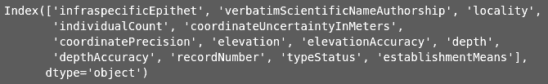
Treating Missing Values
Finding the column which has missing values more than 10% and eliminate those columns.
Remove the rows which contain NaN values.
After treating the missing values we have now 37 Columns and 90184 observations.
Column which contain most missing values:

Slide 4
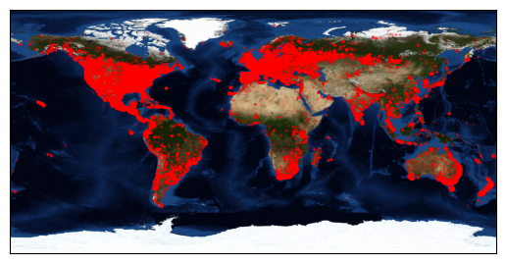
Locating discoveries on world map

Slide 5
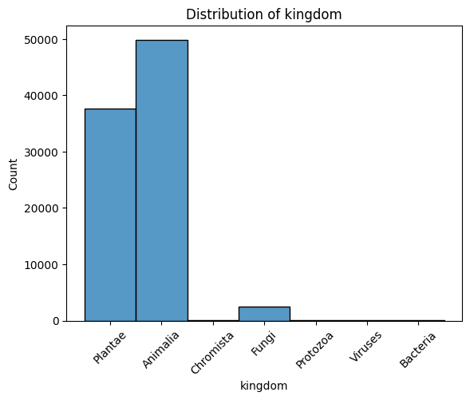
Distribution of kingdom around globe
Animalia and Plantae are the most commonly founded kingdom around globe

Slide 6
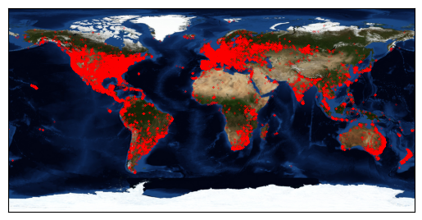
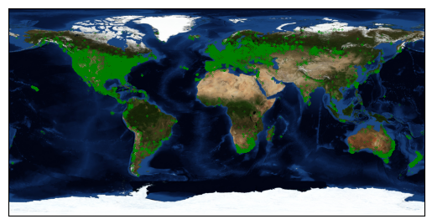
Locating kingdom wise location on Map
Animalia
Plantae
Most of the species found near coastal line in few countries.

Slide 7
Trend of Species discovered
Each year there is increase in discovery of new species, the growth is exponential.

Slide 8
Analysis on country INDIA
Distribution of animalia kingdom is more.
Among those kingdom Arthropoda and Chordata is the mostly found in phylum and Insecta and Aves found in class.
The count of discovery in each year increases exponentially.
In India Maharashtra, Kerala and Karnataka contribute is more.

Slide 9
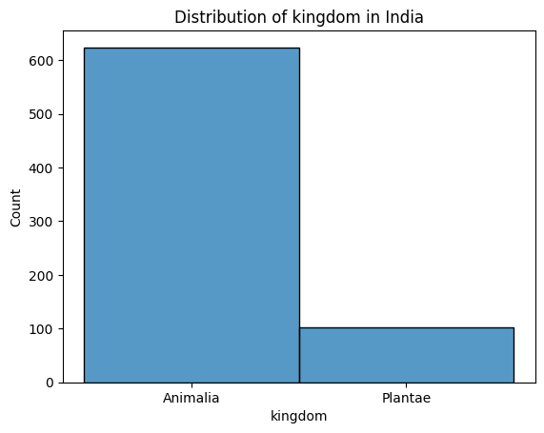
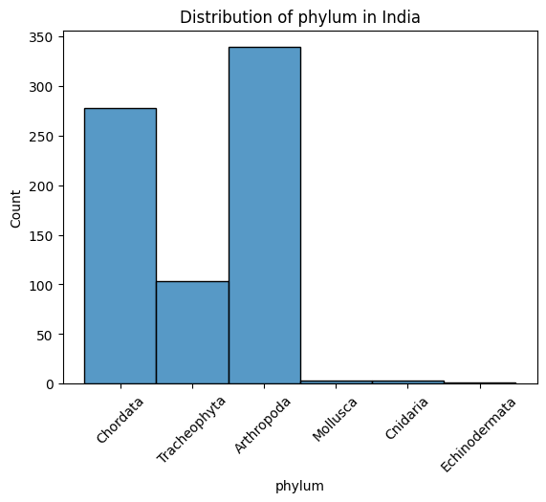
Analysis on country INDIA

Slide 10
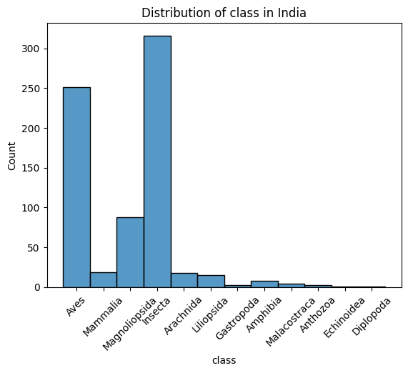
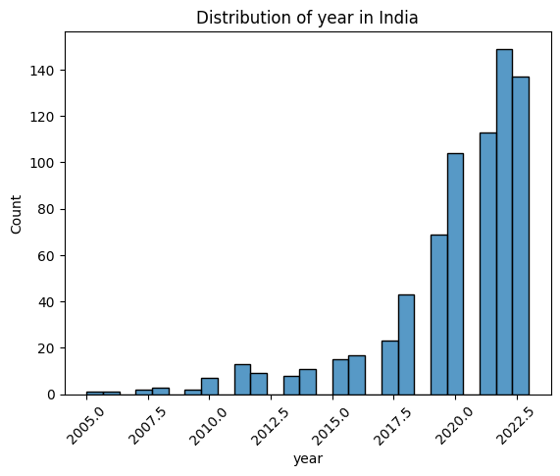
Analysis on country INDIA
Discovery of species in India is also exponential, Insecta class has the highest count.

Slide 11
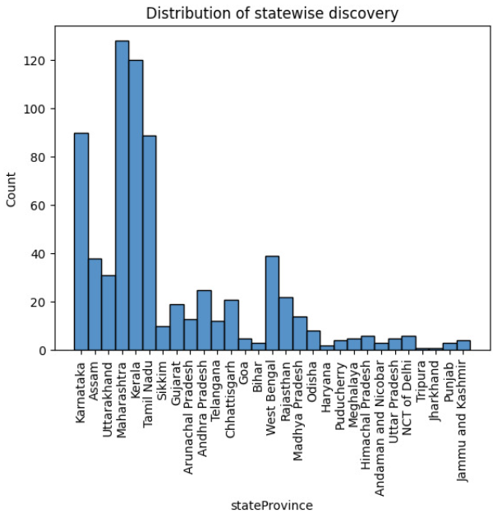
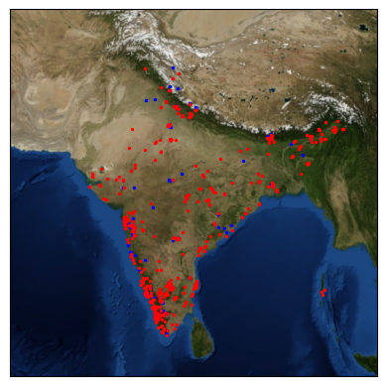
Analysis on country INDIA
Most observation we get from Maharashtra, Kerala and Karnataka.

Slide 12
Animate Trend of Species discovered in INDIA

Slide 13
Top 3 states in India contributing more discovery
Maharashtra
Kerala
Karnataka
Let’s conduct analysis on top 3 states!

Slide 14
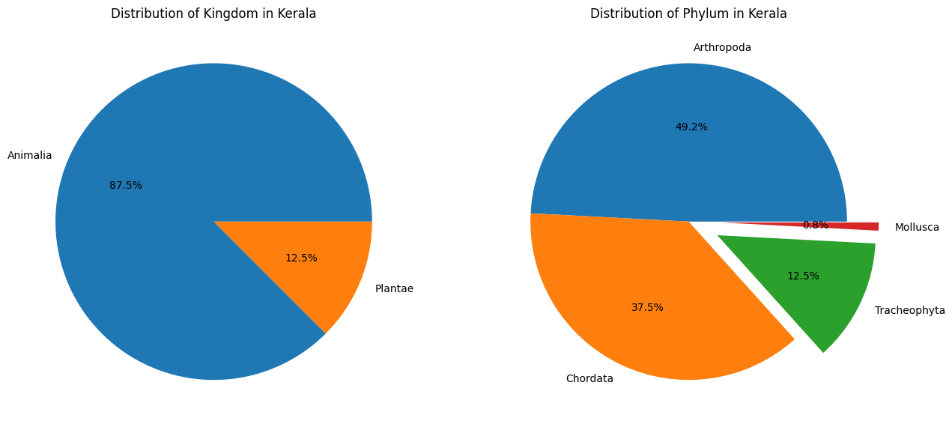
Analysis for state Kerala
88% kingdom is Animalia
49% phylum is Arthropoda

Slide 15
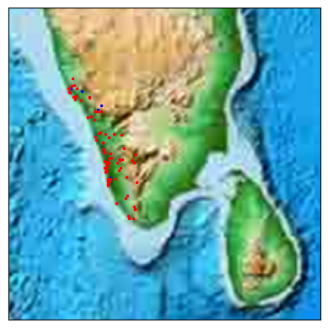
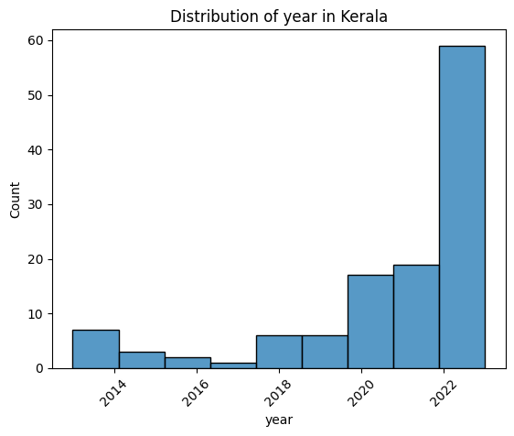
Analysis for state Kerala
From where in Kerala we get most of the observations?
To answer that we can do clustering

Slide 16
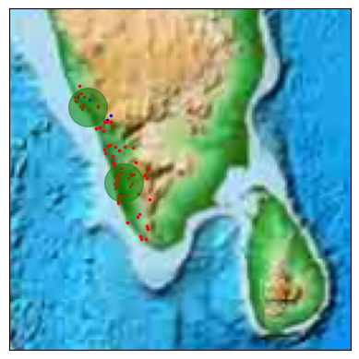
Analysis for state Kerala
From where in Kerala we get most of the observations?
Kochi and Kannur

Slide 17
Analysis for state Kerala
Discover of species in each year growths exponentially with higher rate than in Maharashtra.
Mostly found kingdom was Animalia and 50% phylum is Arthropoda.
Using clustering to find the cluster which gives the dense region where the discoveries are more, found out that cities are Kochi and Kannur.

Slide 18
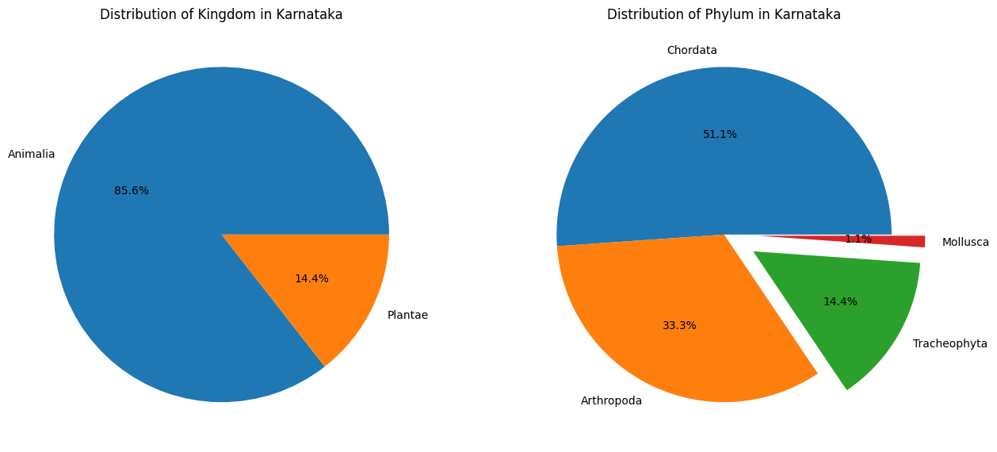
Analysis for state Karnataka
86% kingdom is Animalia
51% phylum is Chordata

Slide 19
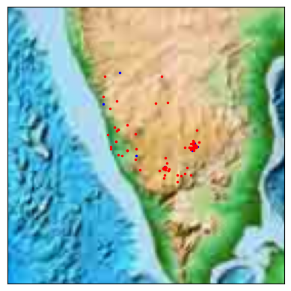
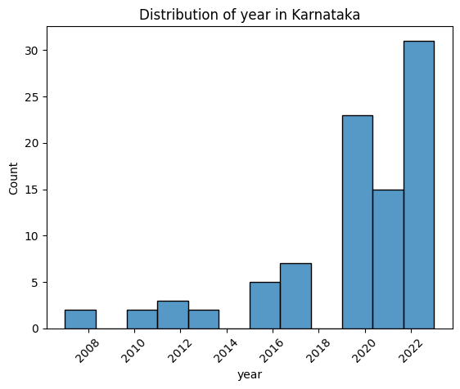
Analysis for state Karnataka
From where in Karnataka we get most of the observations?
To answer that we can do clustering

Slide 20
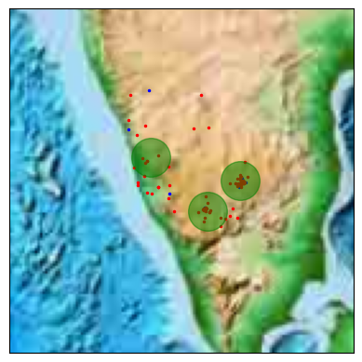
Analysis for state Karnataka
From where in Karnataka we get most of the observations?
Bengaluru, Mysuru and Mangalore

Slide 21
Analysis for state Karnataka
Discover of species in each year growths exponentially.
Mostly found 85% kingdom was Animalia and 51% phylum is Chordata.
Using clustering to find the cluster which gives the dense region where the discoveries are more, found out that cities are Bengaluru, Mysuru and Mangalore.

Slide 22
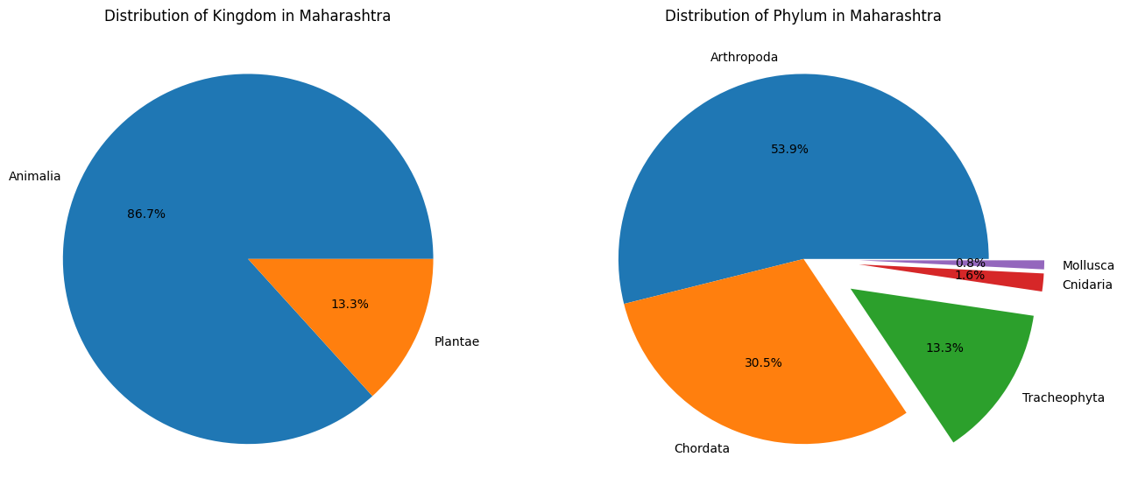
Analysis for state Maharashtra
87% kingdom is Animalia
54% phylum is Arthropoda

Slide 23
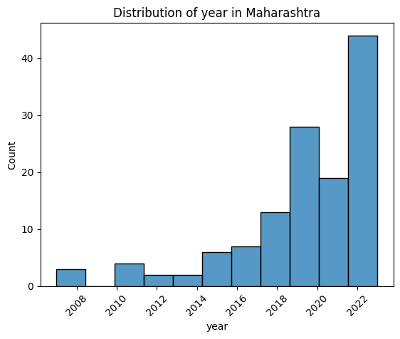
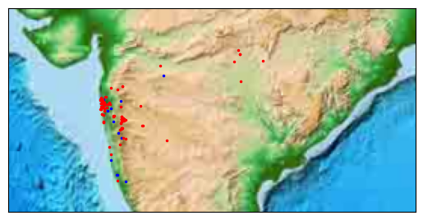
Analysis for state Maharashtra
From where in Maharashtra we get most of the observations?
To answer that we can do clustering

Slide 24
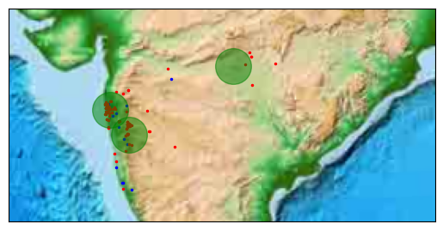
Analysis for state Maharashtra
From where in Maharashtra we get most of the observations?
Mumbai, Pune and Nagpur

Slide 25
Analysis for state Maharashtra
Discover of species in each year growths exponentially.
Mostly found kingdom was Animalia and phylum is Arthropoda.
Using clustering to find the cluster which gives the dense region where the discoveries are more, found out that cities are Mumbai, Pune and Nagpur.

Slide 26
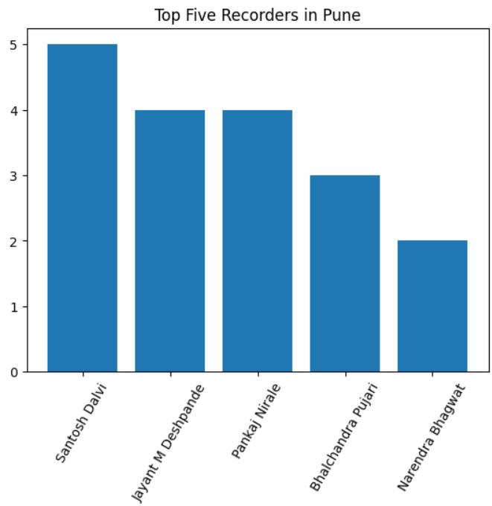
More Analysis in Maharashtra Particularly Pune
We have find out top 5 researchers in Pune.

Slide 27
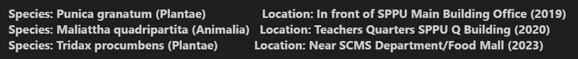

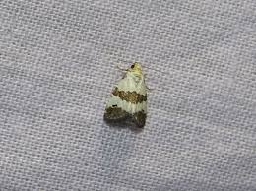
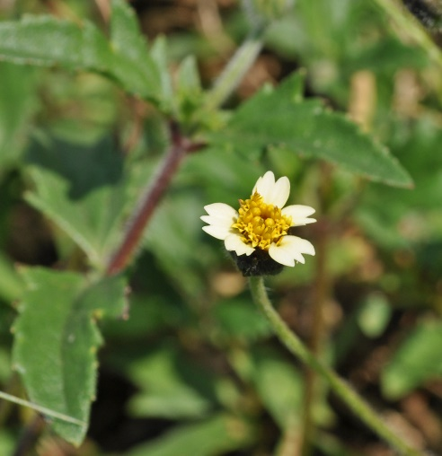
Which species discovered by Bhalchandra Pujari sir and Where?

Slide 28
Conclusion
Each year growth of discovery of species is exponential.
Observation of Animalia is most than other kingdom.
Most of the observation came from coastal area.
Major cities in states contribute more in discovering new species.
As seen on Map southern part of India have dense observations.

