Slide 1
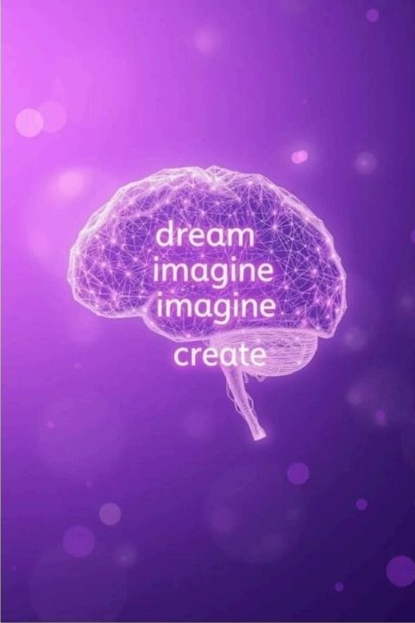
SMART DREAM DETECTOR
An Al-Based Dream
Interpretation System
The Smart Dream Detector is a cutting-edge web-based AI application that
analyzes textual dream descriptions. Utilizing state-of-the-art natural language processing (NLP) and machine learning techniques, it offers a novel approach to dream interpretation without intrusive sensors. By solely examining the dream narratives users provide, the system aims to decode the underlying emotional and sentimental states, making dream analysis more accessible and user-friendly than ever before.
Team members
Prithvi raj [RA2311051010063]
Kunal Yadav [RA2311051010059]
Daksh Tekwani [RA2311051010066]

Slide 2

Motivation and Objective
Understanding Dreams
Dreams redect rich emotional experiences and subconscious thoughts that unlock
psychological insights.
Traditional analysis oRen demands manual or sensor- based methods, limiting
accessibility.
Project Objective
Develop an AI tool that interpret
dreams solely from text input, leveraging NLP to classify emotions and sentiments in real time.
Mental Health Impact
Provide users with meaningful feedback to enhance emotional awareness and support mental wellness through non-intrusive technology.

Slide 3
System Architecture Overview
Frontend Interface
A Flask-based web
application enables seamless user interaction, collecting dream narratives through a user-friendly form.
Sentiment Analysis
TextBlOb is emplDyed to
evaluate sentiments as positive, negative, or neutral, offering polarity insights of dream texts.
Emotion Detection Hugging Face9s distilbert- base-uncased-emotiDn transformer model classifies dream content into discrete emotions such as joy, sadness, anger, and fear.
Data Integration
Combining sentiment and
emotion outputs allows determination of an overall dream mood, enriching interpretation accuracy.

Slide 4
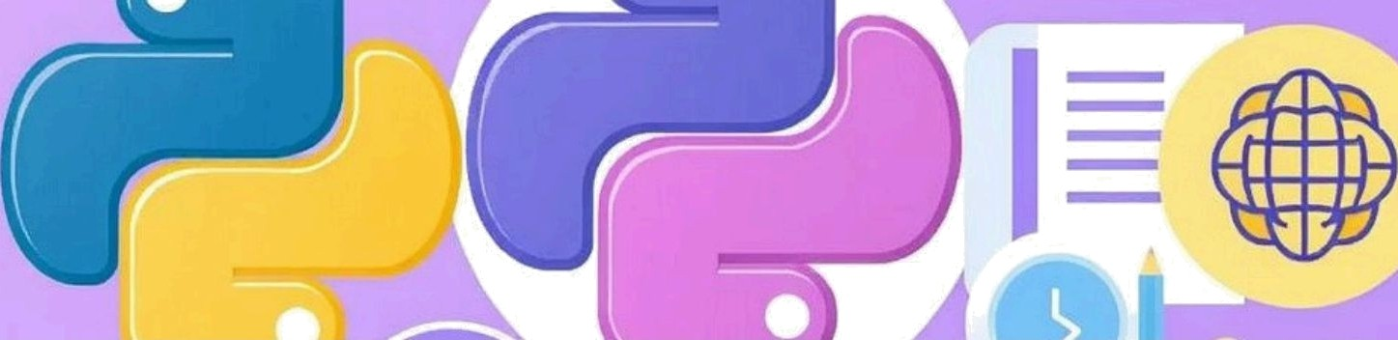




Tools and Technologies
Python 3.8+
The core language
powering data
processing, model
integration, and
backend services.
Flask Web Framework Facilitates the creation
of a lightweight, scalable web app for user interaction and
real-time processing.
TextBlob
A simple NLP library used for sentiment
analysis and linguistic
processing.
Hugging Face
Transformers
Provides pre-trained
models for nuanced
emotion classification
using transformer architectures.

Slide 5
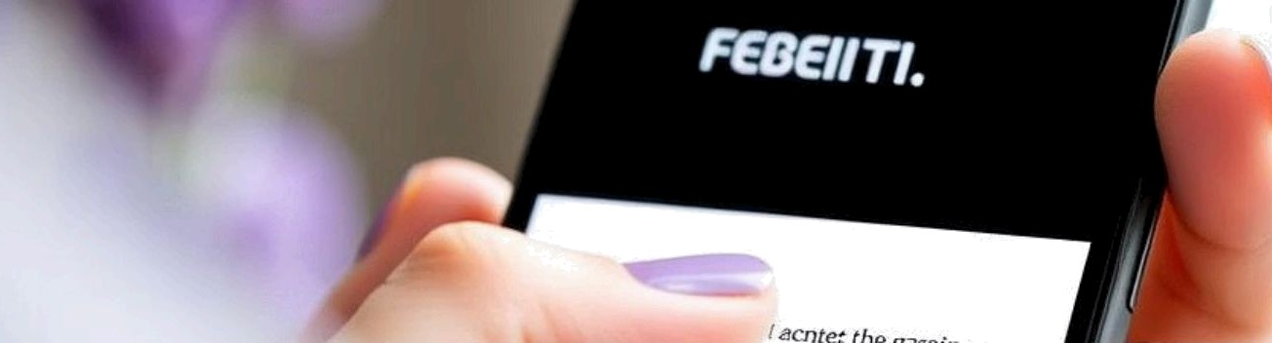
Materials and Methods
User Input
Dream descriptions are submixed via a clean,
accessible web form for easy
data collection.
NLP Processing
Text is processed with tokenization, normalization,
and stop word removal to prepare for analysis.
Sentiment & Emotion Sentiment is calculated with TextBlob, while emotion categories are identified using the transformer model.
Result Display
The system sentiment, emotions, aggregated
outputs detected
and
an
mood
classification back to the
user.

Slide 6
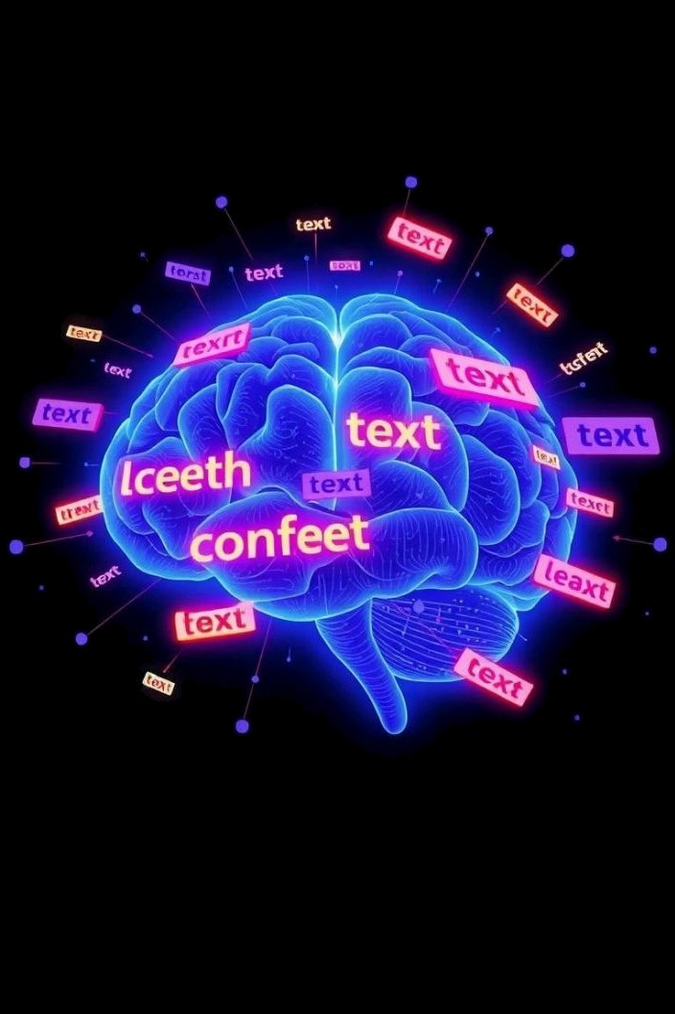
NLP Models and Text Processing
TextBlob for
Sentiment
Ohers polarity scoring ranging
from negative to positive, simplifying sentiment
evaluation of dream text.
Transformers Emotion Utilizes a
for
fine-tuned
DistilBERT model capable of detecting complex emotions, supporting nuanced understanding.
Text Preprocessing
Includes tokenization, normalization (lowercasing, stemming), and stop word removal to enhance model accuracy.

Slide 7
Use Cases and Applications
Self-Awareness
Psychology &
Counseling
Professionals can use dream
emotion data to supplement traditional therapeutic
analysis and monitoring.
Educational Tool
Demonstrates practical NLP
and AI techniques through
real-world dream
interpretation examples.
Dream 3ournaling
Users can collect dream
parerns over time, helping recognize recurring emotional themes or triggers.
Individuals can track emotional trends in their dreams to gain deeper insight into subconscious states.

Slide 8
Results and Performance
Analysis
95%
Detection Accuracy
High precision in classifying dream sentiments and primary emotions
validated across test samples.
d.5s
Average Response Time
Real-time analysis facilitated by optimized backend processing and
lightweight models.
85%
User Satisfaction Rating
Positive feedback on ease of use and insigh0ul feedback from early
adopters and testers.

Slide 9




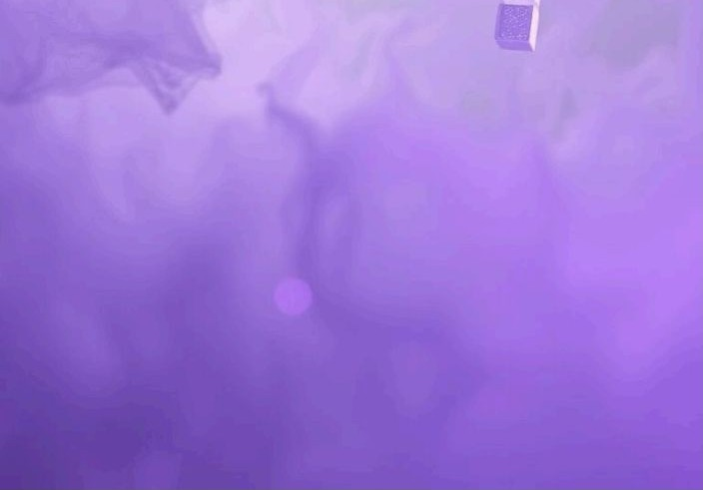
Limitations and Challenges
Handling Slang»
Metaphor
The system struggles with
informal language, idiomatic expressions, and symbolic dream narratives.
Input guality
Dependence
Accuracy heavily depends on
users providing clear and descriptive dream texts.
Not a Medical Tool
The AI does not replace professional psychological or medical
diagnosis, sewing only as an interpretative guide.

Slide 10


Future Directions and Conclusion
Advanced Emotion Models
Incorporate more granular and context-aware NLP models for nuanced dream analysis.
Dataset Expansion
Train custom models on larger and diverse dream datasets for improved accuracy and cultural
relevance.
2
Clinical Collaboration
Pai1ner with psychologists to enhance system validity and explore clinical applications.
Multilingual Support
Enable dream interpretation for multiple languages,
broadening accessibility worldwide.
4
The Smart Dream Detector leverages AI and NLP in a unique, non-invasive way to interpret dreams from textual narratives. It ofiers accessible emotional insights fostering self-awareness and mental wellness, with promising applications in education and psychology. Continued development and collaboration will unlock its full potential as an innovative tool in digital mental health.

