Slide 1
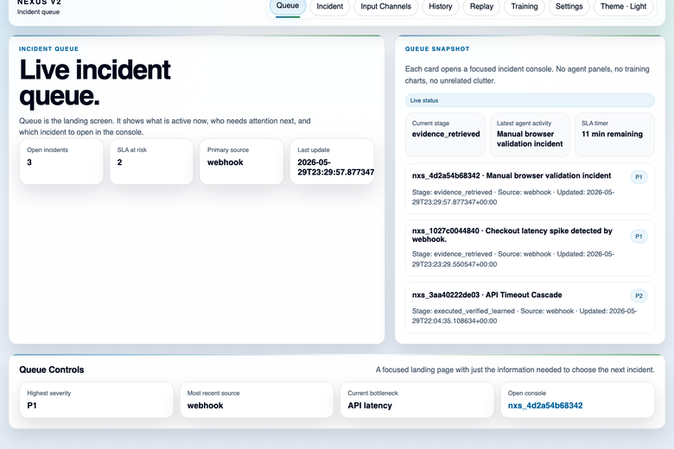
NEXUS v2 | STAR pitch
Situation, Task, Action, Result
A queue-first incident response product for business, product, engineering, and operations stakeholders.
Why this matters
Fragmented intake, unclear ownership, and hidden evidence slow incident work and make demos feel incomplete.
What NEXUS shows
A visible queue, an explainable incident console, and a governed path from intake to outcome.
Live queue-first landing surface
Situation
Task
Action
Result
Incident intake is fragmented across channels.
Create one operating model with visible priority.
Show the live product proving the workflow.
Deliver clarity, credibility, and a path to hardening.
1/5
Notes:
Open with the problem. Explain that STAR is the speaking structure, but the product language remains enterprise-friendly. Point to the live queue screenshot as proof that this is not a mockup.

Slide 2
01 / STAR
Situation and task
The system is designed to convert fragmented incident handling into one understandable operating model.
Situation
Task
Fragmented intake
Normalize everything
Webhook, manual reports, chat commands, streams, and batch data all arrive differently.
Every intake path lands in the same incident envelope and queue.
Slow triage
Show the whole incident
Operators lose time deciding what is first, what is real, and what changed.
The console presents workflow, evidence, audit, and execution state together.
Hidden evidence
Make action governed
The business cannot easily see why an incident happened or what action was taken.
The system is explicit about what is visible now and what still needs hardening.
Supported intake channels: Webhook • Manual form • Slack-style command • Stream anomaly • Batch import
2/5
Notes:
Describe the operational pain first, then the product task. This slide establishes why the product exists and why the queue-first model is the right response.

Slide 3
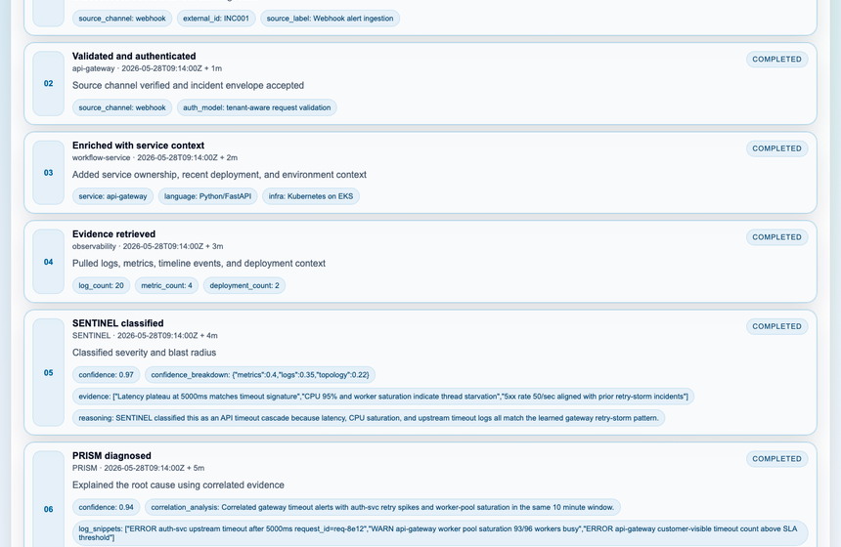
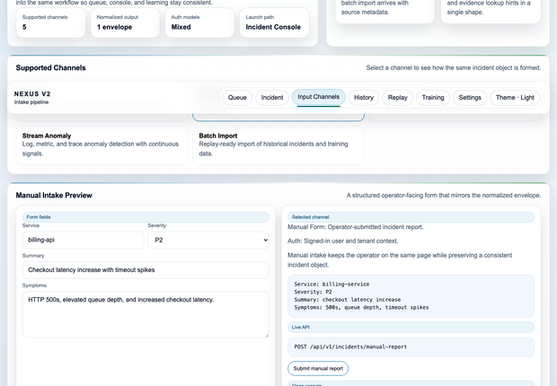
02 / STAR
Action: the live product already proves the workflow
These screens demonstrate intake, queueing, incident analysis, and controlled execution on the same product surface.
Queue
Inputs
Incident console: workflow timeline, evidence provenance, audit trail, and execution state
Workflow timeline
Agent handoff
Evidence provenance
Audit trail
Execution state
3/5
Notes:
Use this slide to prove the product. Walk the judge from queue to intake to the incident console, then point to evidence, audit, and the governed action path.

Slide 4
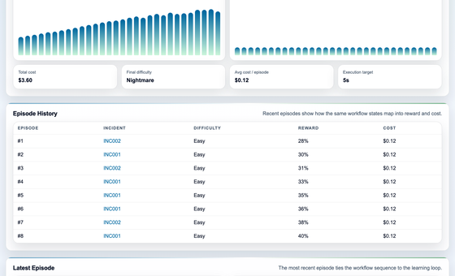
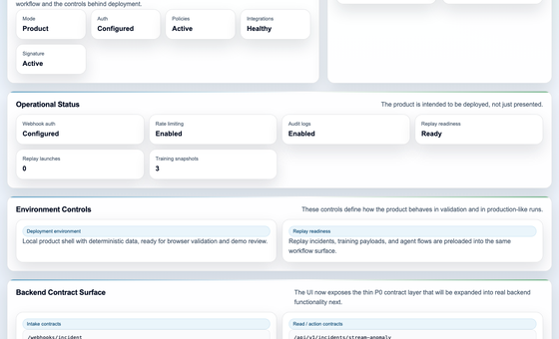
03 / STAR
Result: value for every stakeholder
The product is credible now, understandable to non-technical reviewers, and structured for the next hardening phase.
Business / leadership
Training
Settings
A visible enterprise story with control, traceability, and a clear reason to believe.
Product
A coherent user journey from intake to console to history, replay, training, and settings.
Why this matters to the judging body
Engineering
The product is not just a concept. It is a live, explainable workflow that already demonstrates the business story, the user experience, and the technical direction.
Clear contracts and a bounded architecture that can be hardened without rewiring the UI.
Triage / operations
Queue-first. Explainable. Auditable. Ready to harden.
A queue-first console that shows what is next, what happened, and what action is safe.
4/5
Notes:
Shift to the stakeholder lens. Explain that this solves a business problem, creates a product story, and gives engineering a bounded path forward. The training and settings screenshots show maturity and trust.

Slide 5
04 / STAR
Technical design and next phase
The current implementation is demo-ready, with clear seams for the deeper enterprise hardening work.
Intake
Webhook, manual, chat, stream, batch
Normalize
One incident envelope
Queue
Priority, stage, ETA
Console
Evidence, audit, action
Replay / Training
Learning and validation
Settings
Trust and readiness
Current implementation
Next phase
FastAPI app serving the UI and versioned contracts
Static frontend pages with page-specific controllers
File-backed local persistence for incidents and audit
Signed intake and clear queue/console seams
Real observability integrations and evidence fusion
Stronger GUARDIAN execution policy and governance
Production persistence and hardened auth/tenant boundaries
Further backend service decomposition and operational cleanup
The deck closes with a simple message: the product already reads as enterprise-grade, and the remaining work is focused on hardening, integration, and scale.
5/5
Notes:
End on the architecture and next phase. Make it clear what is already real and what comes next. Keep the tone confident: the product is already usable for demos and review.

