Slide 1
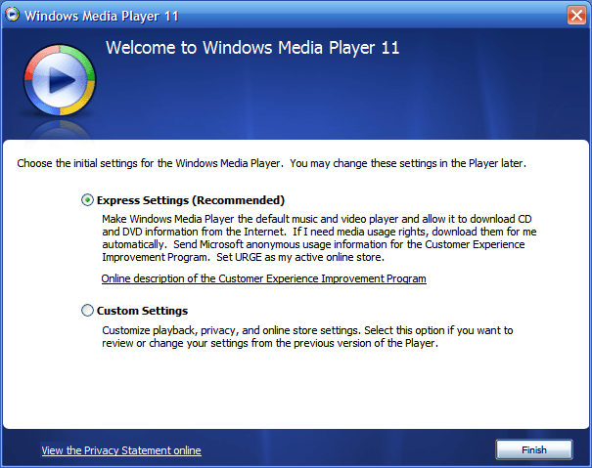
Getting Started Wizard
Getting started wizard will be displayed when the UI comes up for the first time.
This wizard will look something like this:
www.idera.com

Slide 2
First-time Install
Register Servers
Show them and even allow them to edit (if they wanted...but they won't) the default Server Threshold values
Allow them to configure notifications
SQLdm really needs to do a refresh here, so some data exists...simply show a "Data collection is in progress....this may take a few moments" message.
Close the Getting Started Guide
Take them to the All Server View.

Slide 3
Upgrade
Allow them to "Register New Servers" or "Import Existing Servers and Settings"
The Register New Server could follow the above steps.
Import needs to Import their existing settings, which will register the servers, set threshold values, and configure notification (that's it right).
Import their historical data

