Slide 1
DM 5.0 Reporting Requirements
www.idera.com

Slide 2
General (1 of 2)
Display historical data in graphs.
  “Perfmon” view of “scheduled” data stored in the Repository.
We are calling this “reports”, this term may change (or remain the same).
Our “reporting” capabilities are a major differentiator and we cannot lose/hide this functionality.

Slide 3
General (2 of 2)
The functionality in the statistics view must be retained especially it’s ease of use and ease of demos.
Growth statistics are only available in these views.

Slide 4
Use-cases
Allow the user to quickly see the busy or peak usage by time of day (by hour or minute) for a single day
Allow the user to quickly see the busy or peak usage times (avg/total/max by hour, minute) for multiple days (mon-thurs, the past 4 fridays, etc)
Allow the user to quickly see which days have the heaviest usage
Show the monthly average usage/activity for the last six months to see months of heaviest activity

Slide 5
Drivers
Support DM 4.x statistics views
Sample selection (minutes, hours, days, months, and years)
Reporting period (days, months, and years)
Support the following options on the graph
  Save
    Bitmap
    CSV
  Print
  Not supported – rotate, 2D-3D

Slide 6
Riders (in order of priority)
Select servers displayed in a chart
Select metrics displayed in a chart
Select type of values displayed in a chart
  Min/max
  Average
  Total

Slide 7
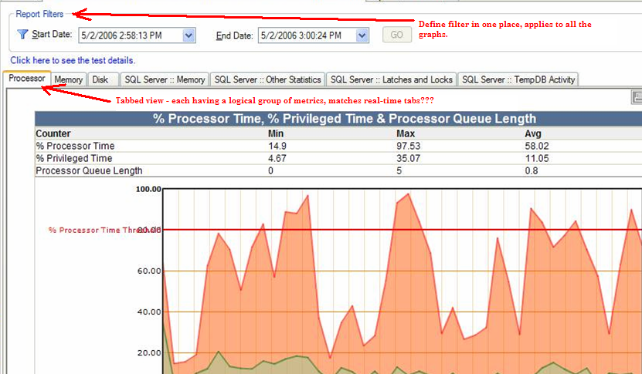
Prototype View – needs to be refined

Slide 8
Open Issues
ISSUE | COMMENT
What is the title in the Outlook navigation pane? | Reports, or something else.
Dev – which control to use for displaying data? | Report viewer, chart FX, etc.
Dev – UI prototype | Trent/Mark
Dev – metric labels and what they mean | Vicky

Slide 9
Supporting Slides
www.idera.com

Slide 10
DM 4.x Statistics – Statistics Since Startup
Total Logins (value)
SQL Activity % (graph)
  CPU
  IO
  Idle (this can be toggled)
Physical Disk Activity (graph)
  Read
  Write
  Error
Network Packets (graph)
  Received
  Sent
  Error

Slide 11
DM 4.x Statistics - OS Statistics
Processor Activity (%)
  Privileged Time
  User Time
  Processor Time
Processor Queue Length
Memory Usage
  Available Memory
  Total Memory
Pages/second
Disk Time (%)
Disk Queue Length

Slide 12
DM 4.x Statistics - Server-Wide Statistics (1 of 3)
CPU to IO Activity (%)
  CPU
  IO
Physical Disk Activity per minute
  Page Reads
  Page Writes
  Errors
  Lazy Writer Writes
  Checkpoint Writes
  Log Writes
Network Activity Packets per minute
  Received
  Sent
  Errors
Logins (including unsuccessful)
User Processes
  Average
  Maximum
  Max Client Computers
SQL Batches
Oldest Open Transactions in minutes
Replication Statistics
  Max unsubscribed
  Subscribed
  Max Nondistributed

Slide 13
DM 4.x Statistics - Server-Wide Statistics (2 of 3)
Replication Max Latency Period in Seconds
Maximum TempDB Size in percent
Maximum TempDB Size in KB
Maximum Procedure Cache Size in Percent
Maximum Procedure Cache Size in MB
Buffer Cache Hit Ratio Percentage
Procedure Cache Hit Ratio Percentage
Server Response Time in Milliseconds
  Average
  Maximum
SQL Compilations per Minute
SQL Recompilations per Minute

Slide 14
DM 4.x Statistics - Server-Wide Statistics (3 of 3)
Work Files and Work Tables Created per Minute
  Files
  Tables
Memory Usage in MB
  Max Memory Allocated
  Max Memory Used
Table Lock Escalations per Minute
Read Ahead Pages per Minute
Page Splits per Minute
Full Scans per Minute
Max Page Life Expectancy – SQL Server 2000 and later
Lock Waits per Minue
Page Lookups and Request per Minue

Slide 15
DM 4.x Statistics - Database Statistics
Transactions per Minute
Log Flushes per Minute
  Log flush waits
  Log flushes
Log Kilobytes Flushed per Minute
Log Cache Reads per Minute
Log Cache Hit Ratio

Slide 16
DM 4.x Statistics – Growth Statistics
Database and Table
  Data Size
  Data Size Allocated
  Index Size
  Log Size
  Log Size Allocated
  Text Size
Period selection – months and days
Sample – days and months

