Slide 1
Practical Performance Monitoring
Andrew J. Kelly
Solid Quality Mentors
akelly@solidq.com
Notes:
SQL Server Magazine Connections
Updates will be available at http://www.devconnections.com/updates/LasVegas _06/SQL_Connections

Slide 2


Who Am I?
Partner & Mentor with Solid Quality Mentors
SQL Server MVP
Executive Counsel Member – NESUG
Over 20 years of development and
database experience
Specialize in performance tuning and maintenance of VLDB / High-volume SQL Server databases
akelly@solidQ.com

Slide 3
Agenda
Performance Monitoring Overview
3rd Party Tools
Perfmon / Sysmon
Profiler / Trace
Wait Stats
File Stats
Index Stats
Blocking
Cached Query Plans
Questions & Answers

Slide 4
Performance Monitoring Overview
Too much data can be overwhelming
Not enough can lead to wrong assumptions
Initially get only what you need to narrow down the issues
You can expand the data collected when troubleshooting a particular issue
Be careful what data you collect and how as it can have a dramatic impact on overall system performance
Experience is the best teacher

Slide 5



3rd Party Tools
Should you use them?
Do they work?
Are they cost effective?
Can you do the job without these tools?
Beware of the overhead!

Slide 6
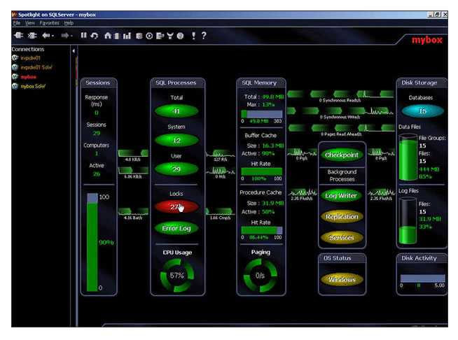
3rd Party Tools
Quest - Spotlight
  http://www.quest.com/sql_server

Slide 7
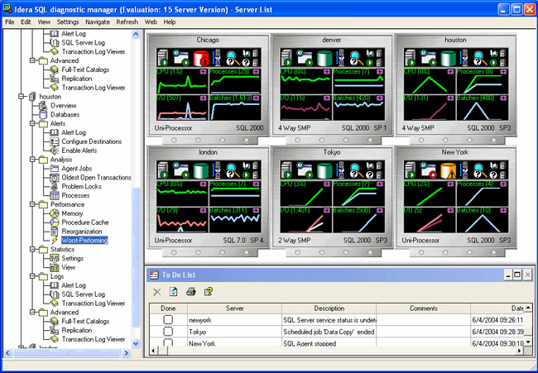
3rd Party Tools
Idera – Diagnostic Manager
  http://www.idera.com

Slide 8
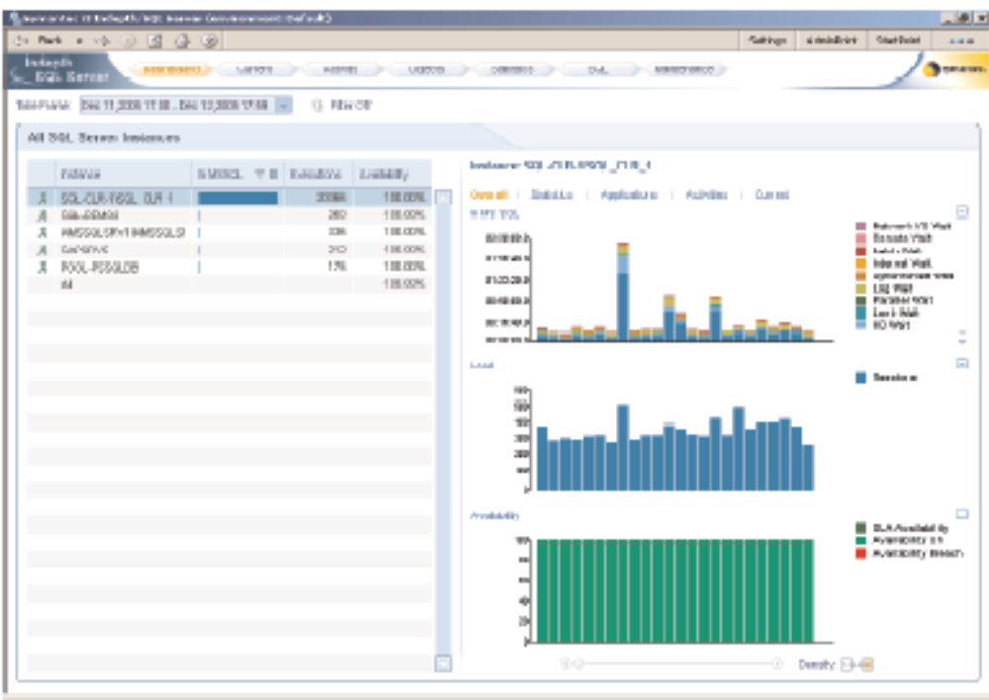
3rd Party Tools
Symantec – I3
  http://www.symantec.com/Products/enterprise?c=prodinfo&refId=317&cid=1021

Slide 9
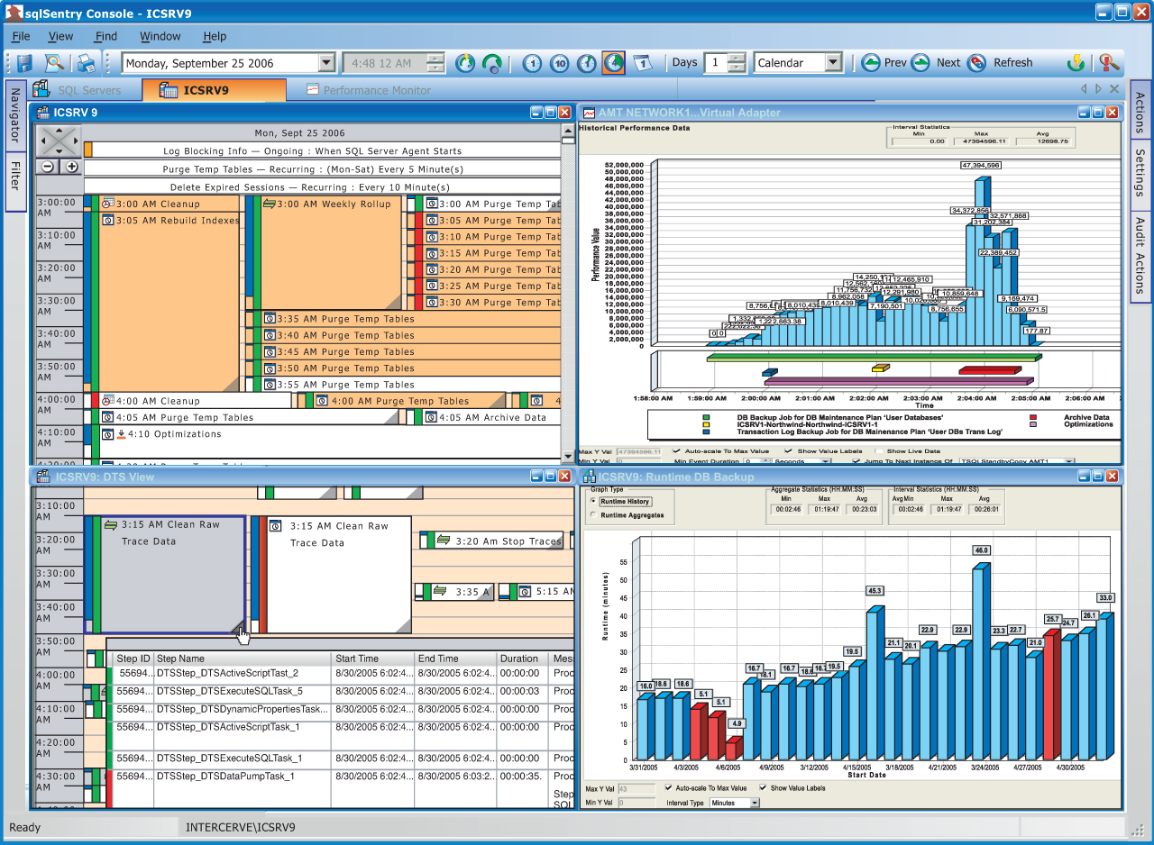
3rd Party Tools
SQL Sentry – Event Manager
  http://www.sqlsentry.net

Slide 10
3rd Party Tools
MOM
  http://www.microsoft.com/mom/default.mspx
BMC Patrol
  http://www.bmc.com/products/proddocview/0,2832,19052_19429_23065_2123,00.html
SQLSpy
  http://www.hybridx.com/SqlSpy.Aspx
SQL Power Tools
  http://www.sqlpower.com/

Slide 11
Perfmon / System Monitor
It’s a Windows tool not a SQL Server one
Allows us to monitor and capture both OS and Application specific counters
It is fairly lightweight when used properly
Simple to set up
Integrates with SQL Server 2005 Profiler

Slide 12
What should we monitor?
Depends on what your goal is
SQL Server alone has over 700 counters
  sys.dm_os_performance_counters
Trouble shooting
  Choose the counters relevant to the issue
  You might have to over do it some
Generic monitoring
  Don’t over do it
  Collect just the essentials

Slide 13
Standard Counters (SQL Server)
Access Methods\Page Splits/sec
Buffer Manager\Buffer cache hit ratio
Buffer Manager\Checkpoint pages/sec
Buffer Manager\Page life expectancy
Databases(*)\Transactions/sec
Databases(tempdb)\Transactions/sec ← Don’t forget
General Statistics\Logins/sec
General Statistics\User Connections
Locks(_Total)\Lock Requests/sec
Locks(_Total)\Lock Waits/sec
Memory Manager\Target Server Memory (KB)
Memory Manager\Total Server Memory (KB)
SQL Statistics\Batch Requests/sec
SQL Statistics\SQL Compilations/sec
SQL Statistics\SQL Re-Compilations/sec
Wait Statistics(Cumulative wait time (ms) per second)\Lock waits
Wait Statistics(Cumulative wait time (ms) per second)\Network IO waits

Slide 14
Standard Counters (OS)
Memory\Available MBytes
Memory\Pages/sec
PhysicalDisk(0 C:)\Avg. Disk Queue Length
PhysicalDisk(0 C:)\Current Disk Queue Length
PhysicalDisk(0 D:)\Avg. Disk Queue Length
PhysicalDisk(0 D:)\Current Disk Queue Length
PhysicalDisk(0 XXX:)\Avg. Disk Queue Length
PhysicalDisk(0 XXX:)\Current Disk Queue Length
Processor(_Total)\% Processor Time
Processor(0)\% Processor Time
Processor(1)\% Processor Time
Processor(XXX)\% Processor Time
System\Context Switches/sec

Slide 15
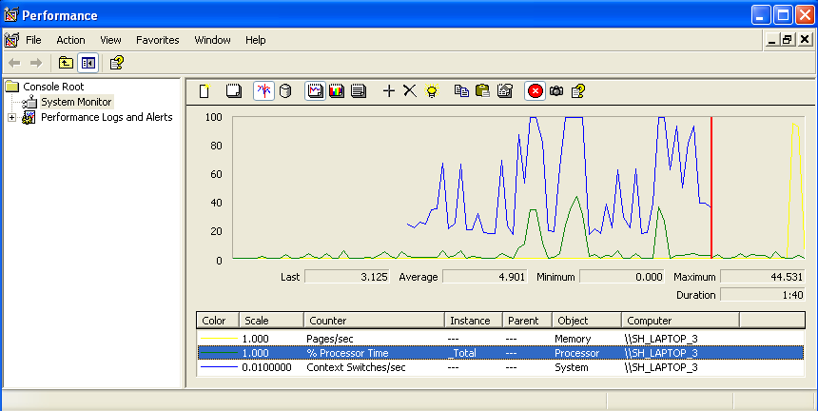
System Monitor (Real Time Mode)

Slide 16
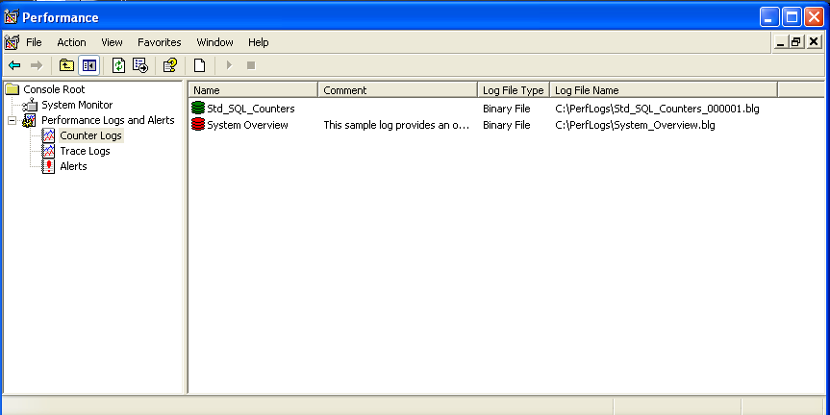
System Monitor (Log Mode)

Slide 17

Lets Take a Look

Slide 18
Profiler
Profiler is one of the most powerful tools in the SQL Server arsenal
  Especially for performance related issues
Profiler is a GUI that abstracts the built in trace commands
Provides a user friendly way to manage & view SQL Server traces
But it can also be one of the biggest hits on performance as well

Slide 19
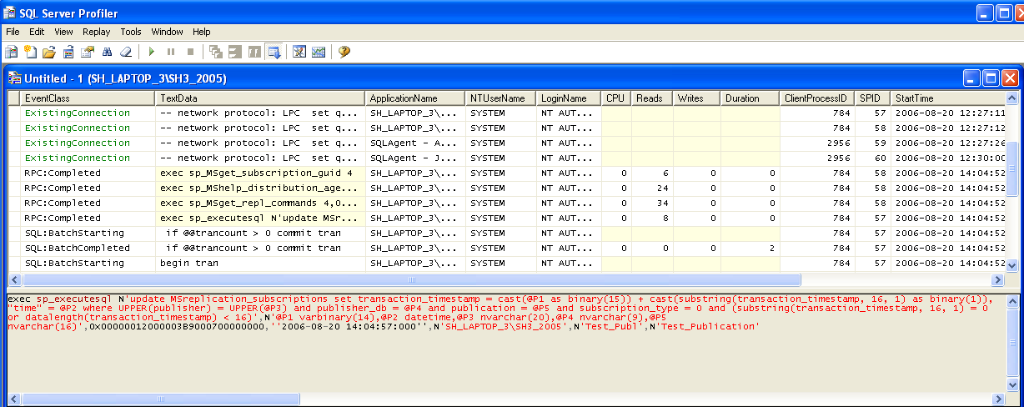
Profiler
Best used for troubleshooting, not ideal for monitoring

Slide 20
Trace
Trace is the actual component of the SQL Server engine that does all the work
You control it via a set of TSQL commands
It does not require a GUI
If done properly Trace can be much less of an impact on performance than Profiler
Capture only the events and columns that you actually need
Trace directly to a file on a local disk
  Never trace directly to a Table
  Use a networked drive as a last resort

Slide 21
Trace commands
sp_trace_create
sp_trace_setevent
sp_trace_setfilter
sp_trace_setstatus
fn_trace_getinfo()
fn_trace_gettable()
fn_RegexReplace()

Slide 22
Lets Take a Look

Slide 23
Trace Results
Remember to capture only the events and columns that you actually need
  Minimizes performance issues due to trace
  Saves disk space
  Minimizes I/O & CPU
  Easier & quicker to analyze
Use fn_trace_gettable() to read or import the results

Slide 24
Analyzing Trace Results
You can easily end up with millions of events, so where do you start?
Individual events are not of immediate concern
It’s the aggregated values that you want
  Max
  Average
  Totals
By query class

Slide 25
Query Class
This allows you to group statements that differ mainly by their arguments
  SELECT * FROM Orders WHERE Order_ID = 1
  SELECT * FROM Orders WHERE Order_ID = 2
  SELECT * FROM Orders WHERE Order_ID = #
  Exec MySP 1, 2
  Exec MySp 3, 6
  Exec MySp #, #
There are several ways to do this:

Slide 26
Query Class
SQL_Signature
  Script popularized by Tom Davidson to parse trace TextData
ClearTrace
  Utility from Bill Graziano to parse traces
  http://www.cleardata.biz/cleartrace
ReadTrace80
  Microsoft utility to parse trace files
fn_RegexReplace()
  Itzik Ben-Gan’s CLR UDF that mimics SQLSignature behavior

Slide 27
Let’s Take a Look

Slide 28
Wait Stats
Any time SQL Server has to wait to do something it records certain information:
  The type of wait (Wait Type)
  The time it waits (Wait Time)
There are currently 194 different wait types in SQL Server 2005
These numbers are cumulative from the last time SQL Server was restarted or you manually reset them

Slide 29
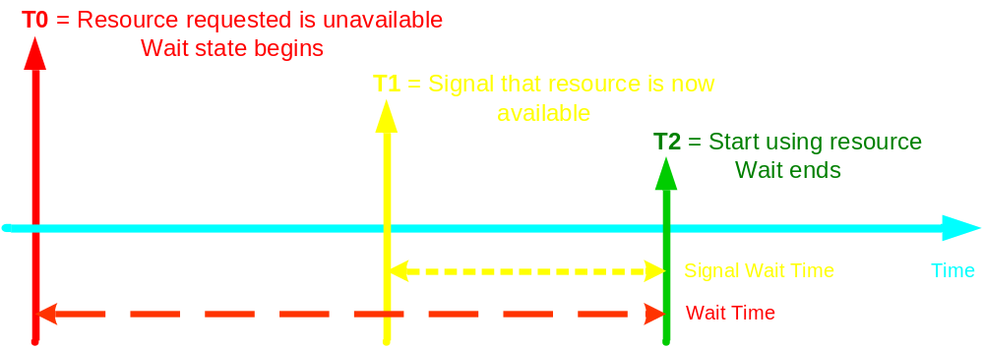
Wait Times
Column name | Data type | Description
wait_type | nvarchar(60) | Name of the wait type.
waiting_tasks_count | bigint | Number of waits on this wait type. This counter is incremented at the start of each wait.
wait_time_ms | Bigint | Total wait time for this wait type in milliseconds. This time is inclusive of signal_wait_time. T2 – T0
max_wait_time_ms | Bigint | Maximum wait time on this wait type.
signal_wait_time | Bigint | Difference between the time the waiting thread was signaled and when it started running. T2 – T1

Slide 30
Wait Stats
Waitstats can dramatically help to narrow down what the source of the performance issues are
Don’t ignore the Signal Wait Time
To get a snapshot of the current waits use:
  sys.dm_os_wait_stats
  Replaces DBCC SQLPERF(Waitstats)
To reset the wait counters you use:
  DBCC SQLPERF ('sys.dm_os_wait_stats', CLEAR)

Slide 31
Wait Stats
Wait stats are easy to capture and report on
There is no excuse not to always be monitoring Wait stats
The frequency in which you take the snapshots is up to you
Periodically review the reports to ensure nothing is sneaking up on you
Remember to get a Baseline
Be careful of system and OLEDB waits

Slide 32
Let’s Take a Look

Slide 33
File Stats
Any time SQL Server must read or write to the physical file on disk it keeps track
It tracks:
  How often you read or write
  How much data you read or write
  How long it takes to write to the file
  How long it takes to read from the file
  Overall size of the file
These are tracked for every file in every database

Slide 34
File Stats
Column name | Data type | Description
database_id | smallint | ID of database.
file_id | smallint | ID of file.
sample_ms | int | Number of milliseconds since the instance of SQL Server has started. This column is can be used to compare different outputs from this function.
num_of_reads | bigint | Number of reads issued on the file.
num_of_bytes_read | bigint | Total number of bytes read on this file.
io_stall_read_ms | bigint | Total time, in milliseconds, that the users waited for reads issued on the file.
num_of_writes | bigint | Number of writes made on this file.
num_of_bytes_written | bigint | Total number of bytes written to the file.
io_stall_write_ms | bigint | Total time, in milliseconds, that users waited for writes to be completed on the file.
io_stall | bigint | Total time, in milliseconds, that users waited for I/O to be completed on the file.
size_on_disk_bytes | bigint | Number of bytes used on the disk for this file. For sparse files, this number is the actual number of bytes on the disk that are used for database snapshots.
file_handle | varbinary | Windows file handle for this file.

Slide 35
File Stats
Use sys.dm_io_virtual_file_stats to view a snapshot of these statistics
  Replaces fn_virtualfilestats()
These numbers are cumulative since the last time SQL Server was restarted
There is no way to reset or clear the counters short of restarting SQL Server
SQL Server 2000 had a bug that prohibited the correct reporting of IO stallms on Log files. It is fixed in 2005

Slide 36
File Stats
File stats are also easy to capture and report on
There is no excuse not to always be monitoring File stats
The frequency in which you take the snapshots is up to you
Periodically review the reports to ensure nothing is sneaking up on you
Remember to get a Baseline here as well

Slide 37
File Stats
Keep in mind that this is purely physical I/O
Logical I/O can often be many times larger than physical I/O
Don’t forget to pay attention to TempDB
Use this in conjunction with WriteLog waits to see how efficient your log writes are
Backups can skew the results if you don’t account for them

Slide 38
Let’s Take a Look

Slide 39


Index Related DMV’s
A series of DMV’s that allow us to monitor usage and activity related to Indexes.
How long have we been waiting for these?

Slide 40
Index Operational Stats
sys.dm_db_index_operational_stats
  Used to track the length of time that users have to wait to read or write to a table, index, or partition
  Also used to identify the tables or indexes that are encountering significant I/O activity or hot spots
SELECT b.[name], a.*
FROM sys.dm_db_index_operational_stats(NULL, NULL, NULL, NULL) AS a
INNER JOIN sys.indexes AS b
ON a.[object_id] = b.[object_id] AND
a.[index_id] = b.[index_id]
WHERE a.[database_id] = DB_ID() AND a.[object_id] > 1000;
Warning: The stats may be temporary

Slide 41
Index Usage Stats
sys.dm_db_index_usage_stats
  Used to track activity on an index
  Tracks both user and system access
  Can help to determine which indexes are used and which are not
SELECT b.[name], a.*
FROM dm_db_index_usage_stats AS a
INNER JOIN sys.indexes AS b
ON a.[object_id] = b.[object_id] AND
a.[index_id] = b.[index_id]
WHERE a.[database_id] = DB_ID() AND a.[object_id] > 1000;
Warning: The stats may be temporary

Slide 42
Other Index DMV’s
sys.dm_db_missing_index_group_stats
sys.dm_db_missing_index_groups
sys.dm_db_missing_index_details
sys.dm_db_missing_index_columns
Warning: The stats may be temporary

Slide 43
Index DMV’s
These can be a bit tricky to monitor since the counters can go in and out of scope
You would not typically monitor these every day
Pull them out of your bag as needed and at regular intervals
Again get a BaseLine to compare against

Slide 44
Let’s Take a Look

Slide 45
Blocking
sys.dm_tran_locks
  Returns information about currently active locks either waiting or granted
The following query can be used to find locks that are waiting:
SELECT
t1.resource_type,
t1.resource_database_id,
t1.resource_associated_entity_id,
t1.request_mode,
t1.request_session_id,
t2.blocking_session_id
FROM sys.dm_tran_locks as t1
INNER JOIN sys.dm_os_waiting_tasks as t2
ON t1.lock_owner_address = t2.resource_address;

Slide 46
Blocking
SELECT
Blocked.Session_ID AS Blocked_Session_ID
, Blocked_SQL.[text] AS Blocked_SQL
, waits.wait_type AS Blocked_Resource
, Blocking.Session_ID AS Blocking_Session_ID
, Blocking_SQL.[text] AS Blocking_SQL
FROM sys.dm_exec_connections AS Blocking
INNER JOIN sys.dm_exec_requests AS Blocked
ON Blocked.Blocking_Session_ID = Blocking.Session_ID
CROSS APPLY
( SELECT * FROM sys.dm_exec_sql_text(Blocking.[most_recent_sql_handle])
) AS Blocking_SQL
CROSS APPLY
( SELECT * FROM sys.dm_exec_sql_text(Blocked.[sql_handle])
) AS Blocked_SQL
INNER JOIN sys.dm_os_waiting_tasks AS waits
ON waits.Session_ID = Blocked.Session_ID

Slide 47
Blocking
SELECT *
FROM [sys].[dm_db_index_operational_stats](NULL,NULL,NULL,NULL)
WHERE [row_lock_wait_in_ms] > 0
OR [page_lock_wait_in_ms] > 0
ORDER BY [row_lock_wait_in_ms] DESC
Aba_LockInfo
  http://www.sommarskog.se/sqlutil/aba_lockinfo.html

Slide 48
Let’s Take a Look

Slide 49
Cached Query Plans
sys.dm_exec_cached_plans
sys.dm_exec_query_plan(plan_handle)
sys.dm_exec_plan_attributes(plan_handle)
sys.dm_exec_sql_text(plan_handle)
SELECT b.*,a.*
FROM sys.dm_exec_cached_plans as a
CROSS APPLY sys.dm_exec_sql_text(a.[plan_handle]) AS b
SELECT (SELECT SUBSTRING(a.[text],1,500)
FROM sys.dm_exec_sql_text(b.[sql_handle]) AS a) AS [query_text]
, b.*
FROM sys.dm_exec_query_stats AS b

Slide 50
Let’s Take a Look

Slide 51
Links
Monitoring Disk Space
  http://www.sqlservercentral.com/columnists/mnash/monitoringdriveanddatabasefreespace.asp
System Monitor
  http://msdn.microsoft.com/library/default.asp?url=/library/en-us/adminsql/ad_perfmon_24u1.asp
How to monitor SQL 2000 Blocking
  http://www.support.microsoft.com/?id=271509
SQL Server Performance.com
  http://www.sql-server-performance.com
Troubleshooting performance issues in 2005
  http://www.microsoft.com/technet/prodtechnol/sql/2005/tsprfprb.mspx

Slide 52
Books
Inside Microsoft (r) SQL Server (tm) 2005: The Storage Engine
Inside Microsoft SQL Server 2005: T-SQL Programming (Pro-Developer)
Inside Microsoft SQL Server 2005: T-SQL Querying (Solid Quality Learning)

Slide 53

Questions & Answers
Don’t forget to fill out your evaluation forms

