Slide 1




Team Vanquisher
Mahindra First Choice Services
Model :Customer Life Time Value Data given 2012-2016
Created by:
Ashfaq Pathan
Amit Gupta
Kunal Kotian
Sakib Alam

Slide 2
Problem Statement
Geolocation Based Customer Analysis : - Identifying the ownership pattern of cars throughout the country. Also spending patterns can be identified.
Mahindra First Choice Services will be benefited in multiple ways. Knowing the ownership pattern targeted marketing campaigns could be carried out. Knowing the spending patterns services could be suited to the particular spending pattern. Market Segmentation:
Customer Lifetime value prediction - Based on Customer segments, we have predicted the revenue that can be extracted from each segment over a life of the car.
This will be beneficial to Mahindra First Choice Services to identify the various segments in the market. Also, these segmentations will allow for targeted marketing activities and sales promotions.

Slide 3
Solution Overview
Exploratory Data Analysis
Data Cleaning and Merging
Feature Engineering
Feature Cleaning
Customer Segmentation
Customer Lifetime Value Prediction

Slide 4

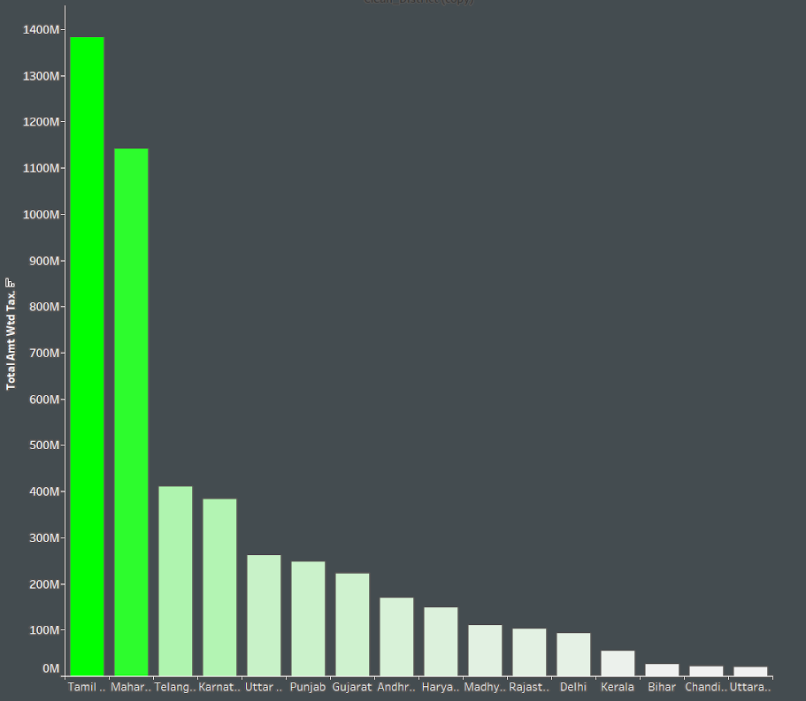
State Revenues
This Bar Graph Represents The Revenue Generated By Each state.
We can see that Highest Revenue Generated .By State is Tamil Nadu .& Maharashtra
The Bar Graph is generated by Y:Total Amout widt tax
X:States

Slide 5
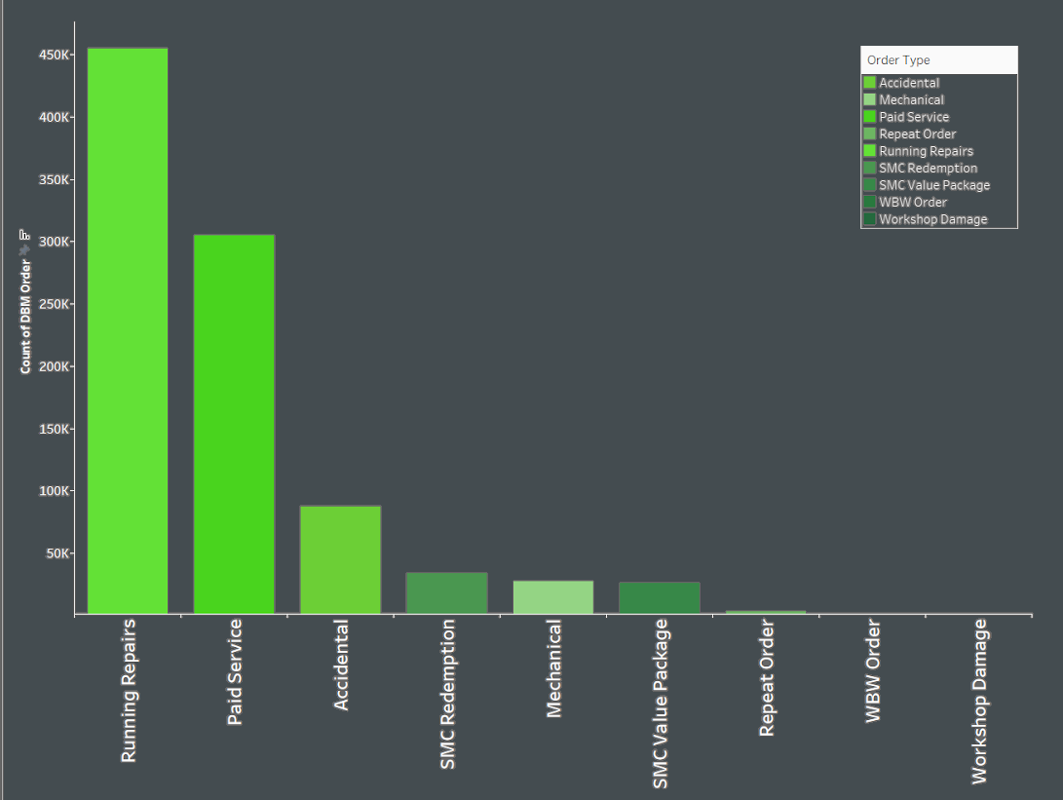
Order Type -Revenues
This Bar Graph Represents The Revenue Generated By Each Order Type
We can see that Highest Revenue Generated by order is Running Repairs
The Bar Graph is generated by Y:Customer no Count
X:Order Types

Slide 6
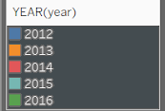
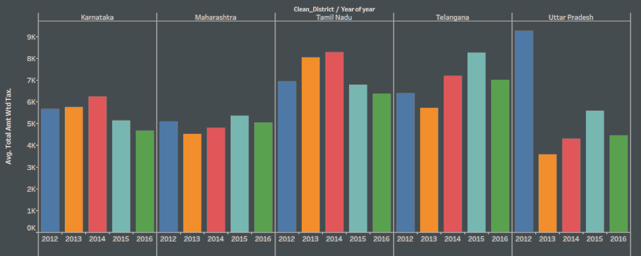
Yearly State Revenues
This Bar Graph Represents The Revenue Generated By Every year by top 5 state. In terms of overall revenue
We can see that Tamil Nadu Business is growing up till 2014
After that there is drop in 2015,2016
For this we have taken yearly average revenue because we don’t have some months of 2012 an 2016 in dataset

Slide 7
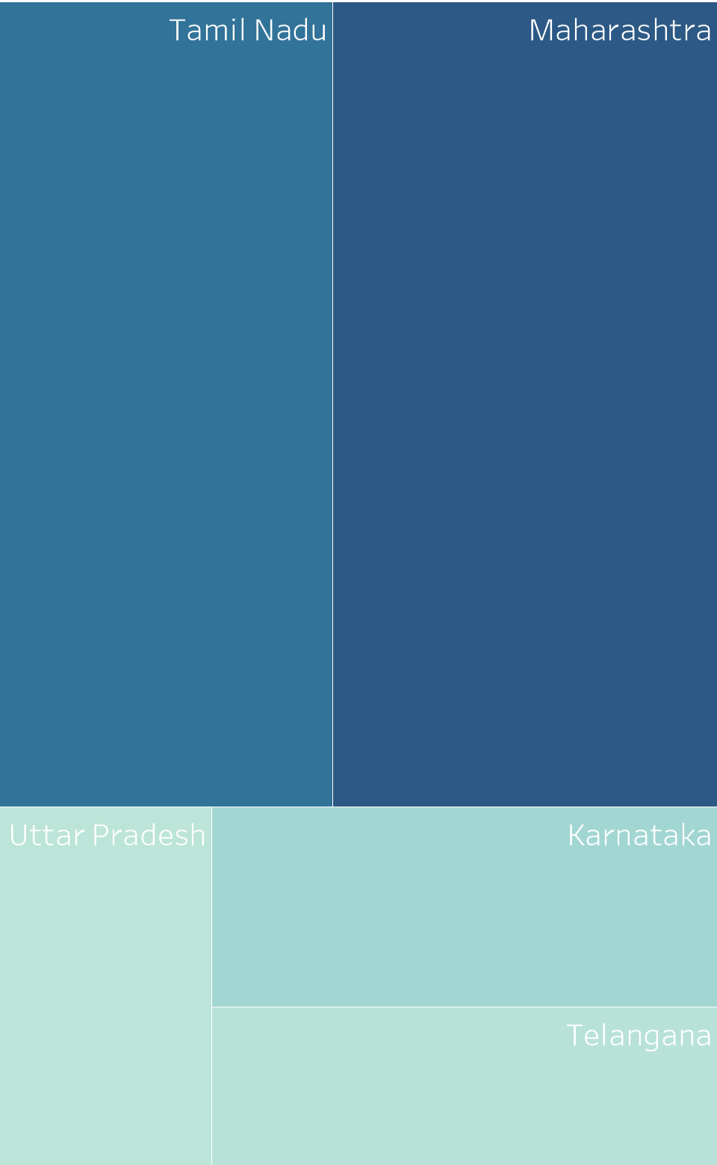
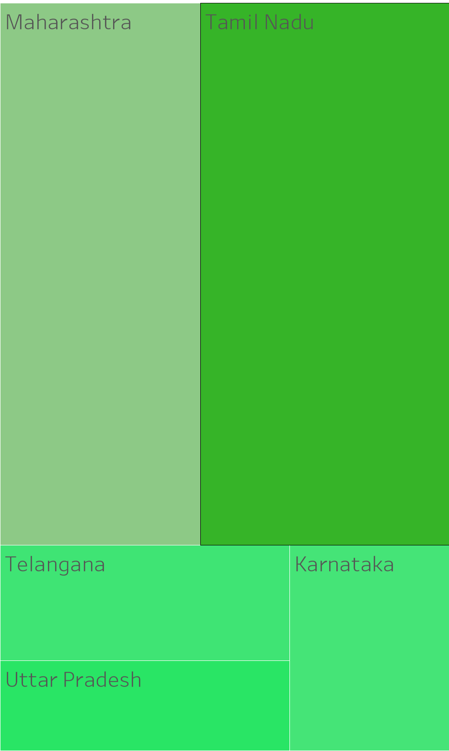
Labour Count
Labour Revenues
Labour
Count & Revenues
This two heatmap show case the total count of labor and labor revenue.
Labor count is more in Maharashtra compared to Tamil Nadu but revenue is generated more in Tamil Nadu by labor charge.
It basically mean that Labor charge in higher in Tamil Nadu comparing to other states.

Slide 8
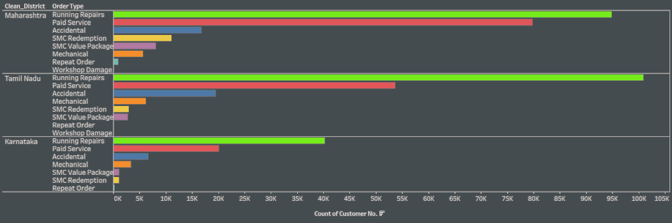
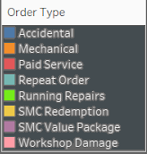
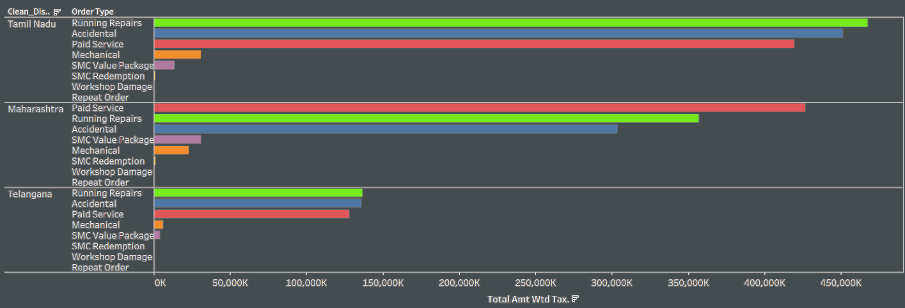
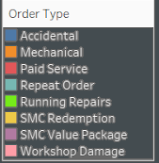
Order Count &
Order Revenue
These graph show us the distribution of service usage of top 3 states, We can clearly see that the Running repairs is the most used service.
We can see that Revenue generated by accidental repairs is higher than other services.
Also Maharashtra has generated higher revenue from paid services than running services.

Slide 9
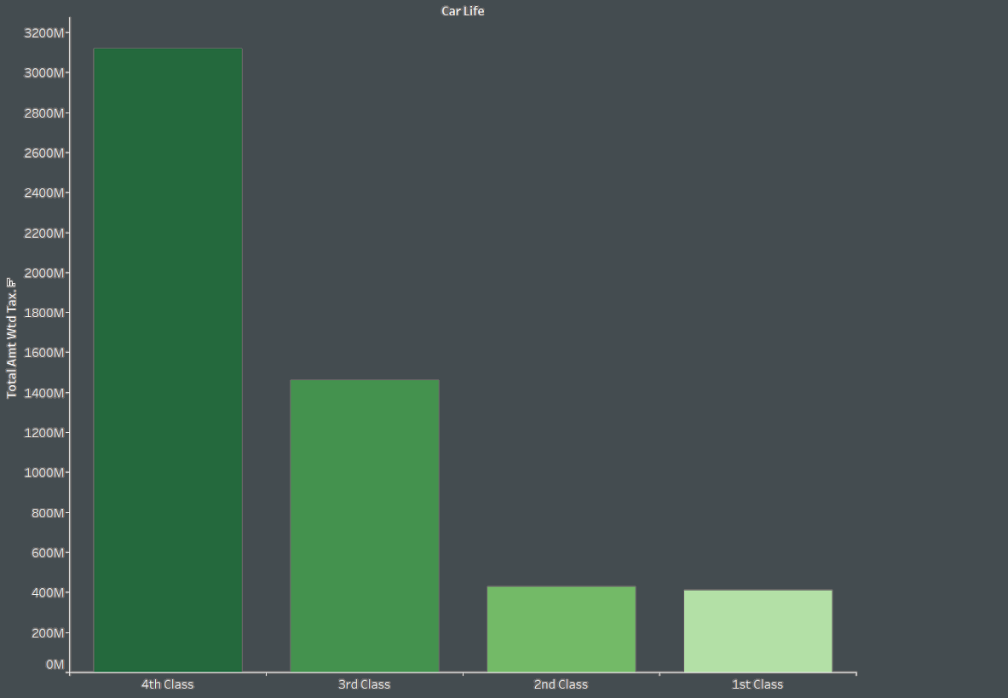
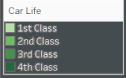
Car life - Kms
The graph here represents the car life distribution of customer according to the Km reading of their vehicle.
We see that the vehicles arrived for servicing is mostly 4th class which have higher Km readings.
These class distribution is based on Kms with IQR (Higher the km reading , higher is the class).

Slide 10
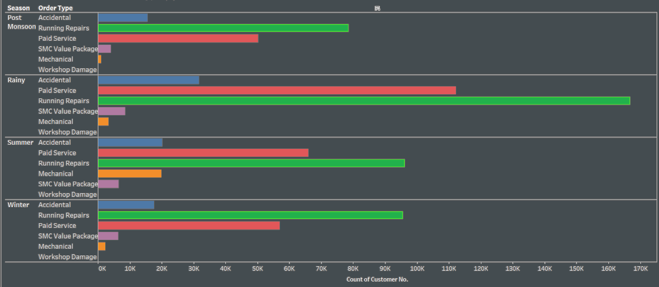
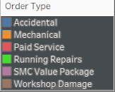
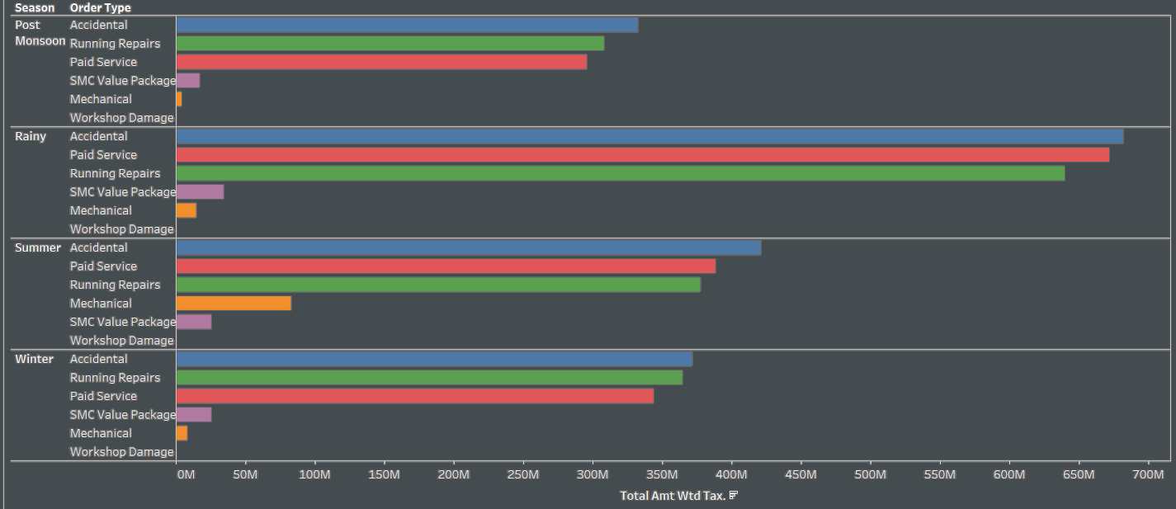
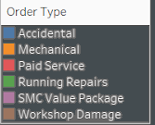
Season – Order Type
We have distributed the season on basis of Indian seasonal months.
The bar graph represents the season wise usage of services.
It is clearly visible that the rainy season is the season for major car services, also accidental count is higher in rainy season.
Running repairs has higher customers but accidental repairs generate more revenue than any other services.

Slide 11
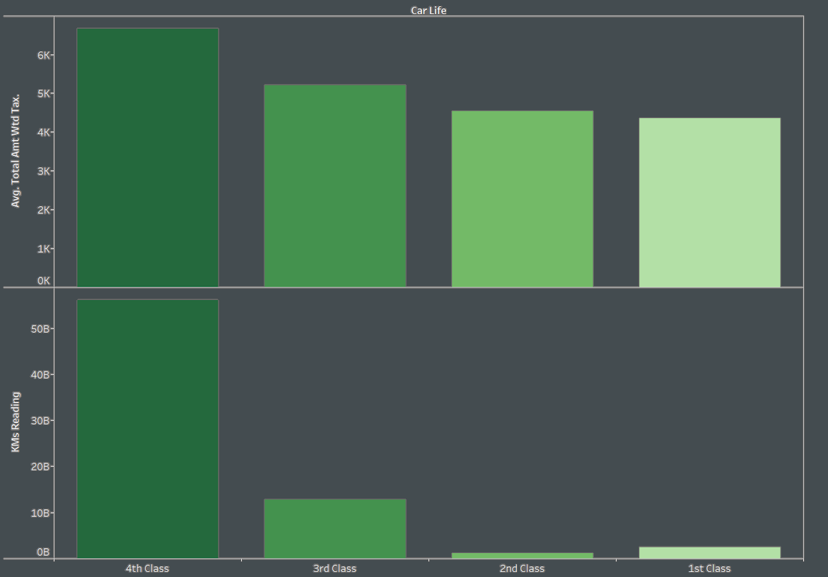
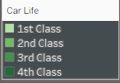
Car Class
Revenue -Count
These graph represent the car life distribution of customer according to the Km reading and revenue generated by each class.
We see that even though Km reading of 1st and 2nd class cars are less, they have generated a good revenue.

Slide 12
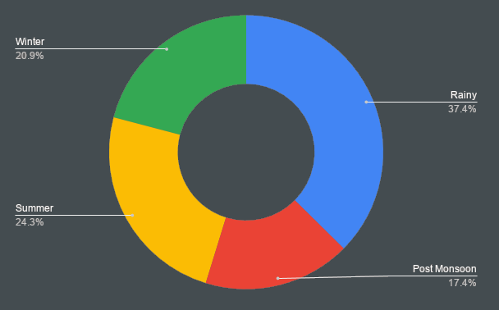
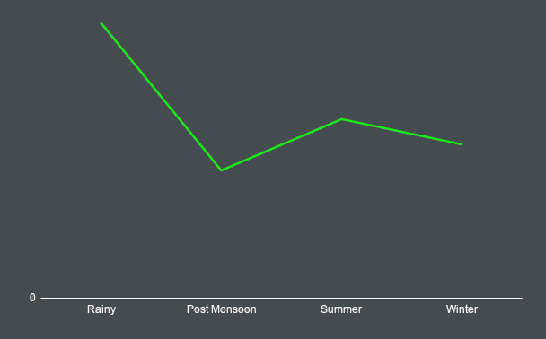
Seasonal Distribution
The graph represents visits of customer according to the season in India.
We see maximum customer visits in rainy season.

Slide 13
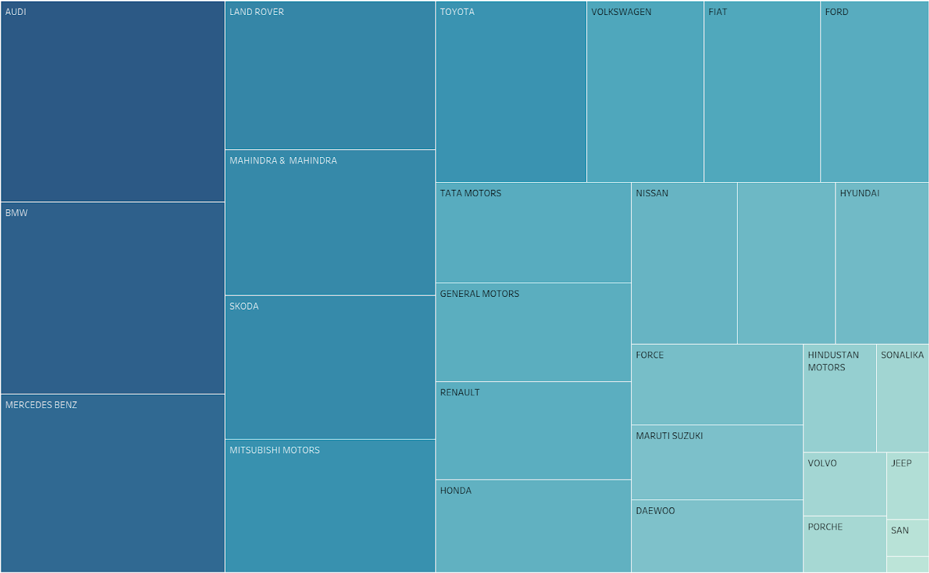
Parts Cost
This heatmap represents the brands with costly car parts.
We see that bigger brands like Audi,BMW parts are costlier than other brands like Mahindra, Honda.

Slide 14
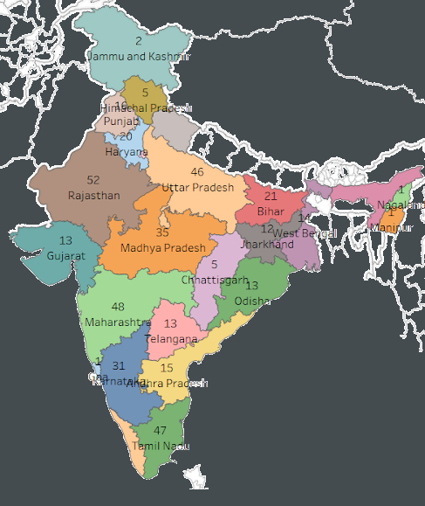
Number of Plant
This Graph represents the number of plants across India.
We have noticed that Rajasthan has the maximum number of plants.

Slide 15
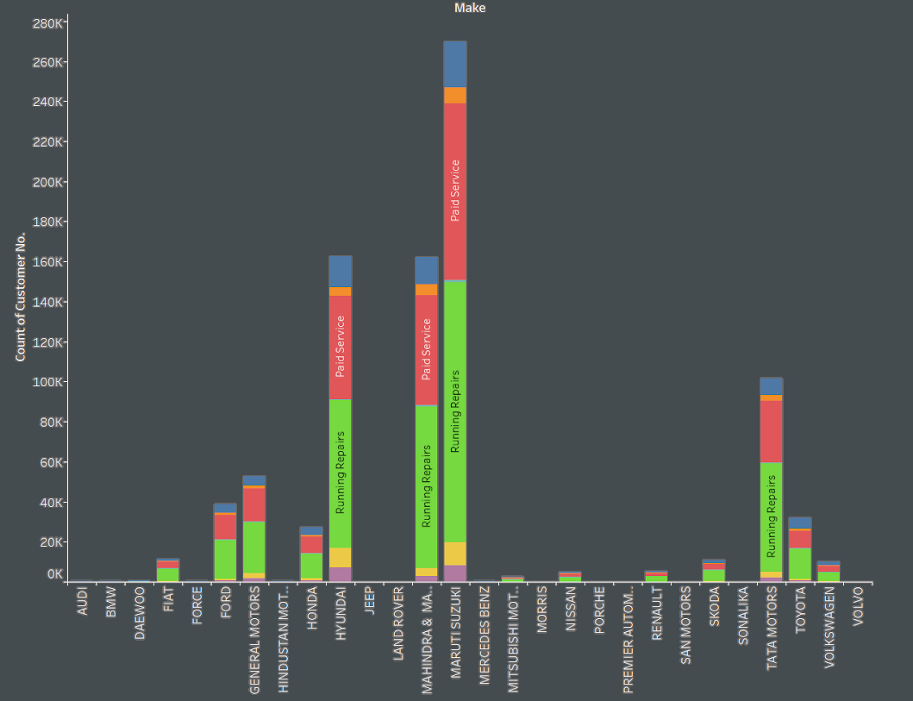
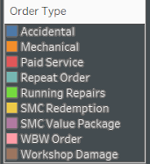
Brand & Service Type
The bar graph shows the distribution of service usage with different brands.
We see that Maruti Suzuki and Mahindra & Mahindra use most services overall.

Slide 16
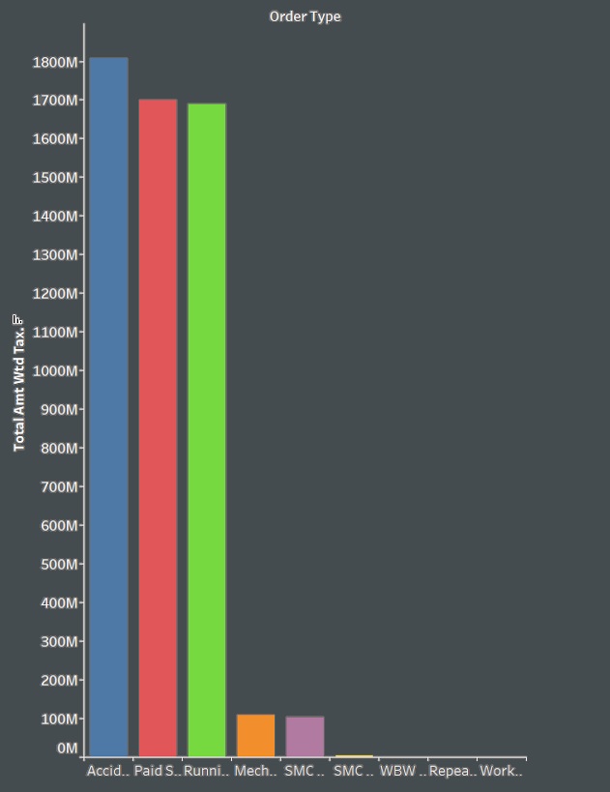
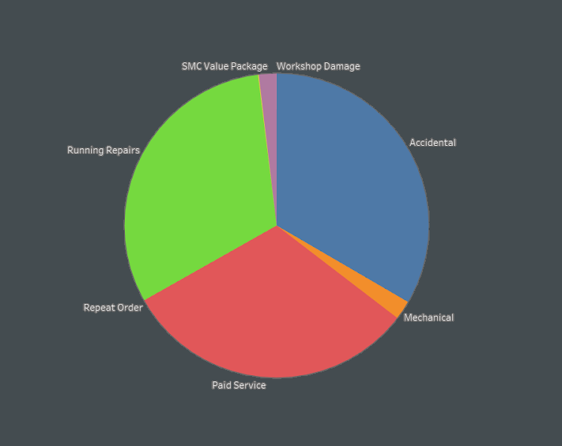
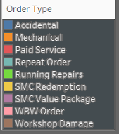
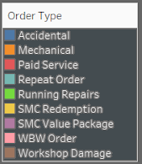
Order Type -Revenue
The graphs here represents revenue distribution of all the types of services.
We see that accidental, paid and running repairs generate the highest revenue for us.

Slide 17
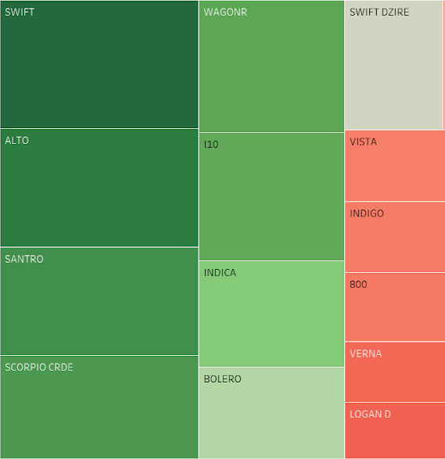
Model Visited for Service
This Heat Map represents that out of all car model the most visited car model for service is Swift and the second car model that is visited for car service is alto .
We can say that Suzuki models are the most visited car models for services.

Slide 18
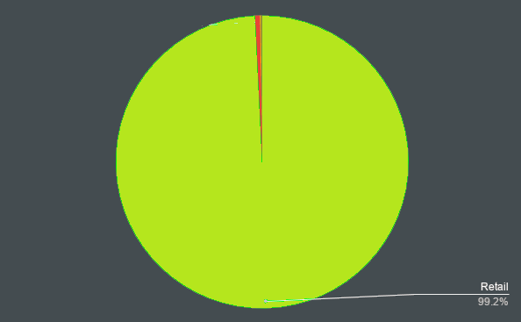
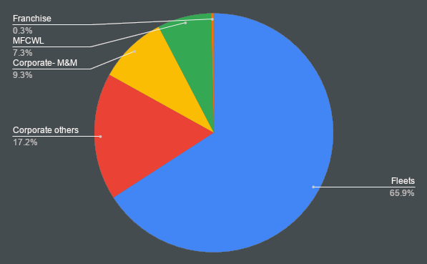
Customer type distribution
The types of customers that we have is represented by the pie chart here.
We see that 99% of the customers are retail customers.
The remaining 1% is distributed in the pie chart below.

Slide 19
Live Dashboards On Excel
All the above graph was basic and was not so dynamic an interactive so we need some advance tool to do so .
We have created an dash bord on excel for lookup thing in different diminution an in detail by selection thing from drop down we can do so
Lets move on to excel dashboard an analysis the advance part of the dataset

Slide 20
Data Pre-processing
Drop Column
Null Value
Drop the column where data point is Null more then 40%
Future contain null value less the 5% an witch can not be replaced we have removed it
Handled text Error
Structure column
We found there is sapling error in data for state city an location column
We add some column base on column we have in data for example we made service time by job card time an invoice time
Join Data frame
We remove unwanted column
JTD+Final_invoice+Customer_data

Slide 21
Extracting Features From Data Frame
RFM
Cluster
Recency
KM_Readings
How much time has elapsed since a customer’s last activity or transaction
K_Mean Cluster Done
Frequency
Revenue-Time
How often has a customer transacted or interacted with the brand during a particular period of time
K_Mean Cluster Done
Monetary
Also referred to as “monetary value,” this factor reflects how much a customer has spent with the brand during a particular period of time.

Slide 22

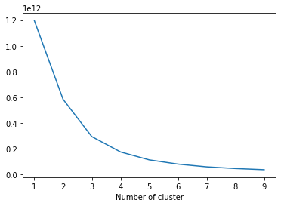


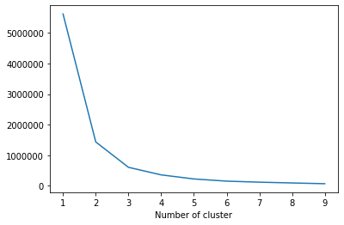
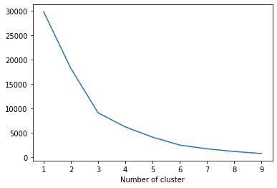
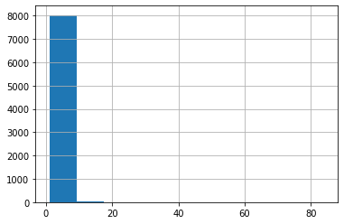
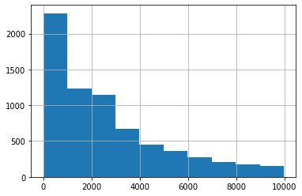
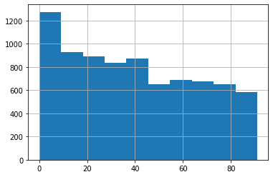
RFM Model Features
Recency
Frequency
Monetary

Slide 23
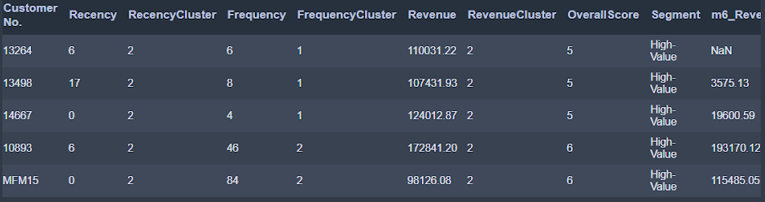
RFM Data Frame use For MODEL
The above data frame Features is used to Train the model For Predicting Customer Life Time Value

Slide 24
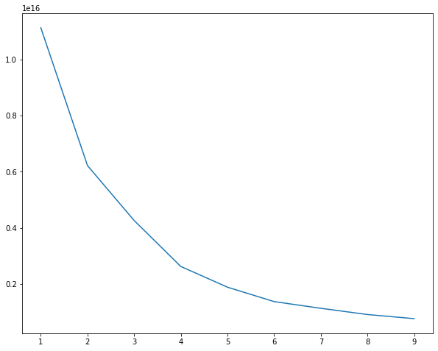
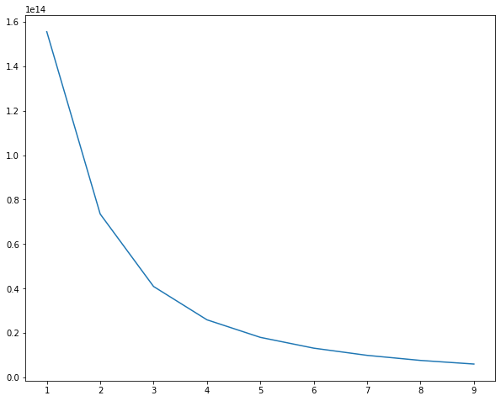
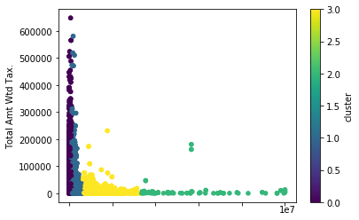
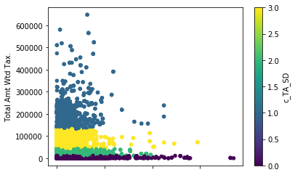
Cluster Features
Service_days','Total Amt Wtd Tax.
KMs Reading','Total Amt Wtd Tax.

Slide 25
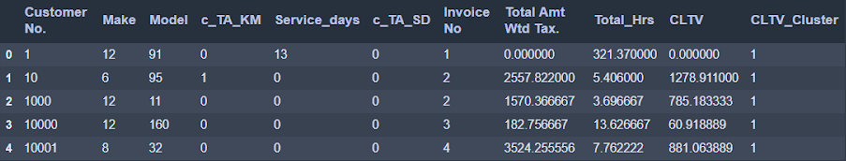
Cluster Data Frame use For MODEL
The above data frame Features is used to Train the model For Predicting Customer Life Time Value

Slide 26
MODEL | CLASSIFICATION CLUSTER MODEL | CLASSIFICATION RFM MODEL
Decision Tree Classifier | 0.95 0.94 | 0.86 0.85
Random Forest Classifier | 0.94 0.94 | 0.85 0.85
XGB Classifier | 0.94 0.93 | 0.86 0.84
XGB Cross Validation | 0.94 0.94

Slide 27
Take feedback from customers after service is done . Since it can be used to find the quality of service
The large share of revenue is from accidental cases. And Service time required is also more. Cars of brands Maruti Suzuki, Hyundai and Mahindra are present most in accidental cases. Spare parts of these cars must be present in stock. So the service time is reduced
Identifying the reason why in some states Paid service is more popular than other service
For accidental order type 25% of total amount goes towards outsourced work, increasing quality of some parts can reduce outsourced work
we should stock Engine Oil, Oil Filters since they are high demands

Slide 28
Next steps
01
02
03
04
Gather more data for other types of data origin. Using collected marketing recommendation.
We would like to do more cohort analysis using more features to get deep insight of customers behavior
During profit calculation, we realized that cost is not provided in the dataset. Hence we would improve the dataset and incorporate profit calculation in the analysis.
Api web app for our model

