Slide 1
The Standard As Value

Slide 2
Concept of Value
Values that are important to people tend to affect the type of decision they make , how they perceive their environment and their actual behaviors.

Slide 3
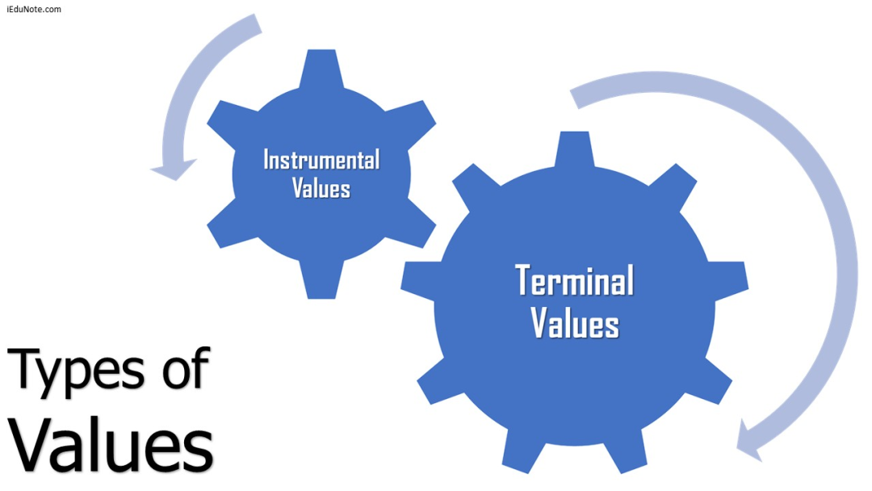

Slide 4
Feature of Value
It contain a judgmental element.
It carries individual or group idea regarding which is good or bad which is preferable
Values are most central to the care of a person
Values may be specific
Value change as experience change values are personal

Slide 5
Source of values
Family factor
Social factor
Personal factor
Culture factor
Religious factor

Slide 6
What is Character
character
Attitude
internal
Invisible
Behavior
External
Visible
independent
dependent

Slide 7
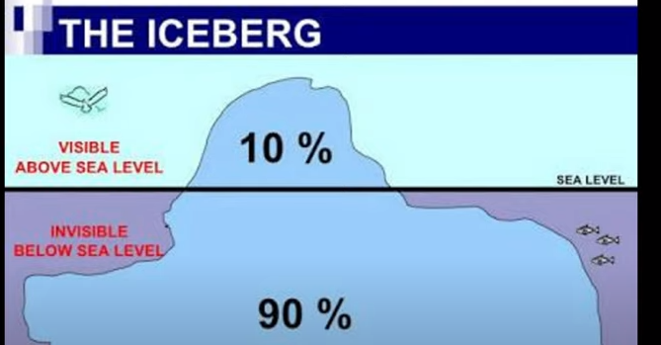

Slide 8
01
Habits
Behavior
10%
02
Doing
Doing
03
sayings
Saying
04
Feeling +intension
Feeling +intension
Aim of Life
05
understand
Understand
Attitude
90%
06
values
Values
07
Belief
Belief
08
Fath in Allah
Faith In Allah
Notes:
© Copyright PresentationGO.com – The free PowerPoint template library

Slide 9
Questions
Define Value and characteristics?
Understanding values and their role in human life?
In the character's view, what is the ultimate goal or purpose of living an ethical life, and how do they pursue this goal?
What are the character's core ethical beliefs, and how do they manifest these beliefs in their interactions with others and their decision-making?

