Slide 1

Reconstructing Netflix
Raghuram SV, Aditya Rao, Kunal Lillaney
600.667 Advanced Distributed Systems & Communication
Johns Hopkins University

Slide 2
Netflix Facts
Internet has overtaken cable TV as preferred medium for delivering video content
Netflix, in 2012, ~30 million subscribers ~30% downstream traffic in the US.
Exclusively uses Amazon AWS for storage,web-services and CDN's for delivery
Revenue of $3.2B , Profit of $200M = $3B Expenses

Slide 3
Netflix Facts
Building CDN, called Open Connect
Pairing with ISP's. Run customized servers
FreeBSDv9 OS, Ngix web server, BIRD internet routing daemons
100TB Space, 4 Cores, 32GB RAM, 10Gbps NIC
Aim to save the cost on bandwidth

Slide 4
Our Project
What if we build our own system?
Would it be easier to rent?
What technologies would we require?
What challenges would we face given the huge number of users?
How would this system look?

Slide 5
Demystifying the Cost
Proposed system with 30 million subscribers
Average User – 80 hours/month
1.5Mbps for each user (HD 1080p 24fps)
Peak of 10 million users
What is the best way to go?

Slide 6
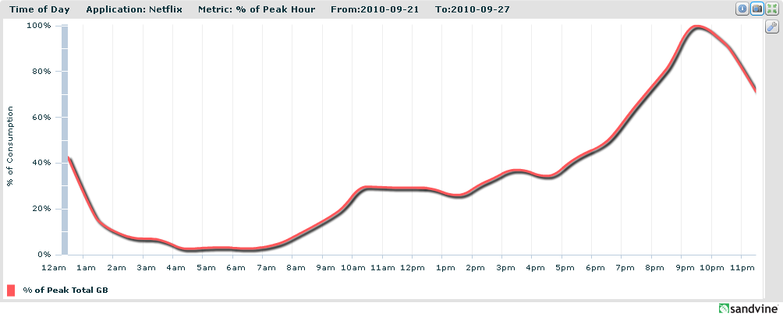

Slide 7
Assumptions we made
Machine Buy + Maintenance for 5 years - $3000
1.5Mbps dedicated line - $6/month
Amazon 1GB data cost - $0.04
Move reserved instances across Amazon data centers
Look at the graph and play with the values

Slide 8
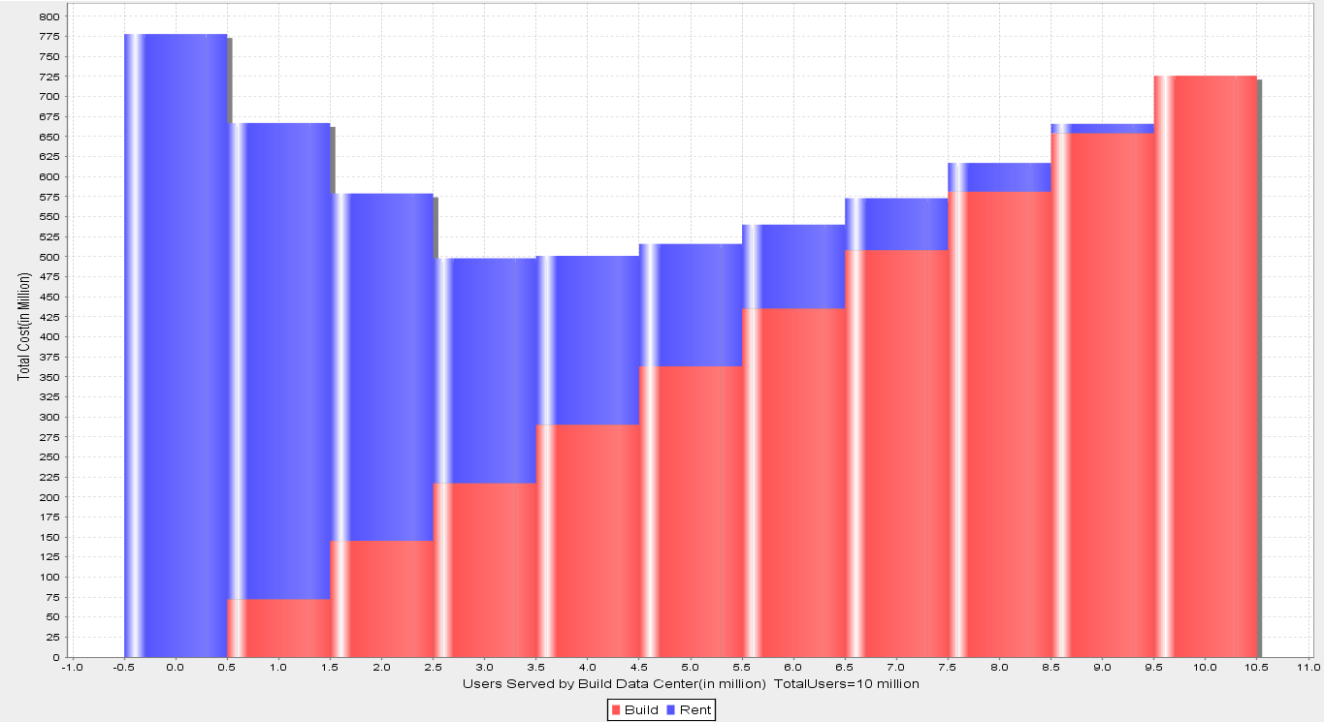
Rent Bandwidth Cost – $0.04/GB
Build Bandwidth Cost - $4.00 for 1Mbps

Slide 9
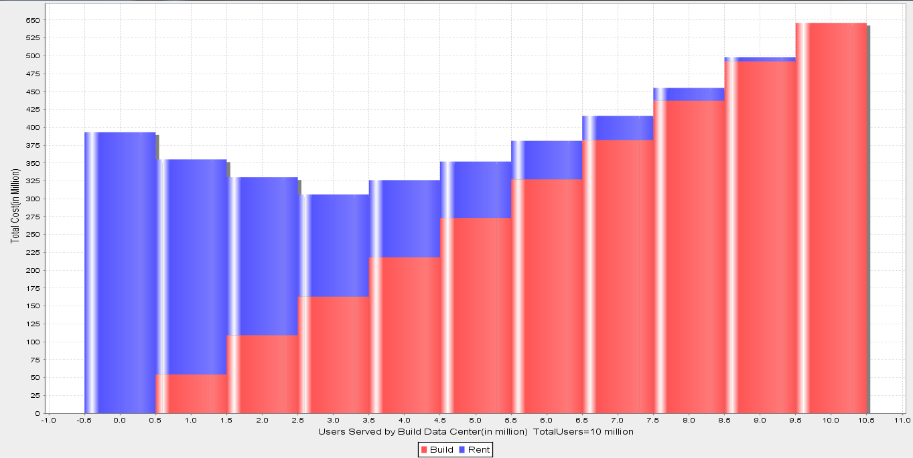
Rent Bandwidth Cost – $0.02/GB
Build Bandwidth Cost - $3.00 for 1Mbps

Slide 10
How we would deploy it
Build Data Center
Amazon Data Center

Slide 11
System Architecture
Two Components – Web Server & Data Center
Data Center – Build and Rent

Slide 12
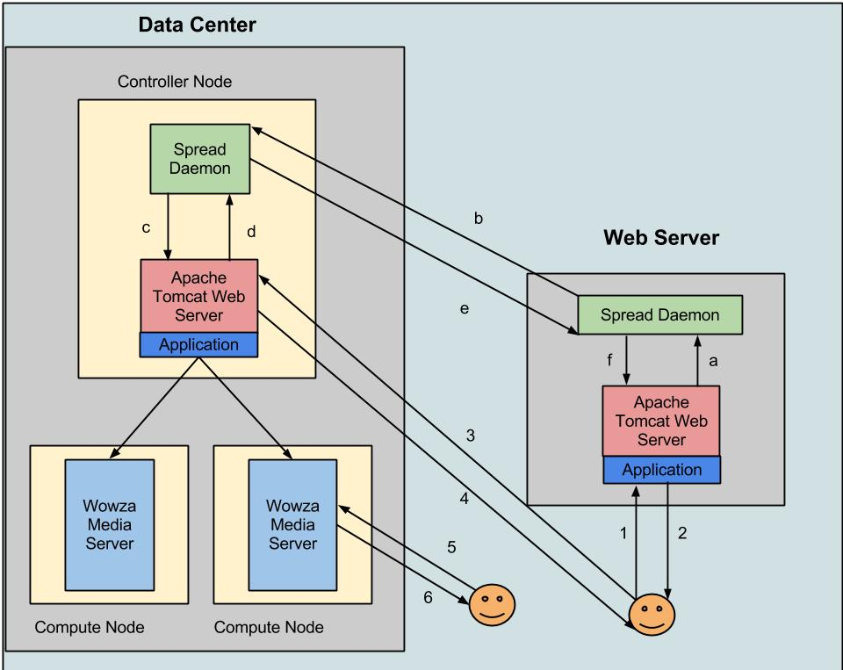
1 – User Request to Web server

Slide 13
2,3 – Redirection to the controller

Slide 14
4,5 – Redirection to the Wowza Media Server

Slide 15
6 – User starts streaming

Slide 16
Steps 1-6 : Redirection using GeoIp to correct Media server
Steps a-f : Token Management between Data Centers and Web Servers

Slide 17
GeoIP for correct Datacenter
Latitude & Longitude for IP
Euclidean Distance Formula
Redirect to the closest build data centers
If build data centers are unavailable, switch to closest rented one

Slide 18
Token for Resource Allocation
Data center
Each data center has a token pool
Datacenter has a token directory for each web server
The allocation is done using first come first serve policy
Allocation is done in sizes called “batch count”
Allocates whatever it has if the leftover is less than batch count

Slide 19
Token for Resource Allocation
Web Server
Request for tokens made in sizes of batch count
Request a new batch of tokens when about to be exhausted.
Periodically sends a token request when all tokens are exhausted
Redirects to a different data center if all tokens are exhausted for one

Slide 20
Token expiry at Data Center
Unused tokens are expired after a timeout if subsequent tokens are received
Token pool count is incremented based on the number of unused tokens
Handling users who have left

Slide 21
Tools used
OpenStack
Tomcat Web-Server
Spread Toolkit
Maxmind GeoIP
Wowza Media Server

Slide 22
Demo
How we deployed the system?
1 Web-Server
East – 1 Build + 1 Rent
West – 1 Build + 1 Rent
1 Wowza per Build – Capacity 4
2 Wowza per Rent – Capacity 2*2
Total Capacity – 16

Slide 23
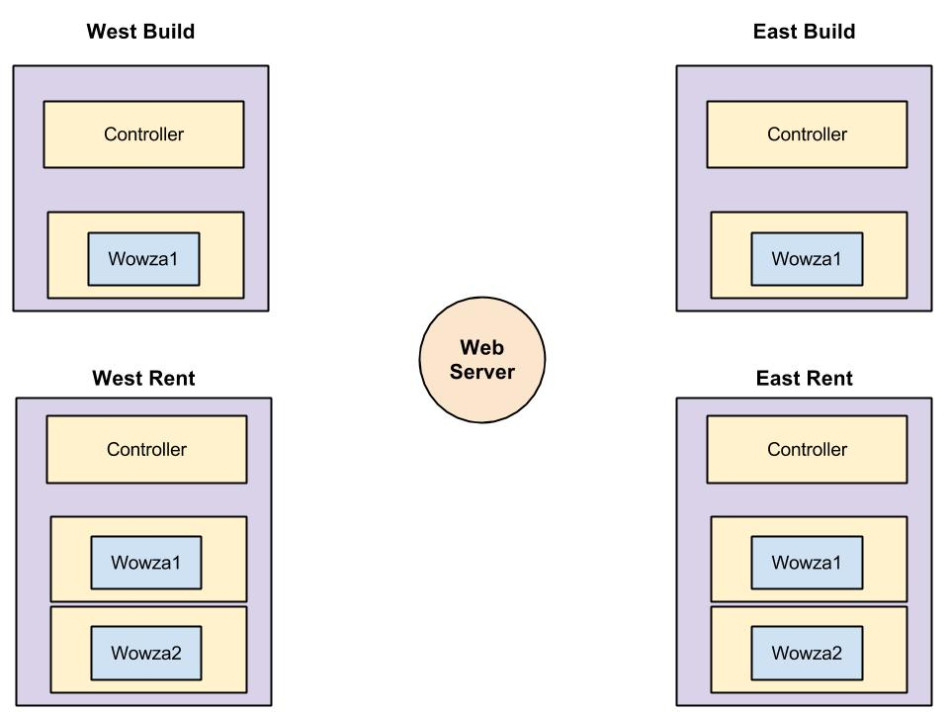

Slide 24
Demo
Demo 1 - A sample video streaming
Demo 2 - Correct allocation of data center
Demo 3 - Transition from build to rent

Slide 25
Future Work
Application in the data center auto-scalable
Login authorization & Access Control
Fault tolerant & Partition aware

Slide 26
References
http://gigaom.com/2012/07/03/netflix-june-one-billion-hours/
http://www.wowza.com/faq
http://aws.amazon.com/about-aws/globalinfrastructure/
http://techcrunch.com/2013/04/22/netflix-beats-analyst-estimates-with-29-2-million-us-subscribers-and-1-billion-in-q1-revenue/
http://www.betterbroadbandblog.com/2010/10/netflix-time-of-day-and-relative-metrics/
http://dev.maxmind.com/geoip/
http://www.spread.org/
http://www.openstack.org/
http://tomcat.apache.org/
http://signup.netflix.com/openconnect

Slide 27
Thank You
Special thanks to the members of the DSN Lab for listening to our long discussions and patiently answering all our questions

