Slide 1
IBM University Engagement Project Submission
“Exploring the Power of Agentic AI with IBM Granite and LangFlow”

Slide 2

Project Tile – AI‑Legal‑Aid Multi‑Agent System (ALAMS)
Domain of Project –
Legal technology (LegalTech) – intelligent assistance for contract review
Student Name | Recent Passport Photo | Email ID | Mobile number [WhatsApp]
KUNAL MANE |  | kunalm0971@gmail.com | 7378665255

Slide 3
Problem Statement -
Access to reliable, affordable, and timely legal advice is limited for individuals, freelancers, and small‑business owners.
High cost & long turnaround for lawyer consultations.
Complex, jargon‑heavy documents (contracts, policies, notices) that non‑lawyers cannot easily interpret.
Scattered legal information across statutes, regulations, case law, and guidance notes makes self‑research time‑consuming and error‑prone.
Existing legal‑aid platforms rely on static FAQs or a single‑purpose chatbot, lacking real‑time, multi‑disciplinary analysis and visual summarisation.
Result – users face hidden risks, non‑compliance penalties, and lost business opportunities.

Slide 4
Proposed Solution -
Agent | Core Functions
Contract Reviewer Agent | Parse uploaded contracts, extract key clauses (payment, liability, termination, IP, data‑privacy), flag risky language, suggest alternative wording.
Compliance Checker Agent | Map obligations to relevant statutes/regulations (e.g., GDPR, consumer‑protection, labor law) and return a compliance score + remediation steps.
Q&A RAG Agent | Retrieve pertinent statutes, regulations, and case excerpts from a curated legal corpus and generate concise, plain‑language answers with citations.
Case Research Agent | Perform similarity search on user facts, retrieve matching judgments, summarize holdings, and highlight precedent relevance.
Conversational Front‑End | Empathetic dialogue layer that routes user intents to the appropriate agent, presents results, and always displays a disclaimer that the output is informational only.

Slide 5
Technology Used
Layer | Tools / Libraries
Data Ingestion & Indexing | Python, LangChain loaders, PDF/DOCX parsers, Apache Tika, OCR (Tesseract) for scanned docs, Elasticsearch / Milvus vector store
Retrieval‑Augmented Generation | OpenAI GPT‑4‑turbo (or Anthropic Claude), Retrieval‑augmented pipelines from LangChain, hybrid BM25 + dense vector search
LLM Prompt Engineering & Agent Orchestration | LangChain Agents, ReAct pattern, tool‑calling APIs
Document Parsing & NER | spaCy / HuggingFace legal‑specific models (LegalBERT, ContractNLI), custom rule‑based clause extractors
Backend & API | FastAPI, Docker, Kubernetes (optional for scaling)
Front‑End Dashboard | React + TypeScript, Ant Design / Material‑UI, Plotly for compliance heat‑maps, PDF.js for document preview
Security & Privacy | OAuth2 / OpenID Connect, end‑to‑end encryption (TLS), data‑at‑rest encryption, optional on‑premise deployment for sensitive contracts

Slide 6
Langflow component Used -
Component | Purpose in the Pipeline
Document Loader | Ingest PDFs, DOCX, images → raw text
Text Splitter | Chunk contracts / statutes into 1‑2 k token windows
Embedding Model | sentence‑transformers/all‑mpnet‑base‑v2 (or OpenAI embeddings) to populate vector store
Vector Store | Milvus / FAISS node for fast similarity search
Retriever | Hybrid (BM25 + vector) to fetch top‑k relevant passages
RAG Prompt Builder | Assemble retrieved snippets with user query for LLM
LLM Node | Call GPT‑4‑turbo (or Claude) for generation
Agent Router | Determines which specialized agent (Contract, Compliance, Q&A, Case) should handle the request
Output Formatter | JSON → dashboard UI, PDF report generator
Feedback Loop | Capture user corrections → fine‑tune retrieval weights or prompt templates

Slide 7
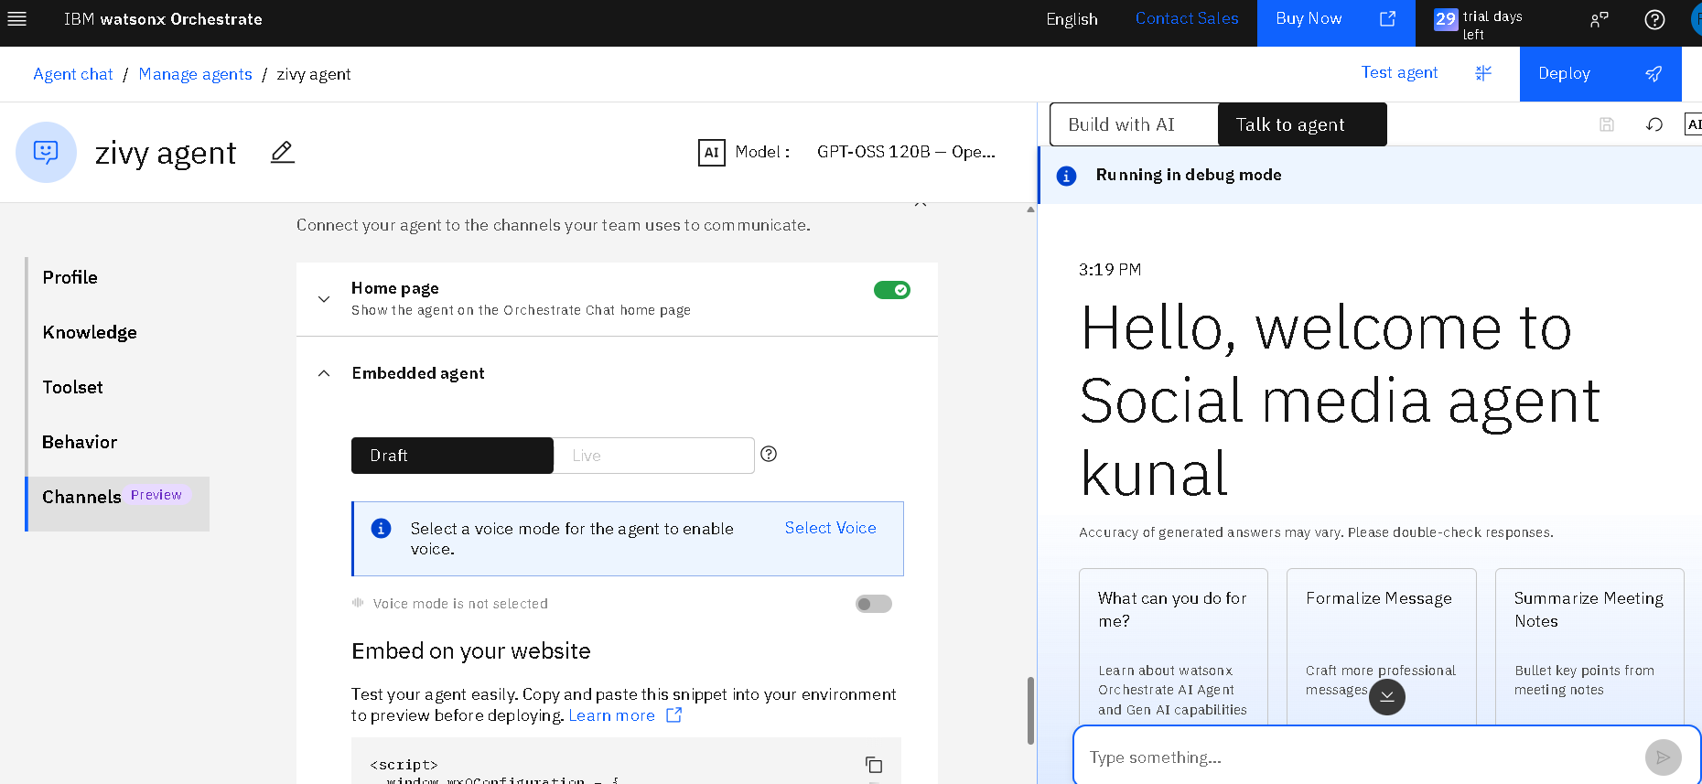
Langflow workflow -

Slide 8
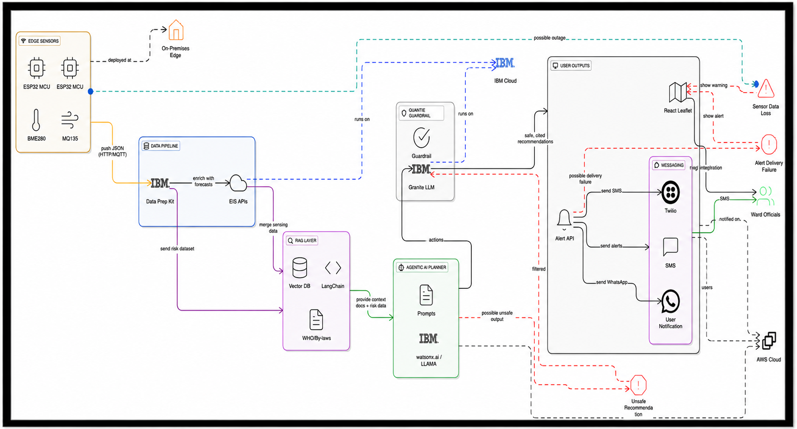
Architecture blueprint

Slide 9

Role of Agentic AI in the solution
Autonomous Task Decomposition – Each agent decides which sub‑tools (e.g., clause extractor, regulator lookup) to invoke, following the ReAct (Reason‑Act) loop.
Dynamic Tool‑Calling – The Conversational Front‑End can request the Contract Reviewer, Compliance Checker, or Case Research agent on‑the‑fly based on user intent.
Self‑Improvement – Agents log “confidence scores” and user feedback; a meta‑agent periodically re‑weights retrieval strategies and updates prompt templates.
Specialised Knowledge Encapsulation – Legal domain expertise is encapsulated in distinct agents, keeping prompts concise and avoiding “one‑model‑fits‑all” pitfalls.
Safety Guardrails – An Ethics/Disclaimer agent intercepts any response that may cross the advice‑boundary and injects the required legal disclaimer.

Slide 10
Novelty and Uniqueness
Aspect | What Makes It Distinct
Multi‑Agent Architecture | Combines contract analysis, compliance checking, statutory Q&A, and case research in one coherent platform rather than isolated tools.
Hybrid Retrieval + Generation | Uses both dense vector similarity and classic keyword BM25 to maximise recall of niche statutes and obscure case law.
Clause‑Level Risk Scoring | Automatic risk taxonomy (high/medium/low) with visual highlights – rare in generic legal chatbots.
Regulatory Mapping Layer | Direct linkage of contract obligations to specific legal provisions (e.g., GDPR Art. 5) and a compliance heat‑map.
Langflow‑Driven Prototyping | Full end‑to‑end pipeline built visually, enabling rapid iteration and easy hand‑off to dev‑ops.
Privacy‑First Deployment Options | Supports on‑premise or private‑cloud vector stores, allowing firms with strict data‑security policies to adopt the system.

Slide 11
Git Hub Link
Github URL –
The Files Uploaded on Github repository 1) project file
2) AI‑Legal‑Aid Multi‑Agent System.pptx file
3)any other files

Slide 12
Future Scope
Jurisdiction Expansion – Incorporate multi‑jurisdictional corpora (US, EU, UK, AU, India) with automatic jurisdiction detection.
Fine‑Tuned Legal LLMs – Deploy open‑source models such as Llama‑2‑Legal or Juris‑BERT for cost‑effective generation while preserving domain accuracy.
Negotiation Assistant – Add a bargaining agent that suggests counter‑offers and simulates negotiation scenarios.
Integration with E‑Signatures & Contract Management Systems (DocuSign, Microsoft SharePoint) for end‑to‑end workflow.
Continuous Learning Loop – Use anonymised user corrections to semi‑automatically retrain clause‑extraction models and update the vector store.
Regulatory Alerts – Subscribe to official gazettes/APIs to push real‑time compliance alerts (e.g., new data‑privacy rules).
Accessibility Features – Voice‑interface and multi‑language support (English, Spanish, Mandarin) to reach broader user bases.
·
·
·

Slide 13
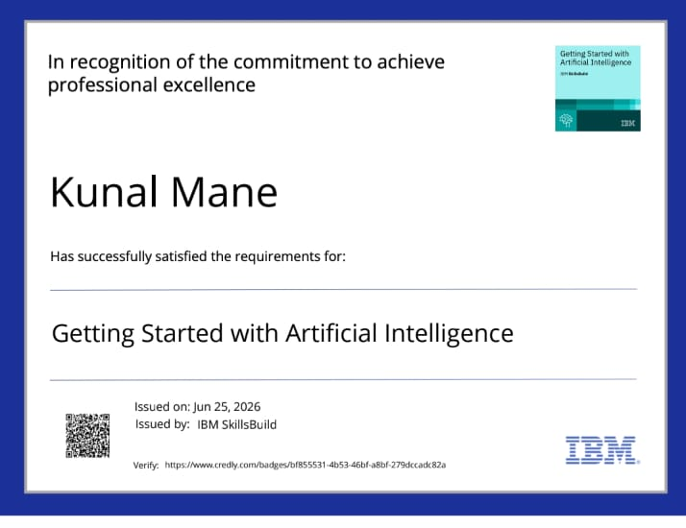
Certificates Earned:
Please add your credly certificate

Slide 14
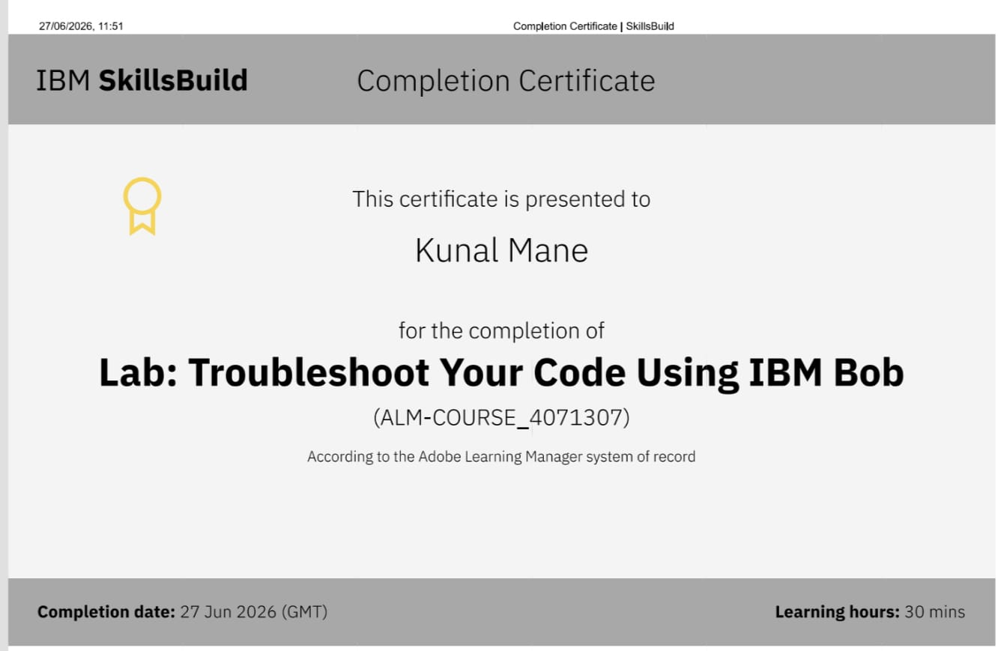
Certificates Earned:​
Add your IBM BOB Certificate

Slide 15


