Slide 1
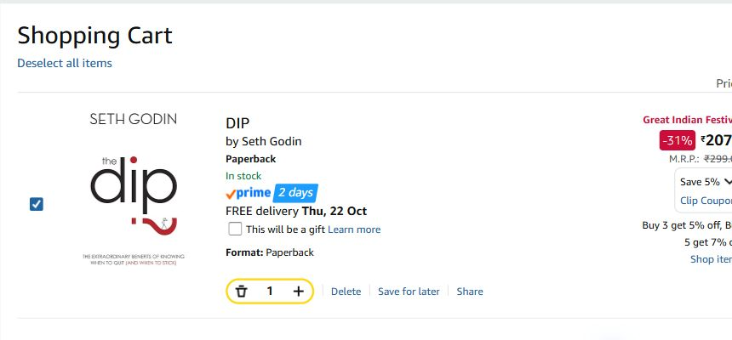
Amazon India web checkout
UX evaluation & redesign
Cart → delivery → payment → review → confirmation → cancellation
Objective
Make the final cost, choices, editing and recovery easier to understand, then validate with shoppers.
7 genuine desktop captures • 1 placed and cancelled COD order
AMAZON INDIA WEB CHECKOUT / INDEPENDENT EDUCATIONAL STUDY
01 / 07
Notes:
Scope: desktop web in Edge, captured 20 October 2026. Independent educational UX case study; not affiliated with Amazon. Objective: document the visible path and test redesign hypotheses. Prototype: https://kunalmahurkar.is-a.dev/amazon-checkout-prototype/

Slide 2
User and checkout journey
Assumption-based persona
Cart
01
Item and quantity
An India-based desktop shopper who wants to confirm the payable amount, choose delivery and payment, and know whether the order succeeded.
02
Address
Saved choices
03
Payment
Method selection
Context
04
Delivery
Speed choice
Signed-in Amazon India web checkout; a ₹207 book, cash on delivery, ₹7 fee, ₹214 final total.
05
Review
₹214 total
06
Outcome
Place and cancel
AMAZON INDIA WEB CHECKOUT / INDEPENDENT EDUCATIONAL STUDY
02 / 07
Notes:
The persona is an assumption, not an interviewed participant. The journey reflects browser captures from 20 October 2026. The six saved addresses were visible by count, but personal address information was withheld from publication.

Slide 3
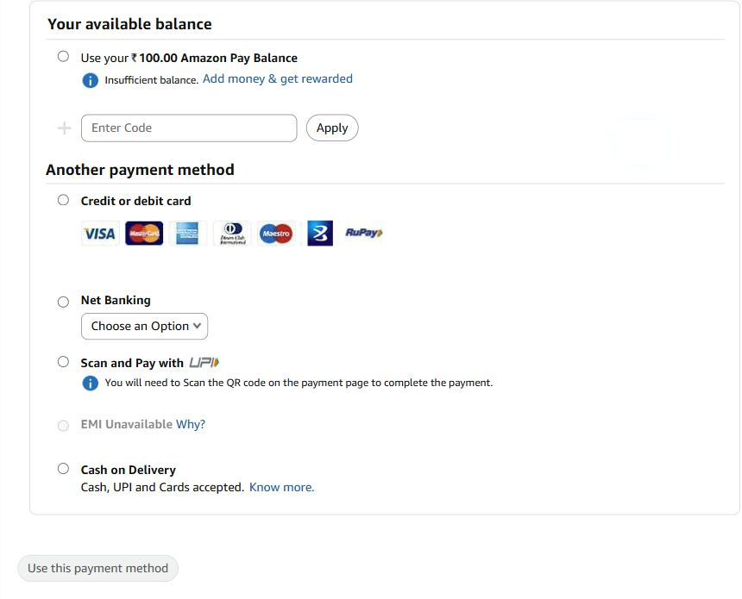
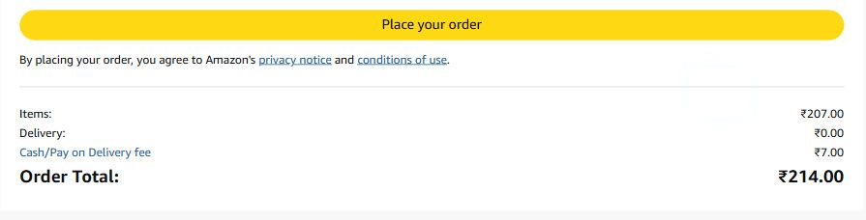

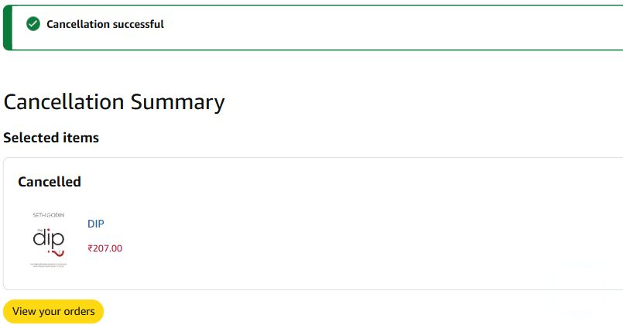
Observed current experience
Review: ₹207 + ₹7 COD fee = ₹214
Cart: item, quantity, coupon and delivery promise
Payment methods
Order placed; then successfully cancelled
No payment failure was encountered or captured.
AMAZON INDIA WEB CHECKOUT / INDEPENDENT EDUCATIONAL STUDY
03 / 07
Notes:
Original screenshots: evidence/cart-item.jpg, evidence/payment-methods.jpg, evidence/review-total.jpg, evidence/order-confirmation.jpg and evidence/cancellation-success.jpg. All were captured from the signed-in desktop web flow on 20 October 2026. Public crops exclude personal account information. Display copies of payment, review and cancellation remove cursor artifacts only; originals remain in the evidence folder. Screenshot evidence establishes visible states, not participant friction.

Slide 4
Nielsen heuristic audit
Observed interface facts support the questions below; user impact needs testing.
ID
Evaluation question
Heuristic
Evidence boundary
Risk
01
Final cost clarity
Visibility of status
Review shows ₹7 COD fee
3/4
02
Choice overload
Minimalist design
Coupon and extra-choice screens
2/4
03
Edit without rework
User control
Change links at review
3/4
04
Payment language
Real-world match
Card, UPI, COD labels
2/4
05
Failure recovery
Error recovery
Failure evidence missing
4/4
06
Primary control ease
Efficiency of use
Controls visible; targets unmeasured
2/4
All six are hypotheses; severity scores are provisional. No participant usability test has been run.
AMAZON INDIA WEB CHECKOUT / INDEPENDENT EDUCATIONAL STUDY
04 / 07
Notes:
All six candidate usability issues are hypotheses. Provisional severity is a risk ranking, not a validated defect rating. UX-01 is grounded in the observed ₹7 cash-on-delivery fee at review; whether it confused users is untested. UX-05 has no original payment-failure screenshot. See the case study for original evidence and full rationale.

Slide 5
UX laws as design considerations
Hick’s Law
Fitts’s Law
Jakob’s Law
UX-02 · HYPOTHESIS
UX-06 · HYPOTHESIS
UX-03 · HYPOTHESIS
Many choices can slow decisions.
Small or distant controls take more effort to acquire.
Shoppers expect familiar checkout editing patterns.
Group delivery and payment choices; reveal secondary details when needed.
Use clear, adequately sized primary and Edit controls.
Keep direct Edit links and preserve earlier choices.
Measure selection time.
Measure missed clicks.
Measure wrong turns.
These laws guide the redesign; the screenshots alone do not establish a violation.
AMAZON INDIA WEB CHECKOUT / INDEPENDENT EDUCATIONAL STUDY
05 / 07
Notes:
Hick's Law: complex choice sets can lengthen decision time; linked to UX-02. Fitts's Law: target acquisition depends on size and distance; linked to UX-06. Jakob's Law: familiar conventions shape expectation; linked to UX-03. None of these law violations has been established for Amazon by the screenshots alone.

Slide 6
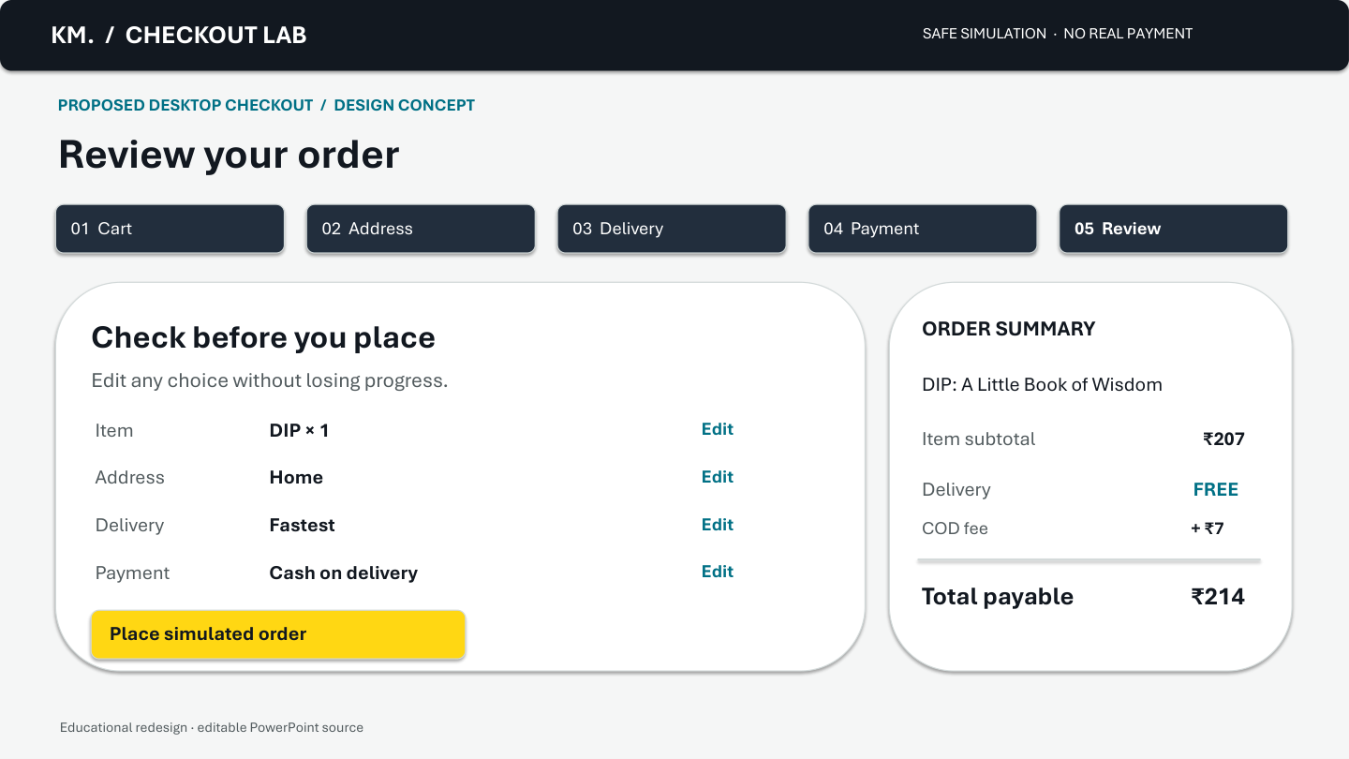
Before / after: review and recovery
BEFORE · observed Amazon review
AFTER · proposed design concept
The ₹7 COD fee and ₹214 final total are visible. Whether shoppers notice the fee is untested.
Clear fee · explicit total · direct Edit actions
Prototype: kunalmahurkar.is-a.dev/amazon-checkout-prototype/
AMAZON INDIA WEB CHECKOUT / INDEPENDENT EDUCATIONAL STUDY
06 / 07
Notes:
Before is the genuine Amazon India review crop, evidence/review-total.jpg. After is a design concept, not an Amazon screen. The concept emphasizes a single itemized total, contextual Edit controls and safe payment retry. Prototype: https://kunalmahurkar.is-a.dev/amazon-checkout-prototype/

Slide 7
Priorities, measures and next test
Priority
Five-participant validation plan
P1 Payment recovery + price clarity
P2 Editing, choices and terminology
P3 Primary control polish
Recruit India-based desktop shoppers with varied checkout familiarity. Ask them to change an address, inspect the payable total, select payment and recover from a simulated failure.
Success measures
Completion / abandonment · time and clicks · failure recovery · cost clarity · unaided task success
Baseline not measured. No usability sessions have been conducted. Prototype: kunalmahurkar.is-a.dev/amazon-checkout-prototype/
AMAZON INDIA WEB CHECKOUT / INDEPENDENT EDUCATIONAL STUDY
07 / 07
Notes:
P1 payment recovery is a risk hypothesis; no original failure was observed. P1 cost clarity is based on visible fee presentation, but comprehension is unmeasured. P2 covers editing and choice grouping. P3 covers click target polish. Five India-based desktop shoppers should try the simulated checkout. Track completion, abandonment, time, clicks, recovery and reported clarity. All baselines are not measured. Prototype and full case: https://kunalmahurkar.is-a.dev/case-amazon-checkout.html

