Slide 1
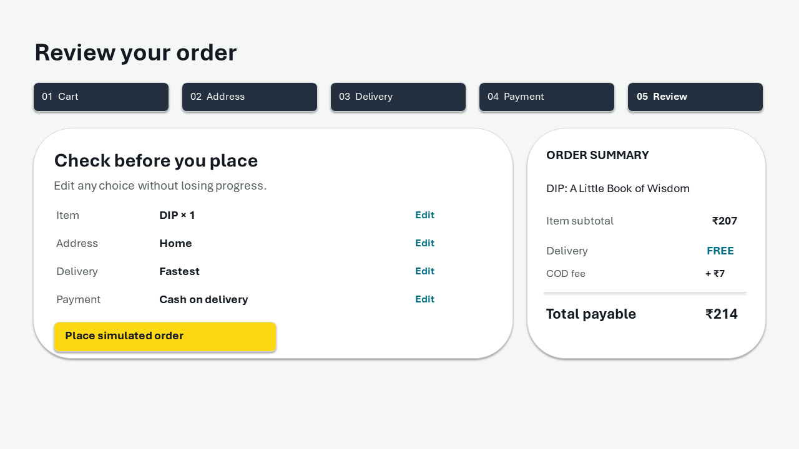
01 AMAZON INDIA CHECKOUT
What the checkout shows, and what I changed
One checkout journey ? six heuristic concerns ? three UX laws
REAL INTERFACE
Seven public screenshot crops from one checkout and cancellation
REDESIGN
Editable screen designs and a working checkout simulation
Proposed review screen. This is a concept, not an Amazon screen.
Kunal Mahurkar · Independent UX evaluation · 20 Oct 2026
01 / 07
Notes:
I observed one Amazon India desktop checkout, placed a cash-on-delivery order and cancelled it. This deck separates visible facts from usability hypotheses and shows the redesign response.

Slide 2
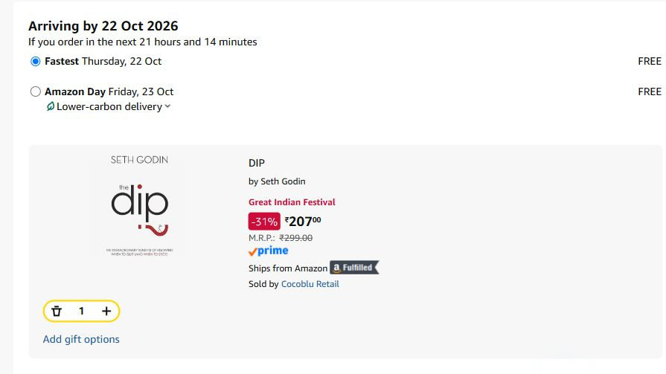
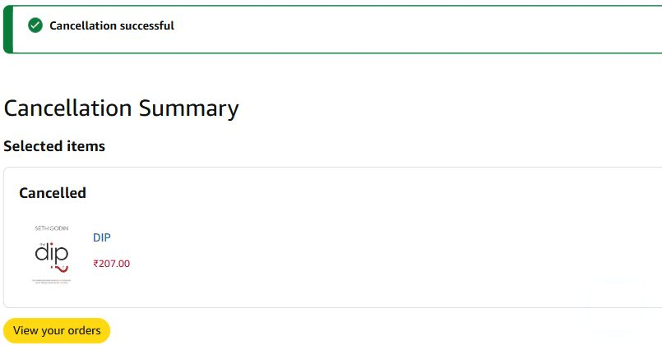
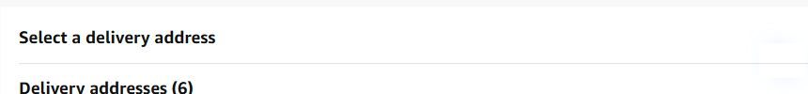
02 AMAZON INDIA CHECKOUT
Evidence: one observed journey
Seven original crops. One cash-on-delivery order placed and cancelled immediately.
EV-02 · ADDRESS
EV-04 · DELIVERY
EV-07 · CANCELLATION
Address choices are indicated; personal rows are withheld.
Two delivery choices appear, both marked free.
Cancellation completed after the observed order.
Evidence boundary: no participants, analytics baseline, or real payment failure were observed.
Kunal Mahurkar · Independent UX evaluation · 20 Oct 2026
02 / 07
Notes:
These are genuine public crops from one desktop browser journey. They establish the displayed UI, not shopper confusion or conversion performance.

Slide 3
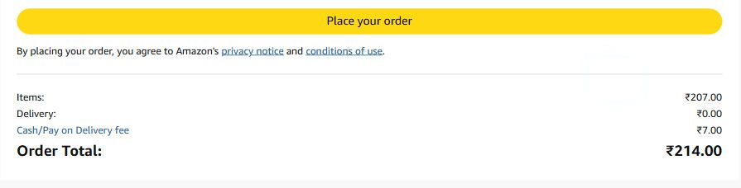
03 AMAZON INDIA CHECKOUT
01 Final cost may be easy to miss
Nielsen #1: visibility of system status · Current fact versus design response
OBSERVED ON AMAZON · EV-05
PROPOSED REVIEW
₹207 item + ₹7 COD fee = ₹214 total
The final amount is visible at review. Whether shoppers notice the fee before commitment is unmeasured.
Itemized summary beside the decision; explicit total payable and Edit actions.
Test: ask shoppers to state the total and the reason for the extra ₹7 before clicking.
Kunal Mahurkar · Independent UX evaluation · 20 Oct 2026
03 / 07
Notes:
Observed: item 207 rupees, cash-on-delivery fee 7 rupees, total 214 rupees. Visibility of system status is the relevant heuristic. The fee is visible, so missed comprehension is a hypothesis, not a proven violation. Test by asking for the total and fee unaided.

Slide 4
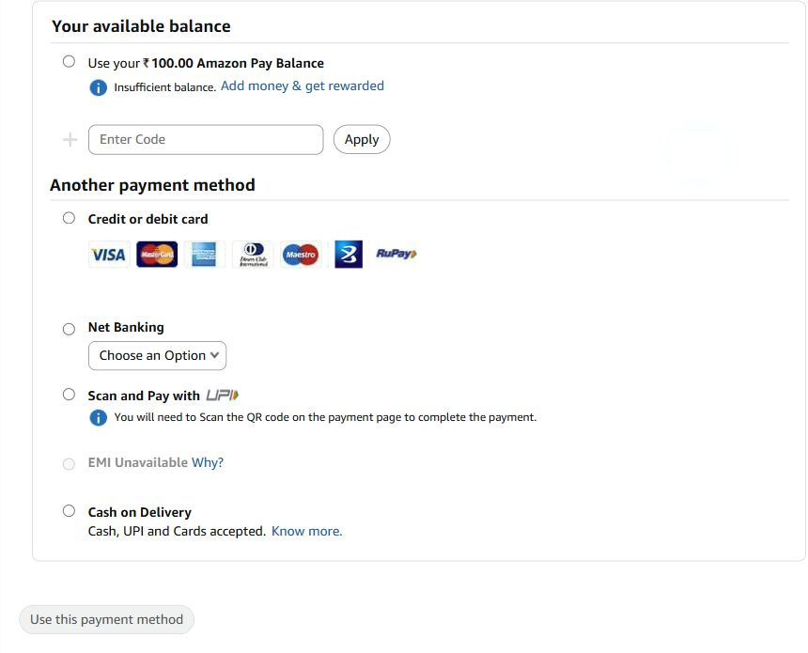
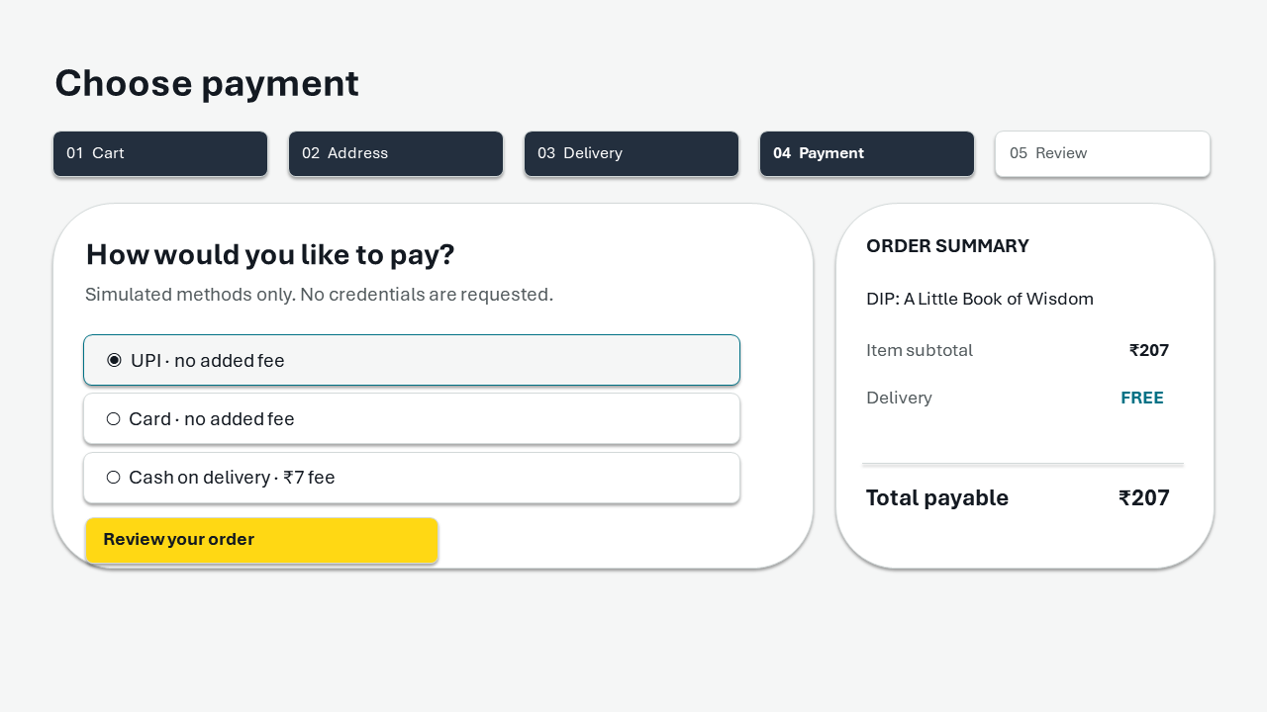
04 AMAZON INDIA CHECKOUT
02 Payment methods need cost context
Nielsen #2: match to familiar language · Hick's Law: decision effort
OBSERVED ON AMAZON · EV-03
PROPOSED PAYMENT DESIGN
Visible fact: multiple payment labels and an insufficient balance message.
Change: group methods, use plain labels, and show the COD fee at selection.
Test: compare method comprehension and selection time; a current violation is unproven.
Kunal Mahurkar · Independent UX evaluation · 20 Oct 2026
04 / 07
Notes:
The screenshot shows cards, net banking, UPI scan and pay, and cash on delivery. The possible comprehension cost is a hypothesis. Nielsen's match with the real world and Hick's Law guide simpler labels and fee disclosure. No selection time was measured.

Slide 5
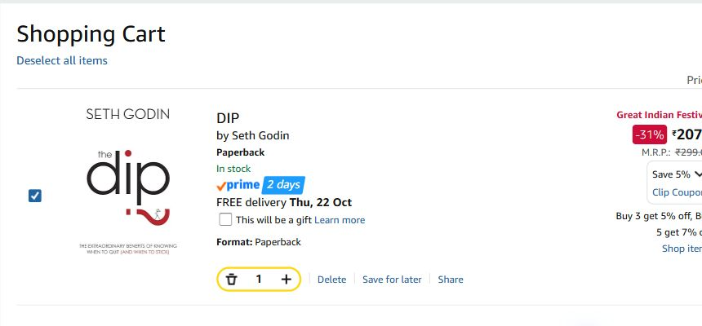
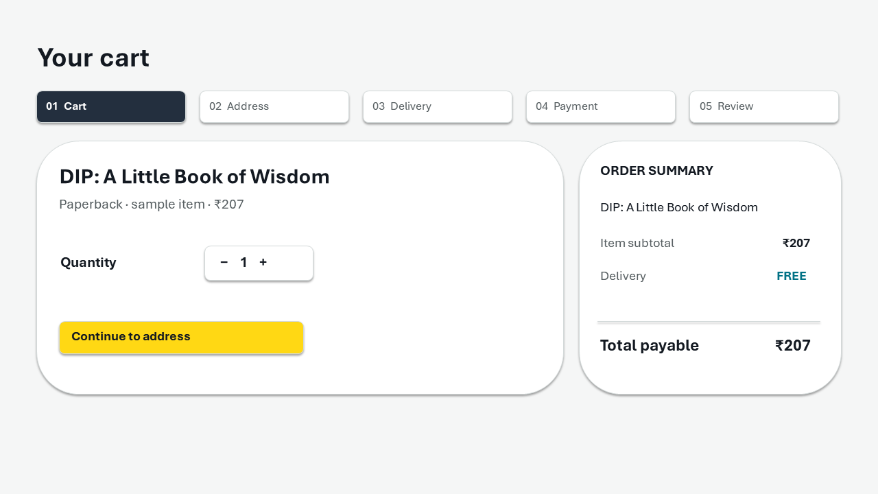
05 AMAZON INDIA CHECKOUT
03 Choices and controls compete for attention
Nielsen #8 and #7 · Hick's Law and Fitts's Law
OBSERVED CART · EV-01
PROPOSED CART
Hypothesis: competing decisions
Change: clearer action hierarchy
Promotion content and quantity control share the cart view. Decision effort has not been timed.
Keep quantity and continue actions prominent, with larger consistent click areas.
Kunal Mahurkar · Independent UX evaluation · 20 Oct 2026
05 / 07
Notes:
The cart crop shows item controls and promotion content. This can raise choice and pointer concerns, but a screenshot does not measure hesitation or missed clicks. Nielsen's minimalist design and flexibility heuristics, plus Hick's and Fitts's laws, motivate grouping and more consistent click areas.

Slide 6
06 AMAZON INDIA CHECKOUT
Heuristic map: observation, risk, response
A heuristic concern is an expert assessment. A user impact requires a user study.
Heuristic | Observed | Risk or limit | Proposed change
#1 Visibility | ₹7 COD fee and ₹214 total visible | Fee comprehension unknown | Persistent itemized total
#2 Real-world match | Several payment labels shown | Meaning or fee may need context | Plain labels and fee at choice
#3 User control | Change links observed at review | Rework not established | Direct Edit, retained choices
#7 Efficiency | Quantity and Change controls visible | Pointer misses unmeasured | Consistent click targets
#8 Minimalism | Promotions and choices share view | Decision effort unmeasured | Clearer hierarchy
#9 Error recovery | No failure captured | Scenario only | Explicit status and safe retry
Hick: group choices ? Fitts: enlarge targets ? Jakob: familiar edits. All impacts await testing.
Kunal Mahurkar · Independent UX evaluation · 20 Oct 2026
06 / 07
Notes:
The six rows summarize which Nielsen heuristic is relevant. None is presented as a verified user harm. Five observations come from the real journey; payment failure is a proposed scenario. Severity is expert judgement and must be checked through user testing.

Slide 7
07 AMAZON INDIA CHECKOUT
Next step: test the proposed improvements
Priority reflects expert judgement. No usability sessions or outcome metrics have been measured.
P1 · Total and fee
P1 discovery · Failure recovery
Ask shoppers to state the amount payable and explain the COD fee before placing an order.
Use a controlled simulated failure. Check whether shoppers understand payment status and recover safely.
P2 · Payment and editing
P3 · Pointer targets
Compare method comprehension and late-edit success without prompting.
Measure target sizes and missed clicks during desktop tasks.
Measures: correct total and fee, unaided task success, time, errors, recovery success, confidence.
References: nngroup.com/articles/ten-usability-heuristics/ · interaction-design.org/literature/topics/hick-s-law · interaction-design.org/literature/topics/fitts-law
Kunal Mahurkar · Independent UX evaluation · 20 Oct 2026
07 / 07
Notes:
Priorities: cost comprehension and risk-led recovery first, then payment choice and editing, then target polish. Recruit five India-based desktop shoppers. Ask for the total and fee, a late edit, and recovery from a simulated failure. Measure unaided task completion, time, errors, missed clicks and confidence. No outcomes are claimed yet. Sources: original screenshots; Nielsen Norman Group heuristics; Interaction Design Foundation summaries of Hick's and Fitts's laws.

