Slide 1



Along and beyond the gas pipe

Slide 2



Initial Analysis
Cleaning the data and searching for simple patterns:
Separating periods of anomalous behaviour
Variance Measure
Difference in averages

Slide 3
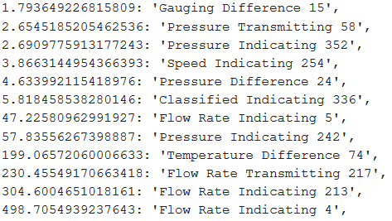
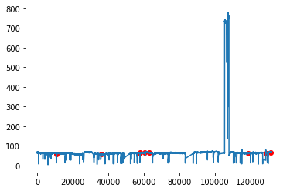
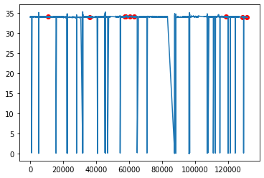
Initial Analysis
Ranking the features
Plots

Slide 4
Initial Analysis
Did not work :(

Slide 5
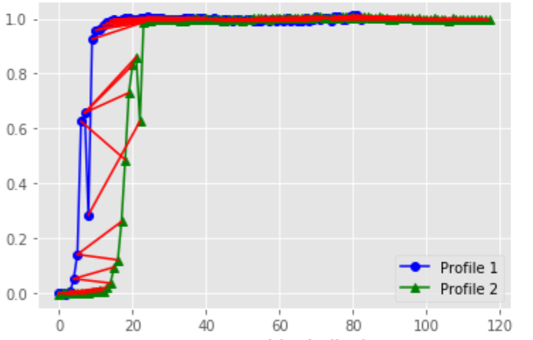
Anomaly detection - DTW
A snapshot of the entire signal detected by all sensors analysed
Observed variation in similarities
Dynamic Time Warping (DTW) used
Uses Euclidean distance mapping

Slide 6
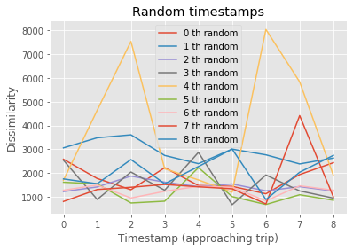
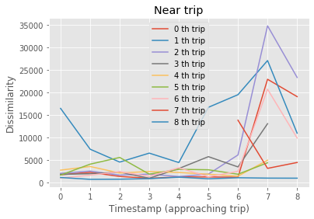
Anomaly detection - DTW
The similarities show a pattern of spikes approaching trip
In contrast, randomly taken windows around timestamp show haphazard behavior

Slide 7
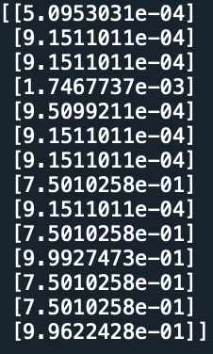
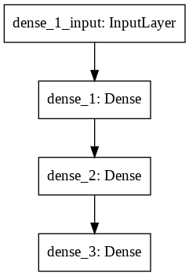
Anomaly detection - DTW + NN
NN trained for similarity patterns
Image shows the NN’s prediction on those points: 1 incorrect prediction
Incorrect prediction could be unrecognized trip

Slide 8
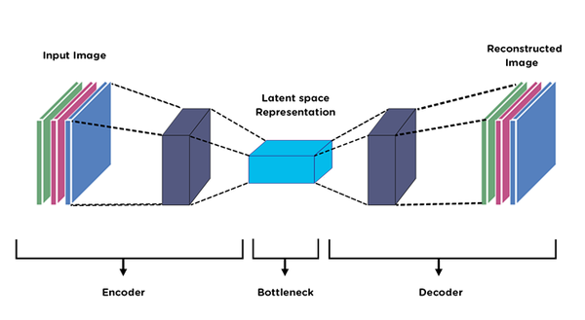
Finding better indicators
Using a LSTM based Autoencoder:
Passing data through a bottleneck
Finding representative variables in the latent space

Slide 9
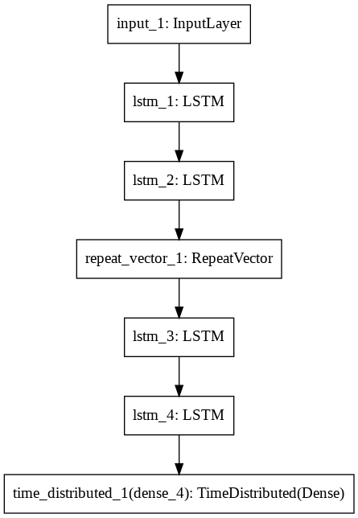
Finding better indicators
Using a LSTM based Autoencoder:
Passing data through a bottleneck
Finding representative variables in the latent space

Slide 10
PCA and K Means
Performing further dimensionality reduction
1x100 -> 1x3
Clustered for a finite state diagram

Slide 11
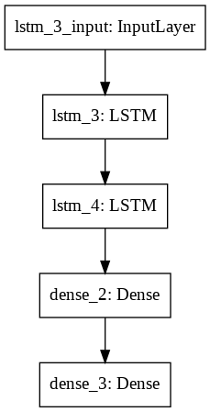
Time series forecasting
LSTM model to predict time series
Investigated different solvers and loss functions
Predicts next time step given 60 time steps

Slide 12
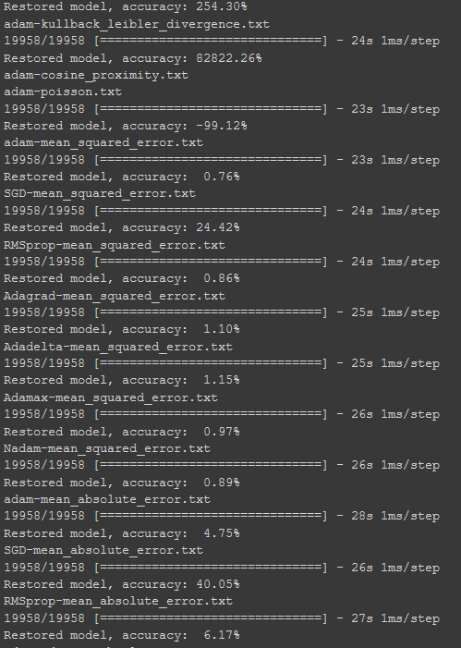
Time series forecasting
RMSprop, mean_squared_error
0.089

Slide 13


Slide 14
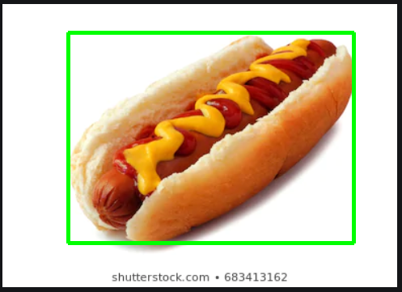
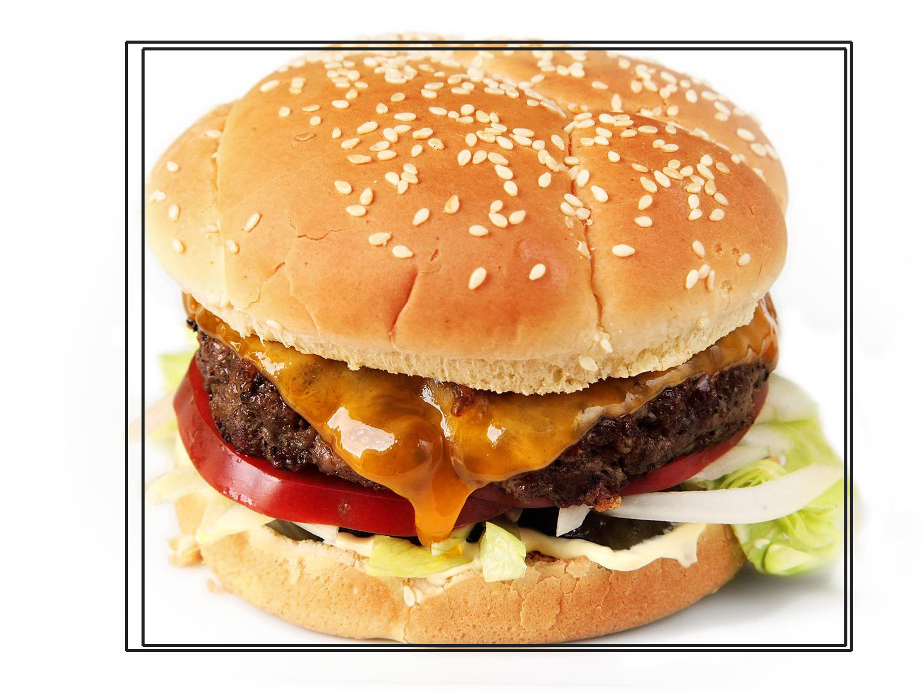
Desktop version:
Google Vision Api
Image Segmentation
Label assignment
True/False

Slide 15

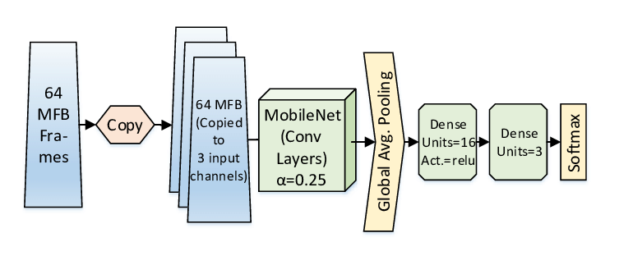
Mobile Version
Tensorflow real time hotdog recognition

Slide 16
Thank you!

