Slide 1

ONLINE MEDICAL CONSULTATION SYSTEM
GROUP 1
202012001 - Janu Shah
202012002 - Deepak Maidasani
202012003 - Kush Modi
202012004 - Niharika Srivastava
202018001 - Kunal Panjwani

Slide 2

Functional requirements
Hospital, Hospital Branch, Medical Branch, FAQ, State, City -
Appointment, Payment, Patient Record, Meet Details, Feedback -
The Hospital has a common Registration Id, Name and Digital Signature for many of its Hospital Branches. For each Hospital Branch its contact details are stored. A Hospital Branch can be located within Many Cities of One State. Each Hospital Branch has multiple Medical Branches which offer their treatment facilities. Common FAQs regarding the hospital are also stored in the system.
Functionality - Computing revenue generated from consultations, accessing performance details of hosptital and medical branches, appointment counts, lab testing, location and contact details for any hospital or medical branch.
A Patient can book Many Appointments for One or Many Doctors. For each appointment, its schedule and status (pending/ completed/ cancelled/ followUpRequired) is stored. While booking appointment, Payment Details are stored separately. After consultation, One Patient Record is created for each Appointment. So, One Patient can have Many Patient Records. Data generated during consultation, like video feed is stored as Meet Details. Patients give review, rating as Feedback.
Functionality - Retrieving patient records or video feed generated during an appointment, computing total appointments made by a patient, ordering doctors of a medical branch based on their number of successful appointments, fetching cancelled appointment details.
Patient, Doctor, Availability of Doctor -
Identification proof, medical history, vitals and contact details of Patients are stored. For Doctors, their Identification proof, contact details, experience details and ratings are stored. The availability details of each doctor are stored separately so that convenient time slots can be allotted to patients while scheduling appointment.
Functionality - Registering patients, evaluating performance of doctors, accessing all reports generated or consultation details of a patient post an appointment, retrieving review of a patient, retrieving details of patients who have had regular consultations in a time frame.
Laboratory, Pharmacy -
Each hospital branch has one Laboratory whose contact details are stored and can be booked by patients to give samples for pathology tests at their home. The Hospital has One Online Pharmacy whose contact details are stored and patients can order medicines from it.
Functionality – Retrieve patient details who booked a particular lab, accessing patient details who have ordered medicine from the online pharmacy during a specific time, evaluate high performing labs based on their number of bookings.

Slide 3
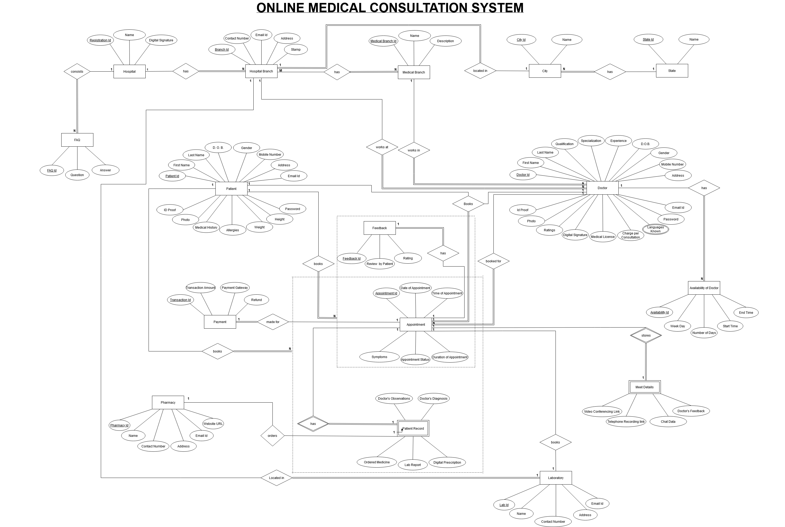
Entity-Relationship Diagram
Click Here

Slide 4
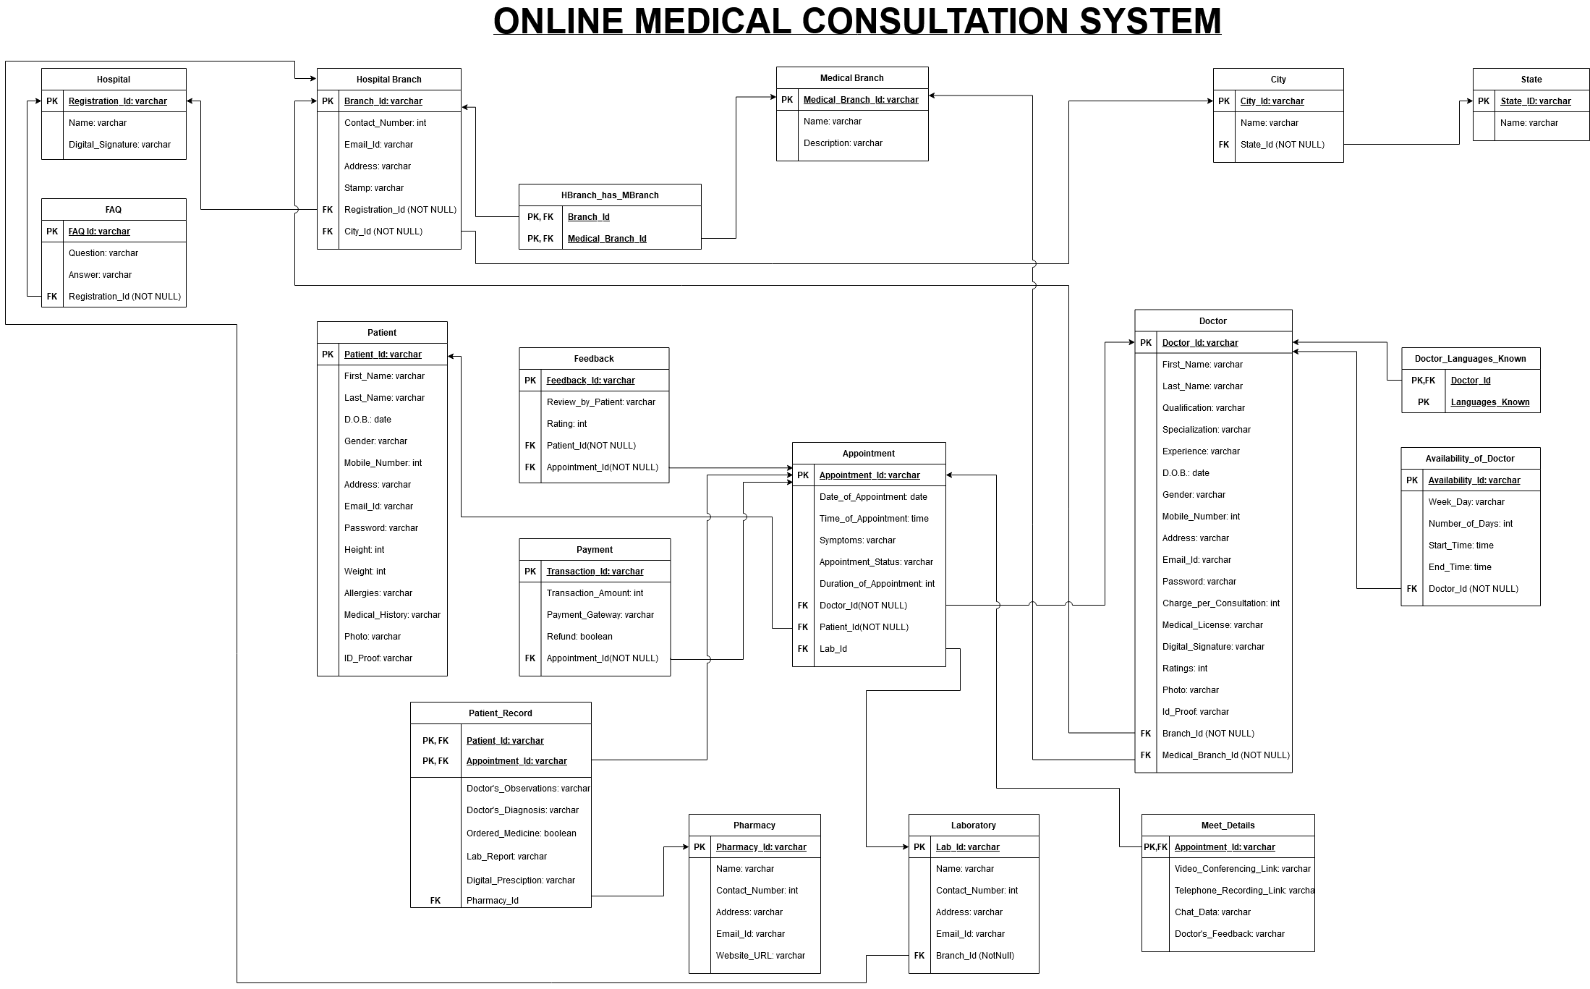
Relational model
Click Here

Slide 5
SQl DDL
Click here to access the SQL DDL Constraints

Slide 6
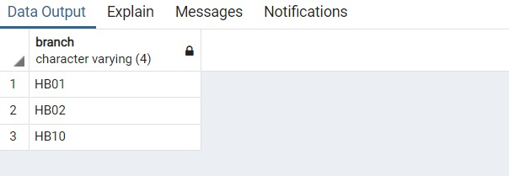
Functional requirementS
List the hospital branch with the least number of consultations in 2020.
SELECT cntBranch.branch FROM
(
SELECT d.branchId AS branch, COUNT(a.appointmentId) AS cnt
FROM doctor AS d
JOIN hospitalBranch AS h ON h.branchId = d.branchId
JOIN (SELECT * FROM appointment WHERE dateOfAppointment >= '2020-01-01' AND dateOfAppointment <= '2020-12-31’ AND appointmentstatus='completed') AS a
ON a.doctorId = d.doctorId
GROUP BY d.branchId
) AS cntBranch
CROSS JOIN
(
SELECT MIN(cnt) AS mincnt FROM
(
SELECT d.branchId AS branch, COUNT(a.appointmentId)
AS cnt
FROM doctor AS d
JOIN hospitalBranch AS h ON h.branchId = d.branchId
JOIN (SELECT * FROM appointment WHERE dateOfAppointment >='2020-01-01' AND dateOfAppointment <= '2020-12-31' AND appointmentstatus='completed') AS a ON a.doctorId = d.doctorId
GROUP BY d.branchId
) AS cntBranch
) AS minCount
WHERE cntBranch.cnt = mincnt
ORDER BY cntBranch.branch

Slide 7
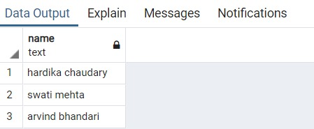
Functional requirements
Retrieve the patients who have paid more than Rs. 5000 in the year 2020 for their online consultation.
SELECT firstName || ' ' || lastName AS name
FROM patient
WHERE patientId IN
(
SELECT a.patientId
FROM (SELECT * FROM appointment WHERE dateOfAppointment >='2020-01-01' AND dateOfAppointment <= '2020-12-31’ AND appointmentstatus = 'completed') AS a
JOIN payment AS py
ON a.appointmentId = py.appointmentId
JOIN patient AS p ON p.patientId = a.patientId
GROUP BY a.patientId
HAVING SUM(py.transactionAmount ) > 5000
)

Slide 8
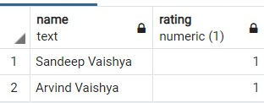
Functional requirements
List the doctor who has the lowest rating in the ‘Cardiology’ medical branch.
SELECT docRating.firstName || ' ' || docRating.lastName AS name, rating FROM
(
SELECT firstName, lastName, rating
FROM doctor
WHERE medicalBranchId IN
(
SELECT medicalBranchId FROM medicalBranch
WHERE medicalBranchName ='Cardiology'
)
) AS docRating
CROSS JOIN
(
SELECT MIN(rating) as minrating
FROM doctor
WHERE medicalBranchId IN
(
SELECT medicalBranchId FROM medicalBranch
WHERE medicalBranchName ='Cardiology'
)
) AS docMinRating
WHERE docRating.rating = docMinRating.minrating

Slide 9
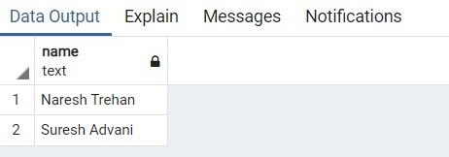
Functional requirements
List the top 2 doctors whose patients have booked labs the minimum number of times.
SELECT concat(firstName,’ ‘,lastName) AS name FROM
(
SELECT d.doctorId, d.firstName, d.lastName, COUNT(*) AS cnt
FROM appointment AS a
JOIN doctor AS d ON a.doctorId = d.doctorId
JOIN patientRecord AS pr ON pr.patientId = a.patientId AND pr.appointmentId =a.appointmentId
WHERE pr.pharmacyId IS NOT NULL
GROUP BY d.doctorId
ORDER BY d.doctorId
) AS docCount
CROSS JOIN
( SELECT MIN(cnt) AS mincnt FROM
(
SELECT COUNT(*) AS cnt
FROM appointment AS a
JOIN doctor AS d ON a.doctorId = d.doctorId
JOIN patientRecord AS pr ON pr.patientId = a.patientId AND pr.appointmentId =a.appointmentId
WHERE pr.pharmacyId IS NOT NULL
GROUP BY d.doctorId
) AS docLabs
)minNoOfLabs
WHERE docCount.cnt = minNoOfLabs.mincnt
ORDER BY docCount.doctorId
LIMIT 2

Slide 10
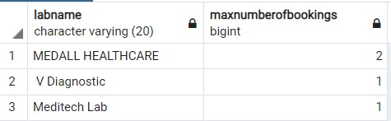
Functional requirements
List the top 3 labs which have been booked the maximum number of times in the year 2020.
SELECT l.labname,
COUNT(*) AS maxnumberofbookings
FROM
(
SELECT * FROM appointment
WHERE dateofappointment>='2020-01-01'
AND dateofappointment<='2020-12-31'
)
AS app
JOIN
(
SELECT * FROM laboratory
) AS l
ON l.labid=app.labid
GROUP BY labname
ORDER BY count(*) DESC
LIMIT 3

Slide 11
CONCLUDING REMARKS
The medical field is rapidly shifting towards online solutions to deliver its facilities and widen its scope for reaching and treating patients irrespective of the physical distance between them. Our project is built for catering such needs.
After successful implementation, our database will be able to efficiently store and manage all the data records specific to the users i.e. doctor and patients as well as the services like laboratory and pharmacy which are involved in the process of an online medical consultation.
Limitation: Our Database is not going to store the details of hospital, laboratory or pharmacy management. We are only concerned with their booking aspect.
Even in the absence of a pandemic, online consultation proves to be a winner for saving travelling time and additional expenses while defying distance and seeking second opinions of specialized doctors located in different parts of the country from your home itself!
‘When you can’t walk in, just login!’

Slide 12

THANK YOU

