Slide 1

SQL

Slide 2
Module 1: Introduction to MSSQL
Overview of MSSQL and its history
Understanding database concepts and terminology
Differences between MSSQL and other relational database management systems

Slide 3

Module 2: Installation and Configuration
Installation of MSSQL server
Configuration of server and client tools
Best practices for installation and configuration

Slide 4

Module 3: Data Types and Tables
Overview of data types in MSSQL
Creating tables and primary keys
Data integrity and constraints

Slide 5

Module 4: Querying Data
Introduction to Structured Query Language
Retrieving data using SELECT statement
Filtering and sorting data

Slide 6

Module 5: Advanced Querying
Querying multiple tables using JOINs
Subqueries and nested queries
Working with aggregate functions

Slide 7
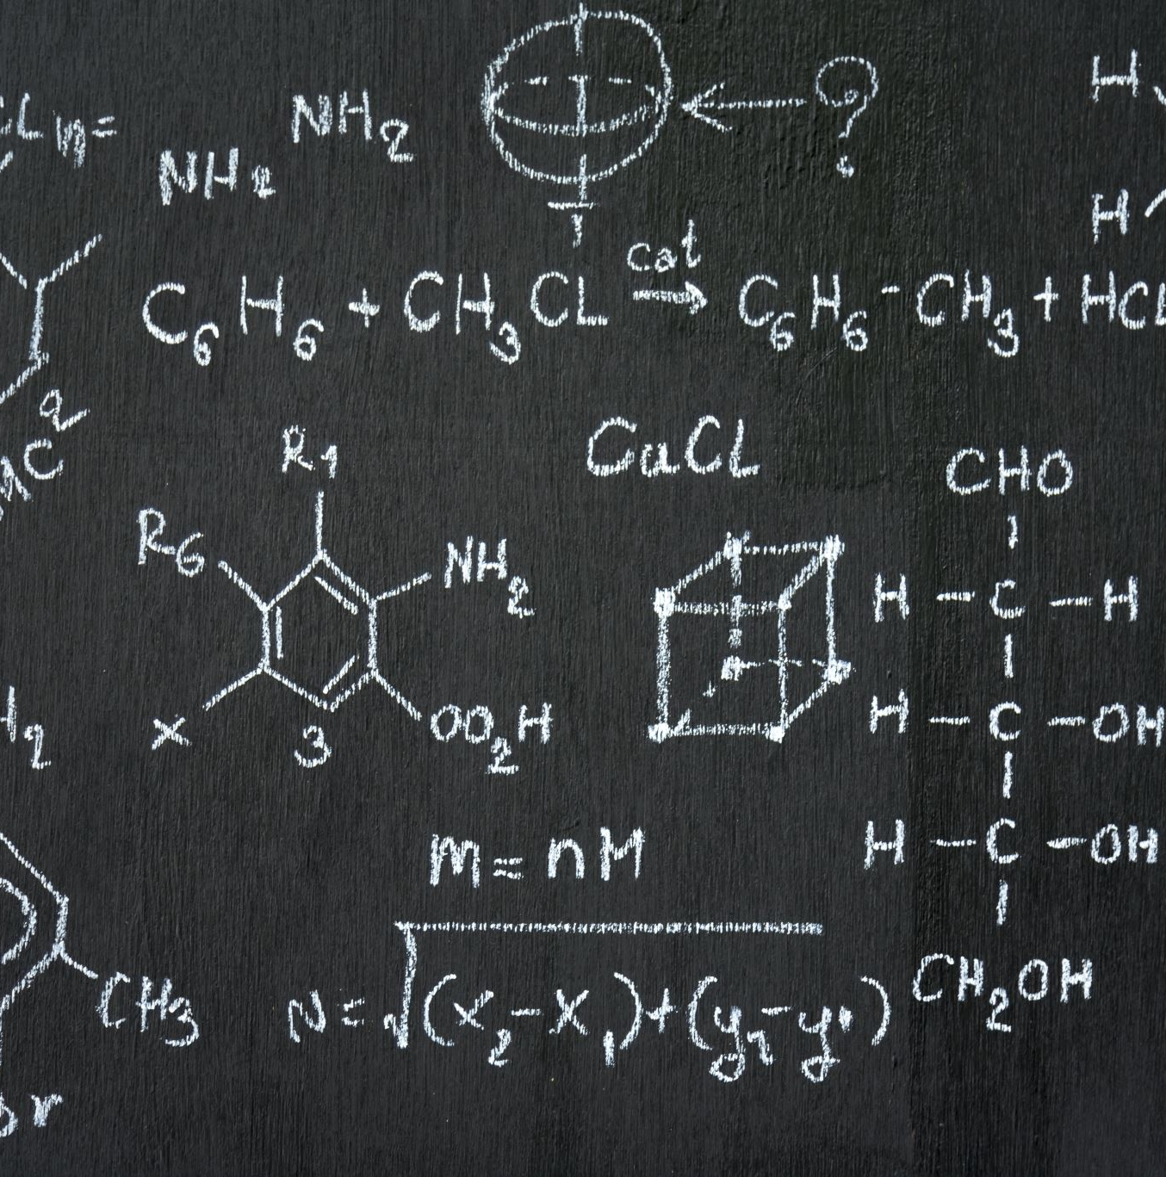
Module 6: Stored Procedures and Functions
Creating and executing stored procedures
Functions and their uses
Differences between stored procedures and functions

Slide 8

Module 7: Transactions and Concurrency
Understanding transactions and their importance
Implementing transactions
Managing concurrency issues in multi-user environments

Slide 9

Module 8: Security and Authentication
Introduction to MSSQL security features
Authentication and authorization
Implementing security best practices

Slide 10

Module 9: Performance Tuning and Optimization
Understanding performance tuning and optimization
Query optimization techniques
Indexing strategies and best practices

Slide 11

Module 10: Maintenance and Backup
Maintenance tasks and best practices
Backup and recovery strategies
Automating maintenance tasks

Slide 12

Conclusion
Recap of key concepts covered in the course
Encouragement to continue learning and exploring MSSQL

