Slide 1

Basic Details of the Team & Problem Statement
Problem Statement Title:
HomeLY: Bridging the Gap for Home Comforts
Team Name: Soup Monsters
Team Leader Name: Kunal Ranjan
Theme Name: Miscellaneous

Slide 2
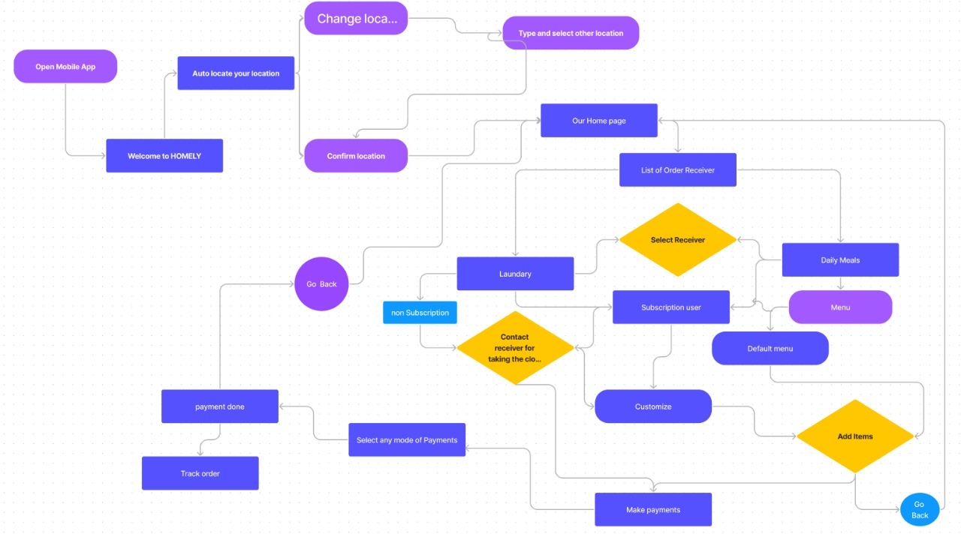










Idea/Approach Details
Process Flow:
Homely is a comprehensive service designed to address the needs of individuals living in different cities who miss home-cooked meals and face laundry challenges. The service combines a meal delivery system with laundry assistance to provide convenience, comfort, and a taste of home for its customers.
Components of Homely:
Homemade Meal Delivery:
Customized Meal Plans:
Regional Cuisines
Daily or Weekly Options
3. Subscription Plans:
1.Homely offers flexible subscription plans, This includes monthly, quarterly, and annual options.
2.Subscribers receive discounts and priority scheduling.
Describe your Technology stack here:
2.LAUNDRY ASSISTANCE:
1. Scheduled Laundry Pickup
2. Professional Laundry Care
3.Eco-friendly Practices
4.Quality and Safety:
1.The service maintains strict quality control and safety standards for food preparation and laundry processing.
2.All staff members are trained in food safety and laundry care protocols.
Some other components includes: Community and Feedback ,Sustainability

Slide 3
Idea/Approach Details
Describe your Use Cases here
Describe your Dependencies / Show stopper here
1.Daily Meals for Busy Professionals:
Actor: Working professional
Use Case: Ordering daily meals for a hassle-free dining experience amid a busy work schedule.
Family Subscription for Weekly Meals and Laundry:
2.Emergency Express Laundry:
Actor: Business traveler
Use Case: Requesting fast laundry service for urgent clothing needs.
3.Subscription for Weekly Meals and Laundry:
Actor: Working Professional
Use Case: Subscribing to a weekly meal plan and laundry service to simplify Daily life.
4.Corporate Employee Well-being Program:
Actor: HR department
Use Case: Providing meal and laundry service subscriptions as part of an employee well-being initiative.
Dependencies:
1.Meal Preparation : Homely relies on mothers of that particular city. The availability of this moms and the quality of food preparation are critical to the service's success.
2.Laundry Facilities: Homely ’s laundry service depends on access to professional laundry facilities, including washing machines, dryers, and equipment for stain removal, ironing, and folding. The service's efficiency and quality depend on these facilities.
3.Delivery infrastructure
4.Payment Processing
5.Website/App
Show stopper:
A potential show stopper for Homely could be the failure to meet food safety and hygiene standards. If there are food contamination issues, illness outbreaks, or violations of safety regulations, it could lead to legal consequences, loss of customer trust, and potential business shutdown. To prevent this show stopper:
1.Homelyshould establish strict quality control and safety standards for food preparation, including the training of moms in food safety protocols.
2.A robust feedback and monitoring system can quickly identify and address any potential issues with food safety and hygiene, ensuring a proactive approach to compliance.

Slide 4
Team Member Details
Team Leader Name: Kunal Ranjan
Branch :Btech Stream: CSE Year :III
Team Member 1 Name: Badal Kumar Singh
Branch :Btech Stream : CSE Year: III
Team Member 2 Name : Najmul Haque
Branch : Btech Stream : CSE Year: III
Team Member 3 Name: Pranjal Kumar
Branch : Btech Stream : CSE Year: III
Team Member 4 Name: Chandni Kumari
Branch : Btech Stream: CSE Year : III

