Slide 1

Basic Details of the Team & Problem Statement
Problem Statement Title:
HomeLY: Bridging the Gap for Home Comforts
Team Name: Soup Monsters
Team Leader Name: Kunal Ranjan
Theme Name: Miscellaneous

Slide 2



Homely: Bringing Home to Your Doorstep
Homely is the ultimate solution for individuals living away from home, providing delicious home-cooked meals and convenient laundry assistance. Experience comfort and convenience with Homely.

Slide 3
Idea/Approach Details
Homely is a comprehensive service designed to address the needs of individuals living in different cities who miss home-cooked meals and face laundry challenges. The service combines a meal delivery system with laundry assistance to provide convenience, comfort, and a taste of home for its customers.
Components of Homely:
Homemade Meal Delivery:
Customized Meal Plans:
Regional Cuisines
Daily or Weekly Options
3. Subscription Plans:
1.Homely offers flexible subscription plans, This
includes monthly, quarterly, and annual options.
2.Subscribers receive discounts and priority scheduling.
2.LAUNDRY ASSISTANCE:
1. Scheduled Laundry Pickup
2. Professional Laundry Care
3.Eco-friendly Practices
4.Quality and Safety:
1.The service maintains strict quality control and safety standards for food preparation and laundry processing.
2.All staff members are trained in food safety and laundry care protocols.
Some other components includes: Community and Feedback ,Sustainability

Slide 4


The Homely Service
Meal Delivery
Our meal delivery system brings the taste of home to your doorstep. Enjoy delicious and wholesome home-cooked meals without the hassle of cooking.
Laundry Assistance
We also offer laundry assistance to take care of your laundry needs. Say goodbye to endless hours spent at the laundromat and let us handle it for you.
Convenience
Homely provides convenience by combining meal delivery and laundry assistance in one comprehensive service. Focus on what matters most while we take care of the rest.

Slide 5

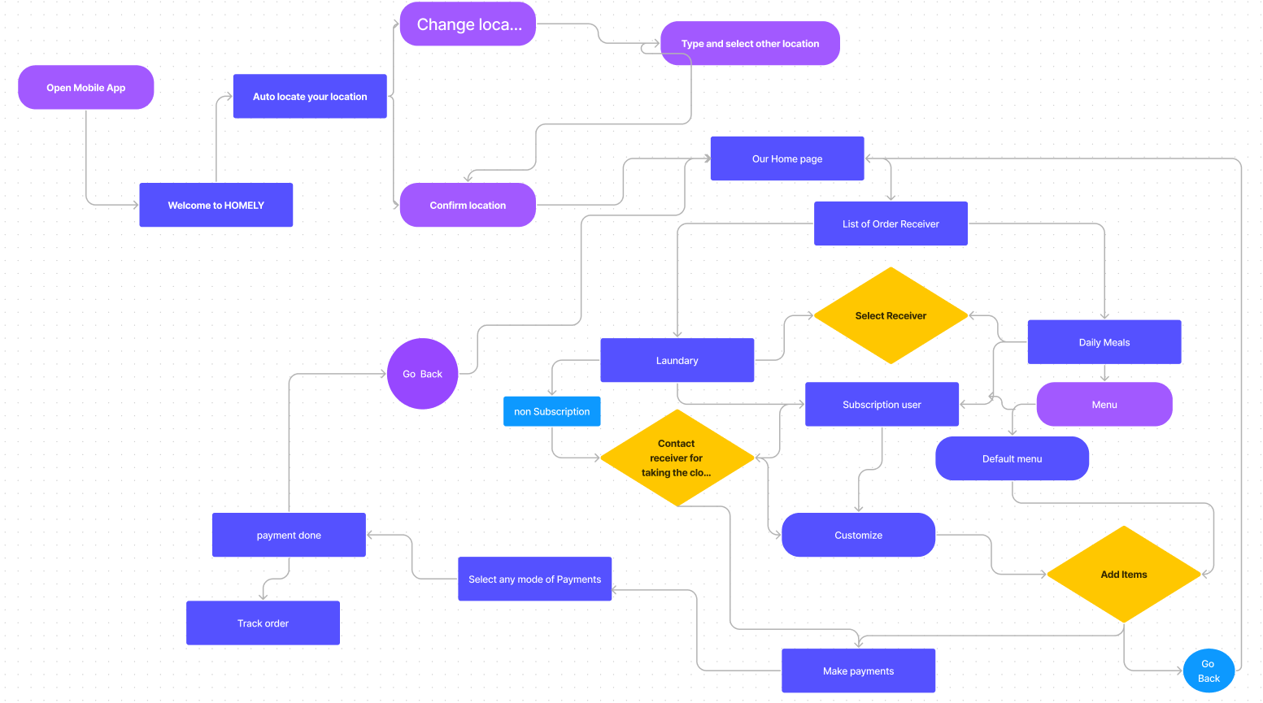
Technologies Used Process Flow

Slide 6

Target Audience
1
Working Professionals
Homely caters to the needs of busy working professionals who crave the comfort of home-cooked meals and require laundry assistance to lighten their load.
2
Individuals Living Away from Home
Homely is designed for individuals who are living away from home, whether it's for work, study, or other reasons. We understand the challenges you face.

Slide 7


Conclusion
Recap of Homely's Offerings
Final Thoughts and Closing Remarks
Homely provides delicious home-cooked meals and convenient laundry assistance, bringing the comforts of home right to your doorstep.
We strive to make your experience with Homely exceptional. Let us take care of your meals and laundry, so you can focus on what truly matters.

Slide 8


