Slide 1
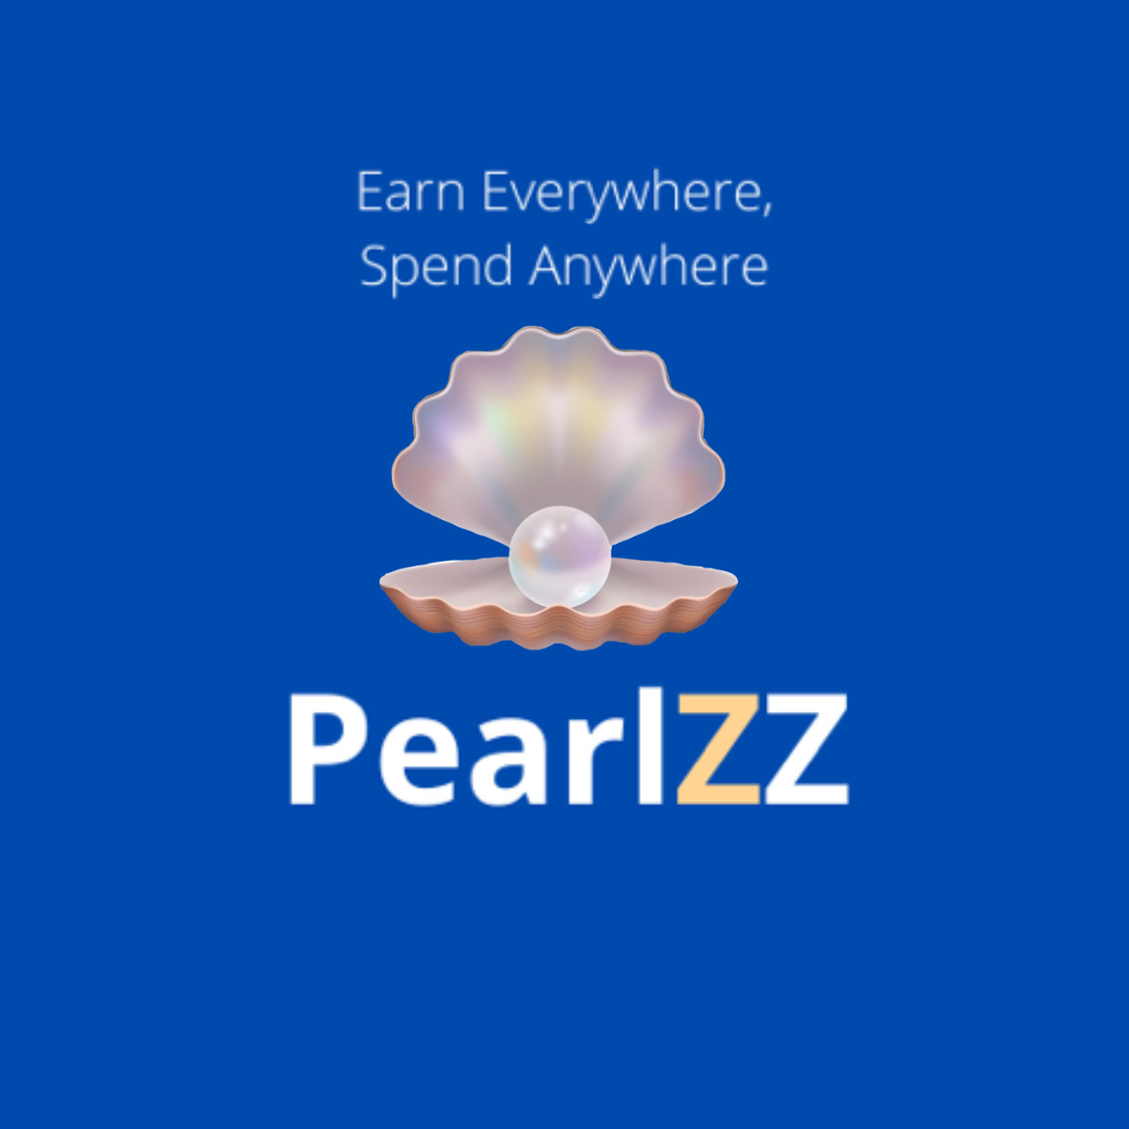
Consensys Blockchain Developer Bootcamp – Final Project (kunalrshah)
Points to Pearls
Unified Loyalty Wallet for Consumers
B2B Loyalty Alliance Marketplace
C2C Points and Rewards Exchange within a Loyalty Alliance
Please look for a complete slide deck on the GitHub Repository for the project, in the root directory of the project

Slide 2
Loyalty Rewards Ecosystem
Redemption Partners Alliance
Loyalty Issuer Brands
Earn Partners Alliance
$300B+ Loyalty Ecosystem
Consumers
Centered around a central issuer
Lop-sided value creation for one central brand
Larger wallet share to the Alliance leader
Limited customer data access for secondary issuers
Limited 1:1 personalization
Loyalty liability reserve capital requirements
Typically, 15-25+ Loyalty Memberships
Active only in a handful
Earns small amounts of retroactive rewards
Generic, non-personalized rewards
Margin on points
Positive working capital
Breakage
CVS | walgreens
Children’s Place | Panera

Slide 3
Disintermediation of Loyalty Market - C2C, B2B
Margin on points
Positive working capital
Breakage
Travel + Entertainment Alliance
Air Travel + Hotel + Car Rental
Sports + Restaurants + Bars
Business Travel Alliance
Travel + Vacation Rental Alliance
Community shopping Alliance
Form your own Alliance
Metropolitan city Alliance
Loyalty Marketplace & PearlZZ Token
Consumers
Country
State / Province
County
Local Community
Continent
Town / City
Unified Digital Loyalty Wallet
Transferability across brands
Trade loyalty currency with other consumers
Achieve higher realizable retroactive value
Mint earned rewards as NFTs
Publish, Discover, Trade Rewards NFTs
Disintermediate the loyalty Alliance
Go-Digital, No paper, No cards
Elevate customer engagement
Broader consumer behavior analytics
Precise micro-personalization (AI/ML)
Take liability off balance sheet faster
B2B Loyalty Alliances Marketplace
CVS | walgreens
Children’s Place | Panera
B2B Alliance Markets
PearlZZ AI/ML
Direct to Wallet Marketing

Slide 4
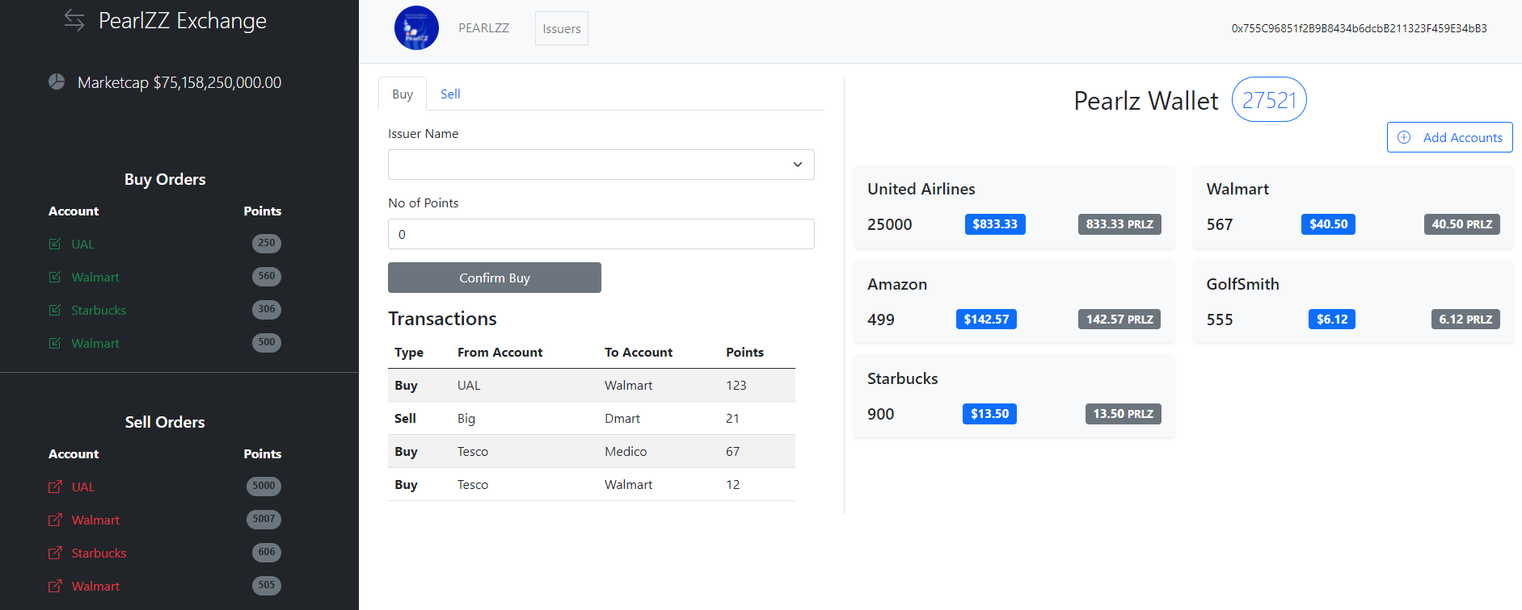
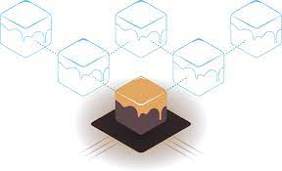
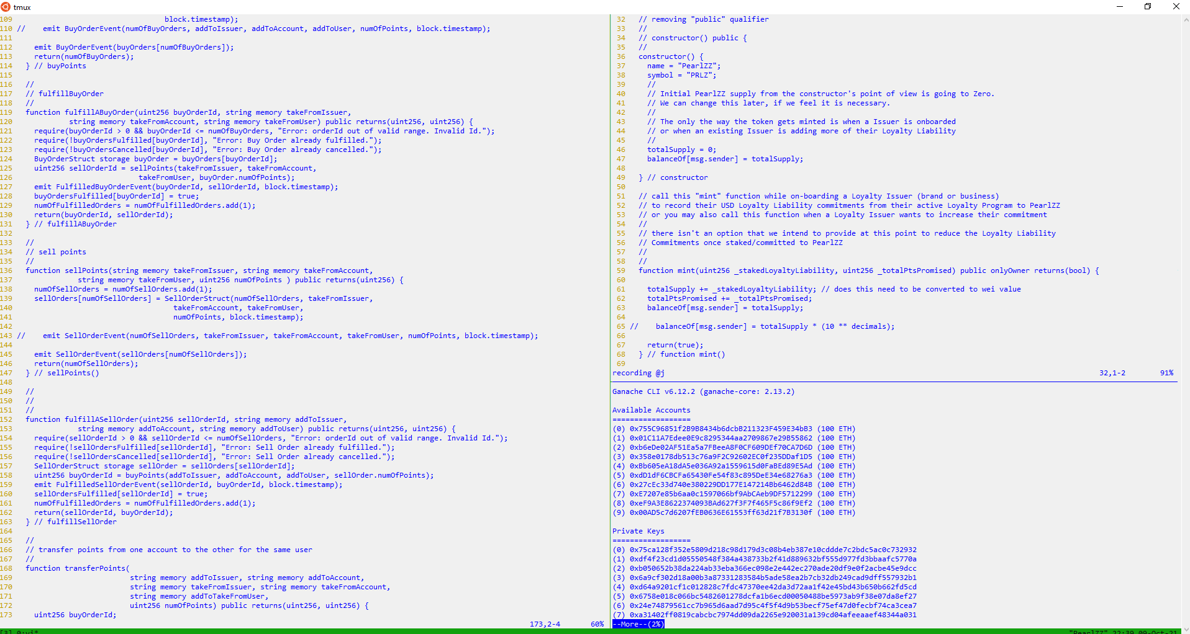
PearlZZ – Blockchain Developer Bootcamp Final Project
Blockchain Developer Bootcamp Final Project
PearlZZ Front-End
Ganache-CLI Blockchain + Kovan Test Network
Smart Contracts
Smart Contracts
PearlZZExchange.sol
PearlZZToken.sol
GenericContract.sol
Tech used
Metamask
React
Redux
web3.js
Node.js
Tech used
Truffle Suite
Ganache, Kovan Test Network
Debug
Remix / Web3
Tech used
Truffle Suite
Solidity, Mocha, Chai,
Open Zeppelin – SafeMath, Ownable
Truffle-Assertions
Remix / JavaScript VM

Slide 5
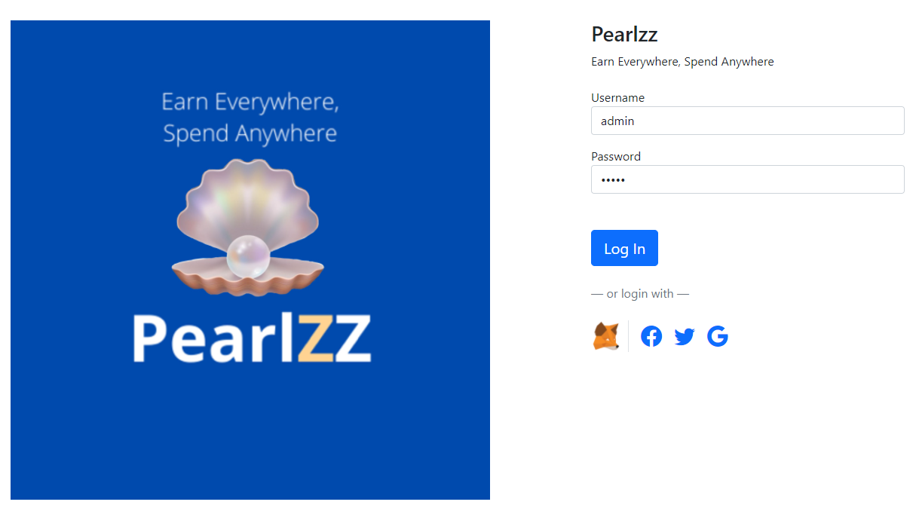
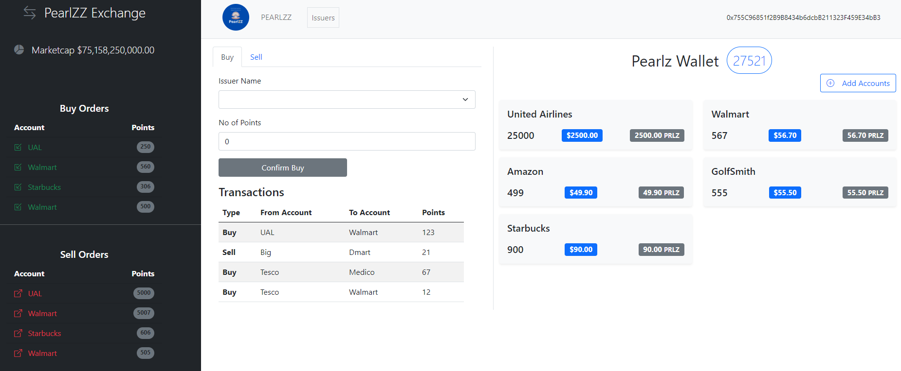
PearlZZ Exchange & Wallet / Video Demo

