Slide 1

Classifying Potentially Hazardous Asteroids
Supervised machine learning on the NASA JPL Small-Body Database
Leonardo R. Fabbro
Madhurishitha Boddu
Kunal Sharma
Shunmuka Valsa
Team Leader
Member
Member
Member
Machine Learning Term Project · Group 16
Notes:
Keep this to 15 seconds. Names, then straight into the problem.

Slide 2

The Problem
Leonardo
Why it matters
The task
NASA JPL designates a small subset of asteroids as Potentially Hazardous. New objects are discovered constantly and telescope time is scarce, so anything that helps triage which orbits deserve follow-up has practical value.
Supervised binary classification
Target: pha, Y or N, encoded 1 and 0
Predictors: orbital elements and physical measurements
Our research question
Can a model predict the hazard designation from catalogue data, and can it still do so once we withhold the two parameters JPL uses to define that designation?
The second half is what turns this from a prediction exercise into an experiment. We answer it in Part 3.
Notes:
Land the research question clearly. Everything later refers back to it.

Slide 3
The Dataset
Leonardo
958,524
938,603
33
2,066
records in the raw catalogue
retained after cleaning
predictive features
hazardous objects, 0.22%
What is in a record
Source and scope
Orbital elements: semi-major axis, eccentricity, inclination, perihelion distance, period
Earth MOID and absolute magnitude H
Physical: diameter and albedo, absent for most objects
Categorical: orbit class and near-Earth flag
NASA JPL Small-Body Database, obtained via Kaggle
Removed identifiers, designations and duplicate date columns
Modelling used a 150,000-record stratified sample for tractable runtimes
Class proportion preserved exactly in the sample
Notes:
If asked why we subsampled: Random Forest fit time. 150k keeps 330 hazardous objects.

Slide 4
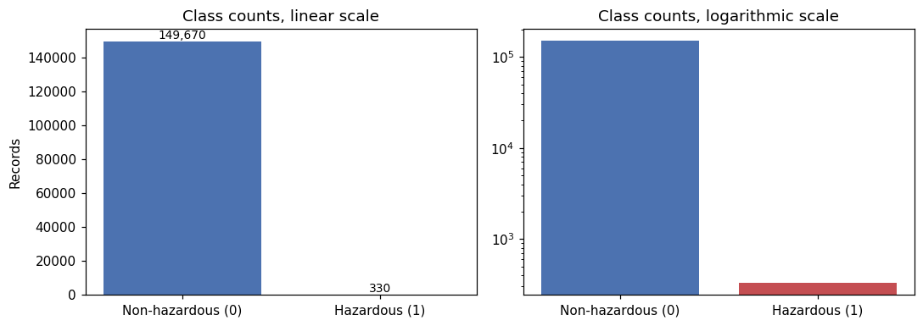
A Severely Imbalanced Target
Madhurishitha
0.22%
The accuracy trap
A model that predicts "not hazardous" for every single object scores 99.78% accuracy and identifies nothing. Accuracy is not reported anywhere in this project. We use precision, recall, F1 and average precision, all measured on the hazardous class.
of catalogued asteroids
carry the designation
Notes:
The 99.78% number is the hook. Say it out loud and pause.

Slide 5
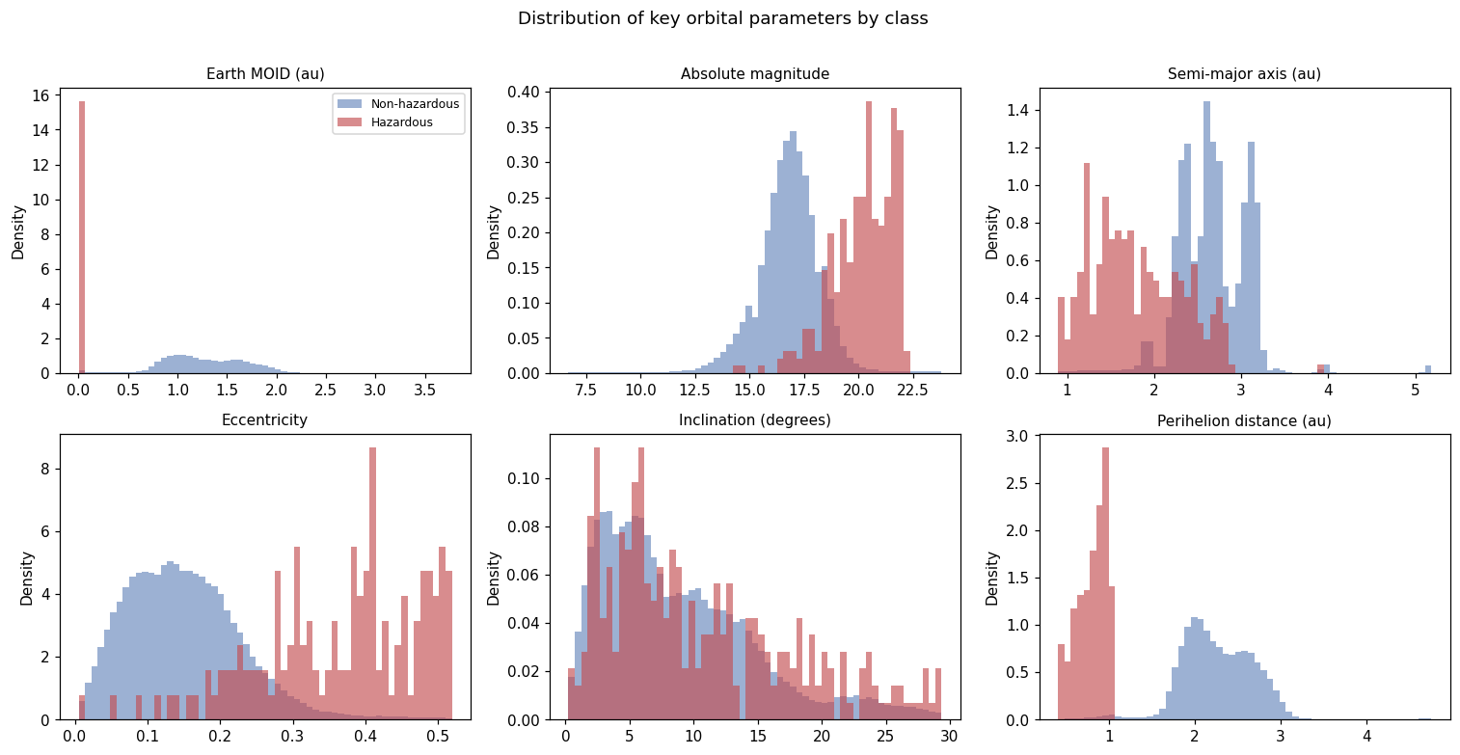
What Separates the Classes
Madhurishitha
This separation is definitional, not discovered. JPL defines a PHA as Earth MOID below 0.05 au and absolute magnitude 22.0 or brighter. Both are columns in our data, so a model handed them is recovering a published threshold rule.
Notes:
MOID and H separate cleanly. This observation is what motivated the experiment design.

Slide 6
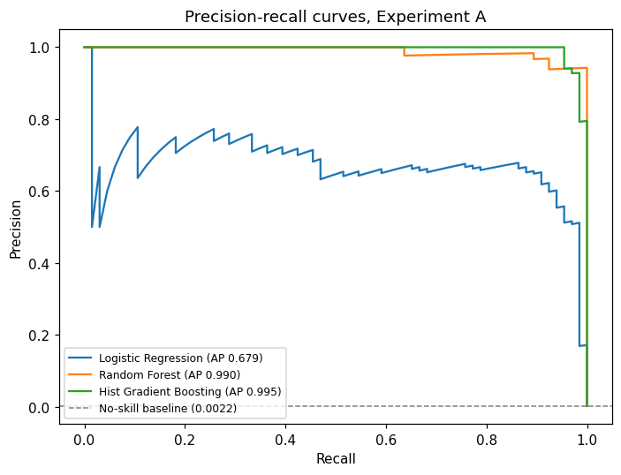
How We Measure Success
Madhurishitha
Average precision is our primary metric
Precision and recall ignore true negatives, so the score moves when performance on the rare class moves. It is threshold-independent, which lets us compare models fairly.
ROC AUC would have misled us
Across all three experiments ROC AUC never fell below 0.98, even where average precision dropped to 0.37. With 99.78% negatives, the true-negative count keeps it high no matter what.
Notes:
Strongest methodological point in the project. ROC 0.98 next to PR 0.37 in the same model.

Slide 7
Cleaning Decisions
Shunmuka
Removed non-predictive columns
Eight identifier and designation fields, plus three calendar duplicates of dates already stored as Julian values.
Resolved the target
Dropped records with an undefined pha label, then encoded the rest as 1 and 0. No duplicate records were found.
Kept the sparse physical fields
Diameter and albedo are absent for most objects. We imputed the median and added a flag recording that the value was missing, because whether an object has been measured is itself informative.
Kept the outliers
Highly eccentric and inclined orbits are physically real, and Earth-approaching objects live in exactly those tails. Removing them would discard the signal.
Notes:
Expect a question on keeping outliers. Answer: they are real objects and they are where the hazardous ones are.

Slide 8
Preprocessing Pipeline
Shunmuka
Plain numeric
Median imputation, then standardisation
Why a sign-preserving log
These fields span orders of magnitude. A plain log is undefined at zero and refuses negatives, and semi-major axis goes negative for unbound orbits, so we take the log of the magnitude and restore the sign.
Skewed numeric
Median imputation, sign-preserving log, then standardisation
Physical
Median imputation with a missingness indicator, then standardisation
Categorical
Mode imputation, then one-hot encoding
Preventing leakage
Every transformer sits inside a scikit-learn Pipeline, so it is fitted on training folds only. Scaling before splitting would let the training data see the test set and every score after that would be inflated.
Stratified 80/20 split. The test partition was evaluated once, at the very end.
Notes:
Leakage point is the one a marker is most likely to probe. Be ready to explain fold-wise fitting.

Slide 9
Models, Imbalance and Tuning
Kunal
Logistic Regression
Random Forest
Hist Gradient Boosting
Linear baseline. Coefficients show which features push toward the hazardous class.
Bagged trees. Captures non-linear boundaries and yields feature importances.
Boosted trees built for large tabular data. Fast enough to tune properly.
Class imbalance
Balanced class weights throughout. SMOTE was tested as an alternative, applied inside training folds only so synthetic rows never reach validation.
Validation
Stratified 5-fold cross-validation, so the rare class appears in every fold.
Tuning
RandomizedSearchCV scored on average precision, run on a stratified slice of the training data, then the winning settings refitted on the full training partition.
Notes:
Do not read every line. Say the three models, then that imbalance was handled by class weights and validated with stratified CV.

Slide 10
Three Experiments
Kunal
Identical pipeline, identical train and test partitions. The only thing that changes is which features the models are allowed to see.
A
Every feature
Can a model reproduce the JPL designation at all?
B
Remove MOID, MOID (lunar) and H
Is the designation recoverable without the parameters that define it?
C
Also remove orbit class and NEO flag
Does predictive signal remain in the raw orbital geometry alone?
MOID in lunar distances is the same quantity in different units, so it has to go with MOID.
Notes:
This slide is the spine of the talk. Make sure the audience understands B and C before showing results.

Slide 11
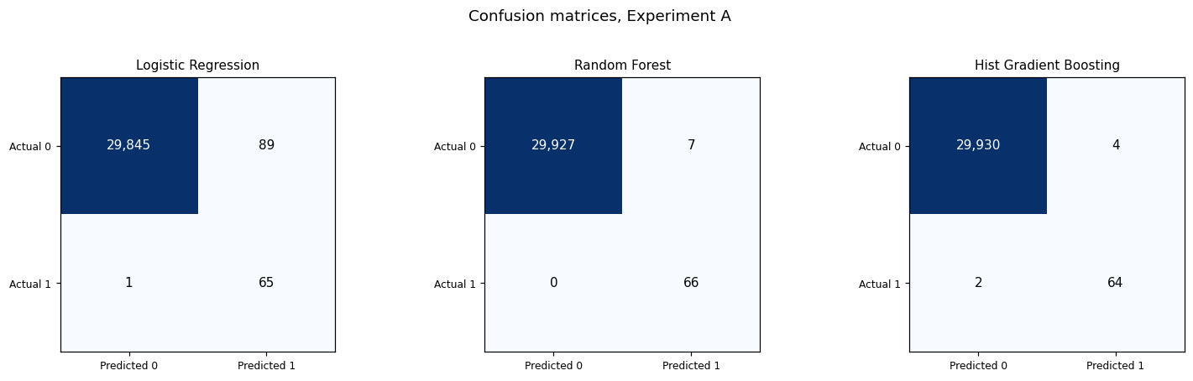
Experiment A: All Features
Madhurishitha
Model | Precision | Recall | F1 | Avg precision
Logistic Regression | 0.4221 | 0.9848 | 0.5909 | 0.6792
Random Forest | 0.9041 | 1.0000 | 0.9496 | 0.9896
Hist Gradient Boosting | 0.9412 | 0.9697 | 0.9552 | 0.9949
Near perfect, and that is the point
All three models recover the JPL rule. This validates the pipeline but tells us nothing new about asteroids.
Lower-left cell of each matrix is a hazardous object the model missed. The test set holds 66 of them.
Notes:
Random Forest caught all 66. HistGB missed 2 but raised far fewer false alarms.

Slide 12
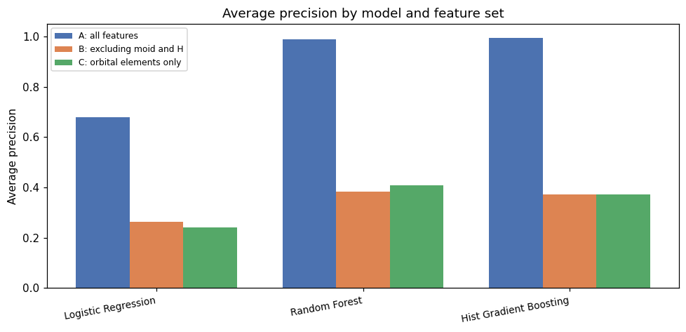
Results Across All Three
Shunmuka
A All features
0.9949
B No MOID or H
0.3712
C Orbital elements only
0.3712
Notes:
Figures are average precision for Histogram Gradient Boosting. The A to B fall is the headline.

Slide 13
Our Most Interesting Result
Shunmuka
We expected removing orbit class and the NEO flag to hurt. It did not. Random Forest improved, and Gradient Boosting produced identical predictions in both experiments.
Model | B | C | Change
Logistic Regression | 0.2633 | 0.2426 | -0.0207
Random Forest | 0.3846 | 0.4073 | +0.0227
Hist Gradient Boosting | 0.3712 | 0.3712 | 0.0000
Why
Dynamical class is derived from semi-major axis, eccentricity and perihelion distance, which the models already had. The categorical fields were redundant rather than informative, so the signal surviving in B and C comes from orbital geometry itself.
Notes:
Most likely question of the whole talk. Apollo, Aten and Amor are defined by a, e and q, which the trees already had.

Slide 14
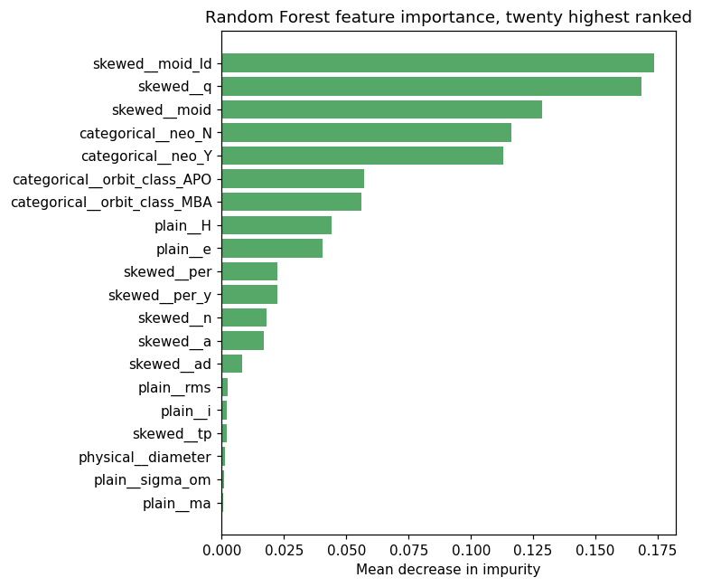
Best Model
Kunal
Highest average precision
Leads on the full feature set at 0.9949, against 0.9896 for Random Forest and 0.6792 for Logistic Regression.
Far cheaper to train
Fits in seconds where Random Forest takes minutes on identical data, which made proper tuning feasible.
Honest caveat
Random Forest edges ahead in Experiment C, 0.4073 against 0.3712. Once the defining parameters are withheld the two ensembles are comparable.
Logistic Regression is not competitive in any condition, which tells us the relationship between orbital parameters and hazard status is not linearly separable.
Random Forest feature importance
Notes:
Name the model, give the number, then admit the Random Forest result in C. Owning it reads better than hiding it.

Slide 15
Conclusions and Limitations
Leonardo
What we conclude
What limits it
Experiment A is not a discovery. The models recover a rule JPL already published.
Withholding MOID and H costs about 0.62 average precision, so most of that performance was definitional.
Real signal does survive in the orbital elements alone, around 0.37 to 0.41 against a no-skill baseline of 0.0022.
Ensembles beat the linear model by a widening margin as features are withdrawn.
Only 66 hazardous objects in the test set, so each one is worth about 1.5 points of recall.
Perihelion distance and semi-major axis partly reconstruct MOID, so Experiment C removes the number but not the geometry.
The catalogue reflects survey bias. Small, dim objects are missing because nobody has found them yet.
Hyperparameters were tuned under A and reused, which may understate B and C.
One stratified sample, one split, so no interval estimates.
Notes:
Lead with the 66-positive limitation. Raising it first is much better than being caught by it.

Slide 16
Lessons Learned
Leonardo
01
Check whether the label is defined by the features
Our first models scored 0.99 and looked like a success. They were reproducing a published threshold rule.
02
Choose the metric before the model
ROC AUC would have told us all three experiments succeeded. Average precision showed us where performance actually collapsed.
03
Redundant features are not evidence
Removing orbit class changed nothing, because the elements it derives from were already in the model.
04
Runtime is a design constraint
Random Forest fitting drove every scheduling decision and pushed us to a stratified subsample.
Notes:
Close on lesson one. It is the intellectual core of the project.

Slide 17

Questions
Thank you.
Group 16 · Leonardo R. Fabbro · Madhurishitha Boddu · Kunal Sharma · Shunmuka Valsa
Notes:
All four stay on camera for questions.

