Slide 1
Sales dashboard design

Slide 2
Objective :-
I designed an interactive Sales Dashboard using Power BI, based on a sales financial dataset from Kaggle. This dashboard helps stakeholders analyze business performance through key metrics like Sales, Profit, and Growth across different regions, categories, and time periods.

Slide 3
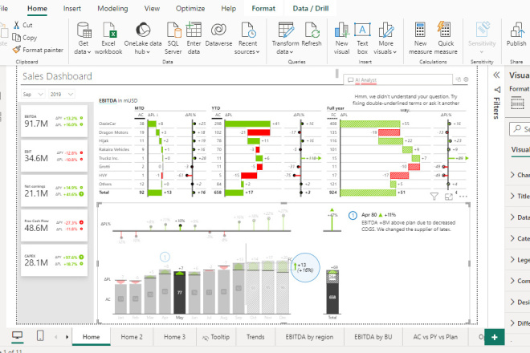
1. Data Cleaning:
Removed duplicates, handled missing values, and ensured date formats and number formats were consistent using Power BI Power Query.

Slide 4
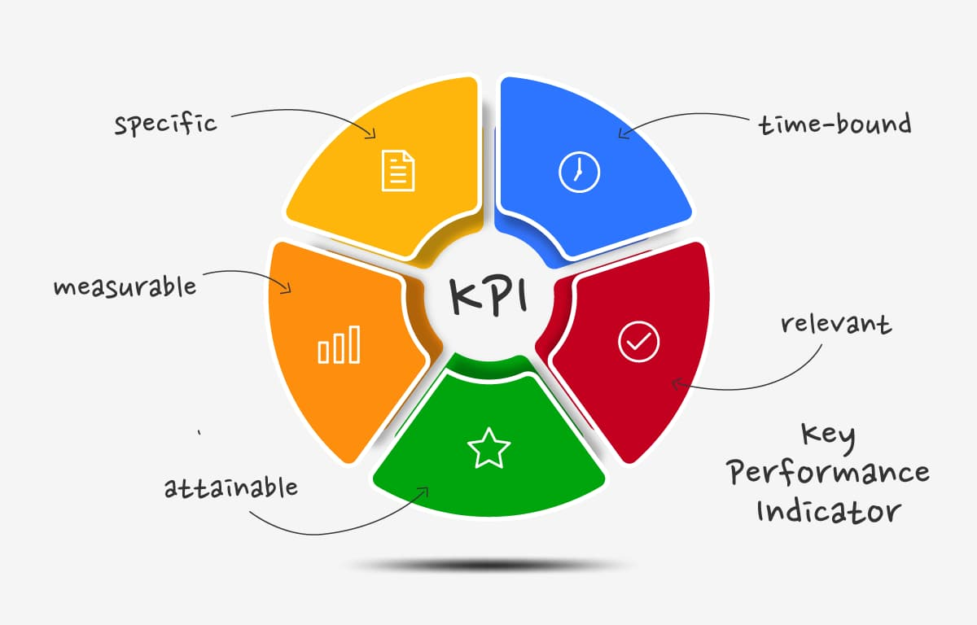
b
2. Selected KPIs:
Total Sales
Total Profit
Profit Margin (%)
YoY Growth

Slide 5
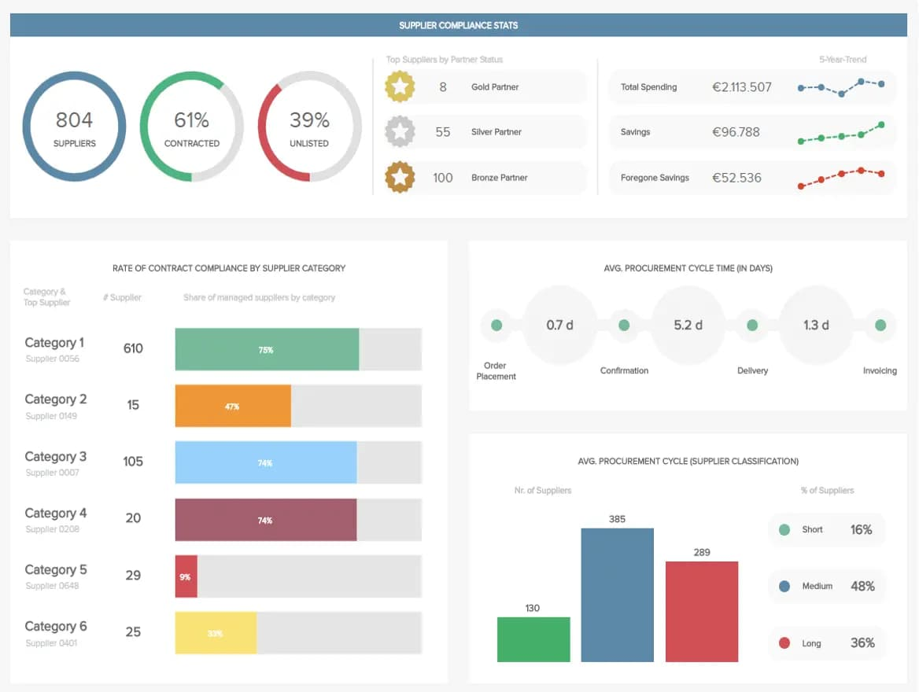
Dashboard Design Elements:
Cards to show total KPIs (Sales, Profit, Orders)
Line charts for time-series analysis (monthly/quarterly trends)
Bar/Column charts to compare regions and categories
Slicers/Filters for Region, Category, Date, and Segment
Consistent color theme and fonts
Navigation menu using bookmarks/buttons (if in Power BI)

Slide 6
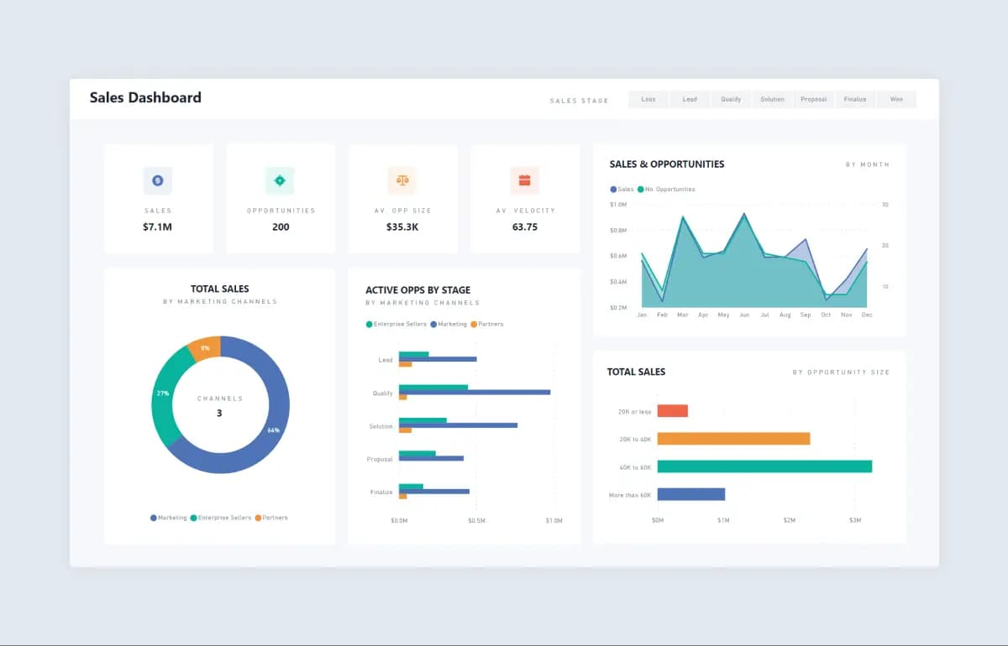
4. Interactivity:
Stakeholders can filter views by region, year, or category
Charts update dynamically based on slicer selections

Slide 7
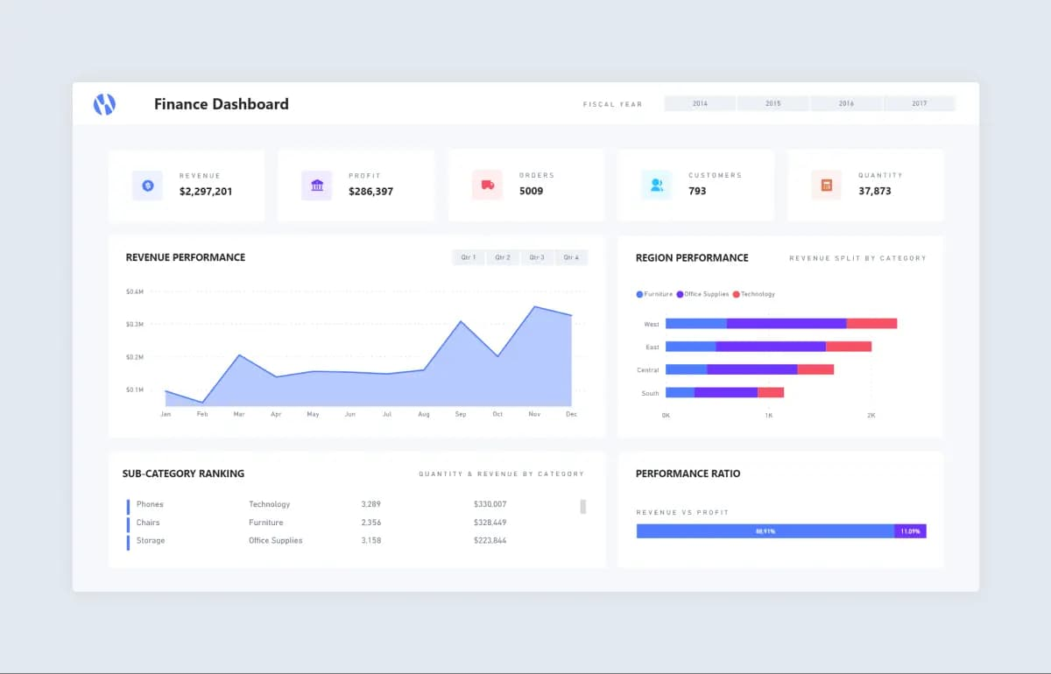
5. Outcome:
Helped visualize key business insights and supported decision-making by identifying top-performing areas and growth opportunities.

