Slide 1

Department of Information Technology
NBA Accredited A.P. Shah Institute of Technology G.B.Road,Kasarvadavli, Thane(W), Mumbai-400615 UNIVERSITY OF MUMBAI Academic Year 2021-2022

Slide 2
A Project Presentation on Chatbot for Healthcare Submitted in partial fulfilment of the degree of Bachelor of Engineering(Sem-6)
in INFORMATION TECHNOLOGY By
Kunal Shetty (19104071) Omkar Bhoir (19104001) Nilesh Virkar (19104072) Under the Guidance of
Prof. Dr. Uttam Kolekar Prof. Yaminee Patil

Slide 3
1.Project Conception and Initiation

Slide 4
1.1 Objectives
To reduce medical professionals workload by diminishing hospital visits.
To help save the time of answering repetitive questions.
To assist people with minor issues.
To provides 24x7 support to the customer requirement.

Slide 5
1.2 Literature Review
Title | Author/s | Findings
Contextual Chatbot for Healthcare Purposes (using Deep Learning) | Kandpal.P, Jasnani.K, Raut.R, Bhorge.S (2020) | The authors discussed in-depth their development of chatbot by using varied concepts (TensorFlow, TFLearn, NLTK and NumPy) for their Healthcare chatbot. The study concluded emphasizing a well-built Healthcare chatbot as an imminent priority for future organizations.
Chatbot for Healthcare System Using Artificial Intelligence | Athota L., Shukla.V.K, Pandey.N, Rana.A (2020) | Objective of this study was to provide basic information related health for their chatbot using N-gram, TF-IDF, developing web interface as per user requirement and enhancing security.

Slide 6
1.3 Problem Definition
Less awareness on general health treatment and health problem.
Money spent on unnecessary treatments and tests.
Patients not able to freely convey their problem.
Time spent commuting to Doctor office.

Slide 7
1.4 Scope
Can be applied in different industries such as consumer companies, banking, healthcare, government, agriculture and education.
Can be useful for students, teacher and parents in education medium as it can directly solve most of quires at any time.
Can be modified to do task like booking of airplane/ train / bus tickets and save on cost.

Slide 8
1.5 Technology stack
Python, Flask for hosting the website.
Numpy, NLTK(Natural Language Toolkit), Pytorch.
HTML, CSS, Javascript and Bootstrap for Frontend Design.

Slide 9
2. Project Design

Slide 10
2.1 Proposed System
Chatbot uses Artificial Intelligence and Machine Learning technique to understand Natural Language.
It process user input and provide information about Covid-19 such as symptoms and prevention.
Chatbot is trained by given data before it would be properly functional.
User will be asked to Login OR Register to use chatbot.

Slide 11
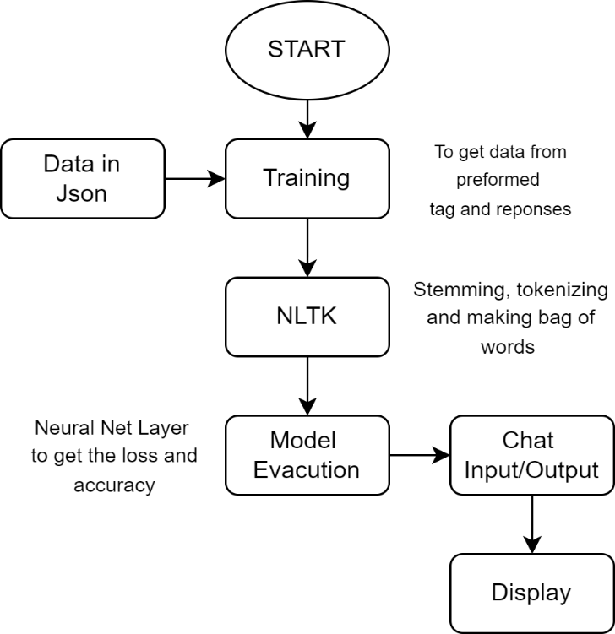
2.2 Design(Flow Of Modules)

Slide 12
3. Implementation

Slide 13
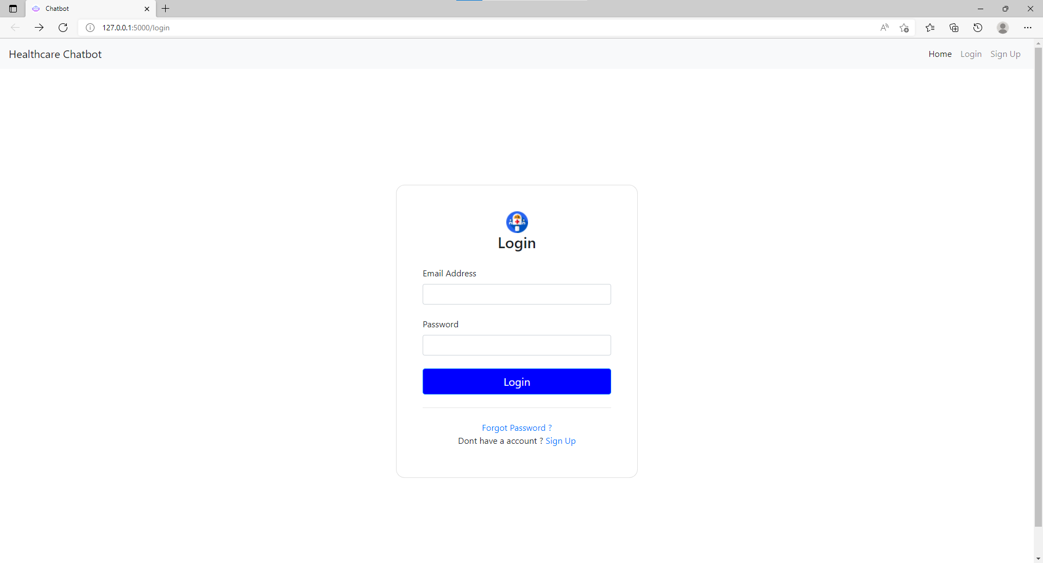
Fig. Login Page

Slide 14
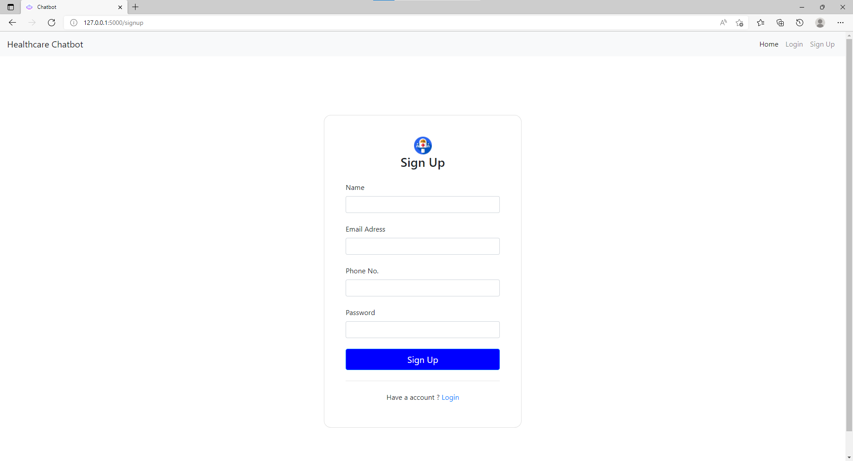
Fig. Register Page

Slide 15
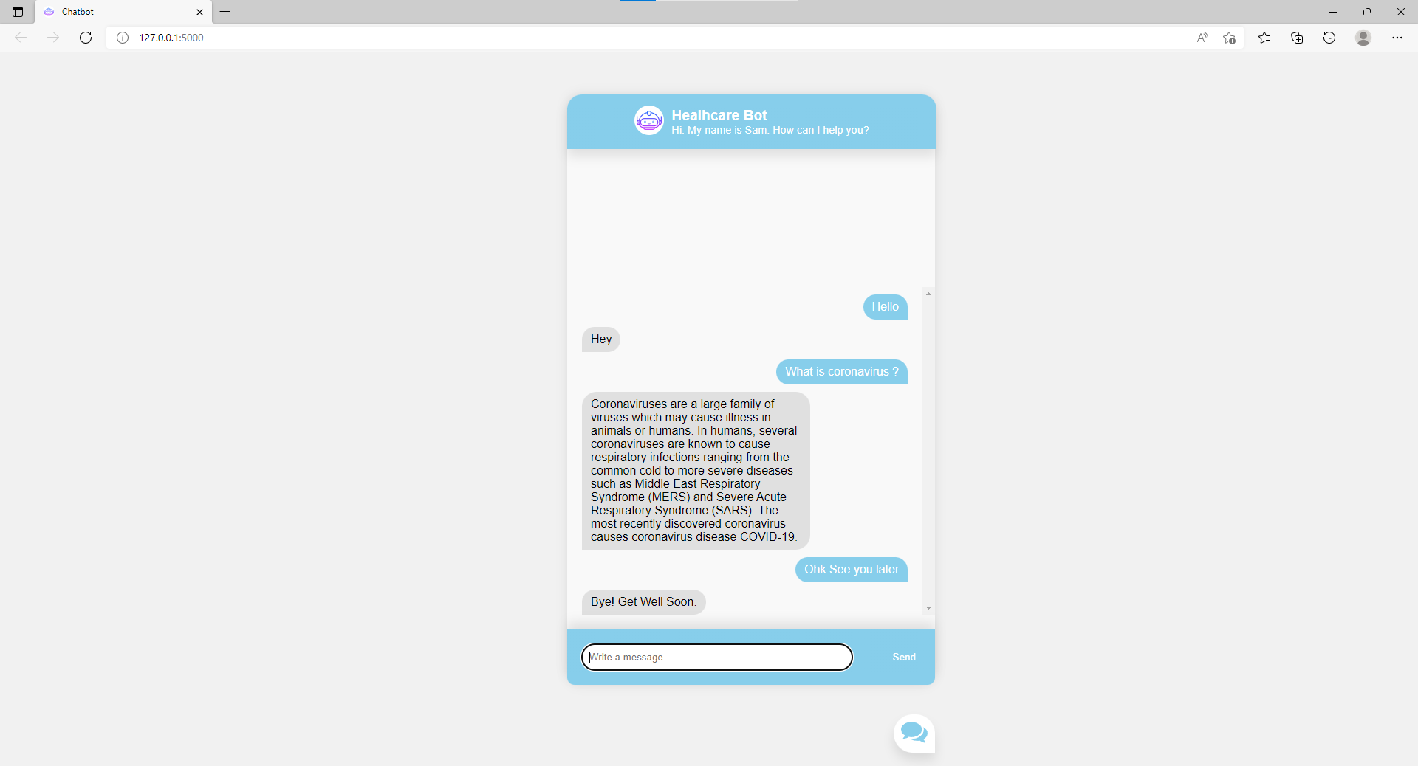
Fig. Main Page

Slide 16
4. Result

Slide 17
Result
As per the implementation a easy to view and clean interface for chatbot is available to type into.
Chatbot is successfully able to process the user input.
It is able to response with most accurate answer or response which is close match to the question asked to it.

Slide 18
5. Conclusion and Future Scope

Slide 19
Conclusion and Future Scope
Chatbot is a great tool for conversion and it is developed to provide a quality of answers in short period of time.
The project is developed for the user to save the user their time in consulting the doctors or experts for the healthcare solution.
By taking the advantage of the extensibility of the system in future it will be used as voice and face recognition to mimic a counselor, also interacting with the patient at deeper levels.

Slide 20
References
[1] Kandpal.P, Jasnani.K, Raut,R (2020), “In-depth development of chatbot using varied concepts (Tensorflow, TFlearn, NLTK and Numpy) for Healthcare in chatbot”. IEEE Contextual Chatbot for Healthcare Purposes 2020.
[2] Athota L., Panday,N, Shukla V.K, “Objective of this study was to provide basic information related health for their chatbot using N-gram, Tf-IDF, developing web interface as per user requirement”. IEEE

Slide 21
Thank You

