Slide 1



Making AWS changes safely
IN THIS DECK
New pipeline
Drift check + change set, any stack
WS2 DNS pipelines
Three deployment pipelines compared — what each one checks, and which one to use when
Bulk changes to DNS records
Old pipeline
Direct deployment, no checks
Kunal Shrivastava · Platform Engineering · October 2026
Notes:
Purpose: show how our three pipelines differ, why the new one is the safer default, and agree which one to use for what.

Slide 2




Two checks every change should pass
What we mean by a drift check and a change set — in plain words
CHECK 1
CHECK 2
Drift check
Change set
“Has anyone changed it by hand?”
“What exactly will change?”
Before deploying, we compare what is live in AWS with what our code says it should be. If someone changed something by hand in the AWS console, we find out first — not after.
AWS prepares an itemised list of every change — what will be added, changed, removed or replaced. A person reviews it and clicks Execute, and exactly that list is what runs.
Like checking nobody has moved a wall before the builders start work.
Like approving a builder’s itemised quote before any work begins.
The new pipeline builds both checks into every run.
Notes:
Two ideas carry the whole deck. Drift check: before deploying, compare live AWS with the code, so manual console changes are caught. Change set: AWS’s itemised list of planned changes, which a person reviews before it is executed. The builder analogies help a non-technical audience.

Slide 3







New pipeline: check, preview, then decide
NEW PIPELINE
latest_cft_deployment.yml — for any CloudFormation stack, in any account and region
Deploy = no
Start
Prepare
Drift check
Change set
Default. A person reviews it in AWS and clicks Execute.
Pick the stack, account and region from dropdowns
Finds the template; checks the stack is healthy
Has anything been changed by hand since the last deploy?
Itemised list of every change, plus a link to it in AWS
Deploy = yes
manual change found
nothing to deploy
The pipeline runs that same change set and reports back.
Brand-new stack?
The drift check is skipped — there is nothing to compare yet. It goes straight to the change set.
Stop
No changes
Shows what changed — expected vs actual
Ends cleanly — nothing is deployed.
One run per stack at a time
Blocks busy or broken stacks
Flags deletions & replacements
Warns if code isn’t merged yet
Notes:
Walk left to right. Prepare takes the role from a dropdown, finds the template and refuses to touch a stack that is busy or broken. The drift check runs on existing stacks; if anything was changed by hand, the run stops and shows expected versus actual values. The change set lists every add, change and removal, flags replacements and deletions, and links straight to it in the AWS console. Default (Deploy = no): a person reviews and clicks Execute in AWS. Deploy = yes: the pipeline executes that same change set and follows it to the end.

Slide 4





What the new pipeline gives us
NEW PIPELINE
Good for: every routine change to AWS that we manage in code
Catches manual changes
Itemised preview
What it doesn’t do
The run stops and shows exactly what was changed by hand — expected vs actual.
Every add, change and removal, with a warning if anything will be deleted or replaced.
Drift check works only where AWS supports it — FMS policies, for example, can’t be checked (slide 12).
A person stays in control
Approved means exactly that
By default nothing goes live until someone clicks Execute in AWS.
The change set that was reviewed is the one that runs; AWS refuses an out-of-date one.
Deploy = yes removes the human pause — keep the default for production.
Doesn’t force a code review on its own — it can run from a branch (it warns when it deploys one).
One way for everything
A clear record of every run
Any resource we manage in CloudFormation — network, security, access, DNS.
Who ran it, what changed, where, and how it ended.
Notes:
Key message: the new pipeline adds both safety checks and keeps a person in control, for any CloudFormation stack. Be upfront about its limits — AWS does not support drift checks for every resource type, and Deploy = yes is meant for changes that are already agreed.

Slide 5
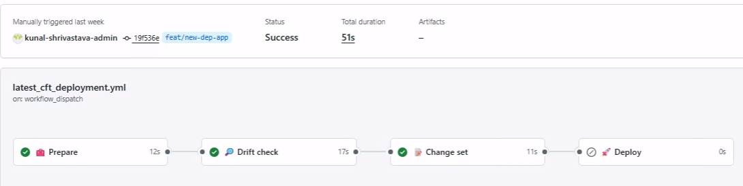
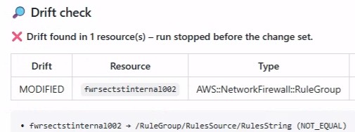
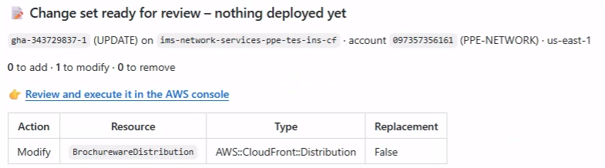
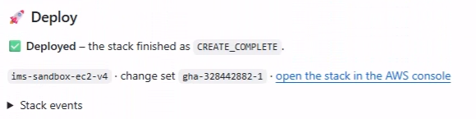
The new pipeline in action
NEW PIPELINE
Screenshots from real runs
1 · The run page Prepare → Drift check → Change set; Deploy (grey) waits until someone decides
2 · Drift found the run stops before the change set and shows what differs
3 · The change set “ready for review”: every add, modify and remove, with a link to AWS
4 · Deployed with Deploy = yes, the same change set runs and the result is reported
Notes:
Four real runs. 1) The run page: Prepare, Drift check and Change set passed; Deploy is grey because Deploy = no, so nothing went live until someone executed the change set. 2) A drift check that found a difference: the run stopped before creating a change set and listed what differs. 3) A change set ready for review: one resource to modify, with the link to review and execute it in the AWS console. 4) A run with Deploy = yes: the pipeline executed that same change set and reported CREATE_COMPLETE.

Slide 6





WS2 DNS pipelines: export, edit, apply
WS2 DNS
ws2-dns-records-export.yml + ws2-dns-records-apply.yml — bulk changes to DNS records only
PART 1
Export
live DNS → Git
Start
Approval
Export
Pull Request
Pick the account and one zone — or all zones
Only when exporting every zone outside sandbox
Live records copied into one file per zone
New branch and Pull Request created for you
In between: edit the record files in that branch → reviewer approves the Pull Request → merge
PART 2
Apply
Git → live DNS
Start
Preview
Approval
Apply
Pick the zone; without ‘execute’ it only previews
Compares files with live DNS: adds, edits, deletes
Outside sandbox, a gatekeeper approves first
Script writes the changes straight into Route 53
How to read this
Red marks gaps compared with the new pipeline. A dashed purple step happens only in some runs.
No manual-change alarm
Preview isn’t locked
Outside CloudFormation
A hand edit looks like any other change — and is overwritten
Apply works the changes out again — what runs isn’t pinned to the preview
No change set, no stack history, separate record files
Notes:
Credit where it is due: WS2 is a well-built tool for bulk DNS record edits. Export copies the live records into files and opens a Pull Request; Apply previews the differences, waits for a gatekeeper’s approval outside sandbox, and then applies them. The red boxes show what it does not do compared with the new pipeline: no alarm for changes made by hand, a preview that isn’t locked in (apply works the changes out again), and it works outside CloudFormation.

Slide 7




WS2 DNS pipelines: strengths and gaps
WS2 DNS
Built for bulk DNS record changes — and good at that job
Good at
What it doesn’t do
Bulk edits — a zone’s records exported to a file and changed in one go
DNS records only — not alias records (CloudFront, load balancers), new zones or other AWS resources
Edits are reviewed as a Pull Request — the export opens one for you
No manual-change alarm — a hand edit is quietly overwritten next time
Preview first; deleting records is off unless someone ticks the box
Preview isn’t locked — the changes are worked out again at apply time
A gatekeeper approves changes outside sandbox
Works outside CloudFormation — no change set or stack history
Strong for bulk edits — but no manual-change alarm, no locked change set, and no alias records.
Notes:
The strengths are real: bulk edits, Pull Request review, a preview with deletes off by default, and a gatekeeper approval before changes outside sandbox. The gaps compared with the new pipeline: DNS records only (the export itself says to use CloudFormation for alias records), no alarm for changes made by hand, a preview that isn’t locked in (apply works the changes out again after approval), and it works outside CloudFormation.

Slide 8
Side by side: new pipeline vs WS2 DNS
How they compare on the checks that matter
✓ yes ◐ partly ✗ no | New pipeline | WS2 DNS pipelines
Spots changes made by hand | ✓ Stops the run and shows what changed* | ✗ No alarm — a hand edit is simply overwritten
Itemised preview before go-live | ✓ Change set: every add, change, removal | ◐ Preview list in the run log
Pause for approval before go-live | ✓ By default, waits for someone to click Execute | ✓ Gatekeeper approval outside sandbox
Runs exactly what was approved | ✓ Same change set; out-of-date ones refused | ✗ Changes are re-worked at apply time
Backup and rollback | ✓ Every record in Git; revert a commit to undo | ◐ Manual snapshot; alias records left out
What it covers | ✓ Any stack — DNS zones and alias records too | ◐ DNS records only
One source of truth | ✓ CloudFormation templates in Git | ✗ Separate files, changed outside CloudFormation
Bulk edits, reviewed in Git | ✓ Edit the template; review a Pull Request | ✓ Export to files; review a Pull Request
* Where AWS supports drift checks — not for FMS policies or individual DNS records (see slide 12).
Notes:
The asterisk matters: AWS cannot drift-check every resource type, and FMS policies and individual DNS records are the ones that affect us. For DNS, the gains are the locked, reviewed change set, full coverage including alias records, and a proper history to roll back from (next slide). Both pipelines pause for a person before go-live: WS2 with a gatekeeper approval outside sandbox, the new pipeline by default (Deploy = no) — keep that default for production.

Slide 9


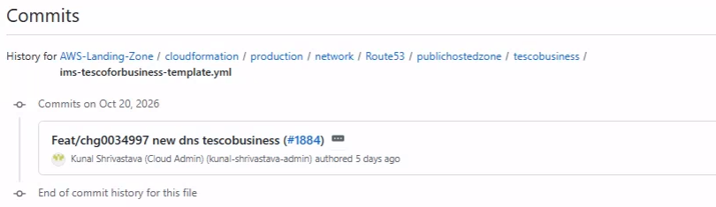

When DNS breaks: find it, undo it
WS2’s export is a snapshot — the new pipeline keeps the real record templates in Git
WS2 DNS EXPORT
NEW PIPELINE
A partial snapshot
The real templates
Only when someone runs it by hand
Every record is a template in Git — alias records too
Saved to a side branch, or a download kept for 30 days
Git shows what changed, when, and who approved it
Leaves out alias records (CloudFront, load balancers)
Undo = revert the commit → check the change set → Execute
Undo = re-apply old files; removals need ‘deletes’ ticked
A failed deployment rolls itself back
In a DNS incident: see what changed, and undo it in one reviewed step.
Git only knows about changes made through the pipeline — hand edits in the AWS console never reach it, so DNS changes should go through the pipeline only.
Git history of a DNS template every change with who, when and its Pull Request
Notes:
WS2’s export calls itself a backup (“periodic backup”, “back up everything”), but it is a snapshot: it runs only when someone triggers it, lands on a side branch or a download kept for 30 days, and skips alias records. With the new pipeline, the record templates in Git are the real thing that gets deployed, so in a production DNS issue we can see exactly what changed, when and who approved it — and undo it by reverting the commit, checking the change set and executing it. The screenshot shows the Git history of one zone’s template, with the Pull Request behind each change. Be clear about one limit: Git only sees changes made through the pipeline; edits made by hand in the console never reach it, and AWS cannot drift-check individual records — one more reason to make the pipeline the only way DNS is changed.

Slide 10


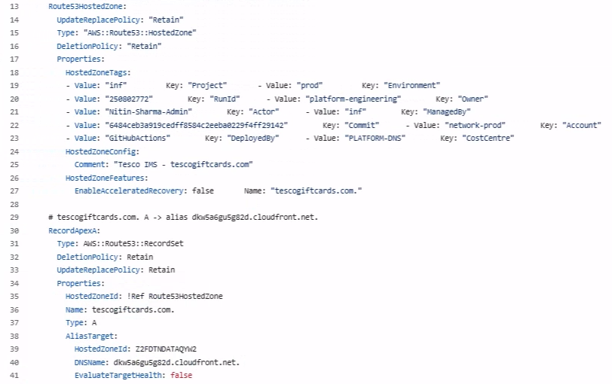
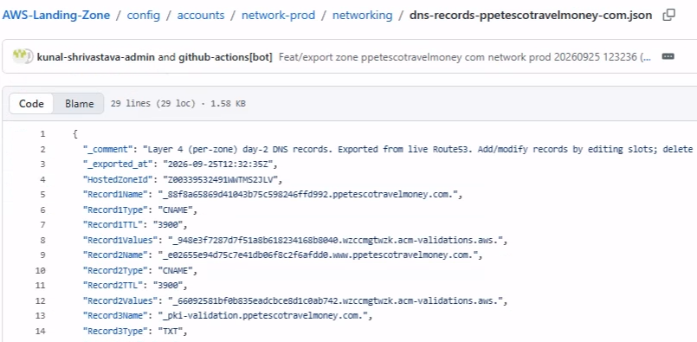
What each backup actually holds
WS2 exports a JSON list of records; the new pipeline’s YAML template holds the whole zone
WS2 export JSON written by a Python script
New pipeline CloudFormation YAML template in Git
Ordinary DNS records
No hosted zone
The hosted zone itself
Every record set
No SOA or zone NS records
No alias records
Alias records too
SOA and NS come with the zone
Notes:
Left: a WS2 export — a JSON file written by pipeline/dns_records_export.py into config/accounts/<account>/networking/. It holds the zone’s ID and a list of record slots; the export run’s own summary (“Record Export Behavior”) says SOA, the zone’s own NS records and alias records are skipped, and the hosted zone itself is not defined in the file. Right: one of our CloudFormation templates — the AWS::Route53::HostedZone resource with its settings and tags, then each record as its own AWS::Route53::RecordSet, including an alias record pointing at CloudFront. The two screenshots are different zones; the structure is what matters. If asked about SOA and NS: Route 53 creates them with the zone, which is why they come with the zone resource rather than being listed as records.

Slide 11


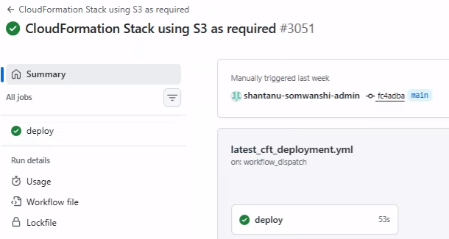
Old pipeline: deploys straight away
OLD PIPELINE
old-pipeline-firewall.yml — one job from code to AWS
Start
Find files
Big template?
Deploy
Done
Type the stack, folder and role name by hand
Template and settings from the chosen folder
Over 50 KB: uploaded to S3 first
Creates or updates the stack straight away
Prints the stack’s outputs
Never stops to check for manual changes, show a preview, or wait for approval
Good for
What it doesn’t do
Simple and quick: one job, end to end
No check for changes made by hand
Works for every resource type, even ones AWS can’t drift-check
No preview of what will change
No pause for a person to approve
Copes with large templates (via S3)
Typed inputs — a typo means a failed run
One-job run the earlier CloudFormation pipeline: a single ‘deploy’ job, straight to AWS
Notes:
The old pipeline is simple and works for every resource type, but it deploys straight away: no drift check, no preview and no pause for approval. For small templates it uses “cloudformation deploy”, which creates and executes a change set in one go, so nobody gets to review it. The screenshot is a run of the earlier version of our CloudFormation pipeline, which deployed the same way; old-pipeline-firewall.yml runs look the same — one deploy job.

Slide 12
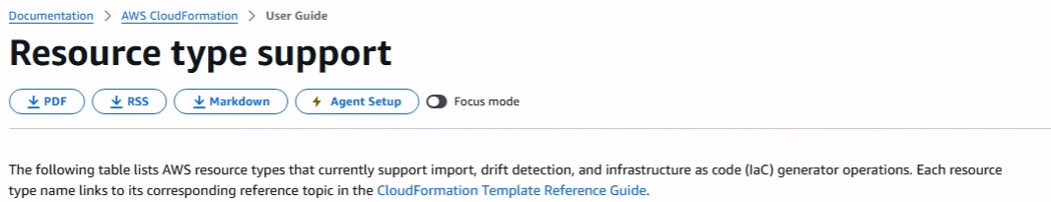

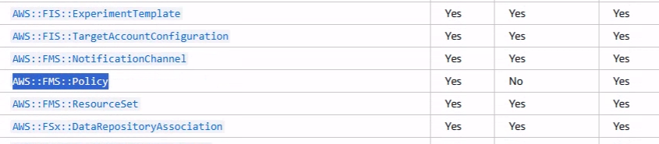


Where the old pipeline still fits
OLD PIPELINE
AWS can’t drift-check every resource type — for our firewall stacks we keep the old route
The drift check relies on AWS. For a few resource types, AWS doesn’t support it or can’t give a dependable answer:
Firewall Manager (FMS) policies
AWS documentation: drift detection is not supported
→ Old pipeline
Rule groups (large JSON settings)
Drift results aren’t dependable for big blocks of JSON
→ Old pipeline
Columns: Resource import · Drift detection · IaC generator
AWS documentation “Resource type support” table — AWS::FMS::Policy shows Drift detection: No
Individual DNS records
AWS checks the zone, not each record — the change set still shows every record change
→ New pipeline
Source: AWS CloudFormation User Guide › Resource type support (checked 24 Oct 2026)
Everything else goes through the new pipeline — drift check and change set included.
Notes:
We keep the old pipeline for the firewall stacks: AWS’s own Resource type support table lists AWS::FMS::Policy as not supported for drift detection, and large JSON rule groups do not give dependable drift results. DNS records are a special case: AWS checks the hosted zone but not each record set, yet the change set still shows every record change, so DNS stays on the new pipeline.

Slide 13
Our recommendation
One safe path for almost everything — and a clear rule for the exceptions
NEW PIPELINE
OLD PIPELINE
Every change, by default
Only the exceptions
Network · security · access · monitoring · DNS
Firewall Manager (FMS) policies and rule groups
Drift check · change set · a person decides · easy undo
Where AWS’s drift check can’t help
What we’re asking for today
Agree the new pipeline as the standard way to change AWS
Keep the old pipeline only for FMS policies and rule groups
Move DNS record changes onto the new pipeline too
1
2
3
Notes:
Ask for three decisions. If DNS is the sticking point, agree points 1 and 2 today and trial DNS on the new pipeline with one zone.

