Slide 1
Three everyday changes, four pipelines
Deploying a plain EC2 instance, handling an instance that has drifted, and adding or updating a DNS record: what each pipeline does, where the proposed pipeline helps, and the emails it sends
October 2026
Notes:
Companion to the pipeline review deck. Three concrete changes are run through each pipeline that can handle them, so the difference between the current workflows and the proposed pipeline is visible step by step.

Slide 2



The scenarios and the pipelines
Each scenario is walked through every pipeline that can run it
Pipeline | 1 · EC2 | 2 · Drift | 3 · DNS record
Current CloudFormation workflow latest_cft_deployment.yml | ● Yes | ● Yes | ● If the record is in a template
Proposed CloudFormation pipeline cfn-deploy-pipeline.yml | ● Yes | ● Yes | ● If the record is in a stack
DNS export ws2-dns-records-export.yml | ● Not used | ● Not used | ● Reads the zone into a PR
DNS apply ws2-dns-records-apply.yml | ● Not used | ● Not used | ● Changes records from the file
1 · Deploy a plain EC2 instance
A new stack: one instance and its security group, with two planted mistakes.
2 · An instance has drifted
Someone resized the instance and opened SSH in the console; a routine tag change follows.
3 · Add or update a DNS record
The DNS workflows only manage Route 53 records, so they take no part in scenarios 1 and 2.
Add app.example.com and repoint www.example.com in a zone other tools also write to.
Notes:
EC2 changes go through the CloudFormation workflows only; the DNS workflows handle Route 53 records. A DNS record can also live in a CloudFormation template, so scenario 3 is shown in the DNS workflows, the current CloudFormation workflow and the proposed pipeline.

Slide 3
Deploy a plain EC2 instance
01
A new stack with one t3.micro instance and its security group, and two planted mistakes
Notes:
Scenario 1 uses the same template and params.json in both CloudFormation pipelines.

Slide 4
The example: one instance, two planted mistakes
ec2-app-template.yaml and params.json, in a folder under cloudformation/
ec2-app-template.yaml (excerpt)
params.json (excerpt)
Parameters:
InstanceType:
Type: String
AllowedValues: [t3.micro, t3.small, t3.medium]
Resources:
AppSecurityGroup:
Type: AWS::EC2::SecurityGroup
Properties:
GroupDescription: App server
VpcId: !Ref VpcId
SecurityGroupIngress:
- IpProtocol: tcp
FromPort: 443
ToPort: 443
CidrIp: 10.20.0.0/16
- IpProtocol: tcp
FromPort: 22
ToPort: 22
CidrIp: 0.0.0.0/0 # SSH from anywhere
AppInstance:
Type: AWS::EC2::Instance
Properties:
ImageId: !Ref AmiId
InstanceType: !Ref InstanceType
SubnetId: !Ref PrivateSubnetId
[
{ "ParameterKey": "InstanceType",
"ParameterValue": "t3.mirco" },
{ "ParameterKey": "AmiId",
"ParameterValue": "ami-0abc1234" }
]
1
1
Typo in params.json
t3.mirco instead of t3.micro. The template only allows t3.micro, t3.small and t3.medium.
2
SSH open to the world
2
The second ingress rule lets anyone on the internet reach port 22 on the instance.
Notes:
Mistake 1 is a typo in params.json. The template's AllowedValues rule rejects it, and CloudFormation enforces that rule itself, so both pipelines stop it before anything is created. Mistake 2 is a security group that allows SSH from anywhere: nothing in CloudFormation objects to it, so only a scan or a reviewer would catch it. Everything else is an ordinary private instance.

Slide 5
Today: the typo is caught, but SSH goes live open
latest_cft_deployment.yml · CloudFormation's own checks are the only checks, and the stack is created as soon as the run starts
Run 1 typo in params.json
Engineer runs the workflow
Inputs typed by hand
CloudFormation rejects it
t3.mirco is not in AllowedValues
Run fails; nothing created
Fix params.json and re-run
Run 2 typo fixed
Engineer runs it again
Instance created at once
No scan, no preview, no approval
Live with SSH open to the world
Nobody is told
Outputs printed in the log
No email, no record of approval
If the create fails half-way for example a capacity or quota limit, or an AMI ID from another Region
Stack rolls back
Left in ROLLBACK_COMPLETE
Generic CLI error
The workflow's own diagnostics never run
Every re-run fails
A ROLLBACK_COMPLETE stack can't be updated
Stack deleted by hand
In the console, outside the pipeline
Notes:
Run 1: aws cloudformation deploy asks CloudFormation for a change set, and CloudFormation rejects t3.mirco straight away because it isn't in the parameter's AllowedValues. Nothing is created; the error is in the job log. Run 2: with the typo fixed, deploy creates and executes the change set in one go. The instance goes live with SSH open to the internet: nothing scans the template, nobody sees a preview, and nobody is asked to approve. Third lane: some failures only show up while resources are being created, such as a capacity or quota limit, or an AMI ID copied from another Region when the parameter is a plain String. The new stack rolls back to ROLLBACK_COMPLETE. The small-template step runs under GitHub's default bash -e, so when deploy fails the step stops at once and the lines meant to print the failure reason never run; the log shows only the CLI's generic message. A ROLLBACK_COMPLETE stack can't be updated, so every re-run fails until someone deletes the stack in the console.

Slide 6



Proposed: both mistakes are caught before anything is created
cfn-deploy-pipeline.yml · each run stops safely until the change is right
Run 1 typo in params.json
Engineer runs the pipeline
Account picked from a list
Preflight
t3.mirco is not an allowed value
Stopped before AWS
Nothing created; fix params.json
Run 2 typo fixed, SSH still open
Preflight and lint pass
Template and params valid
Security scan
SSH open to 0.0.0.0/0 flagged
CREATE change set
Instance LOW · security group MEDIUM
Approval email
Includes the scan finding
Approver rejects
Change set deleted; nothing created
Run 3 SSH rule removed
All checks pass
Preflight, lint, security scan
CREATE change set
Every new resource rated
Approval email
What will be created, and why
Approver approves
GitHub gate
Deployed
Result and outputs emailed
Stricter option. With CFN_SECURITY_SCAN_BLOCKING=true, run 2 stops at the security scan instead of reaching the approver.
If the create fails half-way. The result email names the failed resource and why, and the next run gives the exact command to recover.
Notes:
Run 1: preflight compares every params.json value with the template's rules and stops on t3.mirco before AWS is called. The outcome matches today's (CloudFormation would reject it too), with a clearer message. Run 2: lint passes, Checkov flags SSH open to 0.0.0.0/0, the CREATE change set is rated (instance LOW, security group MEDIUM as a network-sensitive type) and the approval email includes the scan finding, so the approver rejects it and deletes the change set. Run 3: with the SSH rule removed every check passes; the approver approves the GitHub gate, and the pipeline executes the change set and emails the result with the stack outputs. If the approver executes in the AWS console instead (the default mode), the pipeline run has already finished, so the outcome is seen in the console. If the create fails half-way, the result email names the failed resource and the reason, and the next run is blocked with the exact command to delete the failed stack.

Slide 7

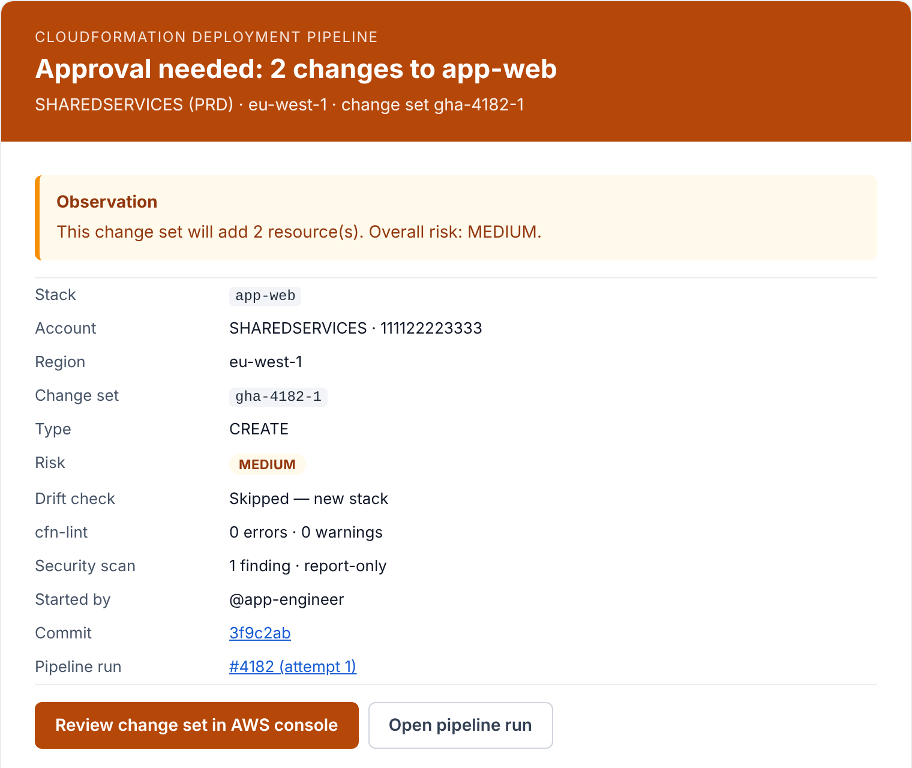
Run 2's approval email: what the approver sees first
Sent before anything is created · the pipeline's own email, rendered with this scenario's data
[APPROVAL NEEDED][PRD] app-web — 2 changes, risk MEDIUM
1
Risk at a glance
From CloudFormation pipeline To platform-approvers@example.com
changes.csv · changeset.json
The subject line and the header colour carry the overall risk: blue for LOW, amber for MEDIUM, red for HIGH.
1
2
What it will do, in one sentence
Here: add 2 resources, overall risk MEDIUM.
2
3
Every check in one place
Drift check, cfn-lint and the Checkov scan, beside the stack, account, change set, commit and who started the run.
3
4
One click to act
Open the change set in the AWS console, or the pipeline run where the GitHub approval waits.
4
Notes:
This is the email the approver receives in run 2 (typo fixed, SSH still open to the world). The email is a screenshot of the HTML that the pipeline's notify.py produces, rendered with this scenario's sample data against simulated AWS responses; the account ID 111122223333, the example.com addresses and the user names are placeholders. 1: the subject and the header colour carry the overall risk (blue LOW, amber MEDIUM, red HIGH). 2: one sentence says what the change set will do. 3: the drift check (skipped for a new stack), cfn-lint and the Checkov scan sit beside the stack, account, change set, commit and who started the run. 4: buttons open the change set in the AWS console and the pipeline run. The email also attaches changes.csv and changeset.json. The next slide shows the rest of the same email.

Slide 8
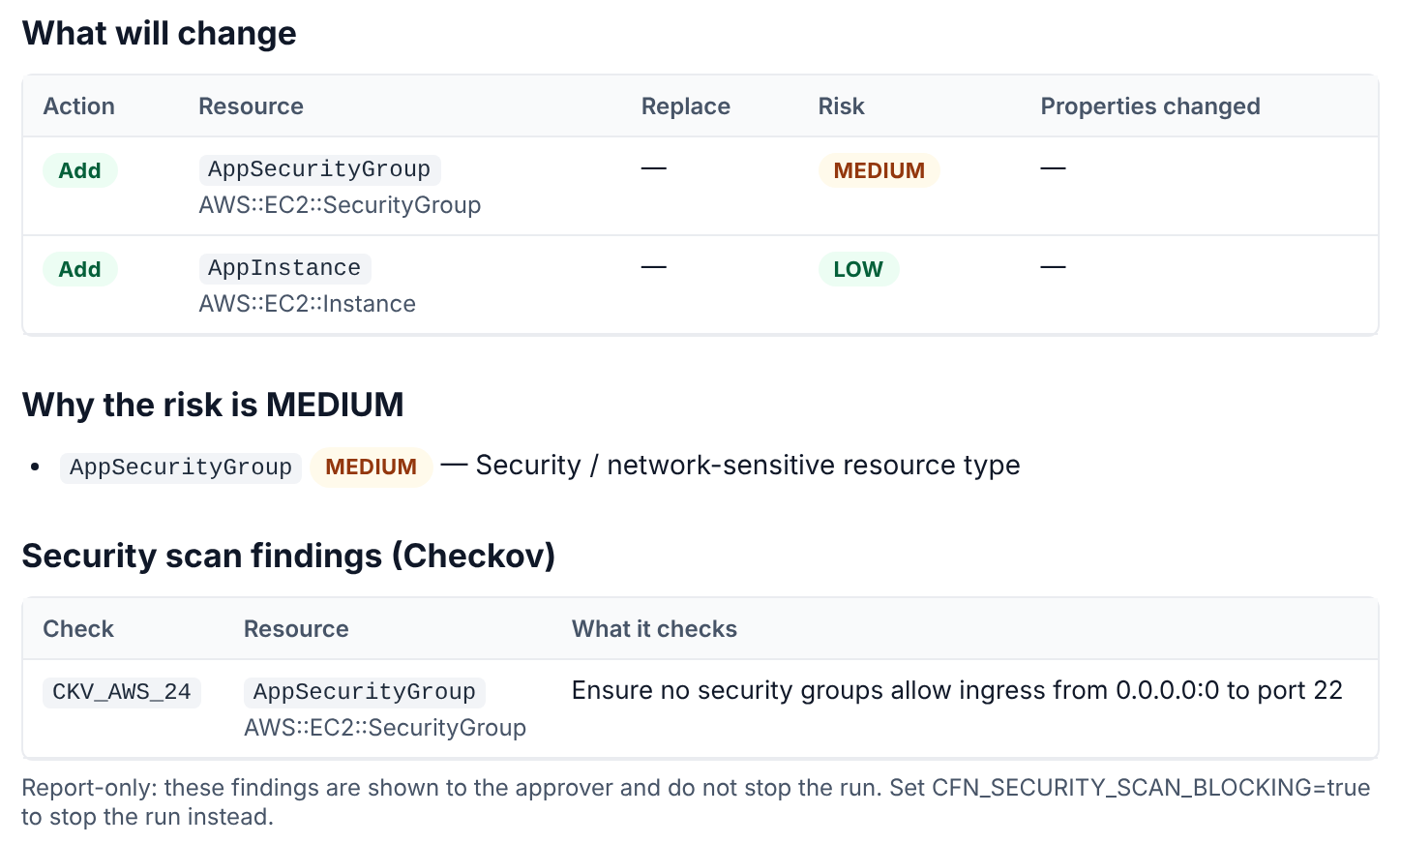
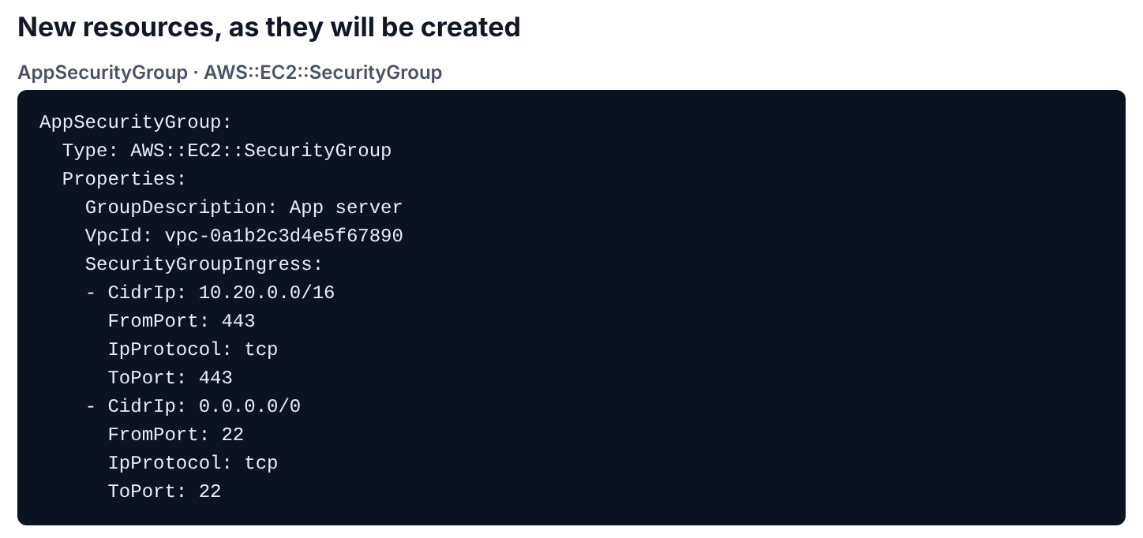

Further down: every change, its risk and the scan finding
The same email, scrolled down · nothing exists yet
5
6
8
7
5
Every change, rated. Add, Modify or Remove for each resource, with LOW, MEDIUM or HIGH risk.
6
Why the risk is MEDIUM. Security groups are network-sensitive.
Approve or reject from here. The approver approves the GitHub gate in the run, or rejects it and deletes the change set; the email gives the CLI commands for both. Nothing exists until then.
7
The scan finding, in plain words. CKV_AWS_24: SSH open to 0.0.0.0/0 on AppSecurityGroup.
8
Exactly what will be created. Every property of each new resource, SSH rule included.
Notes:
The rest of run 2's approval email. The email is a screenshot of the HTML that the pipeline's notify.py produces, rendered with this scenario's sample data against simulated AWS responses; the account ID 111122223333, the example.com addresses and the user names are placeholders. 5: each resource with its action and risk. 6: why the overall risk is MEDIUM (a security group is a network-sensitive type). 7: the Checkov finding CKV_AWS_24, SSH open to 0.0.0.0/0, with the resource it applies to; the scan is report-only by default. 8: for new resources the email shows every property CloudFormation will create, so the approver can see the SSH rule itself (highlighted here). At the end of the email: how to approve in GitHub or reject, and the matching CLI commands.

Slide 9
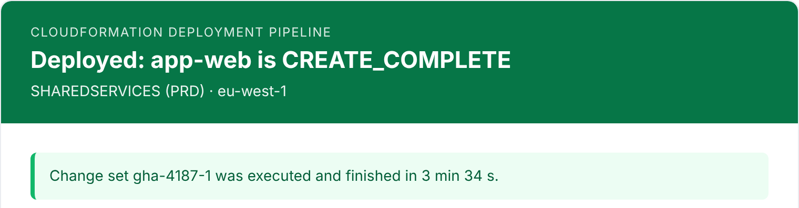
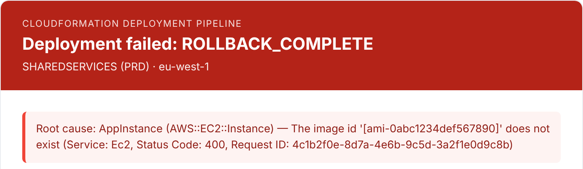
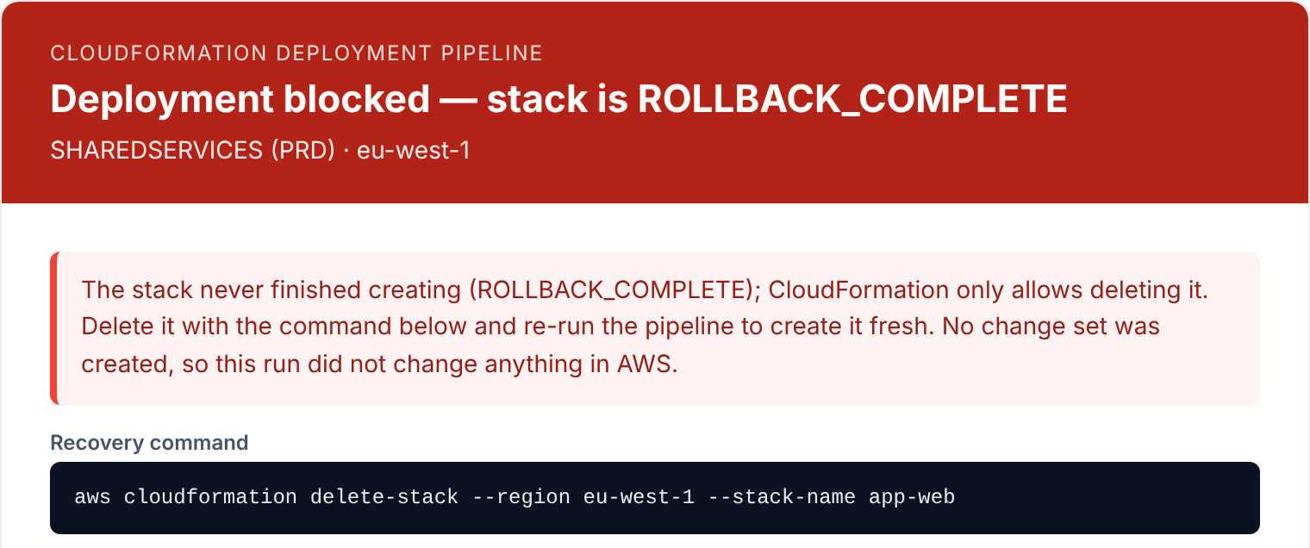
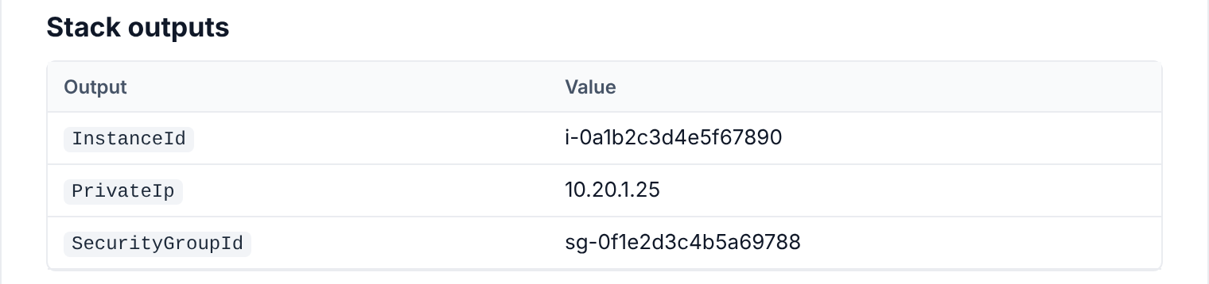
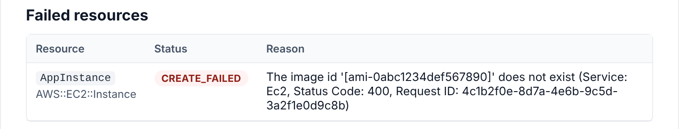

After approval: every outcome lands in the inbox
Run 3's result, a create that fails half-way, and the run after that failure
Run 3 · deployed
If the create fails half-way
The next run
[DEPLOYED][PRD] app-web — CREATE_COMPLETE
[DEPLOY FAILED][PRD] app-web — ROLLBACK_COMPLETE
[BLOCKED][PRD] app-web — stack is ROLLBACK_COMPLETE
Who approved it, how long it took, and the stack outputs: instance ID, private IP and security group.
CloudFormation's reason for the failed resource, at the top of the email, instead of a generic CLI error.
The run stops before touching AWS and gives the exact command to clear the failed stack.
Today, for the same failure: a generic CLI error in the job log, and every re-run fails until someone deletes the stack in the console.
Notes:
Result emails are sent when the pipeline executes the change set itself (GitHub gate mode). The email is a screenshot of the HTML that the pipeline's notify.py produces, rendered with this scenario's sample data against simulated AWS responses; the account ID 111122223333, the example.com addresses and the user names are placeholders. Left: run 3 succeeded; the email names who approved it, how long it took and the stack outputs. Middle: a create that fails half-way, here because the AMI ID does not exist in the Region; the failed resource and CloudFormation's reason open the email. Right: the next run finds the stack in ROLLBACK_COMPLETE, stops before touching AWS and gives the exact delete command, Region included. Compare today, where the job log shows a generic CLI error and every re-run fails until someone deletes the stack in the console.

Slide 10
Deploying an instance: side by side
Same template, same mistakes
● Handled well
● Partly handled
● Not handled
Situation | Current workflow | Proposed pipeline
Typo in params.json | ● CloudFormation rejects it at once; nothing is created | ● Preflight stops it before AWS is called; nothing is created
SSH open to 0.0.0.0/0 | ● Goes live; nobody is told | ● Flagged by the security scan and shown to the approver
What gets created | ● Whatever the template says, at once | ● A rated CREATE change set, executed only after approval
Create fails half-way | ● Generic CLI error; every re-run fails until someone deletes the stack by hand | ● Failed resource and reason emailed; the next run says how to recover
Record afterwards | ● Outputs in the job log | ● Approval email; result and outputs emailed through the GitHub gate
Notes:
Side-by-side summary of scenario 1. The typo row is a tie: CloudFormation enforces AllowedValues itself. The difference is everything CloudFormation doesn't check: risky settings, a preview, an approval, and a usable report when something fails.

Slide 11
An instance has drifted
02
Console changes made during an incident, then a routine tag change through the pipeline
Notes:
Scenario 2 follows the instance from scenario 1 after someone changes it in the console.

Slide 12
The example: console changes during an incident
Day 10's change only adds a tag; the question is what happens to the console changes
Day 1
Day 3
Day 10
Deployed
Incident
Routine change
t3.micro; the security group allows HTTPS from the VPC only.
In the console: resized to t3.medium, and SSH opened to 0.0.0.0/0.
The template adds a CostCentre tag and is deployed.
On day 10
Property | The stack's last deployment says | Live in AWS
Instance type | t3.micro | t3.medium
Security group ingress | HTTPS (443) from the VPC | HTTPS from the VPC, plus SSH (22) from anywhere
Notes:
Drift means the live resource no longer matches the stack's last deployment. Here two things drift: the instance type and the security group's ingress rules.

Slide 13
Today: the tag goes on and the drift stays hidden
A standard deployment compares the new template with the last one, not with what is running
Day 10 add a CostCentre tag
Engineer runs the workflow
Template with the new tag
Change set compares templates
Old template against new, not live
Tag added
Nothing else is looked at
Drift stays hidden
t3.medium and open SSH, unreported
Weeks later someone sets InstanceType to t3.small in params.json
Engineer runs the workflow
params.json with t3.small
Instance stopped and resized
Live t3.medium becomes t3.small, unseen
Incident change undone
Nobody knew it was there
Meanwhile SSH stays open to the internet. Nothing in any run reports it, because the template never mentions the extra rule and the deployment never compares with live state.
Notes:
On day 10 the workflow deploys the tag change. A standard change set compares the new template with the last one, not with live resources, so the console changes are invisible: the tag is added, the instance stays t3.medium and SSH stays open, and nothing reports either. Weeks later someone sets InstanceType to t3.small in params.json. CloudFormation applies it (the instance is stopped, resized and started) and the incident change is undone without anyone seeing it. Source: AWS DevOps blog, 'Safely handle configuration drift with CloudFormation drift-aware change sets'.

Slide 14
Proposed: drift stops the run until the team decides
Then one approved change set keeps the resize, closes SSH and adds the tag
Day 10 first run
Engineer runs the pipeline
Template with the new tag
Drift detection
2 resources changed outside CloudFormation
Amazon Q drafts fixes
Template code; keep or revert each
Drift email
Expected vs actual, live YAML
Stopped
Nothing changed in AWS
Next run the team keeps t3.medium and closes SSH
params.json: t3.medium
PR reviewed and merged
Re-run
driftPolicy = revert-drift
Drift-aware change set
Keep instance, add tag, remove SSH
Approval email
Each change rated
Approver approves
GitHub gate
In sync
SSH closed; result emailed
Why one run settles both. A drift-aware change set compares the template, the last deployment and what is live. Where the template now matches live (the resize), CloudFormation leaves the resource as it is; where it doesn't (the SSH rule), it puts live back to the template.
Notes:
Day 10: drift detection runs on the stack and every nested stack and finds two drifted resources, so the run stops before a change set is made. The drift email shows expected against actual values, the live YAML, a CloudTrail command to see who made each change, and Amazon Q's suggested template code with a keep-or-revert recommendation. The team keeps t3.medium by changing params.json (t3.medium is already in the template's AllowedValues) and leaves the SSH rule out of the template, then re-runs with driftPolicy = revert-drift. The drift-aware change set keeps the instance as it is (sync with live), adds the tag and removes the SSH rule. It is approved like any other change; the result is emailed when the GitHub gate is used.

Slide 15
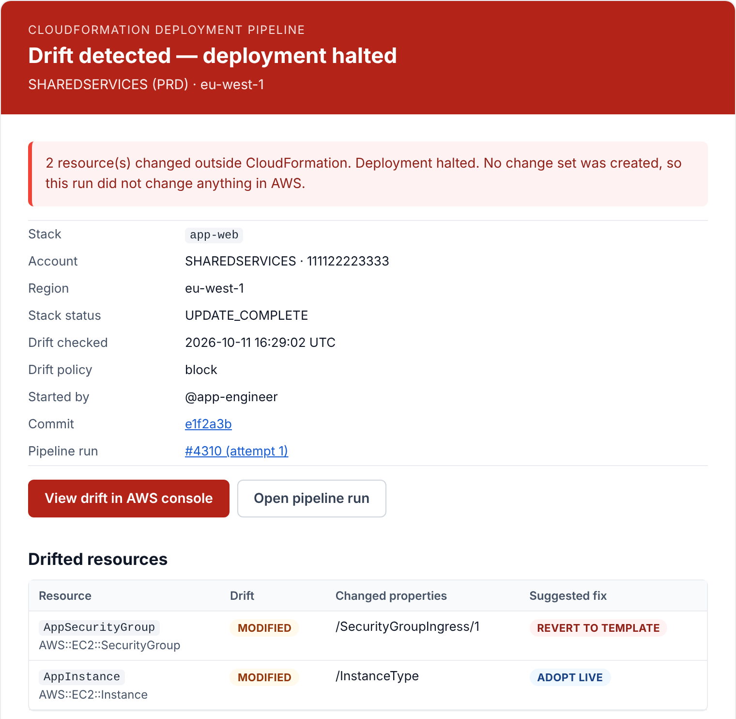
Day 10's drift email: the run stops and says why
Sent instead of an approval email · nothing was changed in AWS
[DRIFT][PRD] app-web — deployment halted, 2 drifted resources
1
Drift found, deployment halted
From CloudFormation pipeline To platform-approvers@example.com
Red header; the subject names the stack and how many resources drifted.
drifted-resources-live.yaml · +3 more
1
2
Nothing changed in AWS
No change set was created, so the run touched nothing.
2
3
Where and when
Stack, account, region, when drift was checked, and the drift policy that stopped the run.
3
4
Straight to the evidence
The drift view in the AWS console, or the pipeline run.
4
5
Every drifted resource, with Amazon Q's verdict
5
REVERT TO TEMPLATE for the SSH rule; ADOPT LIVE for the resize.
Notes:
This is the email the team receives on day 10, when drift detection finds the console changes and the run stops (driftPolicy = block). The email is a screenshot of the HTML that the pipeline's notify.py produces, rendered with this scenario's sample data against simulated AWS responses; the account ID 111122223333, the example.com addresses and the user names are placeholders. 1: red header and a subject that names the stack and how many resources drifted. 2: no change set was created, so nothing changed in AWS. 3: stack, account, region, when drift was checked and the drift policy. 4: buttons open the drift view in the AWS console and the pipeline run. 5: one row per drifted resource, with the property that changed and Amazon Q's recommendation. Attachments: the live YAML of the drifted resources, the suggested code, a markdown summary of the fixes and the full drift report.

Slide 16
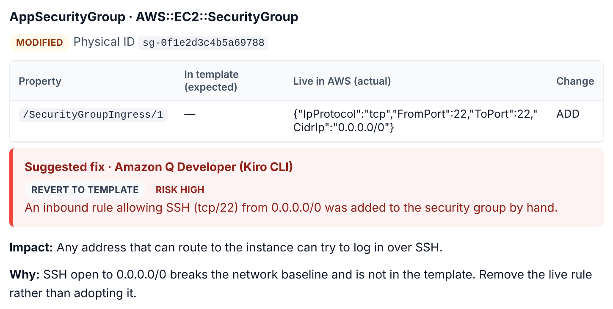
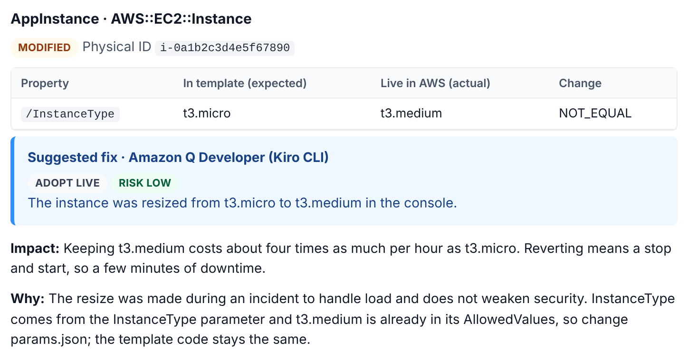
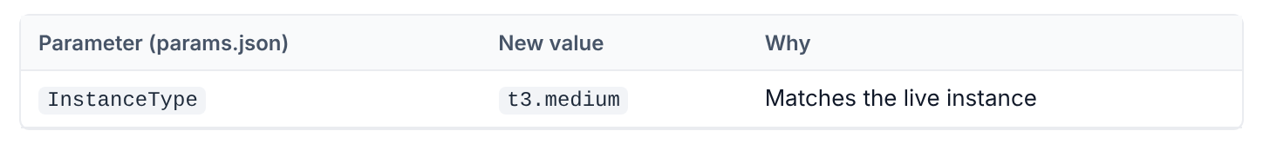

Further down: Amazon Q's suggested fix for each resource
Expected and live values, a recommendation, and template code ready to paste
1
1
2
2
3
1
What drifted. Template value against live value, for each changed property.
4
2
Amazon Q's verdict. Revert the SSH rule (risk HIGH); keep the resize (risk LOW).
Amazon Q in the pipeline. Amazon Q Developer runs headless (Kiro CLI), with Amazon Bedrock as the fallback. A person reviews every suggestion before anything changes.
3
The reasoning. Impact and why, in plain words, for the approver and the owner.
4
The fix, ready to use. Template code for each resource, plus the params.json change InstanceType → t3.medium.
Notes:
The middle of the day 10 drift email: one section per drifted resource. The email is a screenshot of the HTML that the pipeline's notify.py produces, rendered with this scenario's sample data against simulated AWS responses; the account ID 111122223333, the example.com addresses and the user names are placeholders. The recommendations shown are sample text standing in for Amazon Q's answer, which the pipeline asks for each drifted resource. 1: the property that drifted, template value against live value. 2: Amazon Q's recommendation and risk: revert the world-open SSH rule (HIGH), keep the resize (LOW). 3: impact and reasoning in plain words. 4: for the resize, the change belongs in params.json (InstanceType = t3.medium), so the email gives that change as well as the template code. Each section also shows the live YAML, the current code from the repository and a CloudTrail command to find who made the change. Amazon Q Developer runs headless through the Kiro CLI; Amazon Bedrock is the fallback. Nothing is applied until a person acts on it.

Slide 17
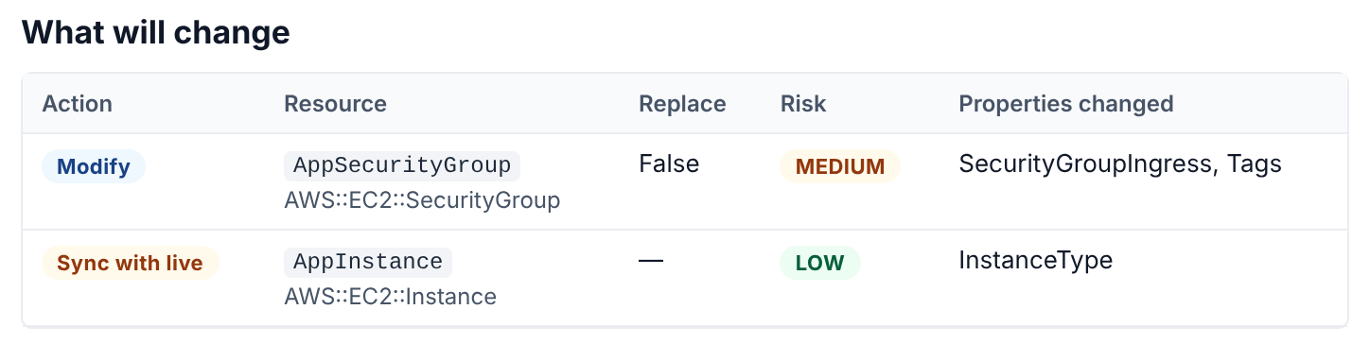
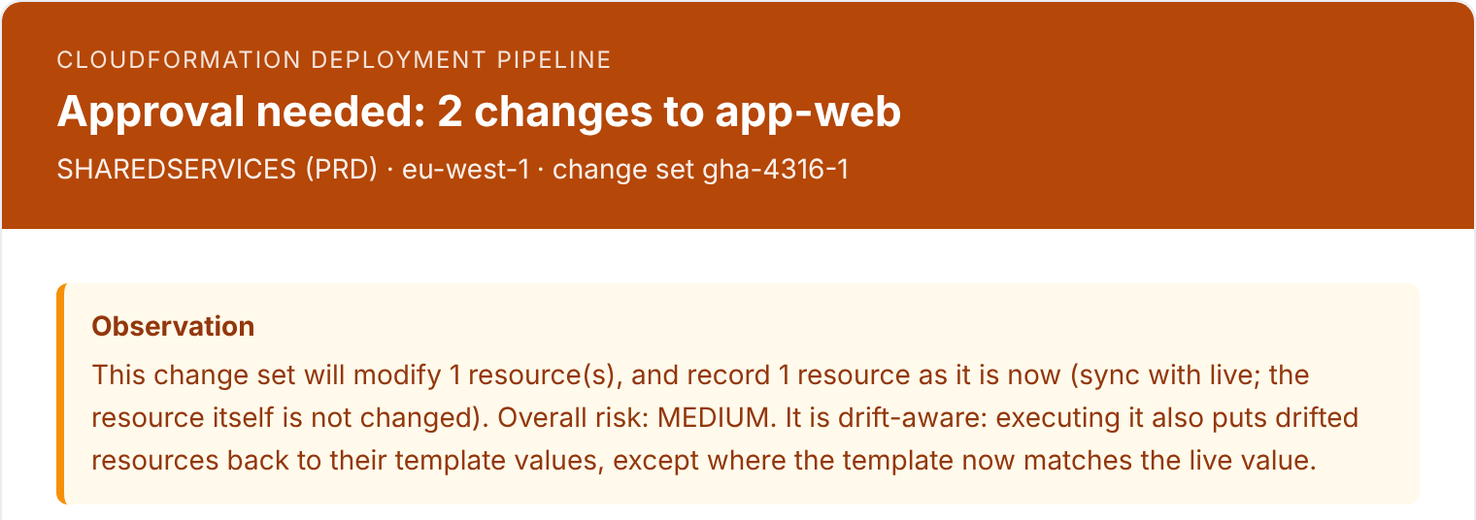
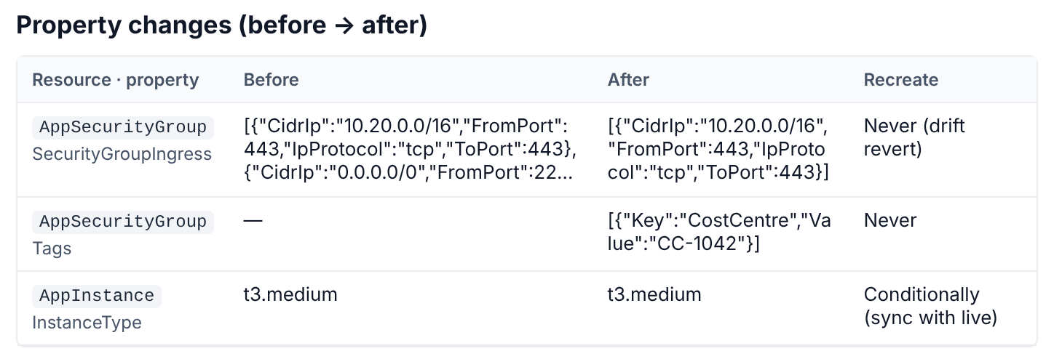
Next run's approval email: keep the resize, remove SSH
A drift-aware change set, approved like any other
[APPROVAL NEEDED][PRD] app-web — 2 changes, risk MEDIUM
From CloudFormation pipeline To platform-approvers@example.com
changes.csv · changeset.json
2
1
3
1
Drift-aware, and says so
Drifted resources go back to the template, except where the template now matches live.
4
3
Drift revert. The SSH rule added in the console is removed; the tag is added.
2
Two changes, one decision
Modify the security group (MEDIUM); sync the instance with live (LOW).
4
Sync with live. The instance stays t3.medium; CloudFormation only updates its record.
Notes:
The approval email for the run after the team's decision (params.json now says t3.medium; re-run with driftPolicy = revert-drift). The email is a screenshot of the HTML that the pipeline's notify.py produces, rendered with this scenario's sample data against simulated AWS responses; the account ID 111122223333, the example.com addresses and the user names are placeholders. 1: the summary says the change set is drift-aware and how drift is handled. 2: the security group is modified (MEDIUM) and the instance is synced with live (LOW). 3: the SSH rule that was added in the console is removed (drift revert) and the CostCentre tag is added. 4: the instance stays t3.medium; CloudFormation only updates its record ('Sync with live', as the AWS console calls it).

Slide 18
A drifted instance: side by side
Same console changes, same tag change
● Handled well
● Partly handled
● Not handled
Situation | Current workflow | Proposed pipeline
Console changes found before deploying | ● No; deploy compares old and new templates only | ● Yes; drift on the stack and nested stacks stops the run
Who made the change | ● Not shown | ● CloudTrail lookup in the drift email
SSH opened to the world | ● Stays open and unreported | ● Reported, then removed through an approved change set
Instance resized to t3.medium | ● Kept until a later change silently undoes it | ● Kept on purpose, or reverted, by an approved decision
Template code for the fix | ● None | ● Live YAML and an Amazon Q suggestion
What changes in AWS on day 10 | ● The tag, with the drift left in place | ● Nothing, until the team decides
Notes:
Side-by-side summary of scenario 2.

Slide 19
Add or update a DNS record
03
A new A record and a changed CNAME, in a zone that other tools also write to
Notes:
Scenario 3 compares the DNS workflows, the current CloudFormation workflow with records in a template, and the proposed pipeline with records in a stack.

Slide 20
The example: two changes in a busy zone
example.com · two records change; three others must be left exactly as they are
Record | Type | Value | In this example
app.example.com | A | 10.20.1.15 | ● Add
www.example.com | CNAME | web-old.example.net → web-new.example.net | ● Change
status.example.com | A | 10.20.9.41 (was 10.20.9.40) | ● Leave alone: repointed in the console during a failover, while the PR was in review
_3f2a9c.example.com | CNAME | _9b1d…acm-validations.aws | ● Leave alone: ACM certificate validation
example.com | A (ALIAS) | CloudFront distribution | ● Leave alone: managed by another CloudFormation stack
What good looks like. The first two records change, exactly as reviewed; the other three stay exactly as they are.
Notes:
The zone holds records from several sources: the DNS workflows, a console change made during a failover, ACM certificate validation and an ALIAS record managed by another CloudFormation stack. A good pipeline changes only the two records asked for.

Slide 21
Today with the DNS workflows: two workflows and a pull request
ws2-dns-records-export.yml, then ws2-dns-records-apply.yml
Export get the zone into Git
Run Export
One zone
New branch and PR
Large diff, even with nothing changed
Edit the zone file
Add app; change www
Review and merge
PR checks don't run on the bot PR
Apply status.example.com was repointed in the console while the PR was in review
Run Apply
Execute changes ticked
Preview
UPSERT app and www, and status back to its old value
Approval
Shared production gate; can wait up to 30 days
Change batch sent
Difference worked out again first
Marked APPLIED
The failover change is undone
With Allow deletes ticked. Anything live but missing from the file is deleted, such as records other tools created after the last export. The ALIAS record depends on how the apply script treats records that export skips.
Notes:
Export copies the zone into JSON on a new branch and opens a pull request. The team has seen large diffs between exports, and checks don't run on a pull request opened with the workflow's own token. The edit is merged. In this example status.example.com was repointed in the console during a failover while the pull request was in review, so the file still holds the old value and Apply's preview contains an UPSERT that puts it back. After approval a new job works out the difference again and sends the change batch with boto3, so anything changed while the approval waited is overwritten too. The run is marked APPLIED; the workflow keeps no copy of the zone beforehand and doesn't check afterwards. With Allow deletes ticked, anything live but missing from the file is deleted.

Slide 22
Today with the current CloudFormation workflow
latest_cft_deployment.yml, with the records defined as AWS::Route53::RecordSet in a template
Records in a template the usual path
Engineer runs the workflow
Inputs typed by hand
Records changed at once
No preview, no approval
Live in Route 53
A typo goes live too
www.example.com isn't in the stack yet it was created outside CloudFormation
Add it to the template
Then run the workflow
Fails: already exists
CloudFormation won't take over a record it didn't create
Sorted out by hand
Delete the old record and re-run, or leave it out
What it gets right. Records outside the template, such as the failover change on status, the ACM validation record and the CloudFront ALIAS, are never touched.
Notes:
Records in a CloudFormation template only affect records the stack owns, which is good. But the workflow changes them as soon as it runs, with no preview, approval or record. A record that already exists in the zone, such as www.example.com created by the DNS workflows, can't simply be added to the template: CloudFormation refuses to create a record that already exists and won't take over one it didn't create, and record sets can't be imported. Someone has to sort it out by hand, for example by deleting the old record and re-running, which leaves a short gap for that name.

Slide 23

Proposed: one run, reviewed as it will happen
cfn-deploy-pipeline.yml, with the zone's records in a CloudFormation stack
One run stack dns-records-example-com
Engineer runs the pipeline
Account picked from a list
Checks
Preflight, lint, drift on the stack*
Change set
Add app · Modify www, old → new
Approval email
Route 53 changes rated MEDIUM
Approver approves
GitHub gate
Applied
Result emailed; rolls back on failure
Only this stack's records change
Getting records into a stack
The failover change on status, the ACM validation record and the CloudFront ALIAS are left alone.
New records can start in a stack today. Existing records need a planned move per zone, because record sets can't be imported into a stack.
* Confirm in CloudFormation's resource type support table that drift detection covers Route 53 record sets.
Notes:
With the records in a stack, the proposed pipeline checks the template, runs the drift check, and creates a change set that shows Add for app.example.com and Modify for www.example.com with before and after values. Route 53 changes are rated MEDIUM. The approver approves the GitHub gate and the pipeline executes the change set exactly as reviewed; on failure the stack rolls back and the root cause is emailed. (In the default mode the approver executes the change set in the AWS console instead.) Records outside the stack are never touched. Caveats: confirm that CloudFormation drift detection covers Route 53 record sets, and plan the move of existing records, because record sets can't be imported into a stack.

Slide 24
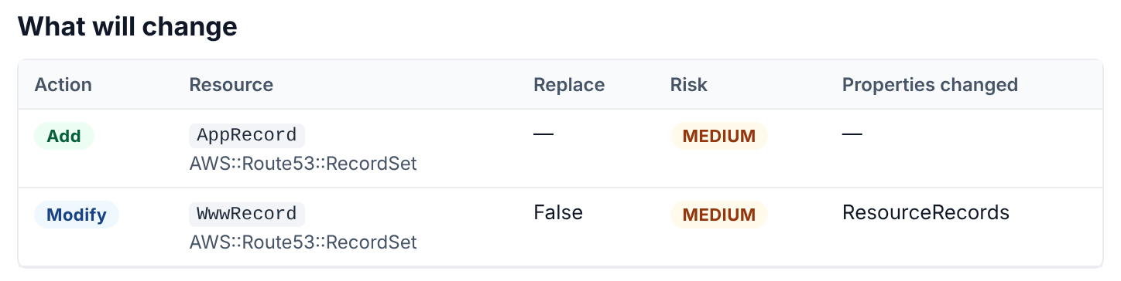
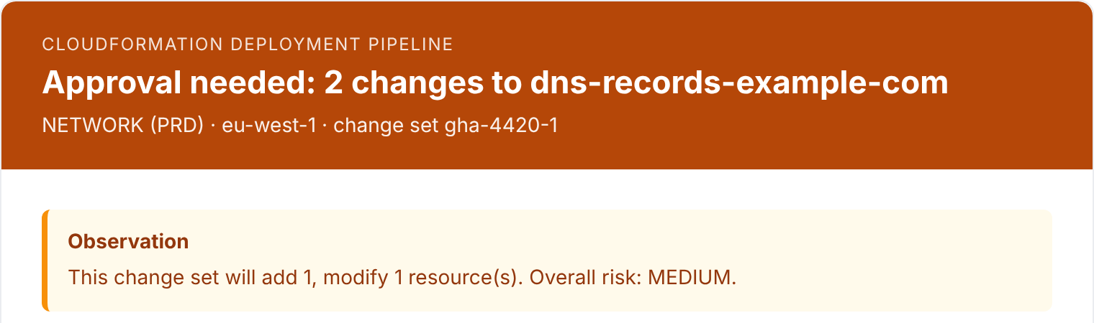
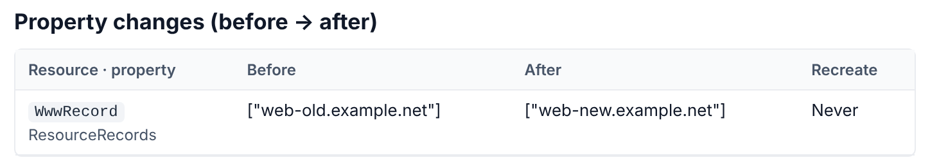
The DNS change's approval email: one Add, one Modify
Only the stack's own records appear · nothing else in the zone can change
[APPROVAL NEEDED][PRD] dns-records-example-com — 2 changes, risk MEDIUM
From CloudFormation pipeline To platform-approvers@example.com
changes.csv · changeset.json
2
1
3
1
Risk MEDIUM, stated up front
Route 53 records are network-sensitive, so both changes are rated MEDIUM.
3
Repoint www. web-old.example.net → web-new.example.net
2
Add app.example.com
Only this stack's records. The failover change on status, the ACM record and the CloudFront ALIAS are not in the change set, so they can't change.
A new A record; its full properties follow further down the email.
Notes:
The approval email for the DNS change, with the records in the stack dns-records-example-com. The email is a screenshot of the HTML that the pipeline's notify.py produces, rendered with this scenario's sample data against simulated AWS responses; the account ID 111122223333, the example.com addresses and the user names are placeholders. 1: overall risk MEDIUM in the subject, the header colour and the summary; Route 53 record sets are a network-sensitive type. 2: app.example.com is added; further down, the email shows every property of the new record. 3: www.example.com before and after. The email also shows the drift check result (in sync) and notes that termination protection is on.

Slide 25
A DNS change: side by side
Add app.example.com and repoint www.example.com
● Handled well
● Partly handled
● Not handled
Situation | DNS export + apply | Current CloudFormation workflow | Proposed pipeline
What the reviewer sees | ● A preview, worked out again after approval | ● Nothing before it goes live | ● A change set with before → after, run as approved
Records the change doesn't mention | ● Pushed back to the file; with deletes, extra records removed | ● Left alone | ● Left alone
Name already used by another tool | ● Overwritten by UPSERT | ● Fails safely; the reason may not reach the job log | ● Fails safely; the reason is emailed
ALIAS records | ● Not supported; export skips them | ● Supported | ● Supported
Approval record | ● GitHub environment approval | ● None | ● Approval email, and who executed it
Steps for the engineer | ● Two workflows and a pull request | ● One run, no review | ● One run and one approval
Notes:
Side-by-side summary of scenario 3 across the three ways a record can change today or in the proposed setup.

Slide 26
Every email the pipeline sends
The subject line always names the outcome, the account tier and the stack
Email | Sent when | What's in it | Subject line (example)
● Drift alert | Drift is found and driftPolicy is block | Expected against live for each property, live YAML, Amazon Q's fix with template code, a CloudTrail command | [DRIFT][PRD] app-web — deployment halted, 2 drifted resources
● Drift check inconclusive | Drift detection could not check every resource | What could not be checked, and the usual fix | [DRIFT CHECK INCONCLUSIVE][PRD] app-web — deployment halted
● Blocked | The stack is in a state that can't be updated | Why, and the exact recovery command | [BLOCKED][PRD] app-web — stack is ROLLBACK_COMPLETE
● Pipeline error | The drift stage itself failed | The error, and the common causes | [PIPELINE ERROR][PRD] app-web — drift check failed
● Approval needed | A change set is ready (header blue, amber or red by risk) | Each change rated, why, scan findings, new resources, before → after, how to approve | [APPROVAL NEEDED][PRD] app-web — 2 changes, risk MEDIUM
● No changes | Template and params already match what is deployed | Confirmation; the empty change set is deleted | [NO CHANGES][PRD] app-web — nothing to deploy
● Deployed | The pipeline executed the approved change set | Who approved it, how long it took, the stack outputs | [DEPLOYED][PRD] app-web — CREATE_COMPLETE
● Deploy failed | Execution failed and CloudFormation rolled back | Root cause, failed resources, CloudFormation's diagnostics | [DEPLOY FAILED][PRD] app-web — ROLLBACK_COMPLETE
Sent as HTML with attachments through Amazon SES, or as plain text through Amazon SNS. Every email is also saved with the run, so it can be previewed even when sending is switched off.
Notes:
Every email the proposed pipeline can send, with an example subject line. Drift, blocked, inconclusive and error emails come from the drift stage; the approval and no-change emails follow the change set; deployed and failed emails are sent when the pipeline executes the change set itself (GitHub gate mode). If a change set fails CloudFormation's validation, the run fails with the exact errors in its summary instead of sending an email.

Slide 27
Where the proposed pipeline helps
The same three changes, today and with the proposed pipeline
Deploy an EC2 instance
A drifted instance
A DNS record
Today
Today
Today
CloudFormation catches the typo, but SSH open to the world goes live unreviewed, and a failed first deploy needs clean-up by hand.
Console changes stay hidden, and a later deployment overwrites them unseen.
Two workflows and a pull request; the change is worked out again after approval, and console changes can be undone.
With the proposed pipeline
With the proposed pipeline
With the proposed pipeline
The open SSH rule is flagged before anything exists, a person approves what gets created, and a failure comes with its reason and the fix.
Drift stops the run, the email shows what changed with suggested template code, and one approved change set keeps or reverts each change.
One run and a change set that runs as reviewed; only the stack's own records change.
Notes:
One card per scenario. In each case the proposed pipeline moves the discovery of a problem from the live account to a check that stops the run, and puts a person's approval in front of every change.

Slide 28
Next steps
Rehearse the scenarios on a sandbox account before switching production
CloudFormation
DNS records
1
Set up
1
Fix now
Deploy the support stack; add the SES sender and the new secrets and variables.
Make the applied change the approved one, and add an ownership rule before deletes are used.
2
Rehearse
2
Start new records in stacks
Run scenarios 1 and 2 against a sandbox EC2 stack, including a deliberate console change.
Create new records through the proposed pipeline from now on.
3
Switch
3
Plan the move
Move production stacks across, then retire latest_cft_deployment.yml.
Move existing zones one at a time; record sets can't be imported, so plan each cutover.
Notes:
Scenarios 1 and 2 can be rehearsed on a small sandbox EC2 stack. For DNS, the high-severity fixes to the apply workflow are worth doing regardless of where the records end up. Until a zone has moved, the DNS workflows will also export records that a stack manages, so the ownership rule matters: without it, a stale zone file can put back a record the stack has since changed.

