Slide 1
1 / 5
CS 331 / COMPUTER NETWORKS / PROJECT 2
Understanding Host
Network Stack Overheads
Paper study + adapted Single Flow experiment
PRESENTED BY
Gurudayal Meena
Kunal Singh Rathore

Slide 2
2 / 5
Why the network stack becomes a bottleneck
SECTION 1 · MOTIVATION
SECTION 2.1 · DATA PATH
Datacenter links reached 100 Gbps, but CPU and cache growth lagged.
Send:
App → socket/skb → TCP/IP → NIC
So host packet processing can limit throughput before the link is full.
Receive:
NIC → NAPI/GRO → TCP/IP → App
Where CPU time goes
Data copying · Protocol processing · Socket buffers · Memory and scheduling
SECTION 2.2 · HOW THE PAPER STUDIES IT
Two servers, direct 100 Gbps link
→
TCP workloads
→
Throughput + CPU profiling

Slide 3
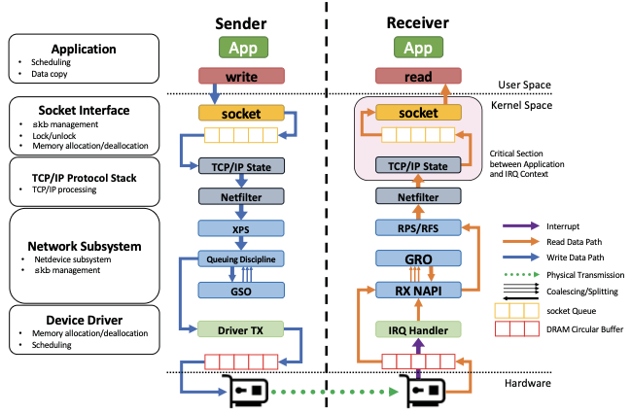
3 / 5
Sender and receiver data paths in Linux
SENDER
App writes data → TCP/IP → driver transmits.
RECEIVER
NIC receives → NAPI/GRO → TCP/IP → app reads.

Slide 4
4 / 5
Single Flow — how we did the experiment
One Ubuntu VM • iPerf3 • TCP over loopback
WHAT WE DID
INSIDE OUR LAPTOP
1
Set up sender and receiver
Ubuntu in VirtualBox
Used iPerf3 in our Ubuntu VM
4 virtual CPUs · about 3.8 GiB RAM
2
Send TCP data locally
Sender
TCP →
Receiver
One TCP stream through 127.0.0.1
iPerf3 client
iPerf3 server
3
Save and analyze results
Address: 127.0.0.1 (loopback)
Python: JSON → CSV → graphs
We measured: TCP goodput (Gbps) + sender and receiver process CPU use

Slide 5
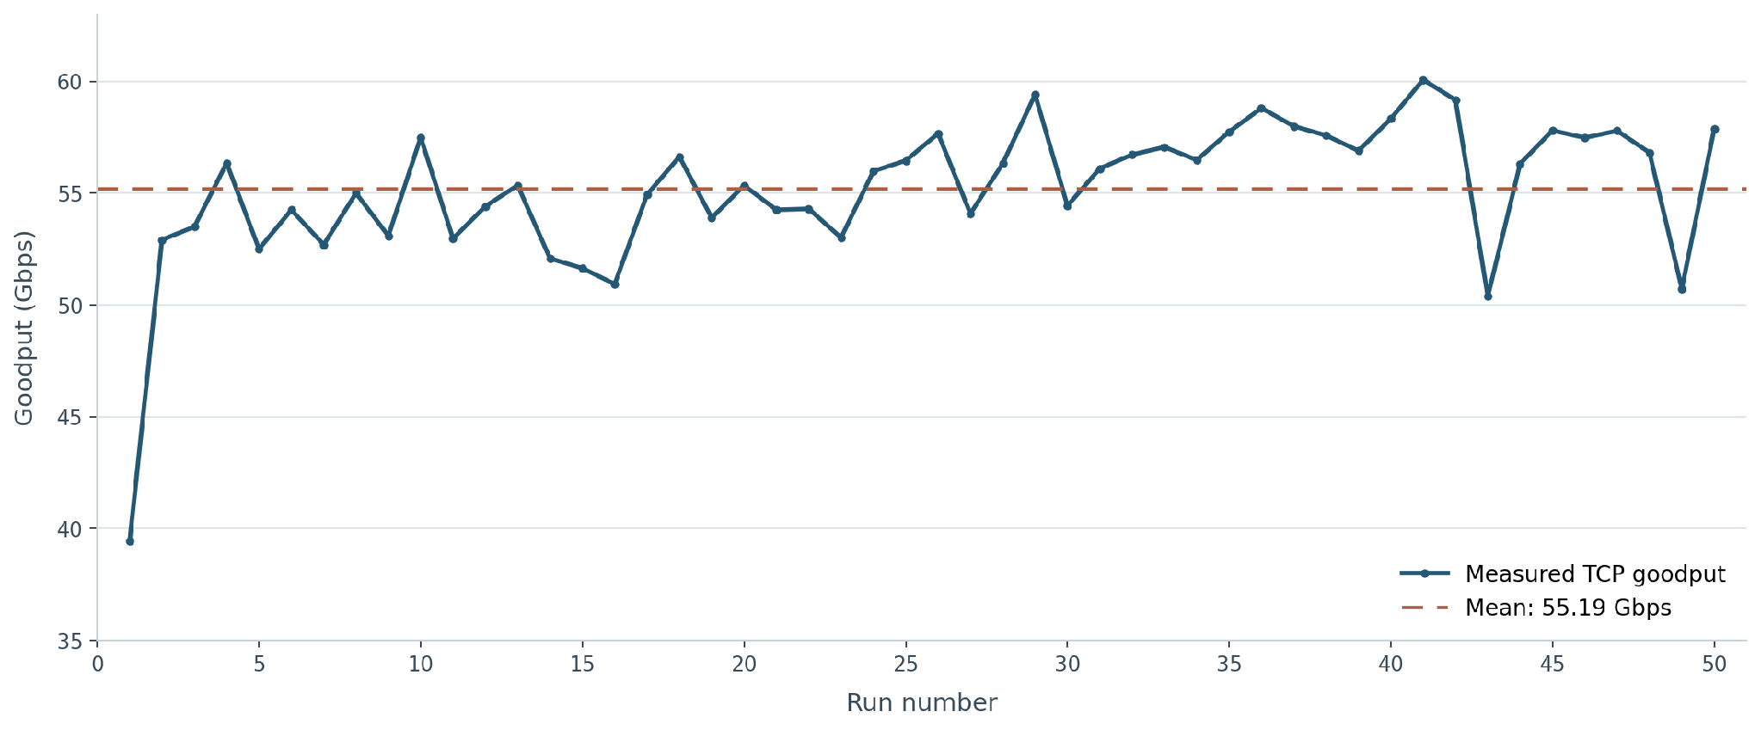
5 / 5
Single Flow results and what they mean
MEAN GOODPUT
55.19 Gbps
Minimum
39.44 Gbps
Maximum
60.07 Gbps
CPU observed
Sender ~98–99%; receiver usually ~60–66% of one logical CPU.
55.19 Gbps is local loopback goodput—not physical NIC speed or the paper’s ~42 Gbps per core.

