Slide 1
Introduction
Understanding Host Network Stack Overheads
Qizhe Cai, Shubham Chaudhary, Midhul Vuppalapati, Jaehyun Hwang, Rachit Agarwal
ACM SIGCOMM 2021 · reproduced on one laptop
What this project is
• A reproduction of the paper's experiments in software, not a new system.
• Two virtual hosts in one Linux VM, joined by a virtual cable (veth).
• Same tools as the paper: iperf3, netperf, mpstat, perf, ss, tc.
• Result: scripts, graphs, a report and a live demo.
Presented by:
Kunal Singh Rathore(23110181)
Gurudayal Meena(23110125)
1 / 6

Slide 2
Problem Statement & Objectives
The problem
Our objectives
• Links got ~10× faster (10 → 100 Gbps), CPU cores did not.
• The host CPU is now the bottleneck, not the network.
• Paper: one core moves only ~42 Gbps; the biggest cost is copying data.
• Key metric: throughput per core = Gbps ÷ CPU cores busy.
1. Reproduce the paper's experiments on one laptop.
2. Measure the paper's metric: throughput per CPU core.
3. Show which kernel features and traffic patterns cost CPU.
4. Fix and automate our first version (scripts, checks, report).
Why one laptop instead of two? Laptop networks run at ~1 Gbps: the link would be full while the CPU is almost idle (≈ 1.6 % of one core per Gbps in our runs).
A virtual cable (veth) has no speed limit, so the CPU becomes the bottleneck, just like the paper's 100 Gbps testbed. Scope: 8 of the paper's 10 experiment sections (§3.8 DDIO and §3.9 IOMMU need server hardware).
2 / 6

Slide 3
Architecture / Mechanism
Laptop → Ubuntu VM (4 vCPUs, one Linux kernel)
How one run works
Sender host
network namespace
Receiver host
network namespace
1. Script creates the 2 hosts + cable
2. Applies ONE setting (offloads, MTU, loss, congestion control …)
3. Starts server on CPU2 and client on CPU0 (taskset)
4. 3 s warm-up ignored, 15 s measured, mpstat logs each CPU
5. Repeats 3×, random order → analyze.py → graphs → PDF
CPU0
CPU1
CPU2
CPU3
iperf3 / netperf clients
veth pair
virtual cable, no speed limit
iperf3 / netperf servers
mpstat
busy % of every CPU, each second
perf
which kernel functions use the CPU
ss · nstat · tc
TCP state, counters, packet loss
write()
copy user→kernel
TCP/IP
GSO / TSO
veth
receive + TCP (softirq)
copy kernel→user
read()
Path of one byte: one data copy at each side; everything else works on packet descriptors (skbs). Key mechanism difference: veth does the receiver's packet processing on the SENDING CPU → our sender core is the bottleneck (paper: the receiver).
3 / 6

Slide 4
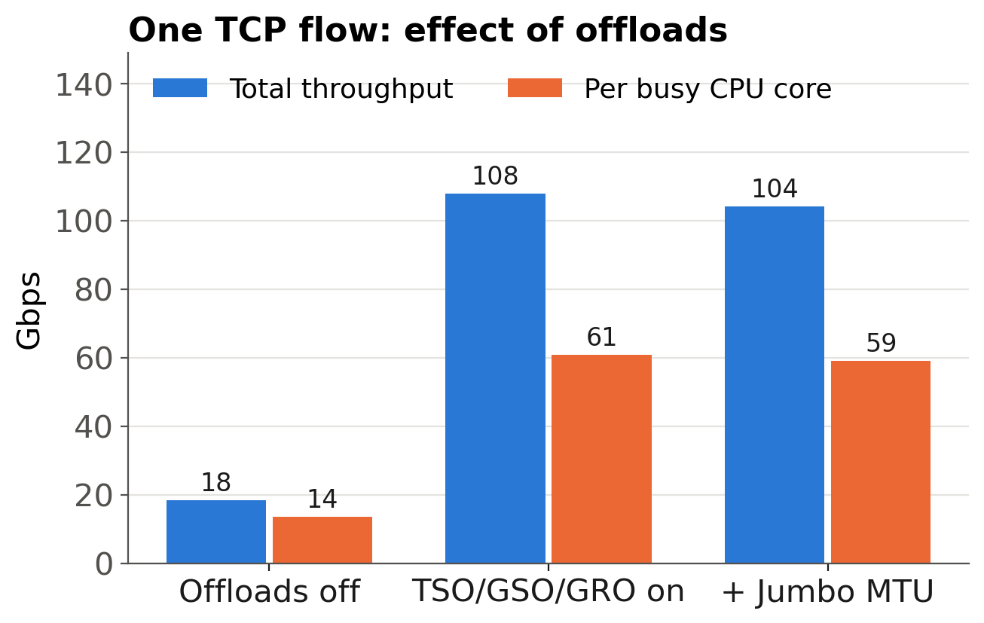
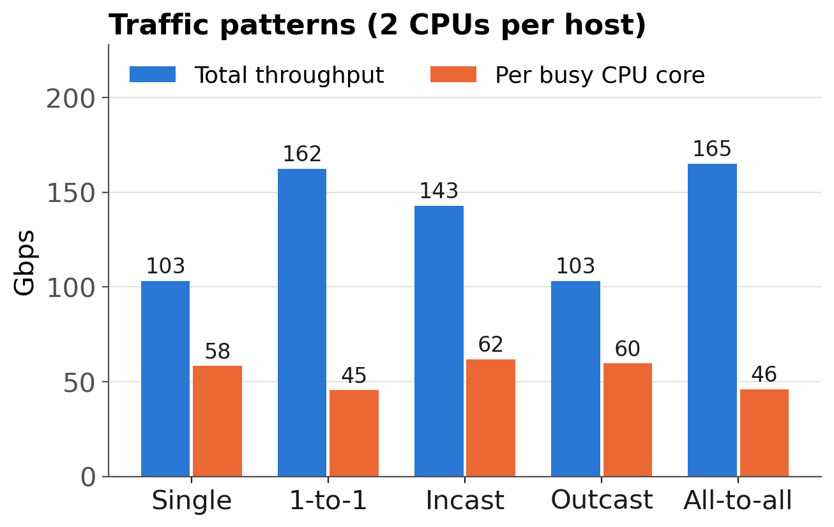
Extension / Issues Fixed / Evaluation
What we added (extension)
Evaluation: main results (mean of 3 runs)
One script per paper section + shared code
Throughput per core from per-CPU logs (paper's metric)
Step-by-step optimisations (Fig. 3a), buffers (Fig. 3e), 1 → 8 flows per core (Figs. 6, 7)
Automatic checks: measured loss, live congestion control, offloads
perf CPU breakdown (Table 1), graphs, report, demo script
Issues fixed in the first version
Issue | Fix
Paper's metric never computed | Per-core CPU from mpstat
CPU taken from iperf3's own process | Every CPU measured
Loss counters added up across runs | Fresh queue; loss measured
Setup by hand; aborted runs mixed in | Scripts + COMPLETED marker
Packet loss 1.5 %
-27 % throughput
measured loss = configured
Message size
4 KB: 9 → 64 KB: 68
Gbps per busy core
Long + 16 short flows
long flow -90 %
short flows -11 %
Congestion control
BBR -33 % vs CUBIC
DCTCP ≈ CUBIC
Takeaway: offloads give 4.5× more work per core; a second host pair gives only 1.57× (not 2×); on veth the sender core is the bottleneck, so everything that adds work there (loss, pacing, small messages) costs throughput.
4 / 6

Slide 5
Non-Functional Testing Parameters
Parameter | What we measured | How | Result
Performance | Throughput (Gbps), transactions per second | iperf3 / netperf; 3 s warm-up + 15 s | 108 Gbps with 1 flow; 165 Gbps with 4
Efficiency | Gbps per busy CPU core (the paper's metric) | mpstat on every core, every second | 13.5 → 60.9 with offloads (4.5×)
Scalability | More cores (1 → 2 pairs); more flows on one core (1 → 8) | Traffic patterns and flow-count runs | 2 pairs = 1.57× one flow; 8 flows on one core -5 %
Reliability | Behaviour under random packet loss 0 – 1.5 % | netem drops; drop counters checked | -27 % throughput; loss exact (1.502 %)
Repeatability | Spread between the 3 runs | Random order; fresh setup each run | median 1.4 % of the mean (max 7 %)
Measurement validity | Background load; correct settings | Idle baseline; ethtool / ss read-back | 1–13 % idle load; disturbed runs repeated
5 / 6

Slide 6
Challenges Faced
Challenge | What we did
No 100 Gbps hardware, only one laptop | Two namespaces + veth in one VM: the CPU becomes the bottleneck
VM has no DDIO, IOMMU, NUMA or cache counters | Explained why; covered 8 of the paper's 10 sections
veth does receive work on the sender's CPU | Measured it (64 % softirq on CPU0) and explained each result
Other programs disturbed runs (up to 52 % CPU) | Idle baseline, random order, repeated the disturbed runs
Misleading numbers (loss counters, iperf3 CPU, retransmissions at 0 % loss) | Fresh counters, per-core mpstat; nstat showed reordering, not loss
Only 4 CPUs; no sudo for some kernel features | 2 CPUs per host; BBR/DCTCP, RFS and perf scripted for sudo
Lesson: at high speed the host CPU is the bottleneck; how we use the cores matters more than the network.
6 / 6

