Slide 1

AI Assisted Translation of English and Turkish Documents
Kunal Gaurav

Slide 2
Problem
ABC currently manually translates documents from English to Turkish and vice versa and this process is time consuming and prone to human errors.
The translators at ABC have the task of Translating documents from English to Turkish and vice versa
This process can sometimes become time consuming especially when there are a lot of documents to translate or when the documents are illegible
Sometimes the customer provides images of documents that are difficult to read and translate
ABC needs an automated way to translate the documents from English to Turkish and vice versa
This Automated workflow should save the translators time and produce accurate translations.

Slide 3
Solution
N8n AI tool is used to create AI Automated workflows that translate the documents and require human interaction in the final stages
2 Workflows are created - The Native pdf translation workflow and The OCR translation workflow
The Native pdf translation workflow takes a standard PDF file and translates it while keeping the original file’s layout and formatting intact. PII is implemented by the Lara Translate node which runs in “Incognito” mode. However, it can’t recognize the content in image PDF files. For that we have the OCR workflow
The OCR translation workflow uses OCR technology on an image that has been generated by taking a picture of the document. This step outputs a pdf file that has a different format than the original image PDF file. PII is implemented by the AI module. There is a change in the layout format of the image file.

Slide 4
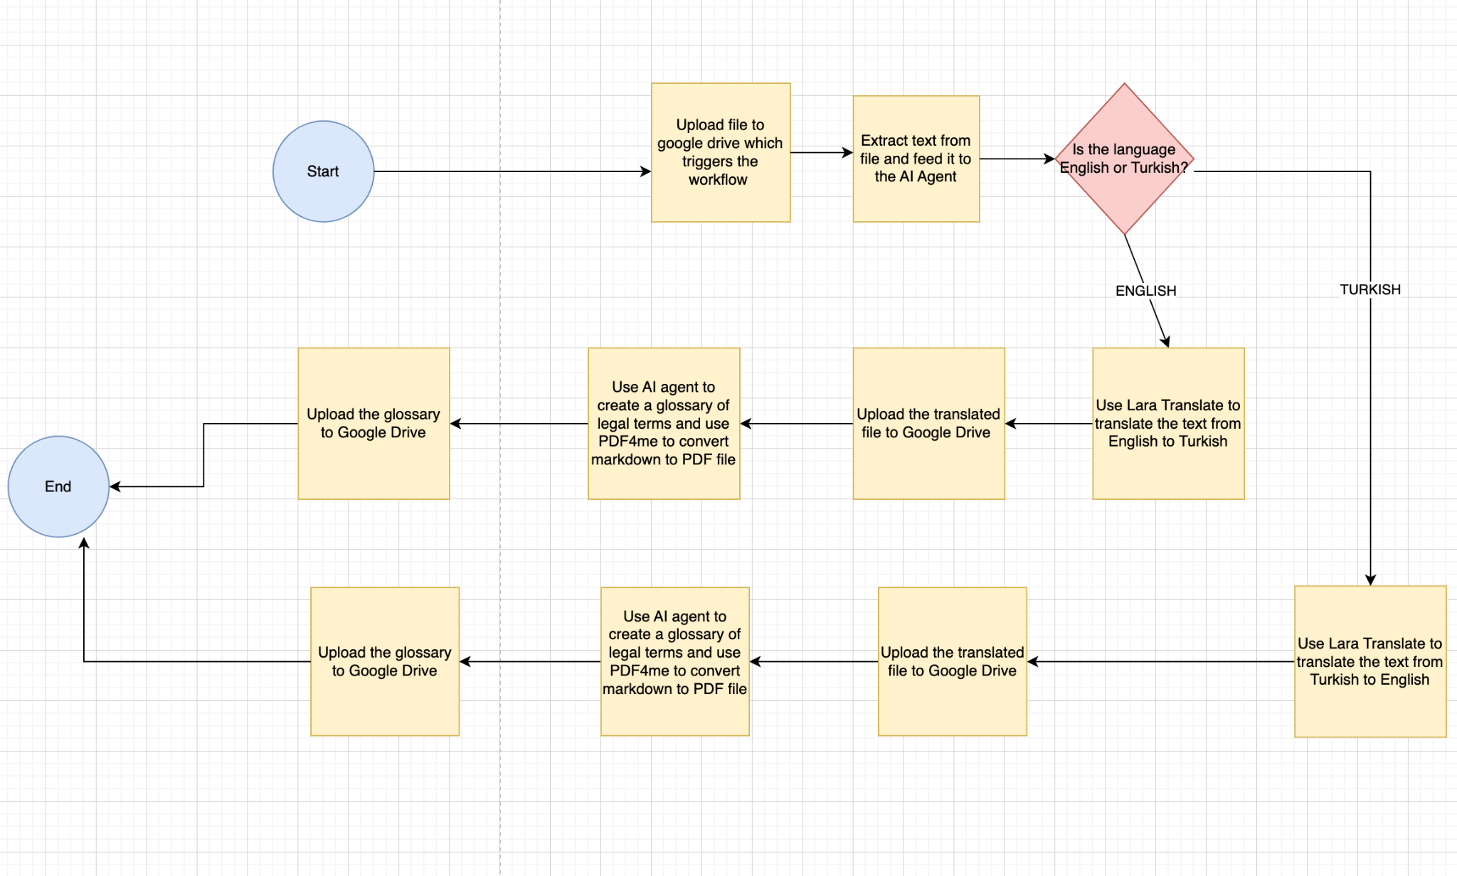
Native PDF Translation Flowchart

Slide 5
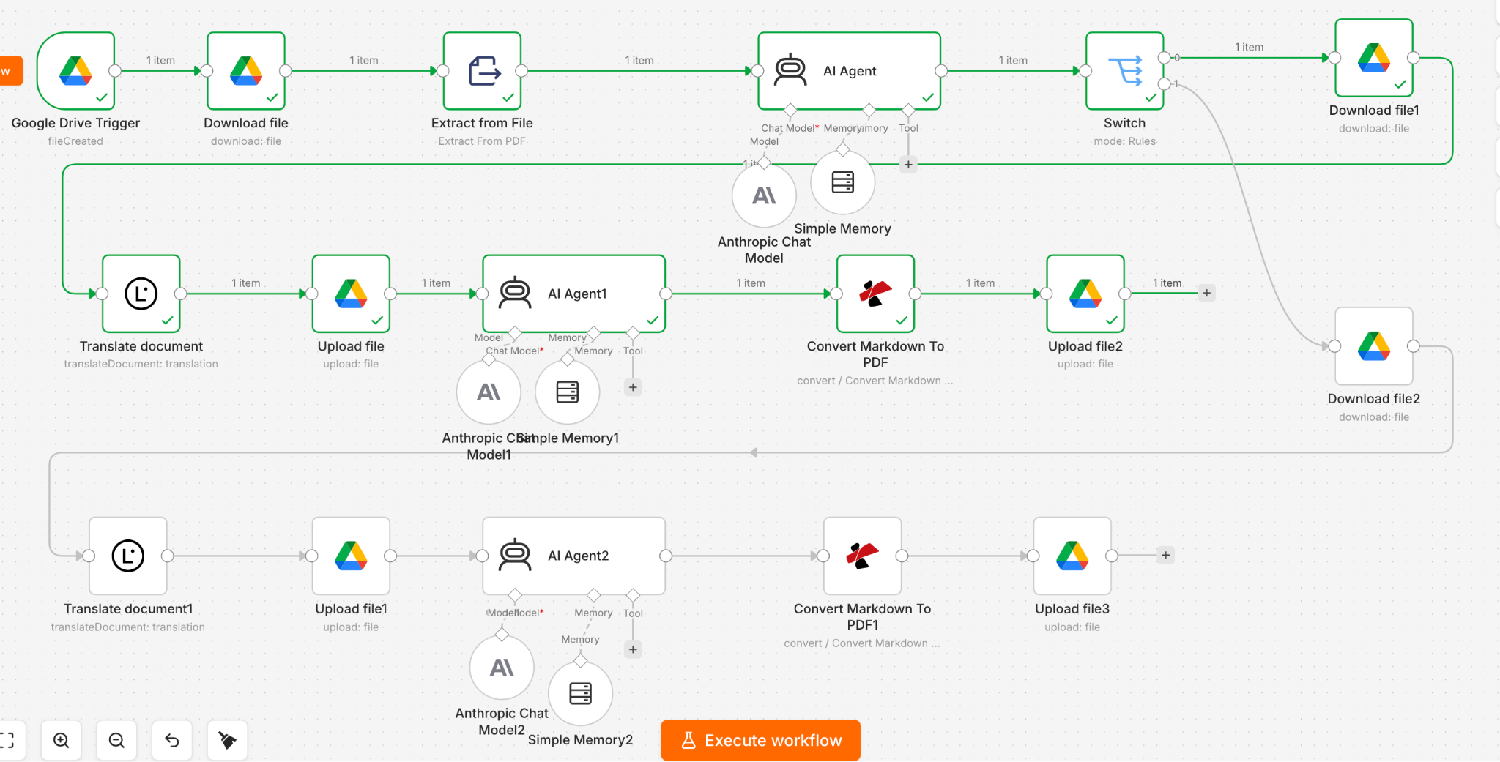
Native PDF Translation Workflow

Slide 6
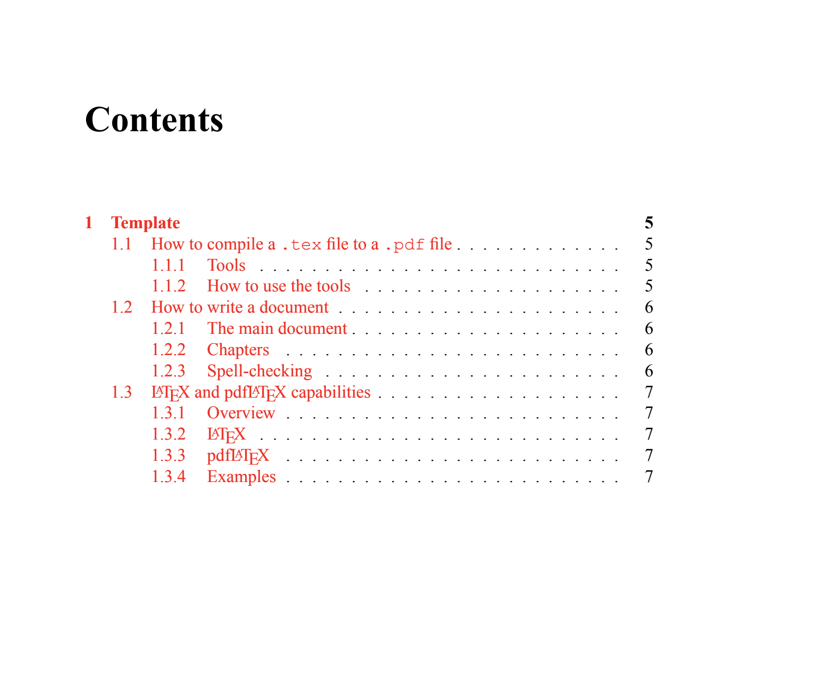
Original PDF Document:

Slide 7
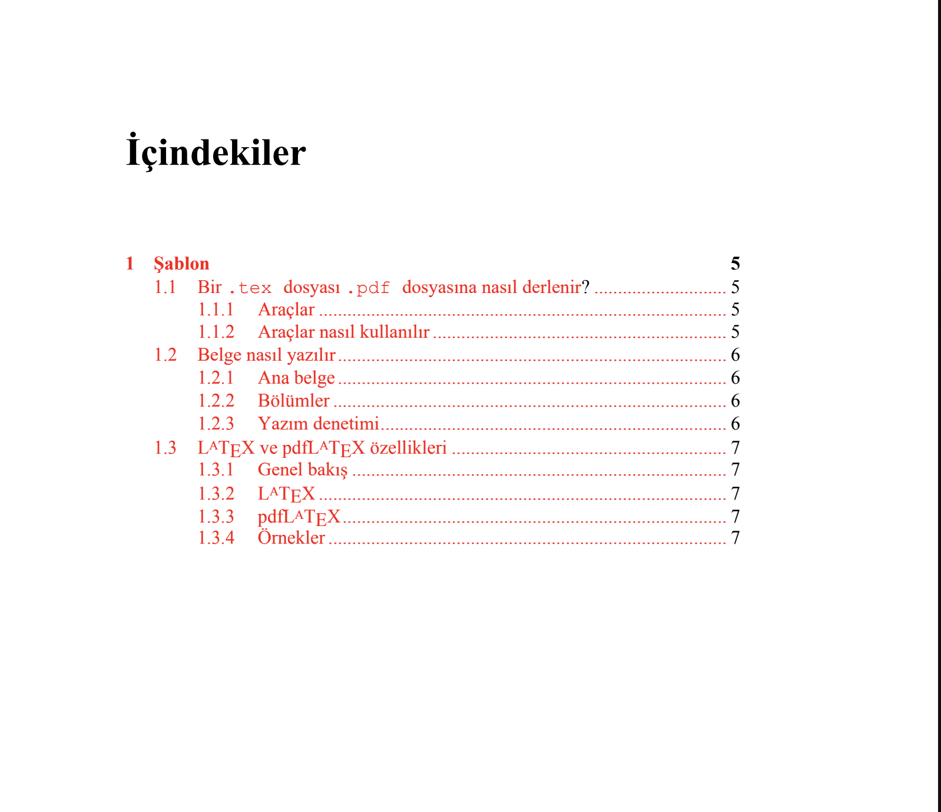
Translated PDF Document:

Slide 8
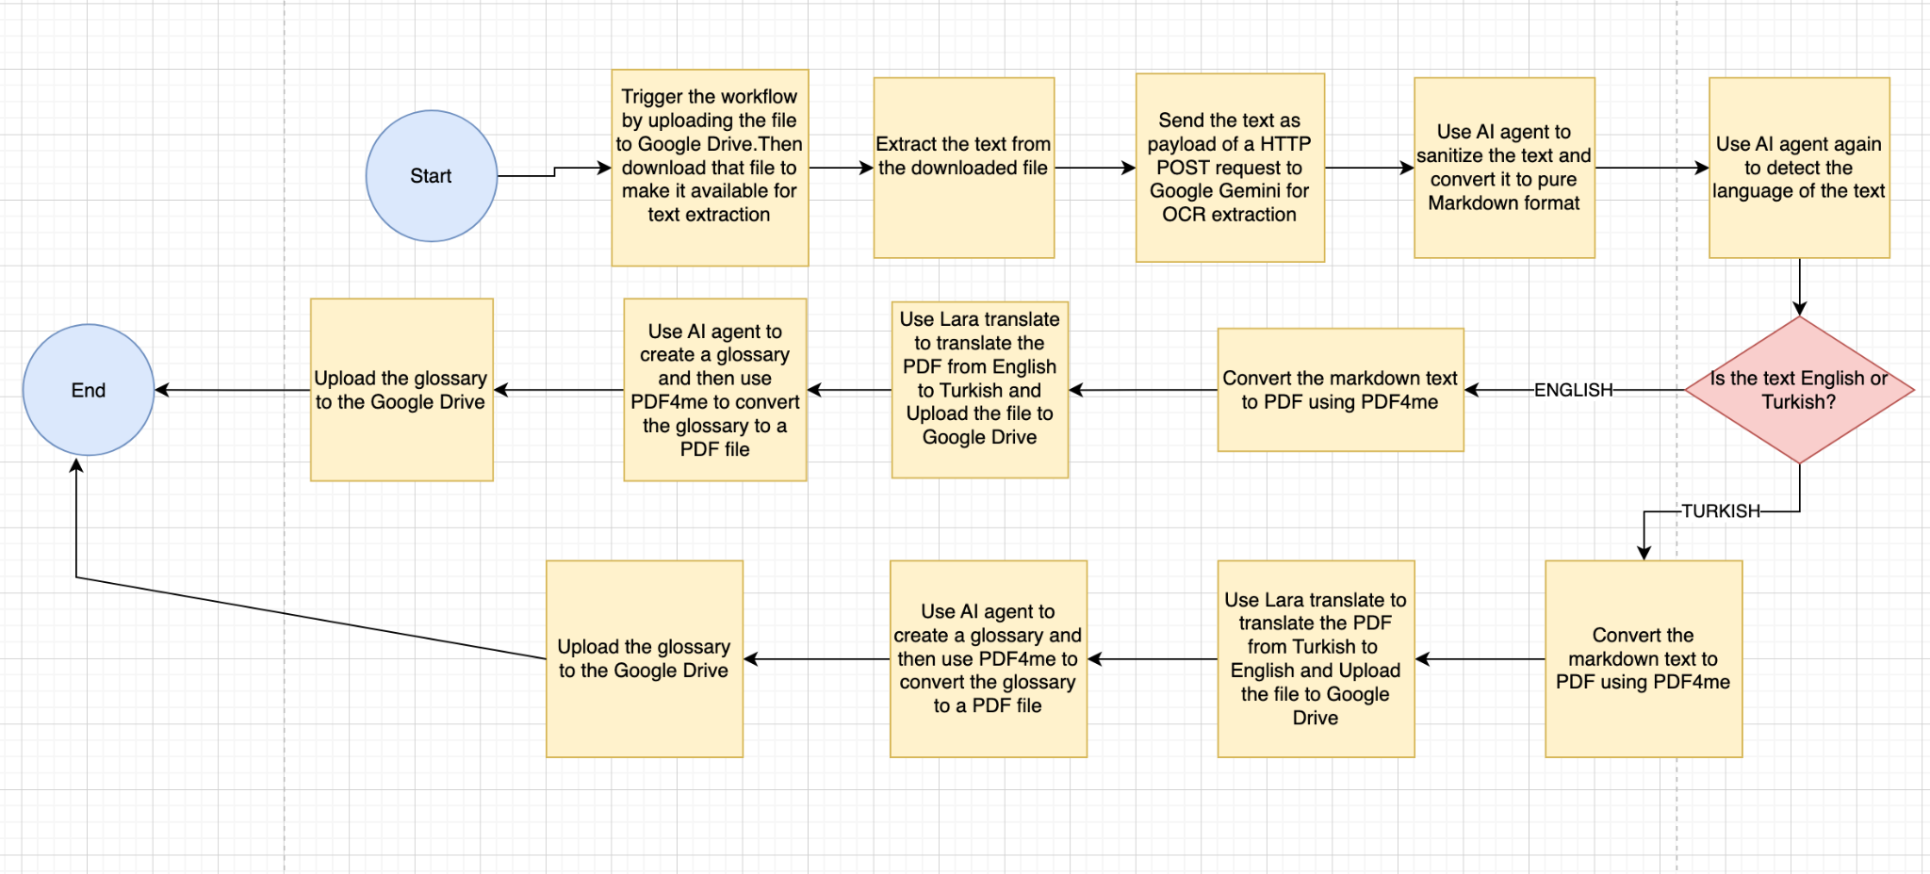
OCR Translation Flowchart

Slide 9
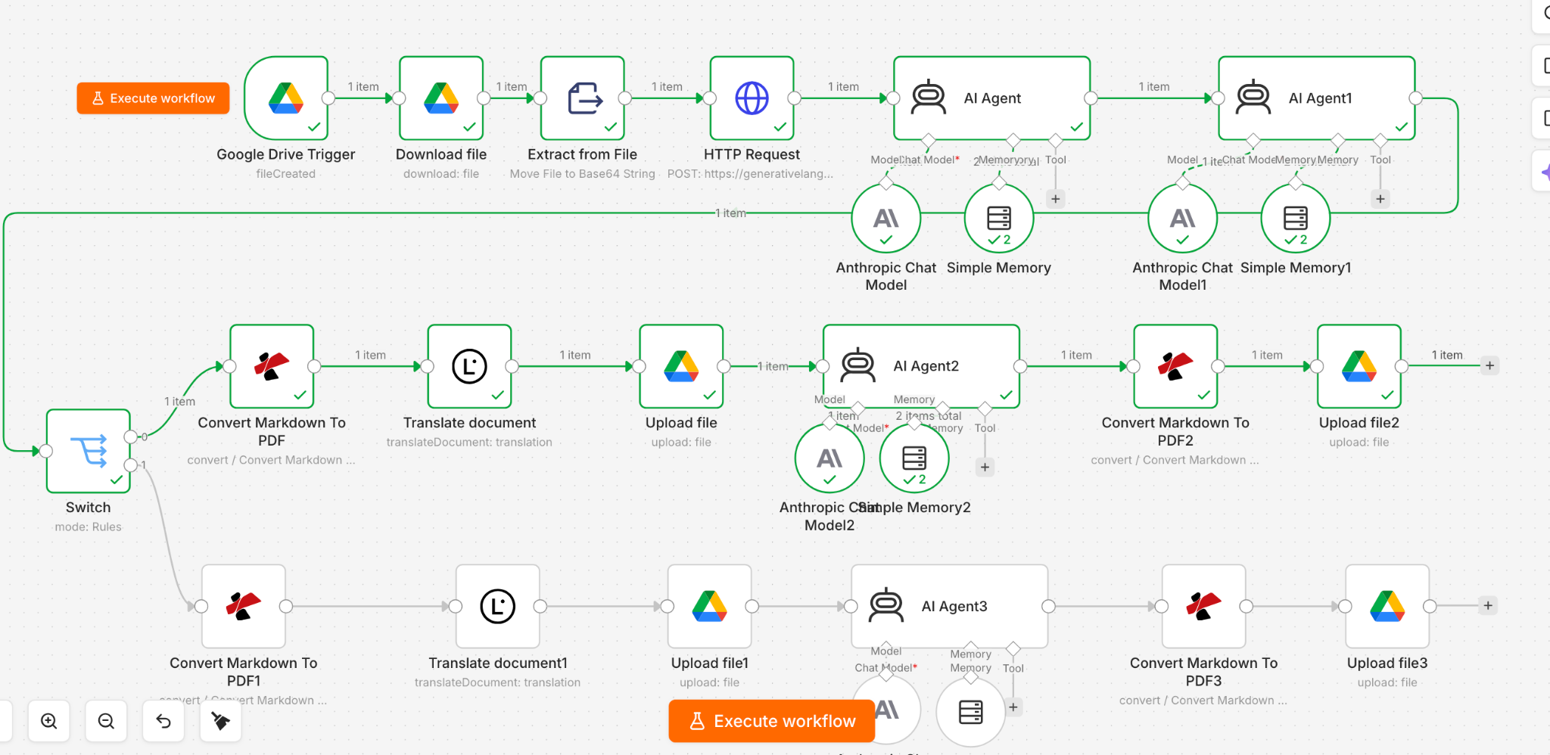
OCR Translation Workflow

Slide 10
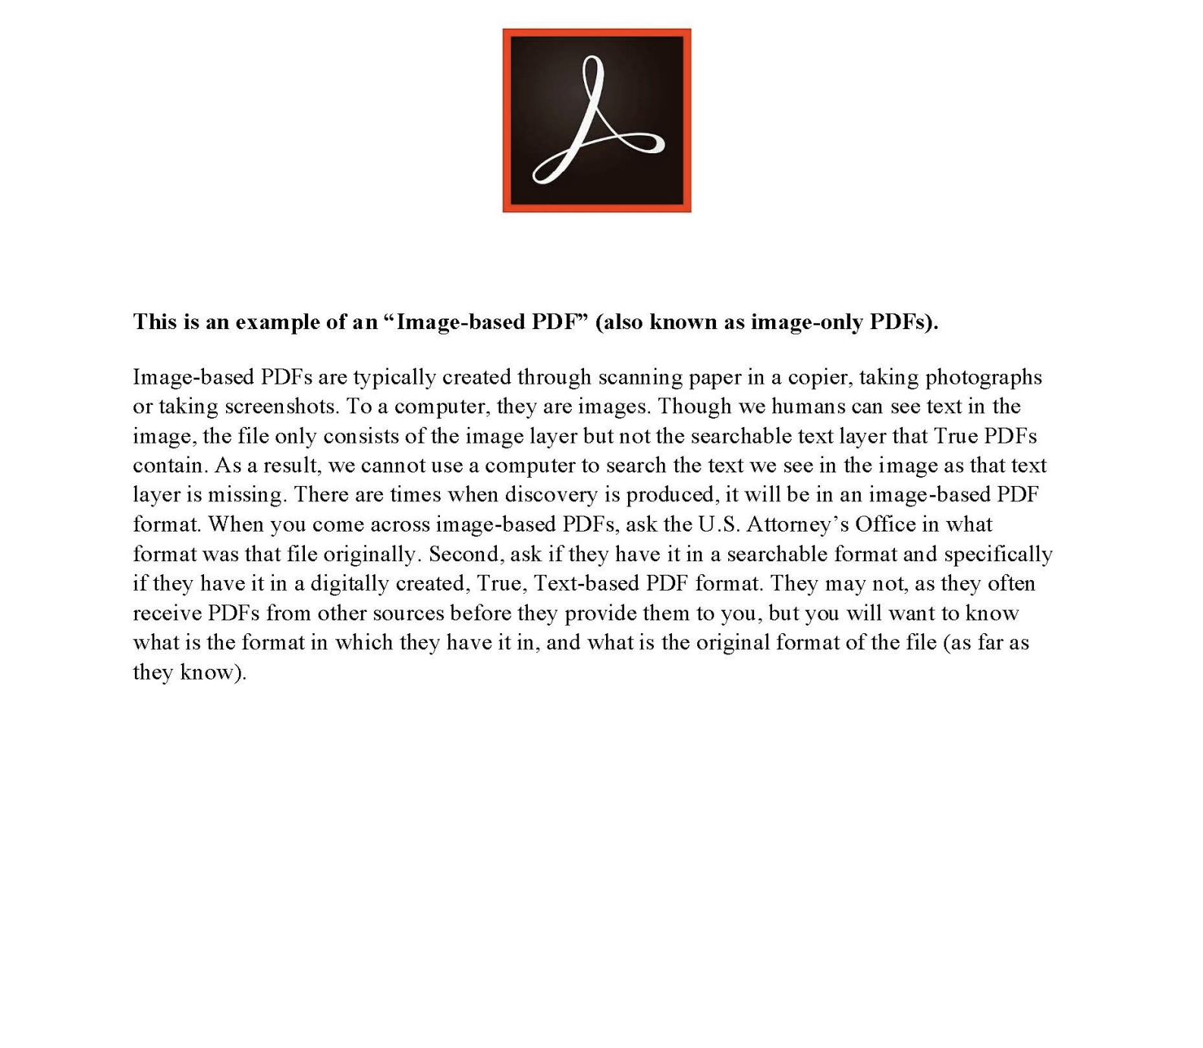
Original Image document:

Slide 11
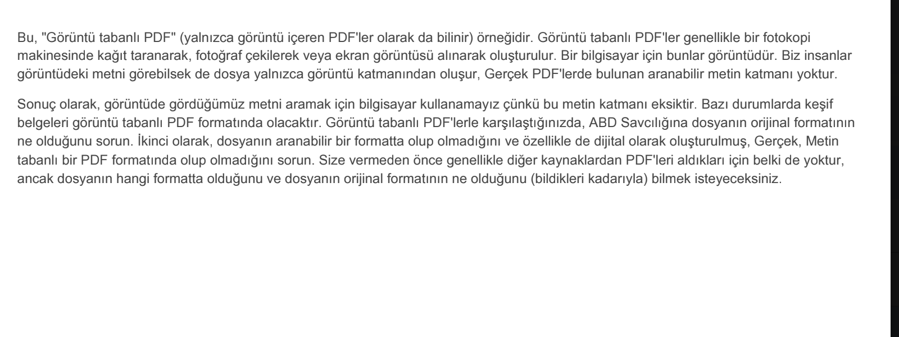
Translated Image document:

Slide 12
Example of the prompt written to sanitize the output text of the previous node to pure markdown and implement PII (check for Personally Identifiable Information) on the text data:
Here is the prompt:
You are an expert at formatting text into clean, organized Markdown.Please take the following raw text, remove all unnecessary line breaks, fix extra spaces, and format it using proper Markdown.
Also make sure to implement PII on the text. Replace the original name by [NAME], original email by [EMAIL],original social security number by [SSN] and original address by [ADD].
Remove the line "Here's the extracted content from the provided PDF:\n\n" from the text. Here is the text: {{ $json.candidates[0].content.parts[0].text }}
Give the resultant text as the final output.

Slide 13
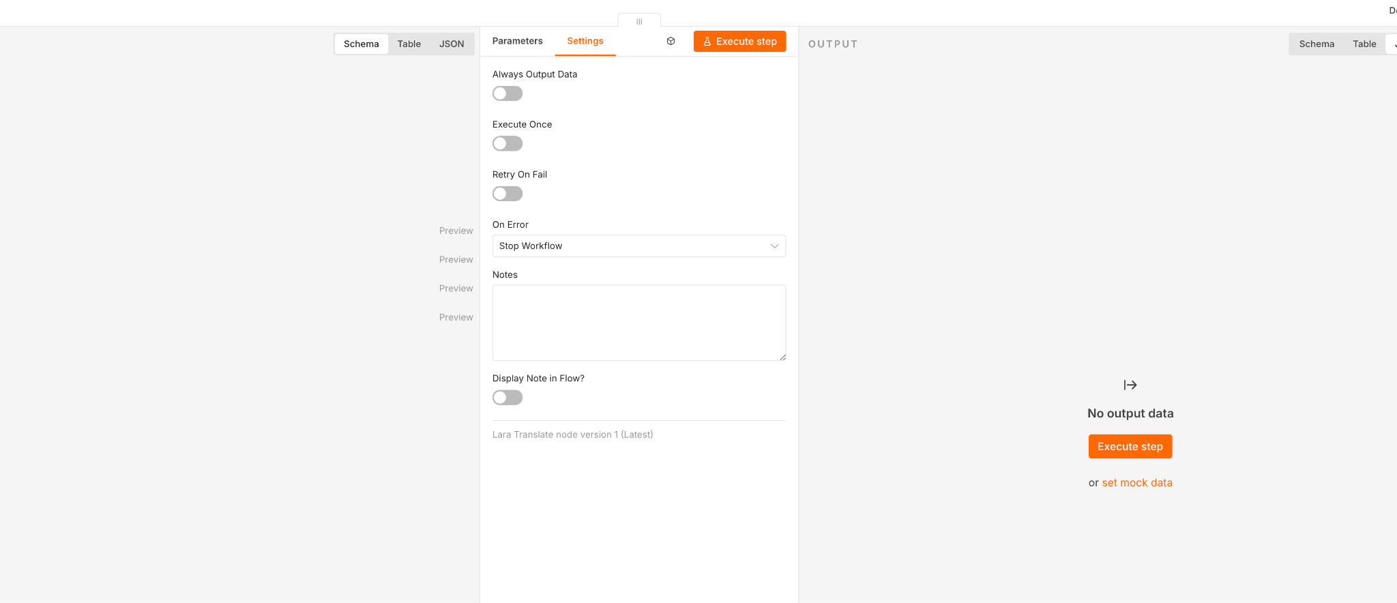
Example of Error Handling
Below is the example of Error handling done by the Lara translate node. If there is an error, the workflow stops:

Slide 14
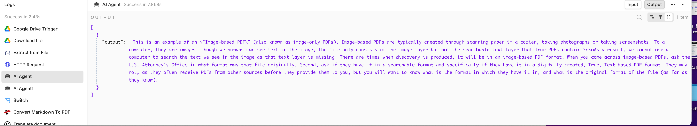
Example of Logging
Below is an example of Logging done by the AI agent node that cleans the data to make sure it’s pure markdown:

Slide 15
Description of Lara Translation API
Lara translate is a highly acclaimed app that integrates its API with n8n
Lara translate can translate almost all the major world languages.
The user only has to provide the original language and the target language
It has a Free to use edition with 60,000 characters/month limit
It has 3 paid editions
8 Euro/month Pro edition doing 500,000 characters/month with 0.25 Euros for the next 10,000 characters.
25 Euro/month Team edition(unlimited users) with 1.5 million characters/month with 0.20 Euros for the next 10,000 characters.
Enterprise plan with negotiable pricing.

Slide 16
Description of PDF4me API
PDF4me is a highly popular and reliable doc format converter
It converts files between various formats including PDF.
A free plan is available for limited use.
It offers the following paid plans:
$6 per month for Pro plan offering 100 automation calls/month
Negotiated Developer/Automation plans with higher limits

