Slide 1

DS PBL
Book Recommendation System
Omkar Sangrulkar PA6
Prajwal Rawoorkar PA32
Kunal Tilaganji PA51

Slide 2
Requirements:
Online book reading and selling websites like Kindle and Goodreads compete against each other on many factors. One of those important factors is their book recommendation system. A book recommendation system is designed to recommend books of interest to the buyer.
Purpose:
The purpose of a book recommendation system is to predict buyer’s interest and recommend books to them accordingly. A book recommendation system can take into account many parameters like book content and book quality by filtering user reviews. In the section below, I will introduce you to a machine learning project on the book recommendation system using Python. For this project we have taken the data from GOOD_READ BOOKS, a data set which consists of approximately 11,128 books.

Slide 3

Tools Used:
Pandas:
pandas is a fast, powerful, flexible and easy to use open source data analysis and manipulation tool.
built on top of the Python programming language.
NumPy:
NumPy is a Python library used for working with arrays.
It also has functions for working in domain of linear algebra, Fourier transform, and matrices.
NumPy was created in 2005 by Travis Oliphant. It is an open source project and you can use it freely.
NumPy stands for Numerical Python.
Seaborn:
Seaborn is a Python data visualization library based on matplotlib.
Provides a high-level interface for drawing attractive and informative statistical graphics.

Slide 4
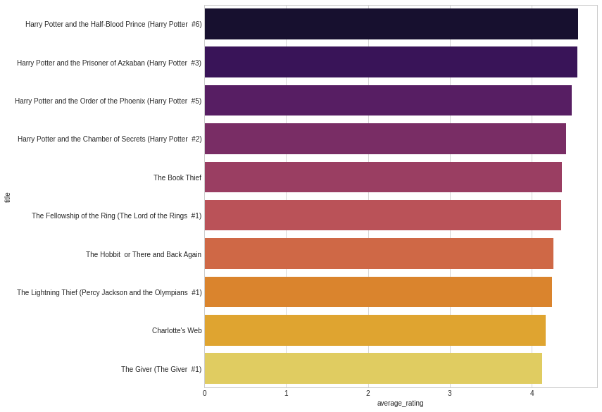
Data Exploration:
The results show us the top 10 books in our data.
Max score in our data was 5.0 but we don’t see any books in the above result with a score of 5.0.
We have filtered these books according to the number of notes. We’ve made sure that all of the books we have in the above results have a decent rating. There may be books in the data that may have only 1 or 2 notes may be rated 5.0. We want to avoid such books, which is why we used this type of filtering.

Slide 5
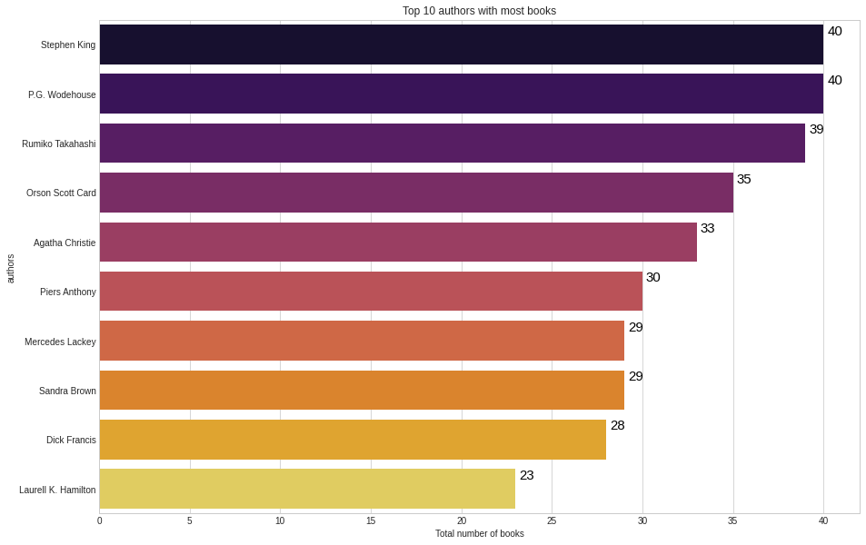
Data Exploration:
Stephen King and P.G. Wodehouse have the most books in the data.
Both authors have 40 books in our dataset followed by Rumiko Takahashi and Orson Scott Card.

Slide 6
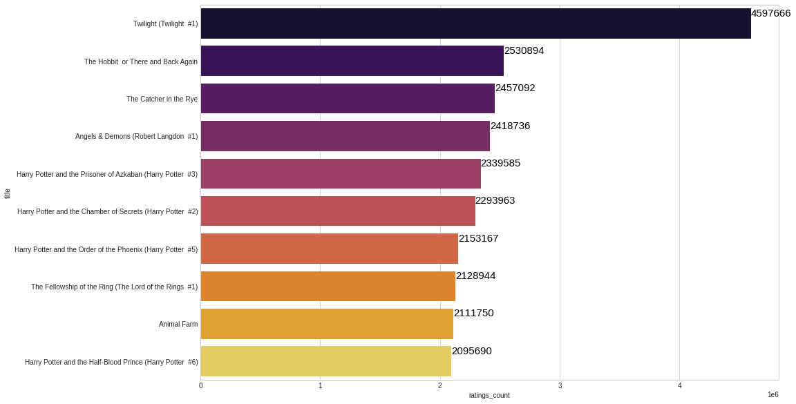
Data Exploration:
Twilight has been reviewed over 4 million times, followed by The Hobbit or There and Back Again and The Catcher in the Rye which has been reviewed over 2 million times.

Slide 7
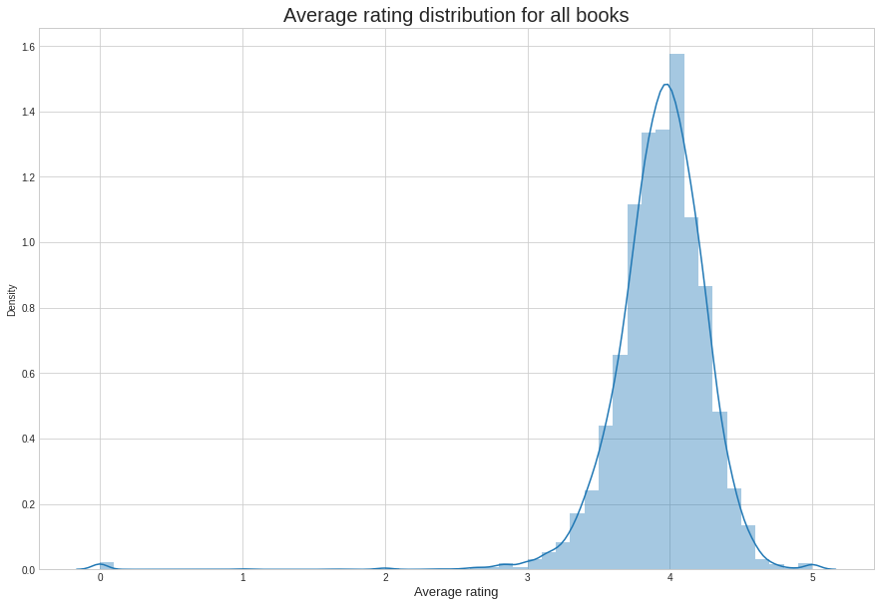
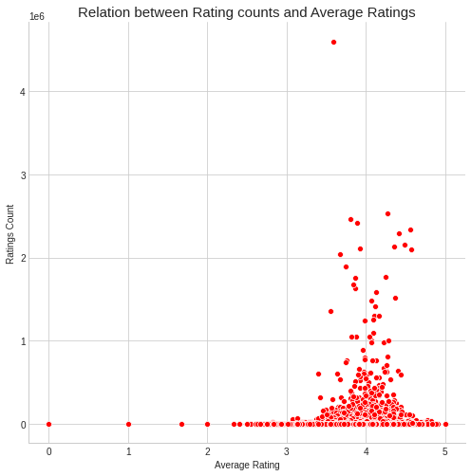
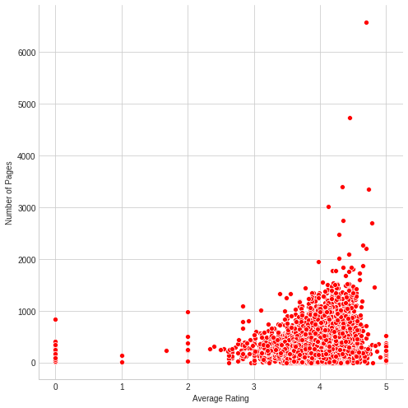
Data Exploration:
Average Rating Distribution for all books
Relation between Rating counts and Average Ratings
Average Rating
After comparing the average rating with the different columns, we can continue to use the language and number of ratings for our recommendation system.

Slide 8
Data Preparation:
create a new column called ‘rating_between’. We will divide our average rating column into different categories such as rating between 0 and 1, 1 and 2, etc. This will work as one of the features that we will build into our model so that it can make better predictions.
create two new Data Frames containing the different values of the rating_between column that we have just created. We will assign a value of 1 if one grade falls under a particular group, say 4 and 5, and the others will be assigned a value of 0.
use the Min-Max scaler to reduce these values. This will help reduce the bias for some of the books that have too many features. The algorithm will find the median for all and equalize it.
reduced the features and we now can use the KNN algorithm to build our Book Recommendation system with Machine Learning using Python
create a function using Python. When this function is called, we will have to pass the name of the book to it. The model will try to find books based on the features. We’ll store those book names that the system recommends in a list and return them at the end:

Slide 9
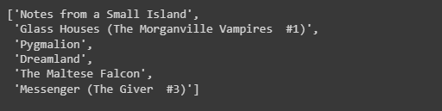
Final Output:
In the slides below we have provided a visualized table of how our data looks like, using the tableau software.

Slide 10
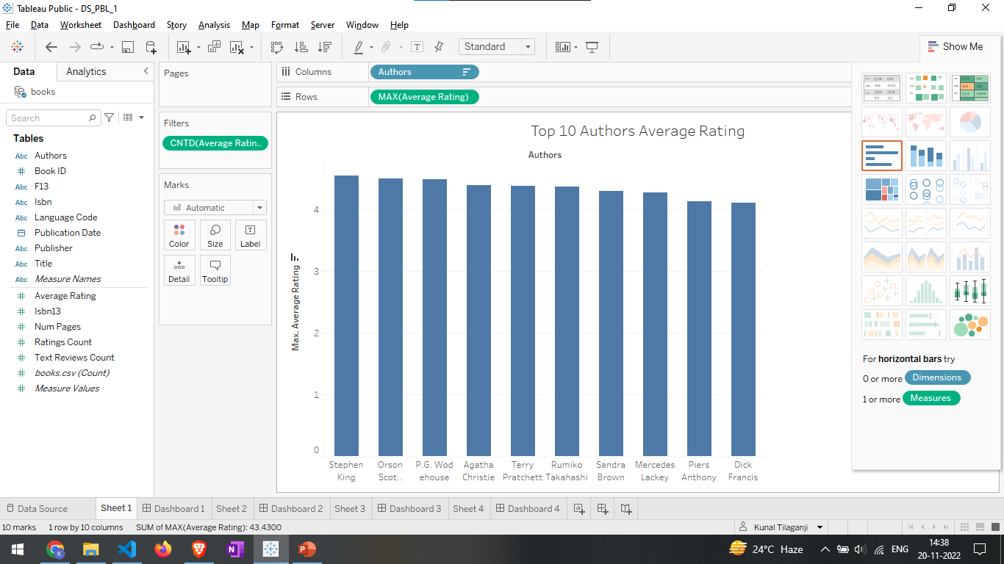
TABLEAU DASHBOARDS

Slide 11
TABLEAU DASHBOARDS

