Slide 1
Recap: Lecture 30, 27th March 2014, 0930-1030 hrs.
Carnot vapour cycle
Rankine cycle
Simple Rankine cycle
Processes in the cycle
Improving cycle performance

Slide 2
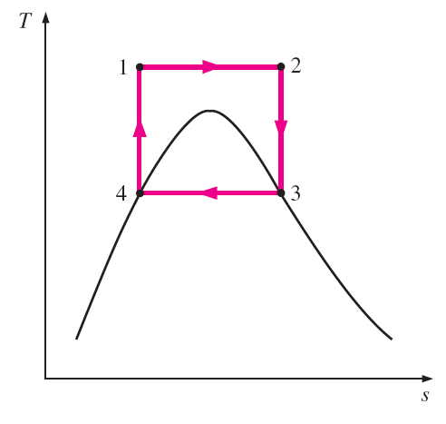
Case 2: Carnot cycle partially outside the saturation dome

Slide 3
Isentropic compression to extremely high pressures → difficult to achieve
Not possible to have isothermal heat transfer at variable pressures.
Therefore Carnot cycle cannot form a realistic model for vapour power cycles.
The ideal cycle for vapour is the Rankine cycle.

Slide 4
Rankine cycle
Rankine cycle is the ideal cycle for vapour power cycles.
The ideal Rankine cycle does not involve any internal irreversibilities.
The ideal cycle consists of the following:
1-2 Isentropic compression in a pump
2-3 Constant pressure heat addition in a boiler
3-4 Isentropic expansion in a turbine
4-1 Constant pressure heat rejection in a condenser

Slide 5
Rankine cycle
T
3
q_{in}
W_{turb,out}
2
1
W_{pump,in}
4
q_{out}
s
The ideal Rankine cycle

Slide 6
Rankine cycle
All the components are steady flow systems.
The energy balance for each sub-system can be expressed as:

Slide 7
Rankine cycle
The thermal efficiency of the ideal Rankine cycle under the cold air standard assumptions becomes:

Slide 8
Rankine cycle
Rankine cycles can also be operated with reheat and regeneration.
The average temperature during the reheat process can be increased by increasing the number of expansion and reheat stages.
A Rankine cycle with reheat and regeneration offer substantially higher efficiencies as compared to a simple Rankine cycle.

Slide 9
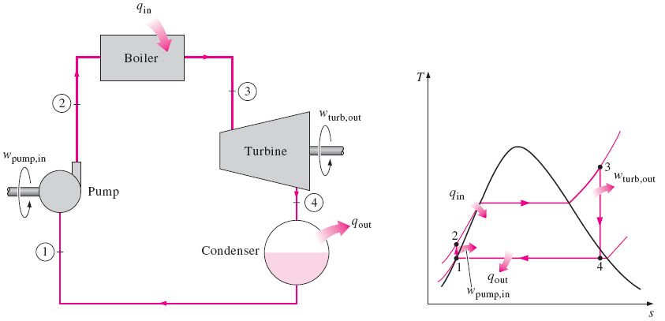
Simple Rankine cycle

Slide 10
Improving efficiency of Rankine cycle
Lowering the condenser pressure
Superheating the steam to high temperatures
Increasing the boiler pressure
Reheating, intercooling and regeneration

Slide 11
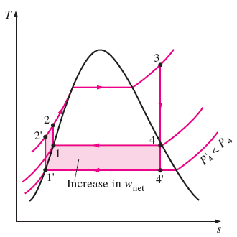
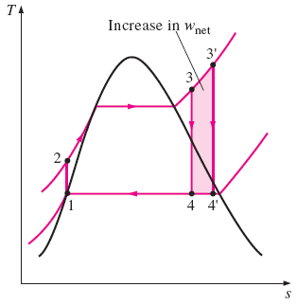
The effect of lowering the condenser pressure on the ideal Rankine cycle.
The effect of superheating the steam to higher temperatures on the ideal
Rankine cycle.

Slide 12
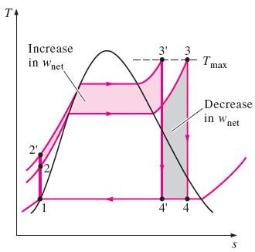
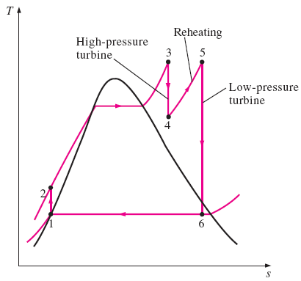
The effect of increasing the boiler
pressure on the ideal Rankine cycle.
The ideal reheat Rankine cycle.

Slide 13
Actual/Real Brayton cycle
Actual Brayton cycles differ from the ideal cycles in all the four processes.
The compression process and expansion processes are non-isentropic.
Pressure drop during heat addition and heat rejection.
The presence of irreversibilities causes the above deviations.

Slide 14
Actual/Real Brayton cycle
Pressure drop
T
3
q_{in}
2a
4s
4a
2s
q_{out}
1
s
Actual Brayton cycle T-s diagram

Slide 15
Actual/Real Brayton cycle
The deviation of actual compressors and turbines from the isentropic versions can be accounted for by using the isentropic efficiencies.
Where, 2a and 4a are the actual states at the compressor and turbine exit and 2s and 4s are the corresponding isentropic states.

Slide 16
Actual/Real Brayton cycle
As a result of non-isentropic compression and expansion, the compressor needs more work than the ideal cycle and turbine generates less work.
Isentropic efficiencies reflect the amount of deviation of the actual compression/expansion processes from the ideal.
Total pressure losses in the heat addition/rejection processes also need to be considered.

Slide 17
Actual/Real Brayton cycle
Other differences between ideal and actual Brayton cycles
Change of specific heats with temperature
Heat exchanger effectiveness (in case of regenerative cycles)
Mass flow rate of fuel
Combustion efficiency
These parameters are often used in actual cycle analysis.

Slide 18
Actual/Real Brayton cycle
Variants of the simple Brayton cycle
Reheating
Intercooling
Regeneration
Actual cycles with the above will be different from the ideal cycles in terms of the irreversibilities present.
Isentropic efficiencies, total pressure losses, heat exchanger effectiveness for each additional components of the cycle.

Slide 19
Actual/Real Brayton cycle
Actual Brayton cycle with intercooling
Isentropic efficiencies of each stage of intercooling
Heat exchanger effectiveness of the intercooling duct
Actual Brayton cycle with reheating
Isentropic efficiencies of each stage of reheating
Total pressure loss and combustion efficiency during reheating

Slide 20
Actual/Real Brayton cycle
Actual Brayton cycle with regeneration
Heat exchanger effectiveness
Actual Brayton cycle with all three of these modifications need to be analysed considering the above discussed irreversibilities.

Slide 21
Ideal Jet Propulsion cycles
Slightly different from the ideal Brayton cycle
Gases are not completely expanded in a turbine
Partly in turbine and remainder in nozzle
Net work output of the jet propulsion cycle is zero
thrust developed in a turbojet engine is the unbalanced force that is caused by the difference in the momentum of the low-velocity air entering the engine and the high-velocity exhaust gases leaving the engine

Slide 22
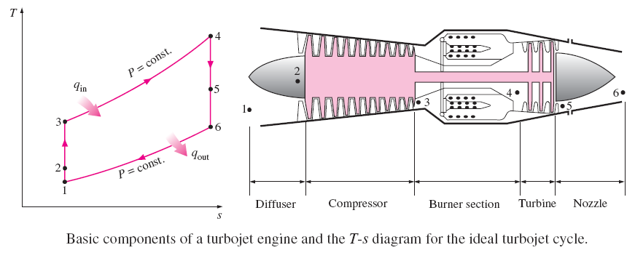

Slide 23
Types of jet engines
Ramjet:
Mach number range 1.5-3.0,
Application: Military
Scramjet:
Mach 3.0-10.0
Application: Military, civil
Turbojet:
Mach 0-2.5
Application: Military, civil?
Turbofan:
Mach 0-0.85
Application: Civil, military?
Turboprop:
Mach 0-0.75
Application Civil, military
Turboshaft:
Mach 0-0.55
Application: Civil, military

Slide 24
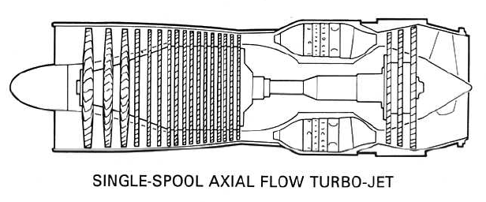
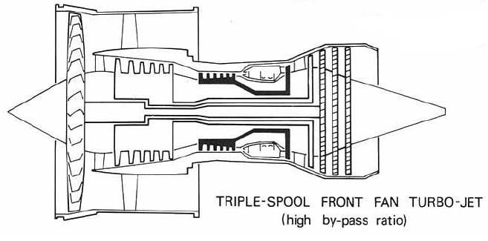

Slide 25
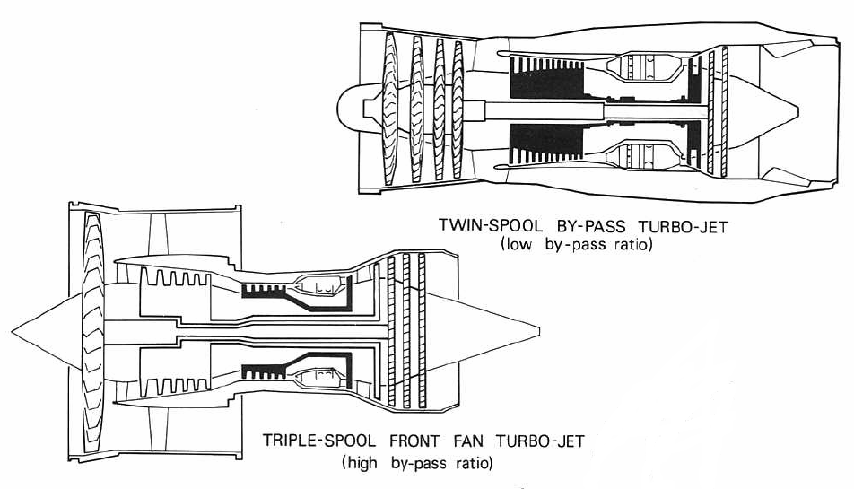

Slide 26
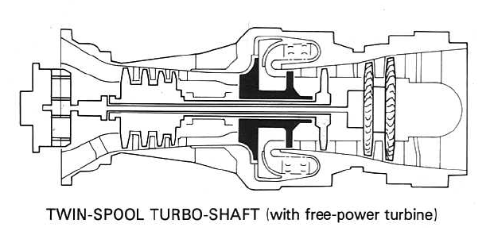

Slide 27
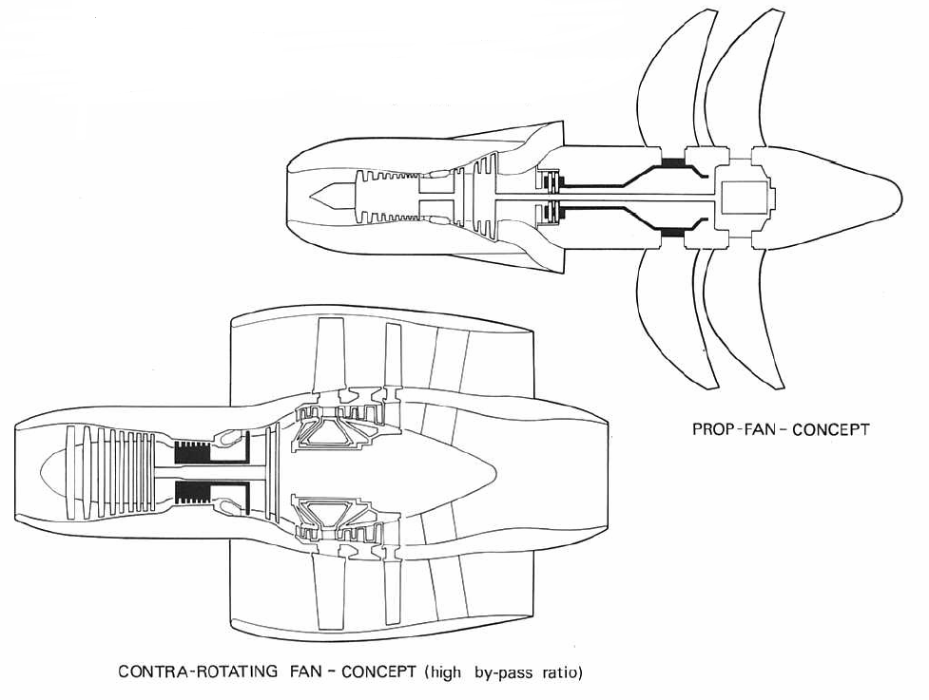

Slide 28
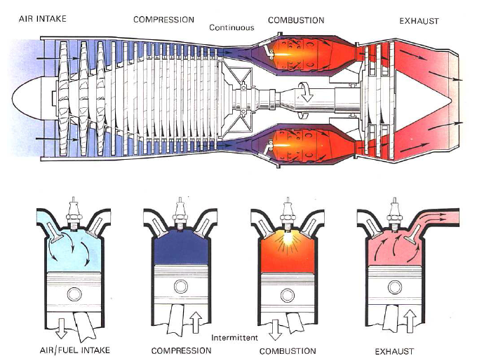
A Comparison between gas turbine engine and a piston engine

Slide 29
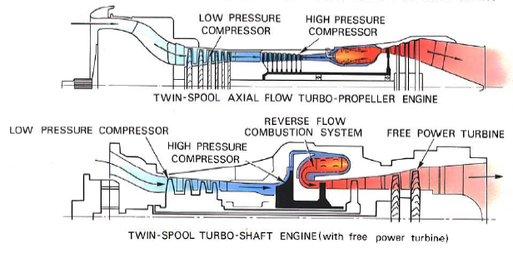
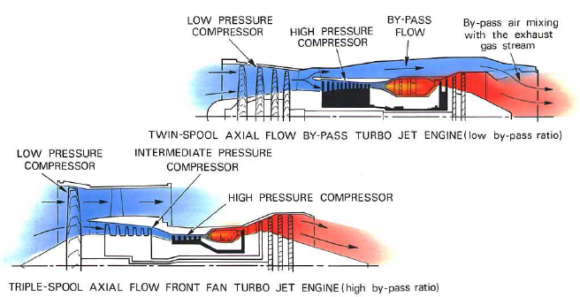

Slide 30
Gas turbine cycles
Gas turbine engines operate on Brayton cycles.
Ideal Brayton cycle is a closed cycle, whereas gas turbines operate in the open cycle mode.
Ideal cycle assumes that there are no irreversibilities in the processes, air behaves like an ideal gas with constant specific heats, and that there are no frictional losses.

Slide 31
Thrust and efficiency
We will now derive expressions for thrust and efficiency of air-breathing engines from the momentum and energy equations.
We shall consider a generalized thrust producing device with a single inlet and single exhaust.
We assume that the thrust and conditions at all points within the control volume do not change with time.

Slide 32
The thrust equation
Control surface
(Reaction)
u
A_{i}
A_{e}
u, Pa
u_{e}
A_{e}, P_{e}
Thrust producer
u
y
1
2
x

Slide 33
The thrust equation
The reaction to the thrust, , is transmitted to the support. The engine thrust is thus the vector summation of all forces on the internal and external surfaces of the engine.
Therefore,
Considering the components of force and the momentum flux in the x-direction only,

Slide 34
The thrust equation
The pressure and velocity can be assumed to be constant over the entire control surface, except over the exhaust area, A_{e}.
The net pressure force acting on this control volume is (P_{a}–P_{e})A_{e}.
The only other force acting on the control volume is the reaction to the thrust, .
Adding up the forces in the x-direction,

Slide 35
The thrust equation
The mass flow that enters the capture area, A_{i}, is
Similarly, the mass flow crossing the exhaust area A_{e}, is,
Also,
Or,
Continuity equation for the CV gives,

Slide 36
The thrust equation
From the momentum balance across the CV,
This is the net outward flux of x-momentum.
This equation reduces to
From the force balance equation, we have,

Slide 37
The thrust equation
If we define fuel-air ratio,
This is the generalised thrust equation for air-breathing engines.
The term (P_{e}–P_{a})A_{e} is not zero only if the exhaust jet is supersonic and the nozzle does not expand the exhaust jet to ambient pressure.
However if P_{a} « P_{e}, it can be substantial contribution.

