Slide 1
Recap: Lecture 32, 2nd April 2014, 0830-0930 hrs.
Actual/real Brayton cycle
Compressor and turbine efficiencies
Variants of Brayton cycle
Ideal jet propulsion cycles
Types of jet engines
Gas turbine cycles

Slide 2
Types of jet engines
Ramjet:
Mach number range 1.5-3.0,
Application: Military
Scramjet:
Mach 3.0-10.0
Application: Military, civil
Turbojet:
Mach 0-2.5
Application: Military, civil?
Turbofan:
Mach 0-0.85
Application: Civil, military?
Turboprop:
Mach 0-0.75
Application Civil, military
Turboshaft:
Mach 0-0.55
Application: Civil, military

Slide 3
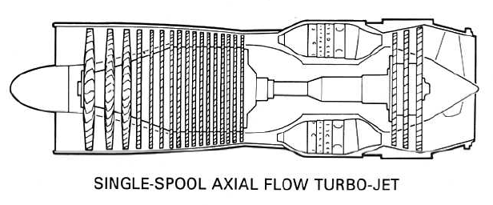
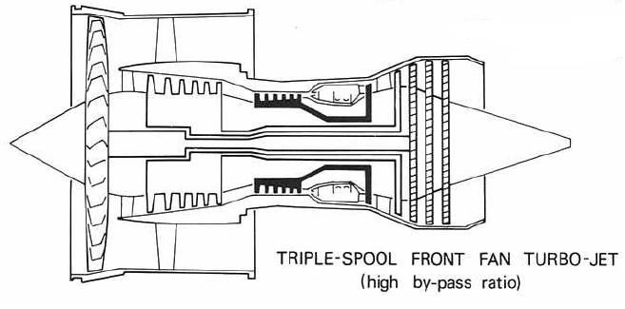

Slide 4
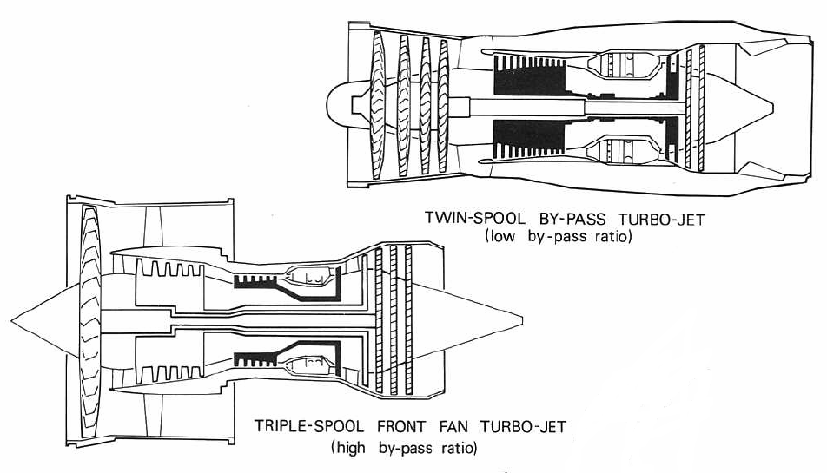

Slide 5
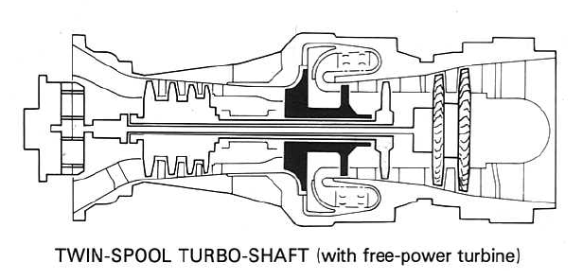

Slide 6
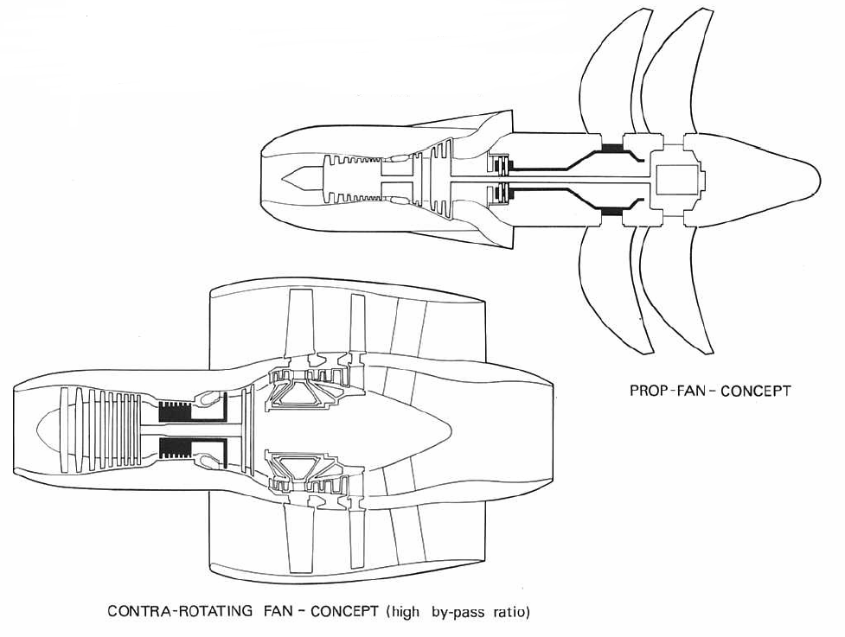

Slide 7
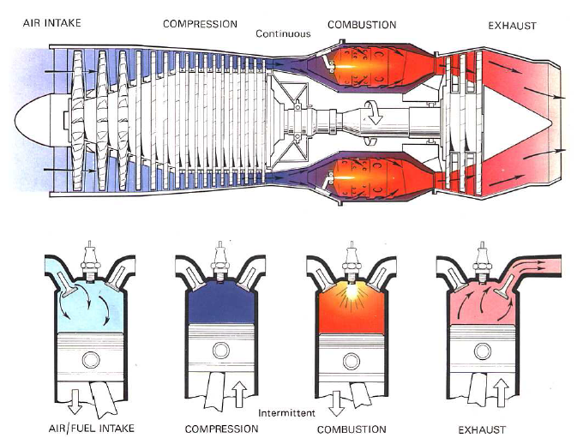
A Comparison between gas turbine engine and a piston engine

Slide 8
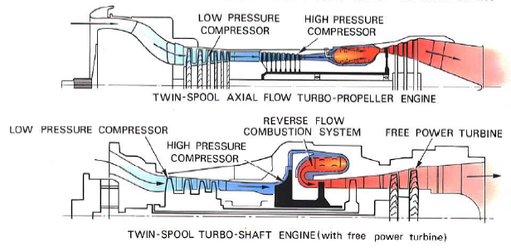
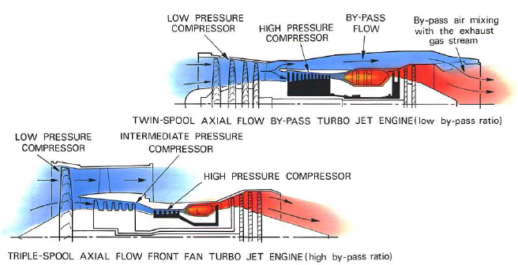

Slide 9
Gas turbine cycles
Gas turbine engines operate on Brayton cycles.
Ideal Brayton cycle is a closed cycle, whereas gas turbines operate in the open cycle mode.
Ideal cycle assumes that there are no irreversibilities in the processes, air behaves like an ideal gas with constant specific heats, and that there are no frictional losses.

Slide 10
Thrust and efficiency
We will now derive expressions for thrust and efficiency of air-breathing engines from the momentum and energy equations.
We shall consider a generalized thrust producing device with a single inlet and single exhaust.
We assume that the thrust and conditions at all points within the control volume do not change with time.

Slide 11
The thrust equation
Control surface
(Reaction)
u
A_{i}
A_{e}
u, Pa
u_{e}
A_{e}, P_{e}
Thrust producer
u
y
1
2
x

Slide 12
The thrust equation
The reaction to the thrust, , is transmitted to the support. The engine thrust is thus the vector summation of all forces on the internal and external surfaces of the engine.
Therefore,
Considering the components of force and the momentum flux in the x-direction only,

Slide 13
The thrust equation
The pressure and velocity can be assumed to be constant over the entire control surface, except over the exhaust area, A_{e}.
The net pressure force acting on this control volume is (P_{a}–P_{e})A_{e}.
The only other force acting on the control volume is the reaction to the thrust, .
Adding up the forces in the x-direction,

Slide 14
The thrust equation
The mass flow that enters the capture area, A_{i}, is
Similarly, the mass flow crossing the exhaust area A_{e}, is,
Also,
Or,
Continuity equation for the CV gives,

Slide 15
The thrust equation
From the momentum balance across the CV,
This is the net outward flux of x-momentum.
This equation reduces to
From the force balance equation, we have,

Slide 16
The thrust equation
If we define fuel-air ratio,
This is the generalised thrust equation for air-breathing engines.
The term (P_{e}–P_{a})A_{e} is not zero only if the exhaust jet is supersonic and the nozzle does not expand the exhaust jet to ambient pressure.
However if P_{a} « P_{e}, it can be substantial contribution.

Slide 17
Gas turbine cycles
Gas turbine engines operate on Brayton cycles.
Ideal Brayton cycle is a closed cycle, whereas gas turbines operate in the open cycle mode.
Ideal cycle assumes that there are no irreversibilities in the processes, air behaves like an ideal gas with constant specific heats, and that there are no frictional losses.

Slide 18
Thrust and efficiency
We will now derive expressions for thrust and efficiency of air-breathing engines from the momentum and energy equations.
We shall consider a generalized thrust producing device with a single inlet and single exhaust.
We assume that the thrust and conditions at all points within the control volume do not change with time.

Slide 19
The thrust equation
Control surface
(Reaction)
u
A_{i}
A_{e}
u, Pa
u_{e}
A_{e}, P_{e}
Thrust producer
u
y
1
2
x

Slide 20
The thrust equation
The reaction to the thrust, , is transmitted to the support. The engine thrust is thus the vector summation of all forces on the internal and external surfaces of the engine.
Therefore,
Considering the components of force and the momentum flux in the x-direction only,

Slide 21
The thrust equation
The pressure and velocity can be assumed to be constant over the entire control surface, except over the exhaust area, A_{e}.
The net pressure force acting on this control volume is (P_{a}–P_{e})A_{e}.
The only other force acting on the control volume is the reaction to the thrust, .
Adding up the forces in the x-direction,

Slide 22
The thrust equation
The mass flow that enters the capture area, A_{i}, is
Similarly, the mass flow crossing the exhaust area A_{e}, is,
Also,
Or,
Continuity equation for the CV gives,

Slide 23
The thrust equation
From the momentum balance across the CV,
This is the net outward flux of x-momentum.
This equation reduces to
From the force balance equation, we have,

Slide 24
The thrust equation
If we define fuel-air ratio,
This is the generalised thrust equation for air-breathing engines.
The term (P_{e}–P_{a})A_{e} is not zero only if the exhaust jet is supersonic and the nozzle does not expand the exhaust jet to ambient pressure.
However if P_{a} « P_{e}, it can be substantial contribution.

Slide 25
Engine performance parameters
The engine performance is described by different efficiency definitions, thrust and the fuel consumption.
The efficiency definitions that we shall now be discussing are applicable to an engine with a single propellant stream (turbojets or ramjets).
For other types of jet engines (turbofan, turboprop) the equations need to be appropriately modified.

Slide 26
Engine performance parameters
Propulsion efficiency: The ratio of thrust power to the rate of production of propellant kinetic energy.
If we assume that f«1 and the pressure thrust term is negligible,

Slide 27
Engine performance parameters
Thermal efficiency: The ratio of the rate of production of propellant kinetic energy to the total energy consumption rate
For a turboprop or turboshaft engine, the output is largely shaft power. In this case,

Slide 28
Engine performance parameters
Overall efficiency: The product of thermal efficiency and propulsion efficiency.
In the case of aircraft that generate thrust using propellers,

Slide 29
Engine performance parameters
Thrust specific fuel consumption, TSFC
For turbine engines that produce shaft power, brake specific fuel consumption, BSFC
For engine (like turboprop) that produce both, equivalent brake specific fuel consumption,

Slide 30
Ideal cycle for jet engines
All air-breathing jet engines operate on the Brayton cycle (open cycle mode).
The most basic form of a jet engine is a turbojet engine.
Some of the parameters of a jet engine cycle are usually design parameters and hence often fixed a priori: eg. compressor pressure ratio, turbine inlet temperature etc.
Cycle analysis involves determining the performance parameters of the cycle with the known design parameters.

Slide 31
Ideal cycle for jet engines
Combustion chamber/burner
Diffuser
Compressor
Turbine
Nozzle
a
1
2
3
4
5
6
7
Afterburner
Schematic of a turbojet engine and station numbering scheme

Slide 32
Ideal cycle for jet engines
The different processes in a turbojet cycle are the following:
a-1: Air from far upstream is brought to the air intake (diffuser) with some acceleration/deceleration
1-2: Air is decelerated as is passes through the diffuser
2-3: Air is compressed in a compressor (axial or centrifugal)
3-4 The air is heated using a combustion chamber/burner

Slide 33
Ideal cycle for jet engines
4-5: The air is expanded in a turbine to obtain power to drive the compressor
5-6: The air may or may not be further heated in an afterburner by adding further fuel
6-7: The air is accelerated and exhausted through the nozzle.

Slide 34
Ideal cycle for jet engines
4
T
5
3
7
2
a
s
Ideal turbojet cycle (without afterburning) on a T-s diagram

Slide 35
Ideal cycle for jet engines
For cycle analysis we shall take up each component and determine the exit conditions based on known inlet parameters.
Intake: Ambient pressure, temperature and Mach number are known, P_{a}, T_{a} and M
Intake exit stagnation temperature and pressure are determined from the isentropic relations:

Slide 36
Ideal cycle for jet engines
Compressor: Let the known compressor pressure ratio be denoted as
Combustion chamber: From energy balance,
Hence, we can determine the fuel-air ratio.

Slide 37
Ideal cycle for jet engines
Turbine: Since the turbine produces work to drive the compressor, W_{turbine} = W_{compressor}

Slide 38
Ideal cycle for jet engines
Nozzle: With no afterburner, T₀₆=T₀₅, P₀₆=P₀₅
Thrust, TSFC and efficiencies can now be determined using the formulae derived earlier.

Slide 39
Ideal cycle for jet engines
Thrust,
Propulsion efficiency,
Thermal efficiency,

Slide 40
Ideal cycle for jet engines
6a
T
4
5, 6
7a
3
2
a
s
Ideal turbojet cycle with afterburning on a T-s diagram

Slide 41
Ideal cycle for jet engines
Afterburning: used when the aircraft needs a substantial increment in thrust. For eg. to accelerate to and cruise at supersonic speeds.
Since the air-fuel ratio in gas turbine engines are much greater than the stoichiometric values, there is sufficient amount of air available for combustion at the turbine exit.
There are no rotating components like a turbine in the afterburner, the temperatures can be taken to much higher values than that at turbine entry.

Slide 42
Ideal cycle for jet engines
For calculating the fuel flow rate required to achieve a temperature of T_{6a}, we carry out an energy balance,

Slide 43
Turbofan engine
Propulsion efficiency is a function of the exhaust velocity to flight speed ratio.
This can be increased by reducing the effective exhaust velocity.
In a turbofan engine, a fan of a larger diameter than the compressor is used to generate a mass flow higher than the core mass flow.
This ratio is called the bypass ratio.
Turbofan engines have a higher propulsion efficiency as compared with turbojet engines operating in the same speed range.

Slide 44
Ideal turbofan engine
2’
3’
7’
Secondary
nozzle
Diffuser
Fan
Combustion chamber/burner
Compressor
Turbine
Primary nozzle
a
1
2
3
4
5
6
7
Schematic of an unmixed turbofan engine and station numbering scheme

Slide 45
Ideal turbofan engine
2’
3’
7’
Diffuser
Nozzle
Fan
Combustion chamber/burner
Compressor
Turbine
a
1
2
3
4
5
6
7
Schematic of a mixed turbofan engine and station numbering scheme

Slide 46
Ideal turbofan engine
The different processes in an unmixed turbofan cycle are the following:
a-1: Air from far upstream is brought to the air intake (diffuser) with some acceleration/deceleration
1-2’: Air is decelerated as is passes through the diffuser
2’-3’: Air is compressed in a fan
2-3: Air is compressed in a compressor (axial or centrifugal)

Slide 47
Ideal turbofan engine
3-4 The air is heated using a combustion chamber/burner
4-5: The air is expanded in a turbine to obtain power to drive the compressor
5-6: The air may or may not be further heated in an afterburner by adding further fuel
6-7: The air is accelerated and exhausted through the primary nozzle.
3’-7’: The air in the bypass duct is accelerated and expanded through the secondary nozzle.

Slide 48
Ideal turbofan engine
A turbofan engine can have different configurations: Twin-spool, three-spool, and geared turbofan. These may be either unmixed or mixed.
Cycle analysis of a turbofan can hence be slightly different depending upon the configuration of the engine.
We shall now carry out an ideal cycle analysis of an unmixed twin-spool turbofan engine.
Subsequently we shall also discuss the mixed version of the engine.

Slide 49
Ideal turbofan engine
Intake: Ambient pressure, temperature and Mach number are known, P_{a}, T_{a} and M
Intake exit stagnation temperature and pressure are determined from the isentropic relations:
Fan: Fan pressure ratio is known,

Slide 50
Ideal turbofan engine
Compressor: Let the known compressor pressure ratio be denoted as
Combustion chamber: From energy balance,
Hence, we can determine the fuel-air ratio.

Slide 51
Ideal turbofan engines
Turbine: There are several configurations possible for a turbofan.
Let us assume that the engine has two spools.
The fan driven by the low pressure turbine (LPT).
The compressor is driven by the high pressure turbine (HPT).
The work done by the LPT should be equal to the fan work and the work done by the HPT should be equal to the compressor work.

Slide 52
Ideal turbofan engines
High pressure turbine:

Slide 53
Ideal turbofan engines
Low pressure turbine:

Slide 54
Ideal turbofan engines
Primary nozzle: With no afterburner, T₀₆=T₀₅, P₀₆=P₀₅
This is similar to what we had derived for a pure turbojet.

Slide 55
Ideal turbofan engines
Secondary nozzle:
The thrust and other parameters can now be calculated.

Slide 56
Ideal turbofan engines
Thrust,
SFC, TSFC, efficiencies can be calculated the same way as done for the turbojet case.
If the turbofan is of a mixed configuration, then, we will have to calculate the temperature at the nozzle entry from enthalpy balance of the two streams.

Slide 57
Ideal turbofan engines
The cycle analysis procedure will need to be slightly modified depending upon the turbofan engine configuration.
The differences in the various configuration arise because of the number of spools and turbine-compressor/fan arrangements as well as mixed and unmixed exhausts.
Exercise: Carry out the ideal cycle analysis for a turbofan with three spool configuration with LPT driving the fan, Intermediate pressure turbine (IPT) driving the LPC and the HPT driving the HPC for mixed and unmixed configurations.

