Slide 1
Recap: Lecture 35, 10th April 2014, 0930-1030 hrs.
Ideal cycle analysis for jet engines
Turbojet engine
Turbojet with afterburning
Turbofan engine
Mixed and unmixed turbofan

Slide 2
Ideal turboprop and turboshaft engines
Turboprop engines generate a substantial shaft power in addition to nozzle thrust.
Turboshaft engines, generate only shaft power. These engines are used in helicopters. The shaft power is used to drive the main rotor blade.
In a turboprop engine, the advantages and limitations are those of the propeller.
Both turboprops and turboshafts have applications at relatively lower speeds.

Slide 3
Ideal turboprop and turboshaft engines
Propeller
Nozzle
Compressor
Combustion chamber/burner
Propeller
pitch
control
Gear box
Compressor- turbine
Power turbine
Schematic of typical turboprop engine

Slide 4
Ideal turboprop and turboshaft engines
Turboprops and turboshafts usually have a free-turbine or power turbine to drive the propeller or the main rotor blade (turboshafts).
Stress limitations require that the large diameter propeller rotate at a much lower rate and hence a speed reducer is required.
Turboprops may also have a thrust component due to the jet exhaust in addition to the propeller thrust.
In turboshafts, however, there is no thrust component due to the nozzle.

Slide 5
Ideal turboprop and turboshaft engines
Cycle analysis for a turboshaft is similar to what was discussed for turbojets. The power output is only the shaft power and there is no thrust generated by the nozzle.
In turboprops, thrust consists of two components, the propeller thrust and the nozzle thrust.
The total thrust of a turboprop is equal to the sum of the nozzle thrust and the propeller thrust.

Slide 6
Ideal turboprop and turboshaft engines
6
5
P₀₅
7
h
05
P₀₆
Δh
Δh
06
P_{a}
7
s
Enthalpy-entropy diagram for power turbine-exhaust nozzle analysis

Slide 7
Ideal turboprop and turboshaft engines
Δh is the enthalpy drop in an ideal isentropic power turbine and exhaust nozzle.
is the fraction of Δh that would be used by an isentropic turbine.
The propeller thrust power, , is

Slide 8
Ideal ramjet engines
Ramjet is the simplest of all the airbreathing engines.
It consists of a diffuser, combustion chamber and a nozzle.
Ramjets are most efficient when operated at supersonic speeds.
When air is decelerated from a high Mach number to a low subsonic Mach number, it results in substantial increase in pressure and temperature.
Hence Ramjets do not need compressors and consequently no turbines as well.

Slide 9
Ramjet engines
Ramjet engines consist of intakes, combustors and nozzles.
The entire compression process is accomplished in the intake of the ramjet.
Intakes therefore form a very important component of ramjets.
After the intake, the compressed air goes into the combustor.
The combustion products are then expanded through the nozzle to generate thrust.

Slide 10
Variants of ramjet engines
Ramjets can be designed in a variety of configurations.
Conventional ramjets: Can type ramjets (CRJ)
Solid fuelled ramjets (SFRJ), Liquid fuelled ramjets (LFRJ) and Gaseous fuelled ramjets (GFRJ).
Integral rocket-ramjets (IRR): SFIRR, LFIRR and GFIRR
Combined cycle: Air-turboramjet (ATR)
Ejector Ramjets (ERJ)

Slide 11
Ideal ramjet engines
Diffuser
Combustion chamber
Nozzle
Flame holders
Supersonic compression
Subsonic compression
Schematic of typical ramjet engine

Slide 12
Ideal ramjet engines
4
a-2: isentropic compression in the intake
2-4: combustion at constant pressure
4-7: Isentropic expansion through the nozzle
T
2
7
a
s
Ideal ramjet cycle on a T-s diagram

Slide 13
Ramjet engines
In an ideal ramjet cycle, there are no irreversibilities considered.
Therefore there are no pressure drops or efficiencies of the components comprising a ramjet.
If we assume complete expansion in the nozzle, P_{a}=P₇=P_{e}
We shall use the isentropic relations to determine the variation of pressure and temperature in the intake and nozzle.

Slide 14
Ramjet engines
If M_{e} = M_{a} and P_{e} = P_{a}

Slide 15
Ramjet engines

Slide 16
Ramjet engines

Slide 17
Pulsejet engines
Pulsejet is a very simple engine like a ramjet.
Comprises of an intake, combustion chamber and an acoustically resonating exhaust pipe.
Combustion occurs in pulses resulting in a pulsating thrust.
Two types of pulsejet engines: valved and valveless engines.
Pulse Detonation Engines (PDE) is being evolved conceptually.

Slide 18
Pulsejet engines
There are two types of pulsejet engines: valved-type and valve-less type.
Valved-type pulsejet have been the more popularly used versions.
In valved type engines, the pulsing is accomplished using a set of valves.
The combustion in the engine is self-sustaining.
The valves operate when the fuel-air mixture ignites in the combustor.
The combustion products are expelled through the tailpipe to create thrust.

Slide 19
Valveless pulsejet engines
The main disadvantage of valved pulsejet engines is the use of mechanical valves.
Wear and tear, reliability and noise problems can be partly overcome by valveless pulsejets.
These engines do not have mechanical valves, but have aerodynamic valves.
One of the most successful valveless pulsejet engines, Lockwood-Hiller engines, have a “U” bend.
The intake and exhaust pipes face the same direction.

Slide 20
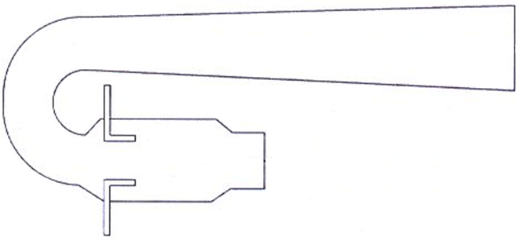
Valveless pulsejet engines
Exhaust
Inlet and exhaust
Fuel
Schematic of a valveless pulsejet engine

Slide 21
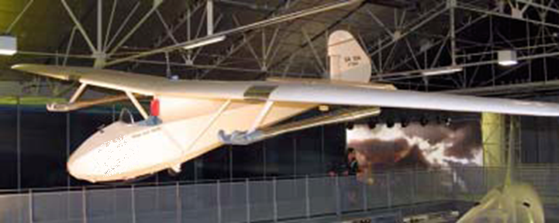
Valveless pulsejet engines
An aircraft with a valveless pulsejet engine

Slide 22
Pulsejet engines
a
2
3
7
Tail pipe
Combustion chamber
Fuel supply
Valves
Schematic of typical pulsejet engine

Slide 23
Pulsejet engines

Slide 24
Pulsejet engines

Slide 25
Cycle components
Jet engine cycle has several salient components
Air intake/diffuser: decelerates air and delivers it to the compressor
Fan: present in turbofan engines, drives the bypass mass flow
Compressor: compresses ingested air to high pressure and temperature
Combustion chamber: fuel is added here, combustion results in high temperature and pressure at turbine inlet

Slide 26
Cycle components
Turbine: Combustion products are expanded through the turbine, generates shaft power to drive the compressor
Nozzle: Turbine exhaust is further expanded through the nozzle, generates thrust
Afterburner: used in afterburning turbojets, function similar to combustion chamber

Slide 27
Air intake performance
Inlet losses arise due to wall friction and shock waves (in a supersonic inlet).
These result in a reduction in total pressure.
The flow is usually adiabatic as it flows through the intake.
Performance of intakes are characterised using total pressure ratio and isentropic efficiency.

Slide 28
Air intake performance
P_{0a}
0a
02
P₀₂
T
P₂
V₂²/2c_{p}
02s
2
2s
V₀²/2c_{p}
P₁
1
P_{a}
a
s
Actual and ideal intake processes

Slide 29
Air intake performance
Isentropic efficiency, η_{d}, of the diffuser is
This efficiency can be related to the total pressure ratio (π_{d}) and Mach number

Slide 30
Air intake performance
During cycle analysis, the value of isentropic efficiency is often calculated based on the Mach number.
The isentropic efficiency drops drastically as Mach number increases.
This is because of the presence of shocks and the resultant total pressure losses.
There are empirical correlations available for estimating the diffuser efficiency as a function of Mach number.

Slide 31
Compressor/fan performance
Compressors are to a high degree of approximation, adiabatic.
Compressor performance is evaluated using the isentropic efficiency, η_{c}

Slide 32
Compressor/fan performance
T
03
P₀₃
T₀₃
03s
T_{03s}
P₀₂
T₀₂
02
s
Actual and ideal compression processes

Slide 33
Compressor/fan performance
The isentropic efficiency is thus a function of the total pressure ratio and the total temperature ratio.

Slide 34
Compressor/fan performance
Besides isentropic efficiency, there are other efficiency definitions, stage efficiency and polytropic efficiency that are used in assessing the performance of multistage compressors.
Stage efficiency will be discussed in detail during the lectures on compressors (AE 309).
The three efficiency terms can be related to one another.

Slide 35
Compressor/fan performance
The polytropic efficiency, η_{poly}, is defined as

Slide 36
Compressor/fan performance

Slide 37
Combustion chamber performance
In a combustion chamber (or burner), there are two possibilities of losses, incomplete combustion and total pressure losses.
Combustion efficiency can be defined by carrying out an energy balance across the combustor.
Two different values of specific heat at constant pressure: one for fluid upstream of the combustor and the other for fluid downstream of the combustor.

Slide 38
Combustion chamber performance

Slide 39
Combustion chamber performance
Total pressure losses arise from two effects:
viscous losses in the combustion chamber
total pressure loss due to combustion at finite Mach number
Combustion efficiency is usually very high in gas turbine engines.
In real cycle analysis both these parameters are used.

Slide 40
Turbine performance
The flow in a turbine is also assumed to be adiabatic, though in actual engines there could be turbine blade cooling.
Isentropic efficiency of the turbine is defined in a manner similar to that of the compressor.

Slide 41
Turbine performance
T
P₀₄
T₀₄
04
T₀₅
P₀₅
T_{05s}
05
05s
s
Actual and ideal turbine processes

Slide 42
Turbine performance
The polytropic efficiency, η_{poly}, is defined as

Slide 43
Turbine performance

Slide 44
Nozzle performance
The flow in the nozzle is also adiabatic.
However losses in a nozzle could occur due to incomplete expansion (under or over-expansion).
Friction may reduce the isentropic efficiency.
The efficiency is defined by

Slide 45
Nozzle performance
h
P₀₆
06
P₆
P₇
7
7s
s
Actual and ideal nozzle processes

Slide 46
Afterburner performance
Afterburner is thermodynamically similar to a combustion chamber.
The performance parameters for an afterburner is thus the combustion efficiency and the total pressure loss.
In case of engines with afterburning, the corresponding performance parameters for an afterburner needs to be taken into account.

Slide 47
Mechanical efficiency
Mechanical efficiency is sometimes used to account for the loss or extraction of power on that shaft.
Mechanical efficiency is defined as
Mechanical efficiency is less than one due to losses in power that occur from shaft bearings and also power extraction for driving accessories like oil and fuel pumps.

Slide 48
Typical component efficiencies
Component | Figure of merit | Type | Value
Diffuser | π_{d} | Subsonic Supersonic | 0.95-0.98 0.85-0.95
Compressor | η_{C} | - | 0.85-0.90
Burner | η_{b} π_{b} | - | 0.96-0.99 0.90-0.95
Turbine | η_{t} | Uncooled Cooled | 0.85-0.92 0.84-0.90
Afterburner | η_{ab} π_{ab} | - | 0.96-0.99 0.90-0.95
Nozzle | η_{n} | - | 0.95-0.98
Mechanical | η_{m} | - | 0.96-0.99

