Slide 1
Recap: Lecture 1, 06/01/2014: 1130-1230 hrs.
Course contents
Evaluation scheme, grading scheme
Attendance policy
Objectives of the course
Introduction to Thermodynamics
Macroscopic and microscopic approach
Continuum
System and control volumes
Closed, open and isolated systems

Slide 2
Property
Property: Any characteristic of a system
Temperature, pressure, density, mass…
Intensive property: independent of mass
Temperature, pressure
Extensive property: dependent on size or mass of the system
Mass, volume, momentum
Specific properties: extensive properties per unit mass
specific volume (v=V/m), specific energy (e=E/m)

Slide 3
Properties of a system
m
V
T
P
ρ
½ m
½ V
T
P
ρ
½ m
½ V
T
P
ρ
Extensive
Properties
Intensive
Properties
System

Slide 4
State of a System
State: a set of properties that completely defines the condition of a system.
It gives a complete description of the system.
At a given state, all the properties of a system have fixed values.
Any operation in which one or more properties of a system change is called a change of state.

Slide 5
State of a System
m = 3 kg
T₁ = 25º C
V₁ = 3.0 m³
m = 3 kg
T₁ = 25º C
V₁ = 2.0 m³
(a) State 1
(b) State 2
A system at two different states

Slide 6
Equilibrium
Thermodynamics deals with equilibrium states.
The word equilibrium implies a state of balance.
In an equilibrium state there are no unbalanced potentials (or driving forces) within the system.
A system in equilibrium experiences no changes when it is isolated from its surroundings.

Slide 7
There are many types of equilibrium.
These are mechanical equilibrium, thermal equilibrium, chemical equilibrium and phase equilibrium.
A system is not in thermodynamic equilibrium unless the conditions of all the relevant types of equilibrium are satisfied.
A system in thermodynamic equilibrium does not deliver any useful work.

Slide 8
Thermal equilibrium: if the temperature is the same throughout the system
Mechanical equilibrium: if the pressure is the same throughout the system
Chemical equilibrium: if the chemical composition does not change with time, i.e., no chemical reactions occur
Phase equilibrium: when the mass of each phase reaches an equilibrium level and stays there

Slide 9
20ºC
26ºC
30ºC
30ºC
31ºC
30ºC
38ºC
30ºC
33ºC
30ºC
40ºC
30ºC
(a) Before
(b) After
A closed system reaching thermal equilibrium

Slide 10
State Postulate
The state of nitrogen gas, for example, can be fixed by two independent, intensive properties.
Temperature and specific volume are independent, intensive properties.
But temperature and pressure are not independent (in case of phase change process), though are intensive properties.
Nitrogen
T₁ = 25º C
v = 0.8 m³/kg

Slide 11
Process, path and cycle
Process: Any change that a system undergoes from one equilibrium state to another.
Path: The series of states through which a system passes during a process.
Cycle: If the system returns to its initial state at the end of the process
That is, for a cycle the initial and final states are identical.

Slide 12
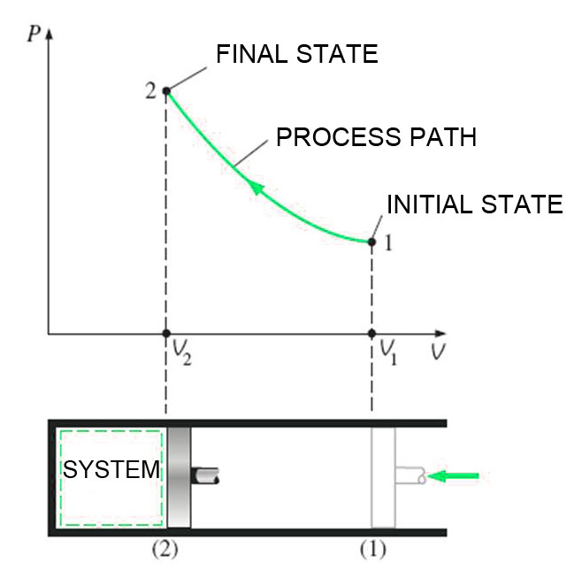
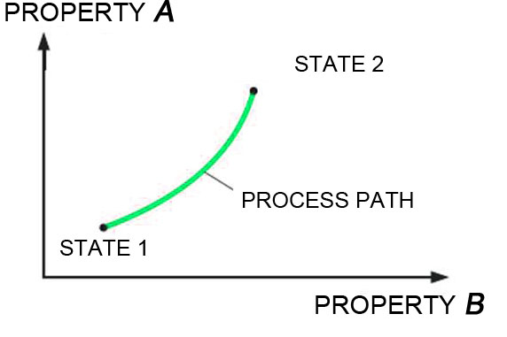
Process, path and cycle

Slide 13
Cycle
p
1
A
B
2
v₁
v₂
v

Slide 14
Types of processes
Usually during a process, we allow one of the properties to remain a constant.
Isothermal process: constant temperature
Isobaric process: constant pressure
Isochoric process: constant volume
Isentropic process: constant entropy (?)
Isenthalpic process: constant enthalpy (?)

Slide 15
Quasi-static processes
When a process proceeds in such a manner that the system remains infinitesimally close to an equilibrium state at all times: Quasi-static or Quasi-equilibrium process
The process proceeds slow enough to allow the system to adjust itself internally so that properties in one part of the system do not change any faster than those at other parts.

Slide 16
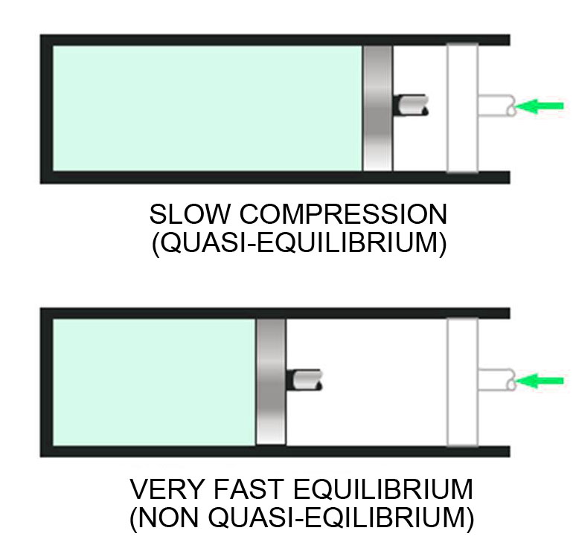

Slide 17
Quasi-static processes
Stops
p
p₁
1
Final state
W
Weight
Piston
2
p₂
Gas
Initial state
p_{1,} v_{1,} t₁
v₁
v₂
v

Slide 18
Quasi-static processes
Stops
p
Equilibrium states
x
1
Final state
x
Weights
x
Piston
x
x
2
x
x
x
Gas
Initial state
p_{1,} v_{1,} t₁
v

Slide 19
Quasi-static processes
Engineers are interested in quasi-static processes because
they are easy to analyse
work-producing devices deliver maximum work when they operate on quasi-static processes
Quasi-static processes serve as standards to which actual processes can be compared

Slide 20
Energy
Energy can exist in numerous forms such as thermal, mechanical, kinetic, potential, electric, magnetic, chemical, and nuclear
The sum total of the above: Total energy, E
e = E/m kJ/kg
Thermodynamics provides no information about the absolute value of the total energy.
It deals only with the change of the total energy, which is what matters in engineering problems.

Slide 21
Energy
Forms of energy:
Macroscopic energy: Energy that a system possesses as a whole with respect to some outside reference frame, eg: Kinetic Energy, Potential Energy
Microscopic energy: These are related to the molecular structure of a system and the degree of the molecular activity and are independent of the outside reference frames
Sum of all microscopic forms of energy of a system: Internal energy, U (kJ) or u = U/m (kJ/kg)

Slide 22
Macroscopic energy
The macroscopic energy, KE and PE, of an object changes with velocity and elevation.

Slide 23
Internal energy
Sensible energy: Part of the internal energy associated with kinetic energy of molecules
Rotational KE, translational KE, vibrational KE
Latent energy: Internal energy associated with phase change of a system
Chemical energy: Internal energy associated with the atomic bonds in a molecule
Nuclear energy: Tremendous amount of energy associated with the strong bonds within the nucleus of the atom

Slide 24
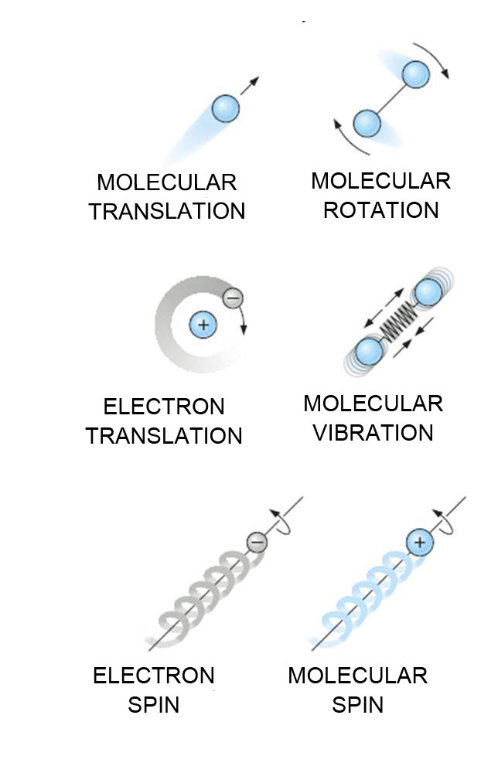
The various forms of microscopic
energies that make up sensible energy.

Slide 25
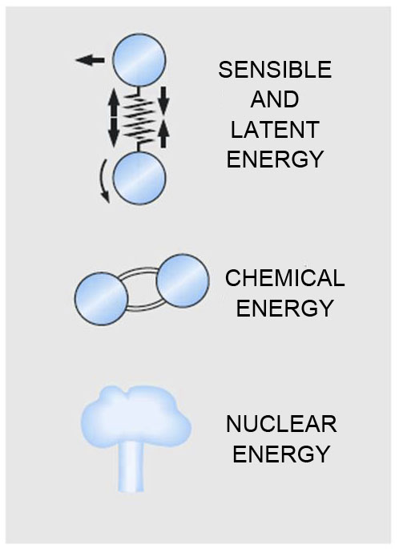
The internal energy of a system is the sum of all forms of the microscopic energies.

Slide 26
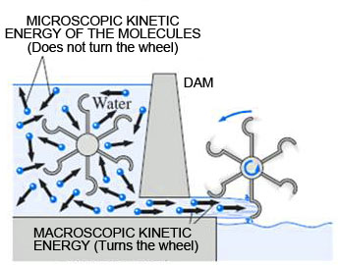
The macroscopic kinetic energy is an organized form of energy and more useful than the disorganized microscopic kinetic energies of the molecules

Slide 27
Kinetic and Potential energies
Kinetic energy, KE, of a system:
Potential energy, PE, of a system:

Slide 28
Total energy of a system
In the absence of magnetic, electric, and surface tension effects, the total energy of a system consists of the kinetic, potential, and internal energies

Slide 29
Total energy of a system
Closed systems whose velocity and elevation of the center of gravity remain constant during a process are frequently referred to as stationary systems.
The change in the total energy E of a stationary system is identical to the change in its internal energy U.

