Slide 1
Recap: Lecture 8: 22nd January 2013, 0930-1025 hrs.
First law for open systems
Conservation of mass
Flow work and the energy of a flowing fluid
Total energy of a flowing fluid
Energy analysis of steady flow systems
Steady flow energy equation
Nozzles/diffusers, compressors/turbines, throttling devices, mixing chambers

Slide 2
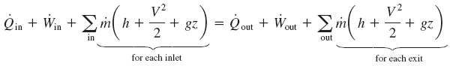
Comparison of steady flow energy equation with Euler and Bernoulli equations

Slide 3
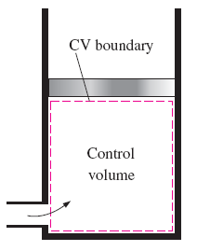
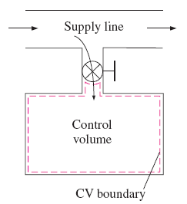
Unsteady flow processes
important to keep track of the mass and energy contents of the control volume as well as the energy interactions across the boundary
Charging, discharging of tanks from pipelines, inflating tyres or balloons, cooking in a pressure cooker
Charging if a rigid tank from a supply line is an unsteady process, due to changes within the control volume.
The shape and size of a control volume may change during an unsteady flow process.

Slide 4
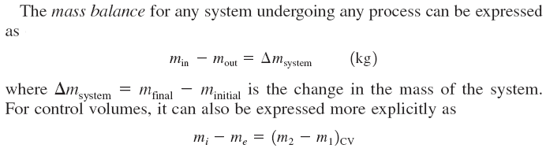

Slide 5
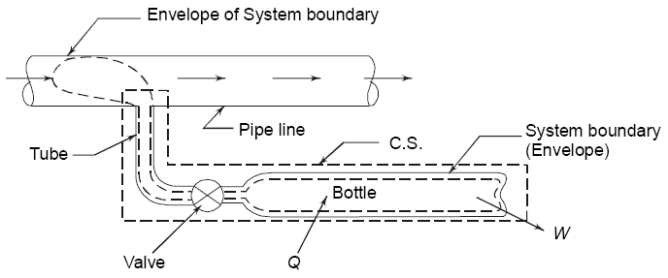
The bottle initially contains a mass m₁ at state P_{1,} T_{1,} v_{1,} h_{1,} and u_{1.} As the valve is opened and gas flows into the bottle till mass m₂ at state P_{2,} T_{2,} v_{2,} h_{2,} and u₂ is attained.
The state of the gas in the supply pipeline can be assumed to be constant P_{p,} T_{p,} v_{p,} h_{p,} u_{p} and V_{p.}

Slide 7
This gives the energy balance for this process.
This equation can also be derived using the control volume (Eulerian) approach.

Slide 8
Second law of thermodynamics
Need for the second law of thermodynamics
Limitations of the first law of thermodynamics
Directionality of a process
Quality of energy
Examples
A hot object does not get hotter in a cooler room.
Transferring heat to a resistor will not generate electricity.

Slide 9
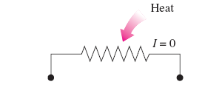
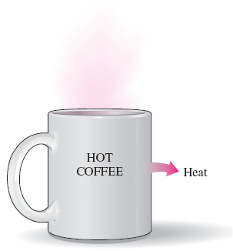
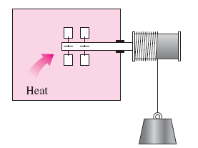
Electricity cannot be generated by transferring heat to a wire
A cup of hot coffee will not get hotter in a cooler room
A paddle wheel cannot be rotated by transferring heat to it.

Slide 10
Second law of thermodynamics
Processes proceed in a certain direction and not in the reverse direction.
The first law places no restriction on the direction of a process.
This inadequacy of the first law to identify whether a process can take place or not is remedied by the second law of thermodynamics.
A process cannot occur unless it satisfies both the first and the second laws of thermodynamics.

Slide 11
Second law of thermodynamics
The first law of thermodynamics was concerned only with the quantity of energy and its transformations.
Second law reveals that energy has quantity as well as quality.
Second law of thermodynamics determines theoretical limits for feasibility of a process.

Slide 12
Thermal energy reservoir
A hypothetical body with a relatively large thermal energy (mass x specific heat).
Supply or absorb infinite amounts of heat without any change in its temperature
Eg. Oceans, lakes, atmosphere
A reservoir that supplies energy in the form of heat: Source
A reservoir that absorbs energy in the form of heat: Sink

Slide 13
Heat engines
Work can be rather easily converted to heat.
The reverse process is not easy and requires special devices: heat engines
Receive heat from a high-temperature source (solar energy, oil furnace etc.).
Convert part of this heat to work
Reject the remaining waste heat to a low-temperature sink
Operate on a cycle

Slide 14
Heat engines
Work
No Work
Heat
Heat
Water
Water
Work can be easily converted to heat, but the reverse does not occur naturally.

Slide 15
Heat engines
High temperature
Source
Q_{in}
Heat Engine
W_{net,out}
Q_{out}
Low temperature
Sink
Heat engines convert part of Q_{in} to W_{net,out} and reject the balance heat to the sink.

Slide 16
Heat engines
High temperature
Source (Furnace)
System boundary
Q_{in}
Boiler
Pump
Turbine
Pump
W_{in}
W_{out}
Condenser
Q_{out}
Low temperature
Sink (atmosphere)

Slide 17
Heat engines
The net work output of the heat engine
W_{net,out} = W_{out} – W_{in} (kJ)
The heat engine system may be considered as a closed system and hence ΔU=0.
W_{net,out} = Q_{in} – Q_{out} (kJ)

Slide 18
Thermal efficiency
Q_{out}: energy “wasted” during the process
Only part of the heat input can be converted to useful work output.
For heat engines, thermal efficiency is defined as

Slide 19
Thermal efficiency
High temperature
Source
Q_{in}=100 kJ
Q_{in}=100 kJ
Heat Engine 1
Heat Engine 2
W_{net,out}
=35 kJ
W_{net,out}
=25 kJ
Q_{out}=75 kJ
Q_{out}=65 kJ
Low temperature
Sink
All heat engines do not perform the same way.

Slide 20
Thermal efficiency
Even the most efficient heat engines reject a huge fraction of the input energy.
Thermal efficiency of common heat engines
Automobile engines: 20-25%
Aero engines: 25-30%
Gas turbine power plants: 40%
Combined cycle power plants: 60%

