Slide 1


IBM-ICE
Hackathon Competition
Team: VIKAS
Face Recognition Based Automatic Attendance System For Education Campus

Slide 2
CONTENTS
Introduction to Concept
Problems with Manual Attendance System
Proposed Solutions
Conclusion

Slide 3
Introduction

Slide 4
Digital Automatic Attendance
Attendance in the education system is very important
Directly proportional to the performance of the students in most of the cases
A system which can reduce the time of the entire class for taking manual attendance
PRESENT
ABSENT

Slide 5
Problems

Slide 6
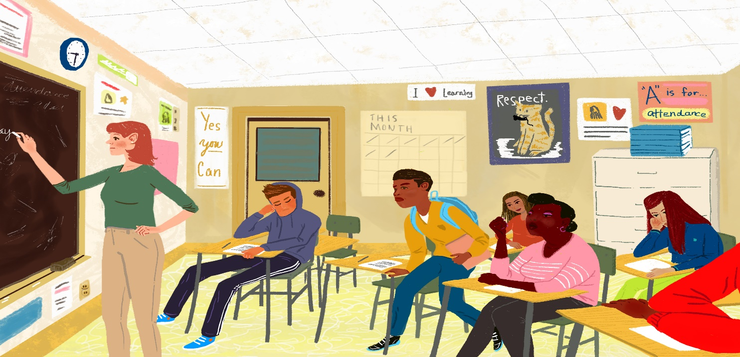
Problems with Manual Attendance Management....
Traditional Attendance Management System is as much effective now-a-days because of the following reasons:
1. ABSENTEEISM
2. LOCATING AND ADDRESSING INEFFICIENCIES
3. CHALLENGE OF TIME MANAGEMENT IN SCHOOLS & COLLEGES
4. TOO MUCH PAPERWORK

Slide 7
Solutions

Slide 8
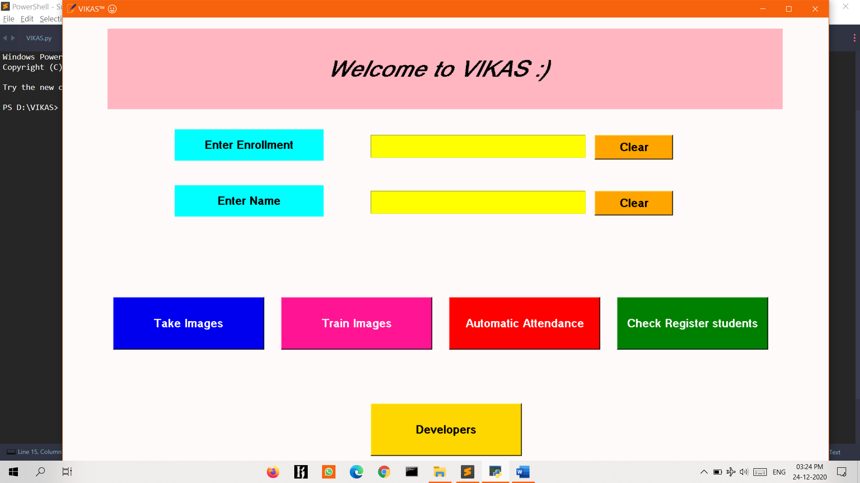
Proposed Solutions
Software-based approach
A dedicated software to record Attendance based on Face Recognition Technique.

Slide 9
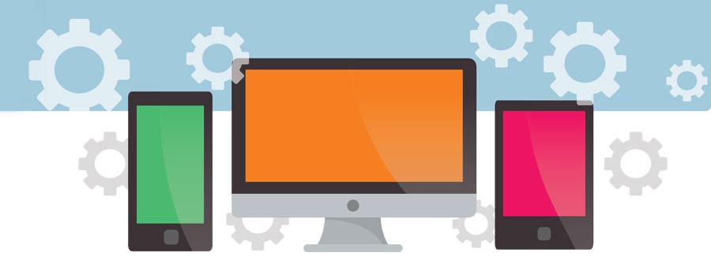
Software-based
Approach
In this approach, we ain't require to setup a physical or sensor to take attendance.
Instead we use a dedicated software via laptop or desktops, to record attendance.
This approach is very useful in current Pandemic situation where schools and colleges are operational in online mode only and online classes are held.
For that we will use this software to record attendance of students.

Slide 10
Practical Implementation
- Here is a scenario of how we can implement this solution practically in a college/school situation.
1. Installing the VIKAS Software on System.
2. Installing Camera in front of classroom or in the class for Image Input.
4. For once take Images and train it, for automatic Attendance.
3. Manually operate the Software, if any change is there from the regular Behavior.

Slide 11
Our Approach for Practical Implementation of
Software-Based Approach
We will present a basic prototype model of this Approach.
In this model, we have created the following elements:
Face Recognition Attendance Software –
- It is desktop app developed using Python Language and OpenCV module.
- Its main purpose is to take images from a dedicated camera and recognize it using Image processing technique.

Slide 12
Tools and Technologies Used
Hardware Components
Laptop or any Desktop equipped with Webcam can be used.
Otherwise External Webcam can be connected to Outer Premises of Classroom but connected to system.
It can be implemented using IOT devices also.
Special mention of Raspberry pie System {as they as very cost effective}

Slide 13
Coding Components
Python is the core language used in the project. [Version 3.8 higher Used]
OpenCV is a cross-platform library using which we can develop real-time computer vision applications. It mainly focuses on image processing, video capture and analysis including features like face detection and object detection.
The Local Binary Pattern Histogram(LBPH) algorithm is a simple solution on face recognition problem, which can recognize both front face and side face. However, the recognition rate of LBPH algorithm under the conditions of illumination diversification, expression variation and attitude deflection is decreased
Python Imaging Library is a free and open-source additional library for the Python programming language that adds support for opening, manipulating, and saving many different image file formats.
NumPy is a library for the Python programming language, adding support for large, multi-dimensional arrays and matrices, along with a large collection of high-level mathematical functions to operate on these arrays
Pandas is a software library written for the Python programming language for data manipulation and analysis.

Slide 14
VIKAS Tkinter App Prototype

Slide 15
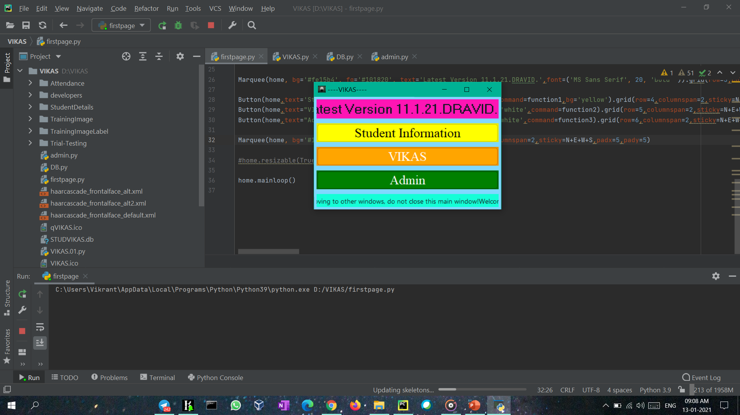

Slide 16
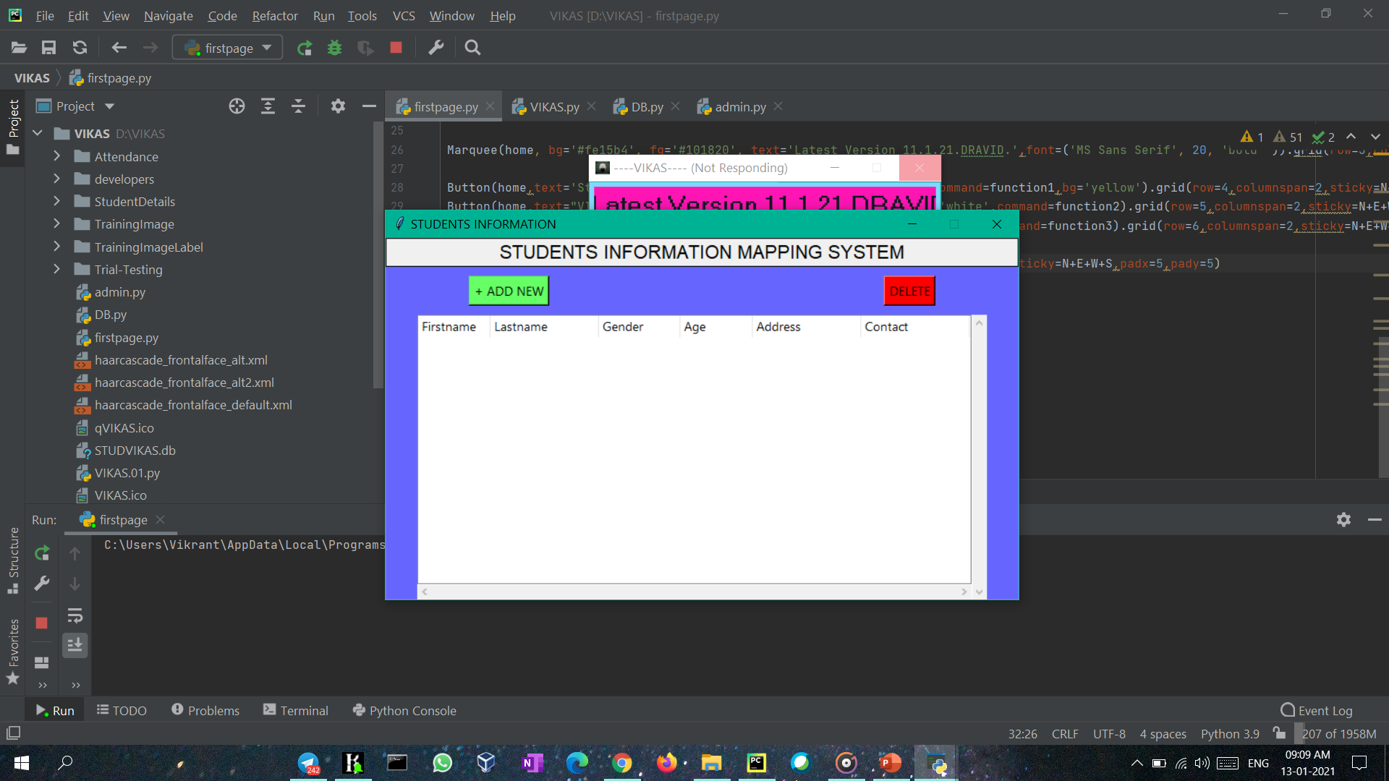

Slide 17
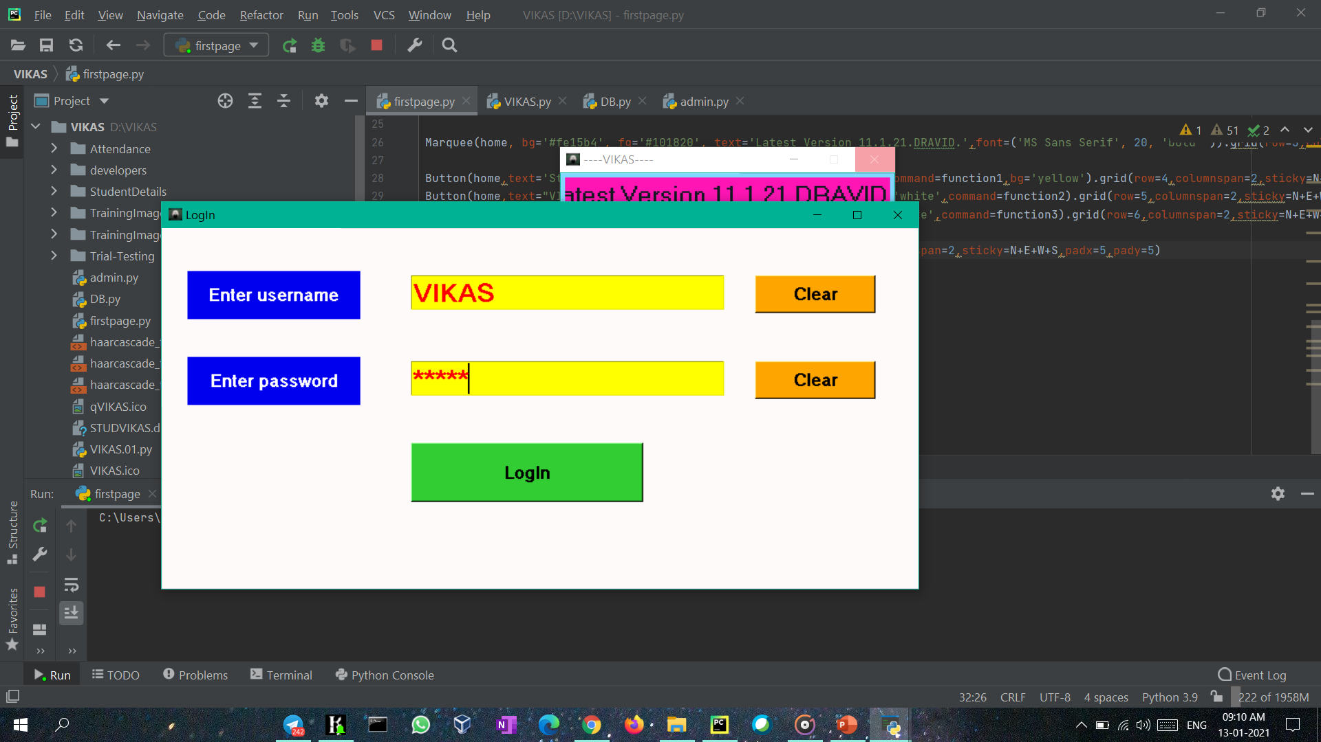

Slide 18
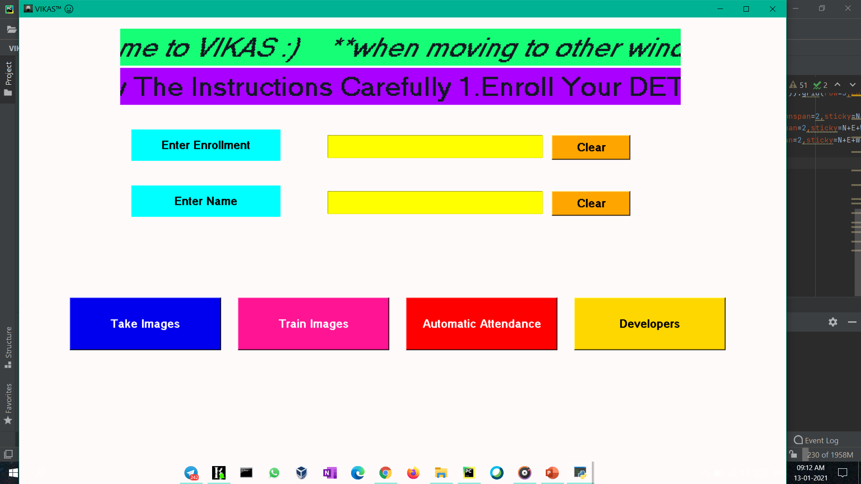

Slide 19
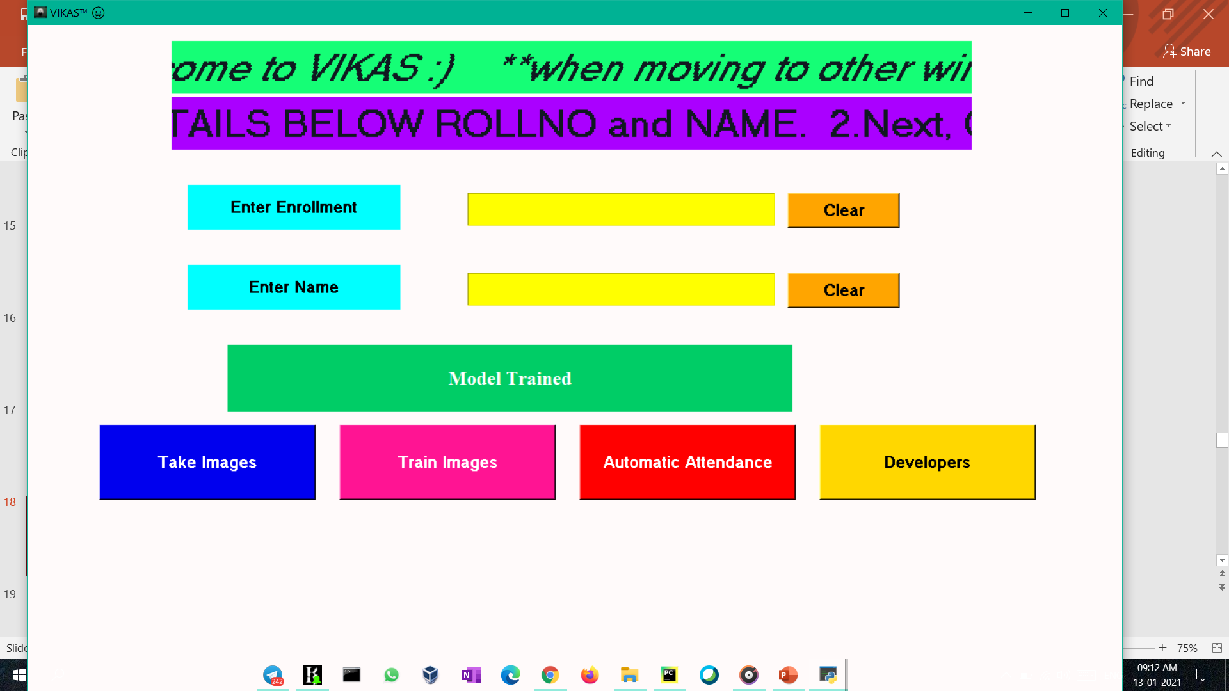

Slide 20
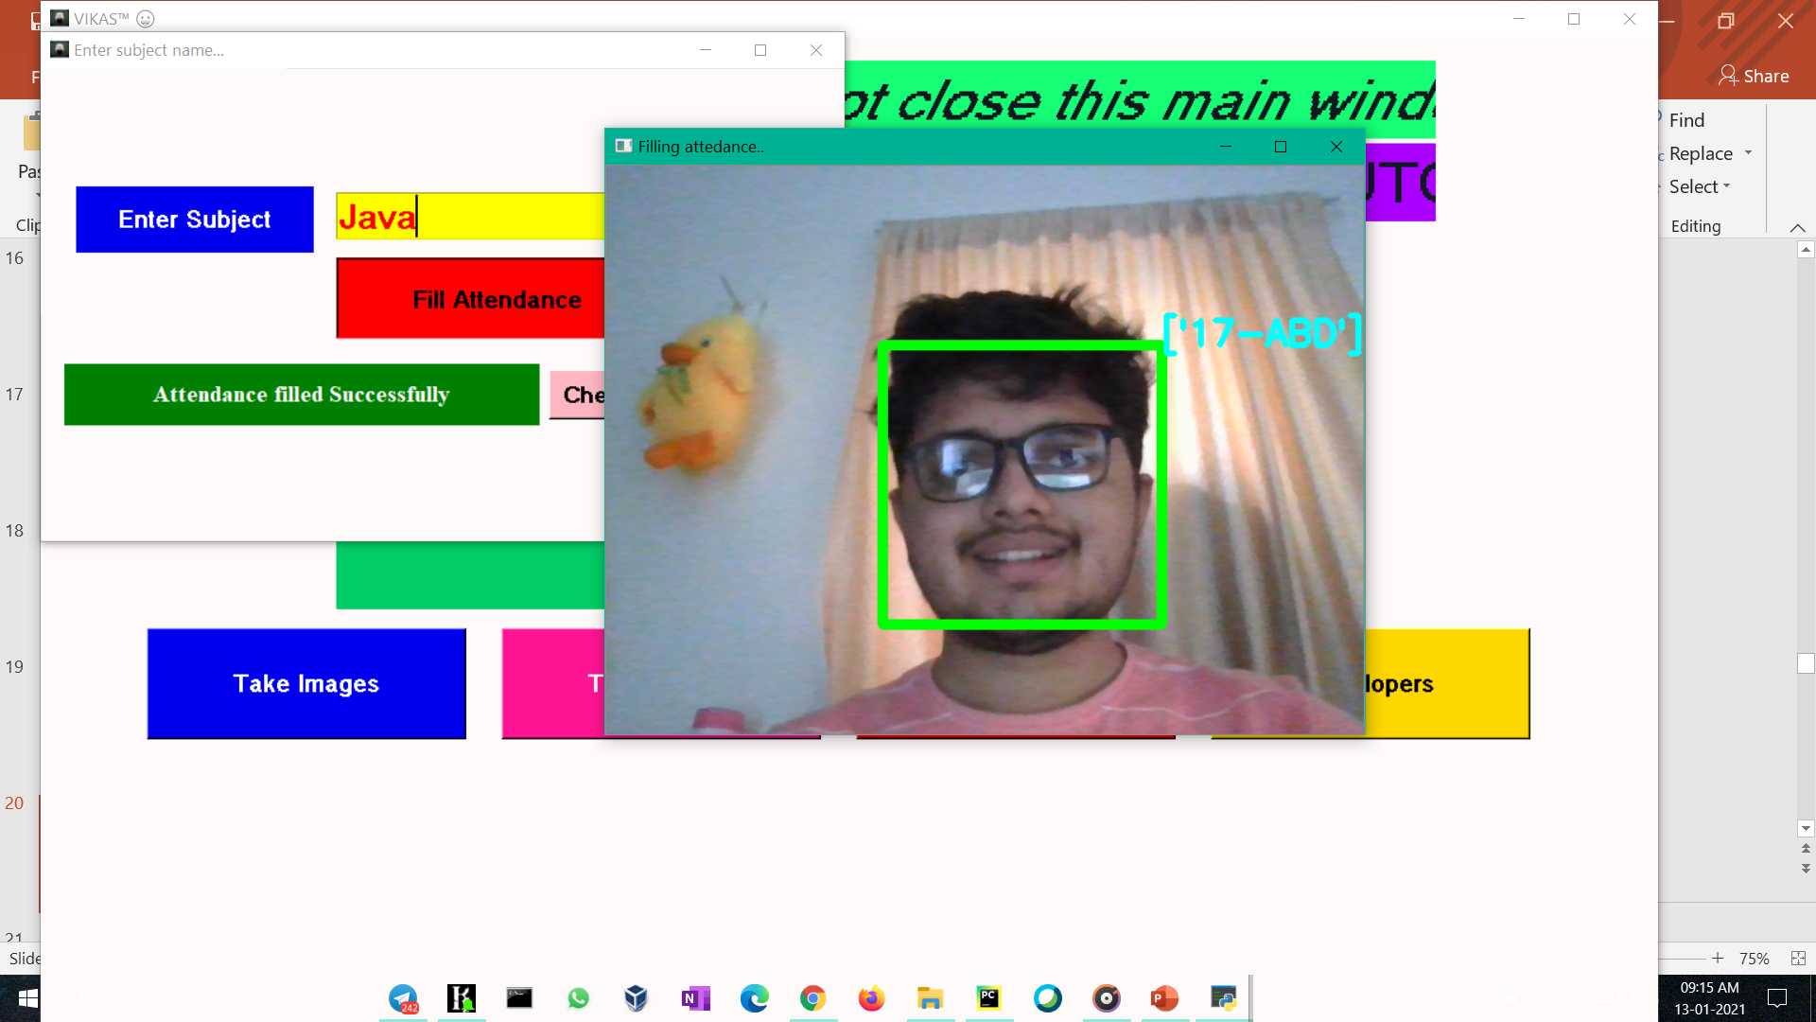

Slide 21
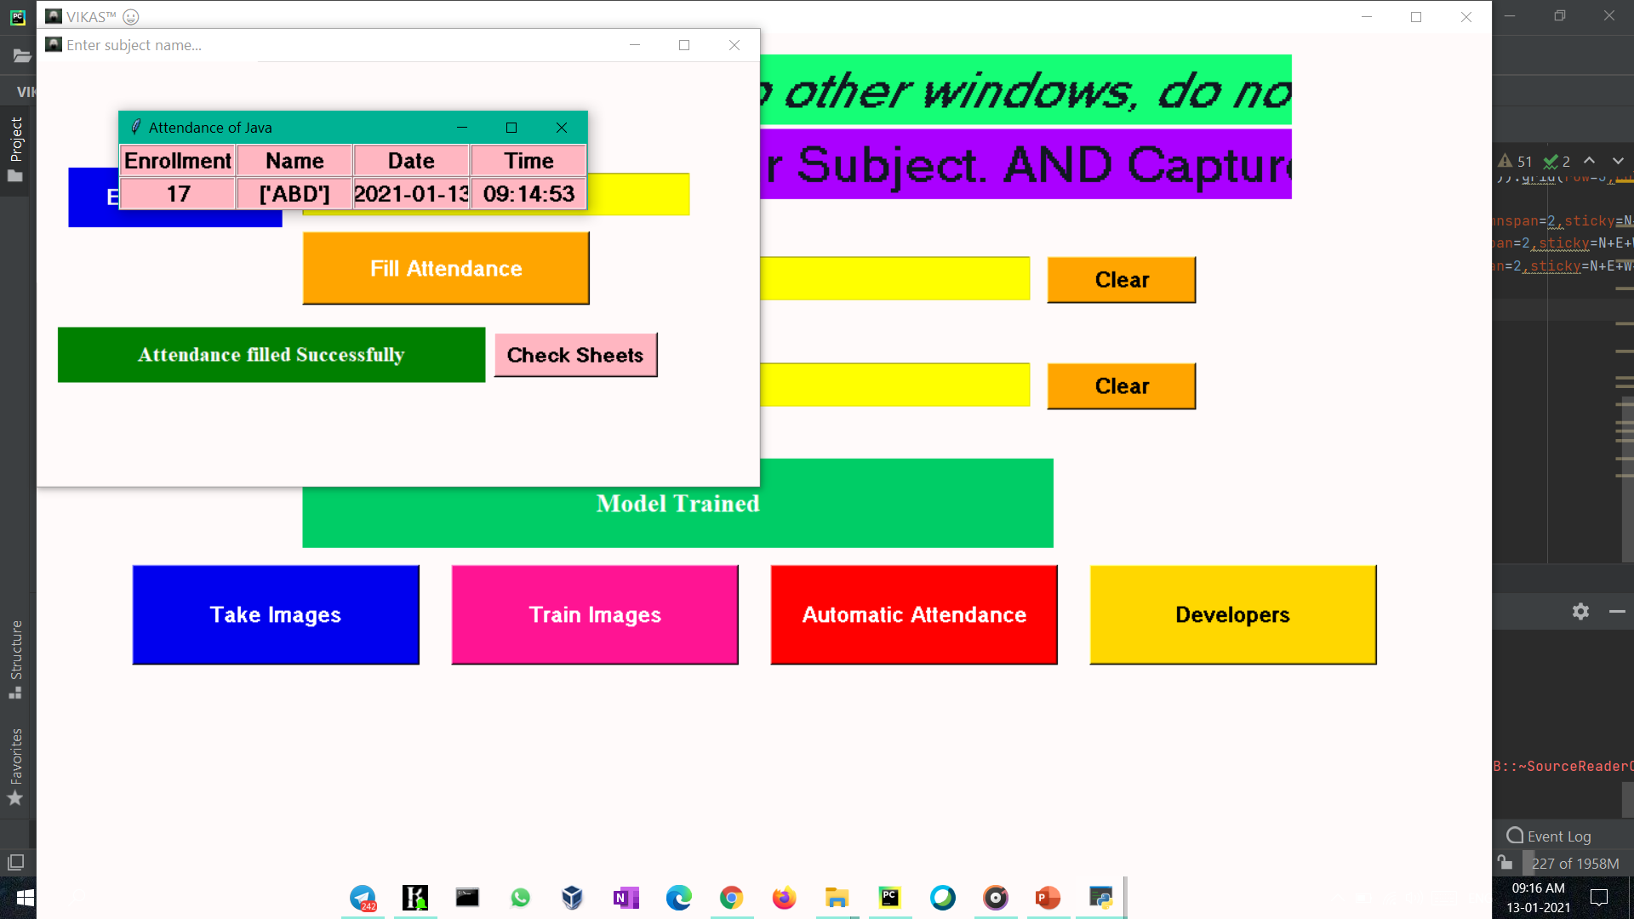

Slide 22
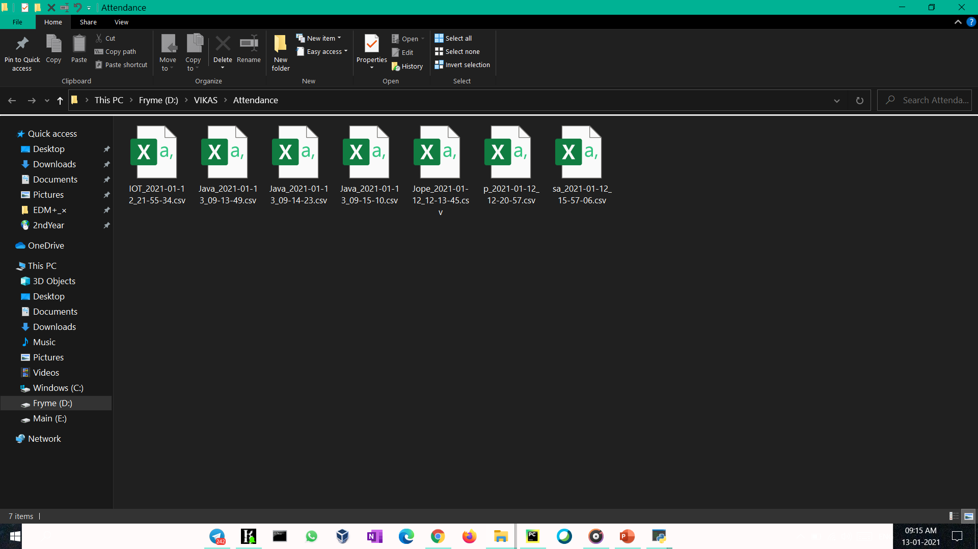

Slide 23
Progress Current Status
Code is in the debugging stage where we are committed to correct the errors.
Moreover we are emphasizes to implement on broad scale using Django Web framework and Selenium .
We have referred various projects from GitHub, for further implementation.

Slide 24
Bibliography
www.stackoverflow.com
www.opencv.org
www.realpython.com
www.geeksforgeeks.org
www.w3schools.com
www.medium.com
www.towardsdatascience.com
www.upgrad.com
www.sourceforge.net
www.journaldev.com
www.tutorialspoint.com
www.tensorflow.org
www.anaconda.com
Machine Learning for OpenCV 4 Second Edition
OpenCV 4 with Python Blueprints Second Edition
Automate the Boring Stuff with Python Second Edition
Learning OpenCV 4 Computer Vision with Python 3 Third Edition
OpenCV 3.x with Python By Example Second Edition
Django 3 Web Development Cookbook Fourth Edition
Beyond the Basic Stuff with Python
GITHUB 😁

Slide 25
Conclusion

Slide 26
In a nutshell, issues related to Manual Attendance can be overcome by using Automatic Attendance approach in schools and colleges, which is very cheap and solution proposed is easy to implement in practical way.

Slide 27
THANK YOU
TEAM : VIKAS
MAIN.html
For giving us an oppurtunity to present our idea...
Team members
Kunal Vasudevan (9919004153)
Vikrant Joilya (9919004368)
Ashutosh Patel (9919004378)
Shagun Pandey (9919004211)
Imam Afsar (9919004355)

Slide 28
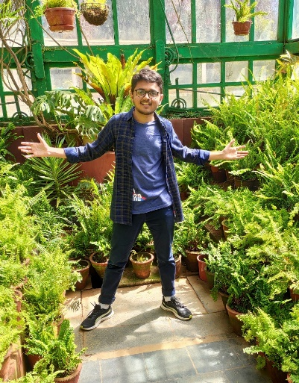

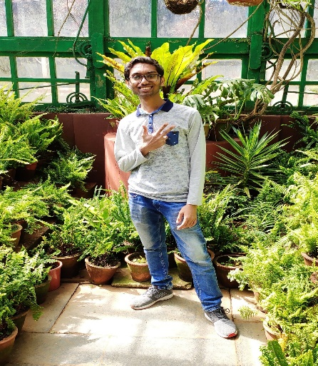
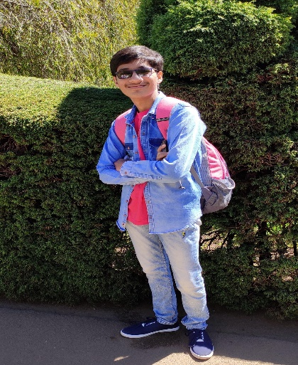

V I K A S
V I K A S
Vikrant Joliya Afsar Imam Kunal Vasudevan Ashutosh Patel Shagun Pandey
9919004368 9919004355 9919004153 9919004378 9919004211

