Slide 1
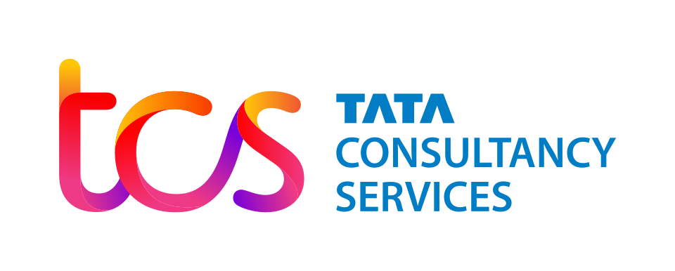

RevGOV: AI-Powered Multilingual Revenue Services Platform
Team Members
Mohit Oraon - 2721410
Mihika Saxena - 2825746
Vikrant Chakole - 3202415
Kunal Wandhare -3202420

Slide 2
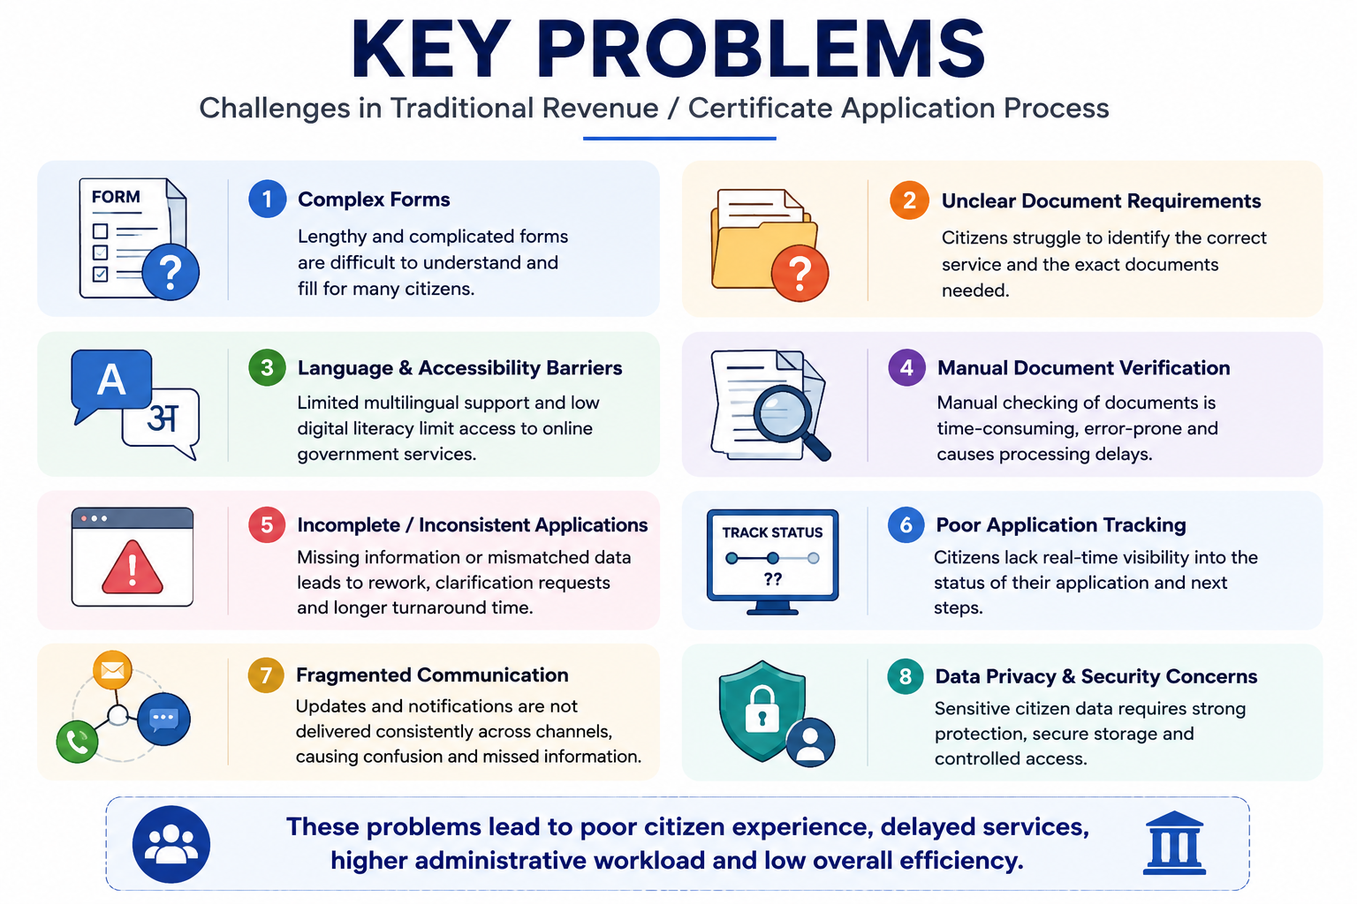
Problem Statement
Citizens often face difficulties navigating complex government certificate applications and understanding the required documents. Language and digital-literacy barriers make these services less accessible. Manual document verification can be time-consuming and error-prone, while incomplete or inconsistent applications lead to delays. Citizens also lack a unified way to apply and track applications across different channels. Government departments therefore need a secure, intelligent, multilingual, and citizen-centric platform to simplify and streamline the entire process. Existing processes also involve repetitive data entry and limited real-time guidance. Document and application information may require repeated manual checking. A unified system is needed to improve accessibility, transparency, and overall service efficiency.

Slide 3
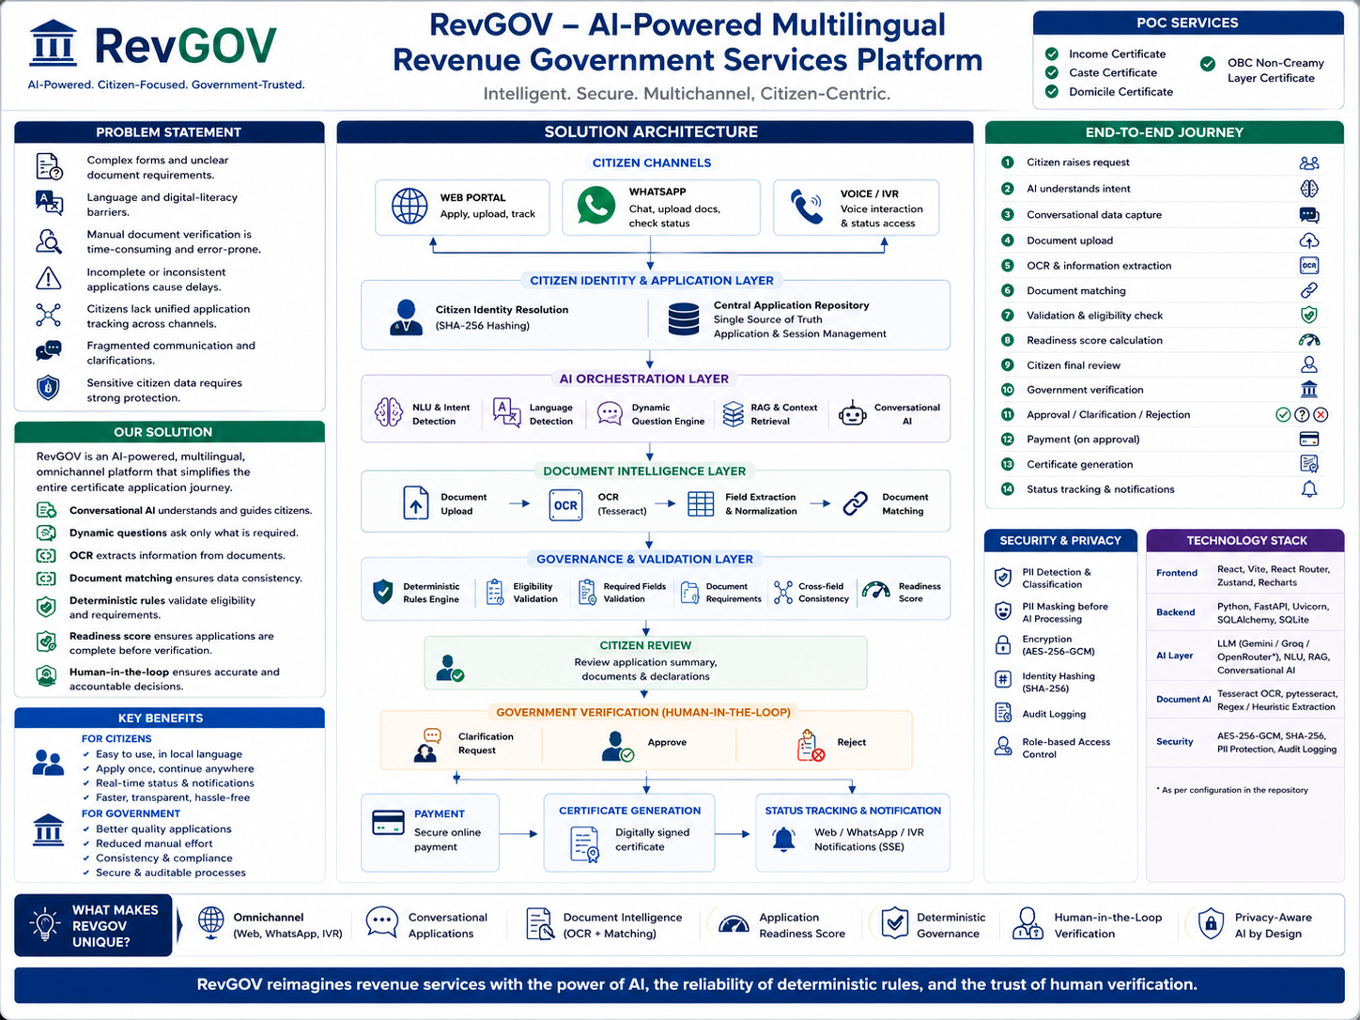
Solution Architecture

Slide 4
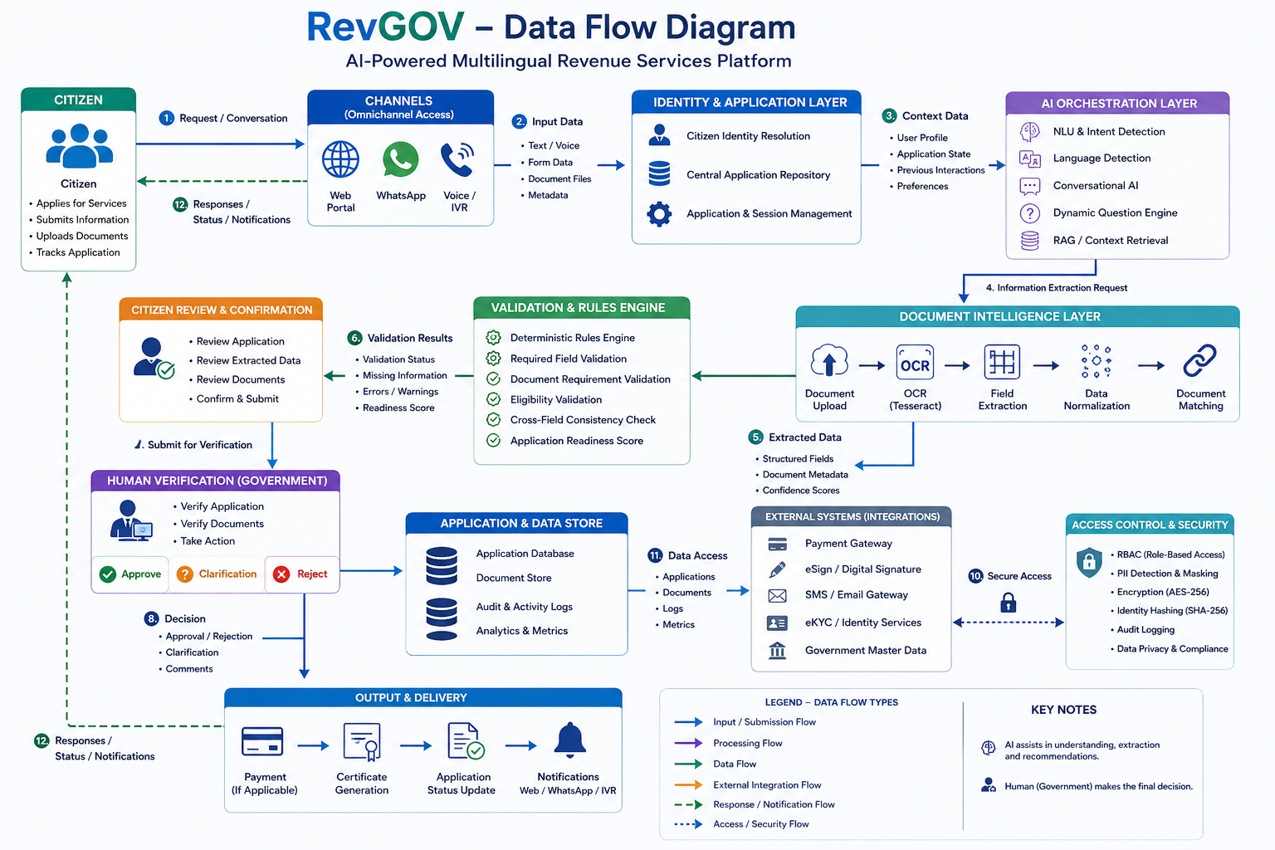
DATA FLOW DIAGRAM

Slide 5
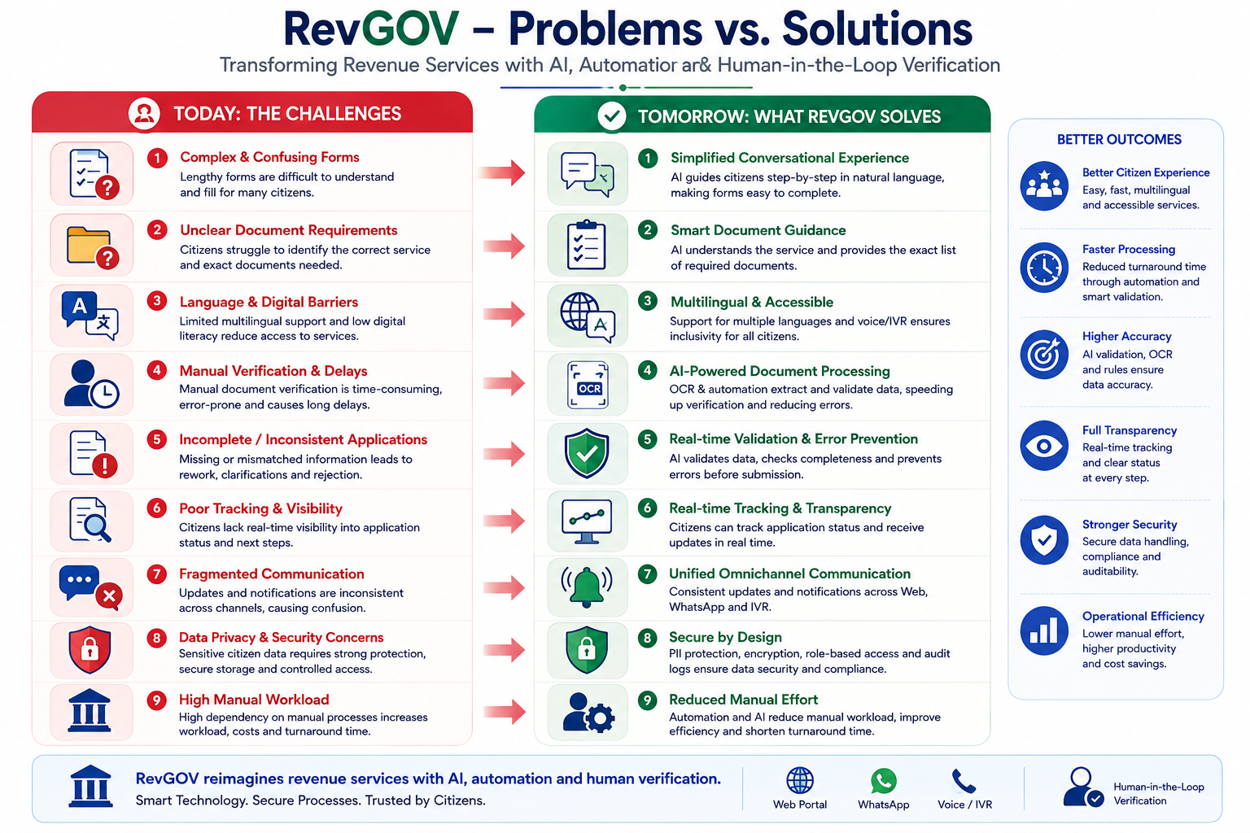

Slide 6
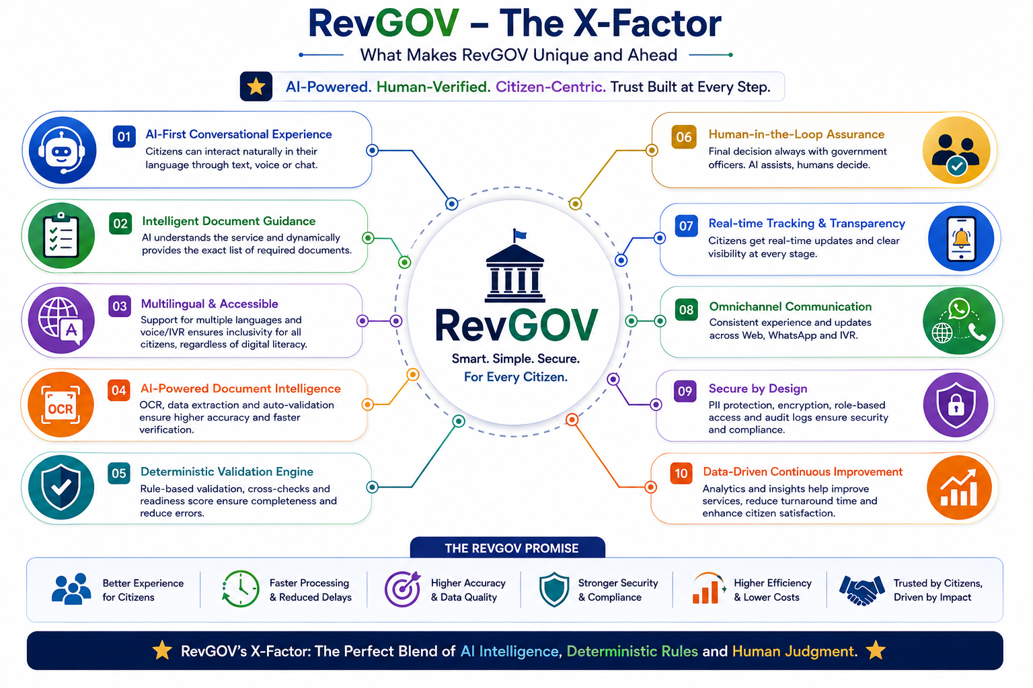

Slide 7
Conclusion
RevGOV simplifies complex government certificate services through a citizen-centric digital experience.
It combines multilingual Conversational AI, OCR, RAG, and intelligent document processing.
Deterministic rules improve validation, eligibility checking, and application readiness.
Web, WhatsApp, and IVR provide a unified omnichannel application journey.
Human-in-the-loop verification ensures accountability, trust, and reliable decision-making.
Overall, RevGOV enables simpler, secure, transparent, and more efficient revenue services.

Slide 8
Thank You

